Slide 1
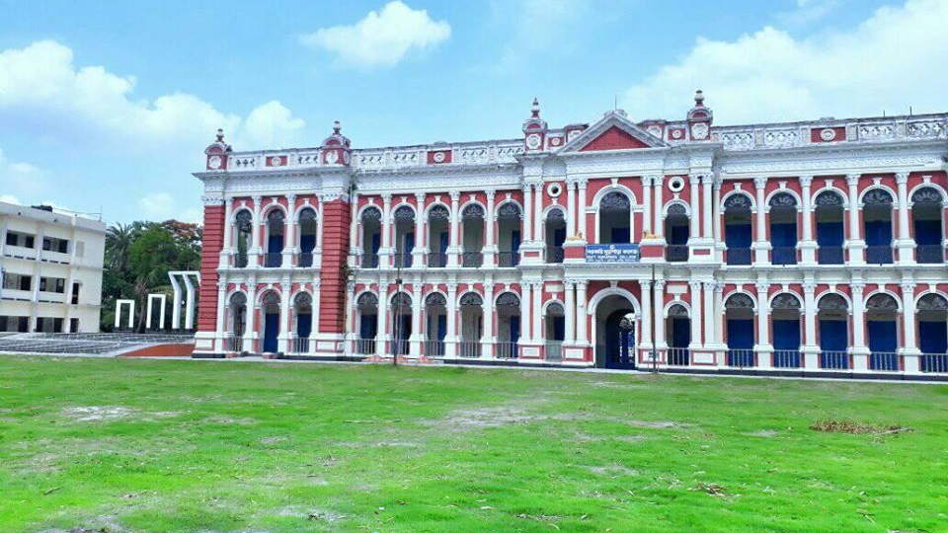
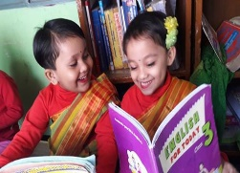


Mahmudabad Education Rupganj / +8801533230106 / 01933265423, (Tariqul Islam Sir)
Six secrets of Right form of verbs.
Prepared and presented by –Muhammad Tariqul Islam, M.A (in English) B.Ed First Class
Email : tariqulislam707@yahoo.com/ tariqul7077@gmail.com. Cell no: 01933265423/01533-230106. Rupganj, Narayanganj.
YouTube Channel name : Tariqul Islam Tapan.
Notes:
Go for it.

Slide 2

01
The Summary of Six Secret Rules :
Use of to be verb.
Use of Modals.
Use of having verb.
Use of Prepostions.
Use of double verbs
Use of verb in present form.
See details in the following:
Mahmudabad Education Rupganj / +8801533230106 / 01933265423, (Tariqul Islam Sir)

Slide 3
01
To be Verb (am/is/are/was/were/being) এর ব্যবহারঃ
I এর সাথে am/was বসে। You/we/they এর সাথে are/were এবং He/she/It এর সাথে was বসে।)
যদি বাক্যটি Active হয় অর্থাৎ Subject যদি নিজে কোন কাজ করে তবে to be verb এরপর verb এর সাথে ing যুক্ত হয়।
          Tanisha is planting a sapling on the roof.
          Anika is preparing her lessons.
          We are staying at home to avoid corona.
Mahmudabad Education Rupganj / +8801533230106 / 01933265423, (Tariqul Islam Sir)

Slide 4
01
NADIR এই শব্দের যেকোন একটি থাকলে Subect+am/is/are+verb এর সাথে ing + object বসিয়ে বাক্যটি করতে হবে।
N for Now. A for At present/At this time/at this moment.
D for Day by day. I for Increasingly. R for Right now/Rapidly
Mahmudabad Education Rupganj / +8801533230106 / 01933265423, (Tariqul Islam Sir)
Mobile phone users are increasing day by day.
The price of daily necessary commodities is increasing day by day.
At present Roza is staying at her in laws house .

Slide 5
01
কিন্তু যদি বাক্যটি Passive হয় অর্থাৎ Subject যদি নিজে কোন কাজ না করে অন্যকে/অন্যের সাহায্য নিয়ে কোন কাজ করে তবে to be verb এরপর verb³ (Past participle) হয়।
      English grammar is taught by Tariqul sir.
      Rupganj is visited by the curious people of Bangladesh.
      A special grammar was presented by me.
      English is spoken all over the world.
কিন্তু am to / is to / are to/ was to / were to এর পর verb এর Present form হয়।
We are to go their to join the party.
I am to do this difficult tusk.
Mahmudabad Education Rupganj / +8801533230106 / 01933265423, (Tariqul Islam Sir)

Slide 6
02
To have Verb (have / has / had / having) এর ব্যবহারঃ
(I / You / We/ They এর সাথে have/had এবং He/she/It এর সাথে has/had বসে।) Present হলে have/has এবং Past হলে Had বসে।
যদি কোন বাক্যে Having Verb অর্থাৎ (have/has/had) থাকে তবে এরপর Verb³ / Past participle হয়।
    Tanisha has planted a sapling on the roof.
    They have prepared their lessons.
    We had stayed at home to avoid corona.
    Having finished the video, I will join Faria’s weeding ceremony.
Mahmudabad Education Rupganj / +8801533230106 / 01933265423, (Tariqul Islam Sir)

Slide 7
02
কিন্তু যদি কোন বাক্যে Having Verb অর্থাৎ (have/has/had) থাকে এবং এরপর to থাকে তবে verb এর present form বা V¹ হয়।
    We have to join the meeting to please our Tariqul sir.
    Rupganj had to declare red zone for spreading Covid19.
    A worker has to learn skill to get a good job.
Mahmudabad Education Rupganj / +8801533230106 / 01933265423, (Tariqul Islam Sir)

Slide 8
02
কোন চলমান কাজ যদি উল্লেখ থাকে এবং তাতে সময়ের উল্লেখ থাকে তবে have been/has been/had been এরপর verb এর সাথে ing যোগ করে বাক্যটি সম্পূর্ণ করতে হয়।
      It has been raining since morning.
      Selina had been waiting for two hours when I arrived.
আবার Passive বাক্যে have been/ has been/ had been + verb³(Past Perticiple) হয়।
    Rinku has been expelled from the examination hall.
ব্যতিক্রম had better, had rather, had sooner এরপর verb এর Present হয়।
      We had better read newspaper regularly
Mahmudabad Education Rupganj / +8801533230106 / 01933265423, (Tariqul Islam Sir)

Slide 9
03
Modal Auxiliary Verbs: (shall,will,should,would,can,could,may, might, must, ought to, need, dare, used to, going to….) এর ব্যবহারঃ
যদি কোন বাক্যে উপরোক্ত Modal auxiliary Verbs থাকে তবে এরপর Verb¹ / verb এর present form হয়।
    We must respect our parents.
    My daughter is going to open an English Language Club.
    One should take care of one’s health.
    It may rain today.
    Tanisha could not eat all the mangoes.
Mahmudabad Education Rupganj / +8801533230106 / 01933265423, (Tariqul Islam Sir)

Slide 10
03
কিন্তু যদি কোন বাক্যে M0dal Auxiliary Verbs + be অর্থাৎ বাক্যটি যদি Passive হয় তবে verb এর Past Perticiple হয়।
    The work can be done by Tanisha.
    The lessons will be taught by Tariqul Sir.
    All the mangoes could be eaten.
    Your duty must be performed very soon.
    The work can be done immediately.
Mahmudabad Education Rupganj / +8801533230106 / 01933265423, (Tariqul Islam Sir)

Slide 11
Preposition এর ব্যবহারঃ (in/of/for/with/without/before/after/at/ on/ from/ by/ into/ across/ about)
04
যদি কোন বাক্যে preposition থাকে তবে এরপর Verb¹ / verb এর present form এর সাথে ing যুক্ত হয়।
    I don’t believe in overloading my stomach.
    I had never thought of going there.
    I could not live without helping the poor.
    After doing the work I will go out.
    The porter came here for doing the work.
    Answer the questions by writing one point of information.
    By being conscious of a language one can develop his ‘explicit’ learning.
    No student can pass the examination by adopting unfair means in the examination.
    While making this video, I was informed that It was Roza’s wedding.
Mahmudabad Education Rupganj / +8801533230106 / 01933265423, (Tariqul Islam Sir)

Slide 12
04
আবার যদি কোন বাক্যে
With a view to/ look forward to/ object to /confess to/Addicted to/ Accustomed to / admit to/ Prior to/ prefer to/ Be used to / Get used to/ ইত্যাদির পর verb এর present form এর সাথে ing যুক্ত হয়।
    I am looking forward to getting your reply.
    They become addicted to taking drugs.
    Prior to leaving work place and stay at home to avoid covid19.
    We went to Cox’s Bazar with a view to see the sea shore.
    People of Bangladesh are used to eating by their hands.
Mahmudabad Education Rupganj / +8801533230106 / 01933265423, (Tariqul Islam Sir)
নিয়মটি মনে রাখার উপায় হলোঃ ABC WO GLP ( এবিসি ও জিলাপি)
    ABC (এবিসি ) A = Addicted, Accustomed to, Admit to, B = Be used to, C = Confess to.
    WO (ও ) W = With a view to , O = Object to.
    GLP (জিলাপি) G = Get used to, L = Look forward to, P = Prefer to.
    কিন্তু শুধু used to এর পর verb এর Base form (present) verb¹ হয়।

Slide 13
05
Mind, would you mind, worth, past, can not help, could not help -এর পরে Verb এর সহিত ing যোগ হয়। যেমন:
Would you mind giving me a pen ?
I can not help doing the work.
He could not help helping the poor.
She never mind having ice cream.
একটি বাক্যে দুইটি Verb থাকলে দ্বিতীয় verb এর সাথে ing যুক্ত হয়। কিন্তু উদ্দেশ্য বুঝাতে t0+ verb¹ হয়।
Mahmudabad Education Rupganj / +8801533230106 / 01933265423, (Tariqul Islam Sir)
I saw him opening a box.
Tanima stopped writing letter to me.
The fat man is trying hard to lose weight
The man is cutting grass and feeding the cows.

Slide 14
Practise, Prefer, Postpone, Quit, Finish, Complete, Consider, Continue, Miss, Mind, Mention, Avoid, Regret, Remember, Keep, Admit, Appreciate, Dislike, Desire, Deny, Delay, Enjoy, Start, Stop, Hesitate, Hate এর পরপরই যে verb থাকে তার সাথে ing যুক্ত হয়।
You should avoid mentioning his divorce. Cricket enjoys a huge following in Bangladesh.
Tanisha completed writing the report. Be,quiet! Tanima hasn’t finished speaking.
We miss going to school for Covid19. It was an unwise decision to postpone breaking the logdown.
05
মনে রাখার কৌশলঃ
Tariqul Sir তার wife এর জন্য একটি দেশ আবিষ্কার করলঃ দেশের নামঃ PQ FC MARKA DESH
Mahmudabad Education Rupganj / +8801533230106 / 01933265423, (Tariqul Islam Sir)
PQ FC | MARKA | DESH
Practise, Prefer, Postpone | Miss, Mind, Mention | Dislike, Desire, Deny,Delay
Quit | Avoid | Enjoy
Finish | Regret, Remember | Start, Stop
Complete, Consider, Continue | Keep | Hesitate, Hate
 | Admit, Appreciate

Slide 15
06
কোথায় Verb এর Present form হয়ঃ
যদি কোন বাক্যে Often, Usually, Regularly, Generally, Always, Regularly, Daily, Everyday, Normally, Sometimes ইত্যাদি থাকে তবে Verb এর Present হয় এবং Do/Does/Did এরপর verb¹ হয়।
মনে রাখার কৌশলঃ কোথায় Verb এর Present form হয়ঃ
OUR GARDENS
O = Often. Roza often read newspaper.
U = Usually. We usually use umbrella on a rainy day.
R = Regularly. Tanisha goes to school regularly.
G = Generally. We did not miss the opportunity.
A = Always. Tanisha does not wait for me.
R = Regularly.
D = Daily.
E = Everyday.
N = Normally.
S = Sometimes.
Mahmudabad Education Rupganj / +8801533230106 / 01933265423, (Tariqul Islam Sir)

Slide 16



Make Learning Fun !
You can get the video on my
YouTube channel name : Tariqul Islam Tapan
Mahmudabad Education Rupganj / +8801533230106 / 01933265423, (Tariqul Islam Sir)

