Slide 1
Welcome

Slide 2
Introducing
Biplab Das
Assistant Teacher (M.S.S; M.Ed.)
Raozan R.R.A.C Govt. High School.
E-mail: biplabd80@yahoo.com
Time:50 Minutes, Date:03July,2020
Class Ten
English 1st Paper.

Slide 3
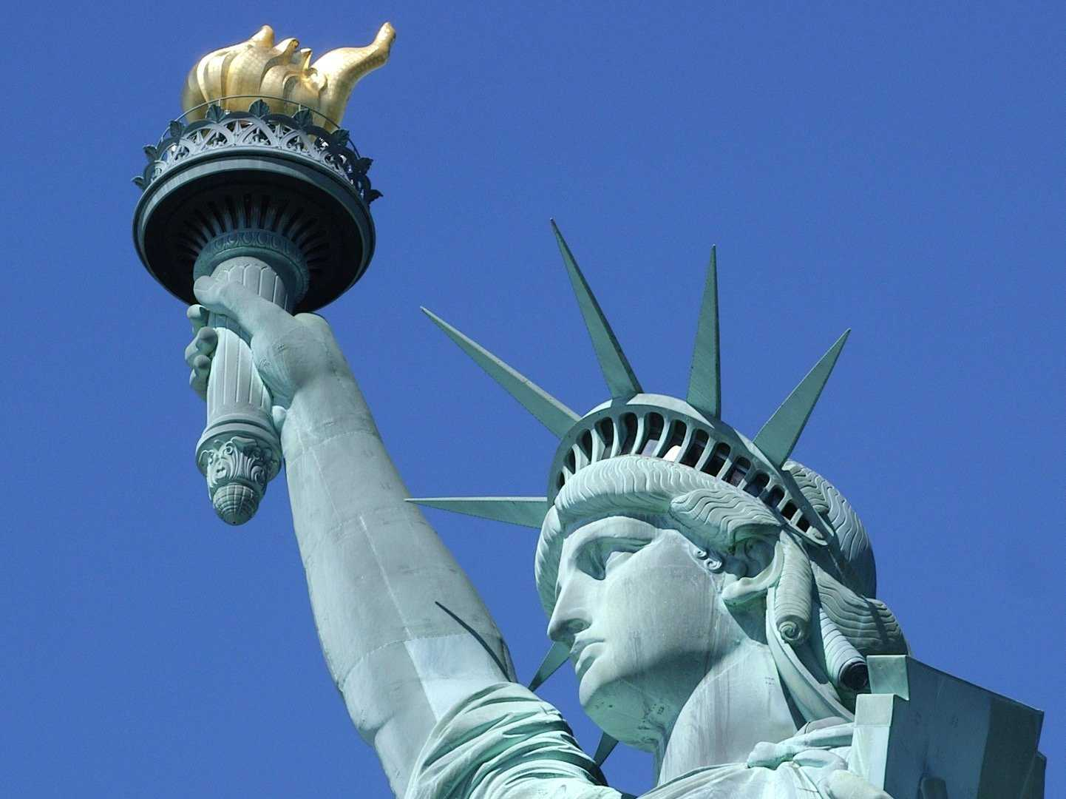
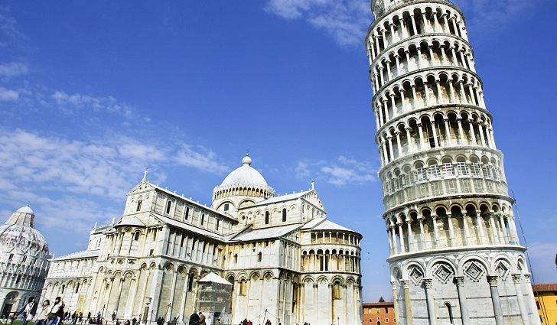
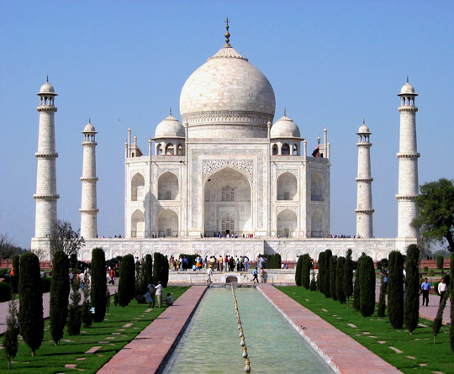
Thanks
For Good Guess
What do you see in the pictures?

Slide 4
Watch the video for next question

Slide 5
Can you imagine today’s lesson?
Yes, teacher.
What ?
The Statue of Liberty
Good Guess
unit-8
Lesson-3/D,Page-107 Date: 03 July 2020

Slide 6
Learning Outcomes:
after completing the lesson students will be able to……
read and understand texts
ask and answer questions.
write a short paragraph.

Slide 7
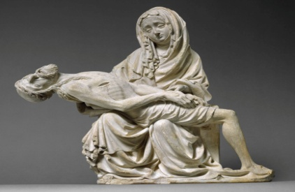
Some Key Words & Synonym
Sculpture
Monument
present
Gift
Declaration
announcement
Statue
figure

Slide 8
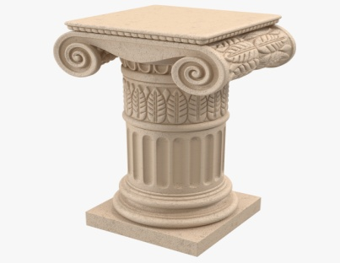
Some Key Wards & Synonym
Assemble
gather
Pedestal
base
Ceremony
observance
Centennial
anniversary

Slide 9
Some Key Words & Synonym
Freedom
liberty
Wrapped
covered
Enlightening
instructive
Oppression
domination

Slide 10
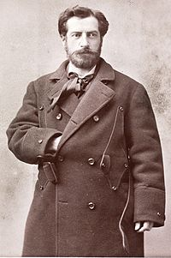
French Sculptor Frederic Auguste
Bartholdi Who was designer of
The Statue of Liberty.

Slide 11
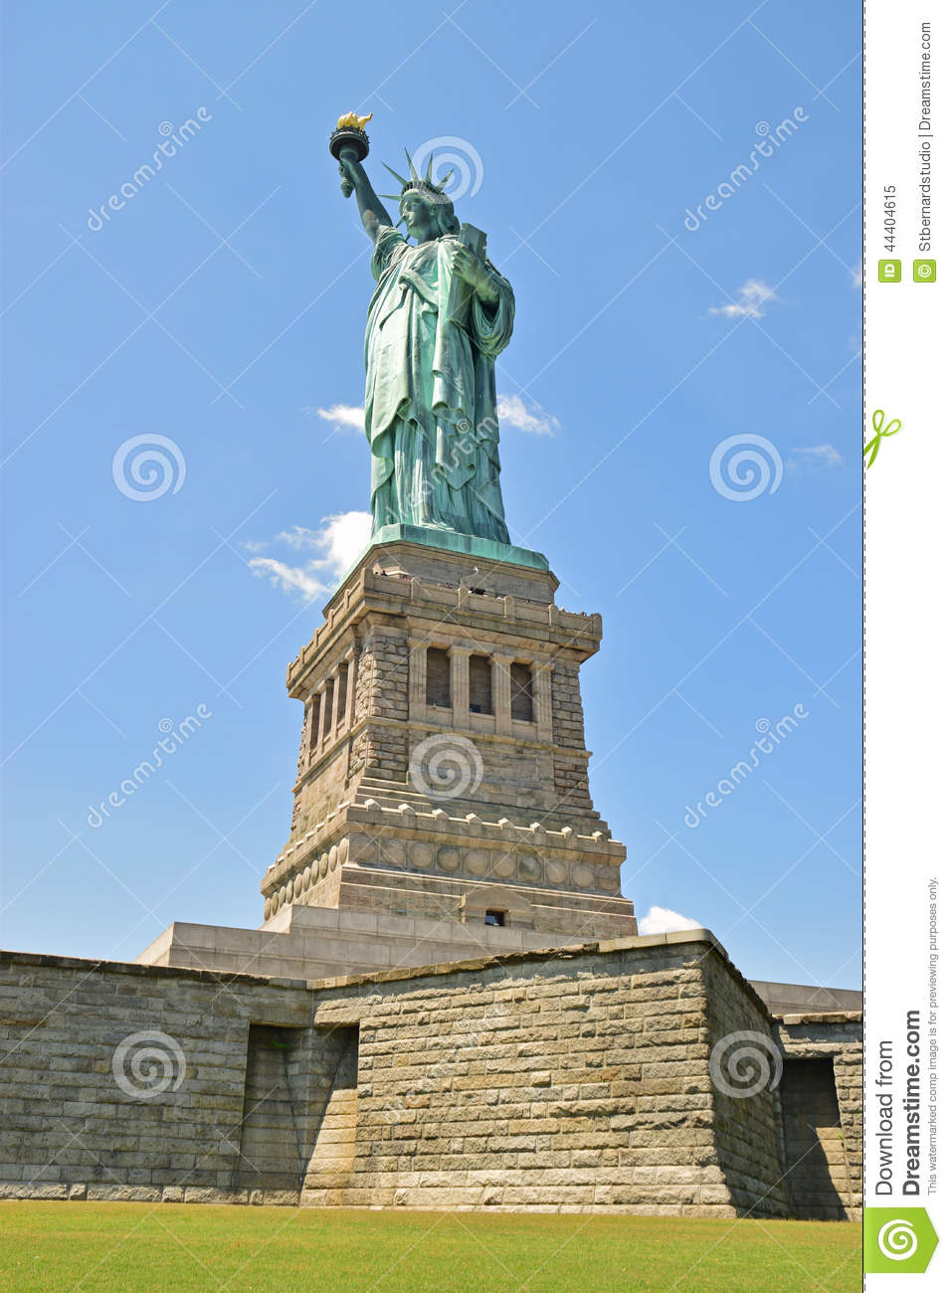
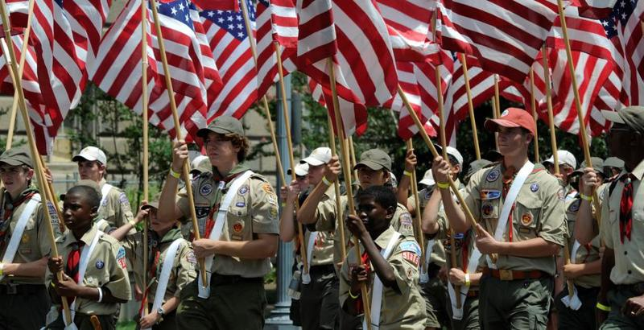
It was given as a gift for the Americans on the occasion of celebrating the 100 years of the American Declaration of Independence by French.

Slide 12
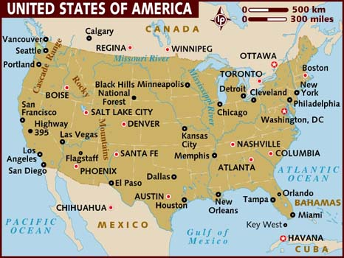
The Statue was a join venture between the USA And France.

Slide 13
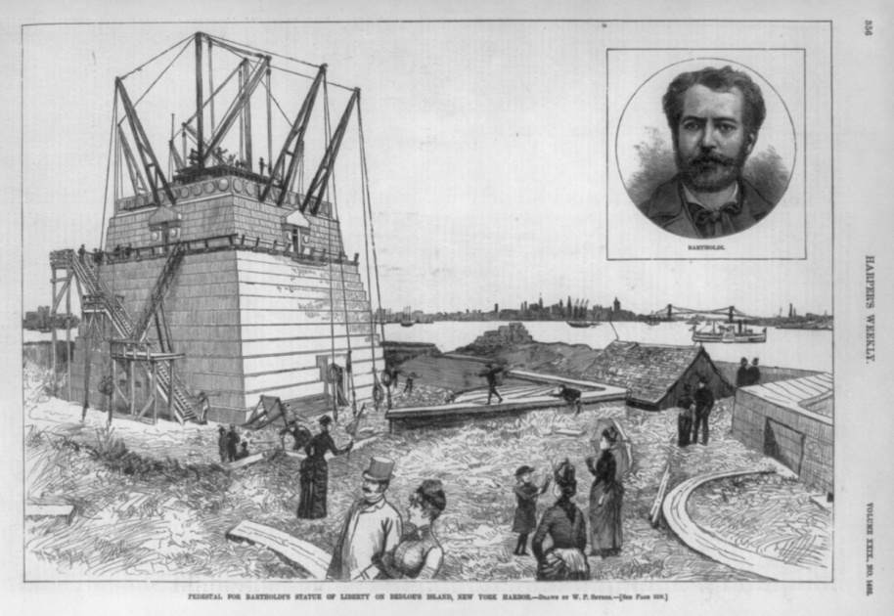
The pedestal
was finished
in April 1886.
The people of the U.S.A were to build the
pedestal.

Slide 14
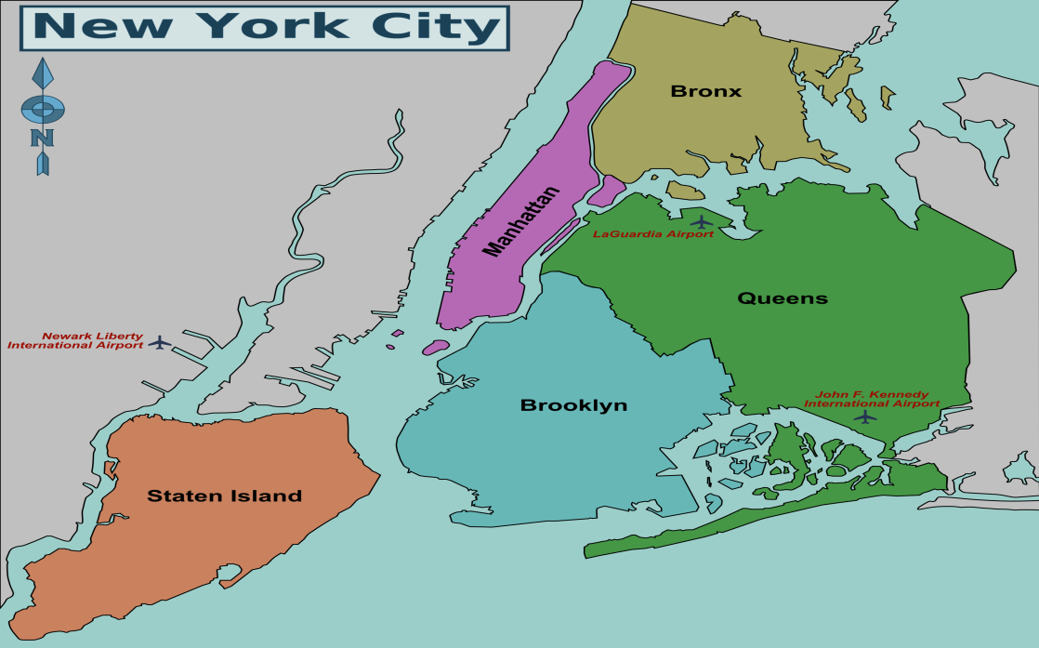
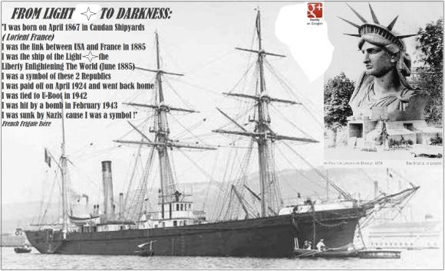
The Statue of liberty was sent to New York on board the French war ship “Isere” in 1885.
The French war ship “Isere” in 1885.

Slide 15
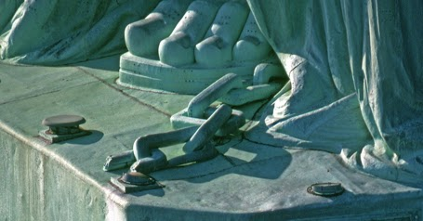
The broken chain symbolizes her free forward movement.

Slide 16
The statue`s original
torch was the first
part constructed
in 1876.
It was replaced by a new copper torch covered in 24k gold leaf in 1984.

Slide 17
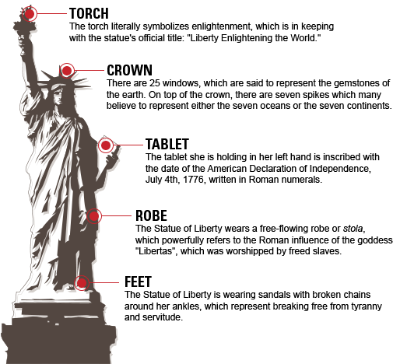
Describing the different Parts of the Statue.

Slide 18
Group Work
1. Why did France present the statue of Liberty to the USA?
2. When was the construction of the pedestal finished?
Rose
Dalia
3. Who designed the Statue?
4. What does broken chain symbolize?
Tulip
Lily

Slide 19
Evolution
Each Group Mach your Answer.
1. France presented the statue of liberty to the USA as a gift for the Americans on the occasion of celebrating the 100 years of the American Declaration of independence.
2. The pedestal means base which was finished in April 1886.

Slide 20
Evolution
Each Group Mach your Answer.
3. French Sculptor Frederic Auguste Bartholdi Who was designer of The Statue of Liberty.
4. The broken chain symbolizes her free forward movement.

Slide 21
work
“Write a summary of the passage
in no more than 70 to 80 words”.

Slide 22
Thanks

