Slide 1
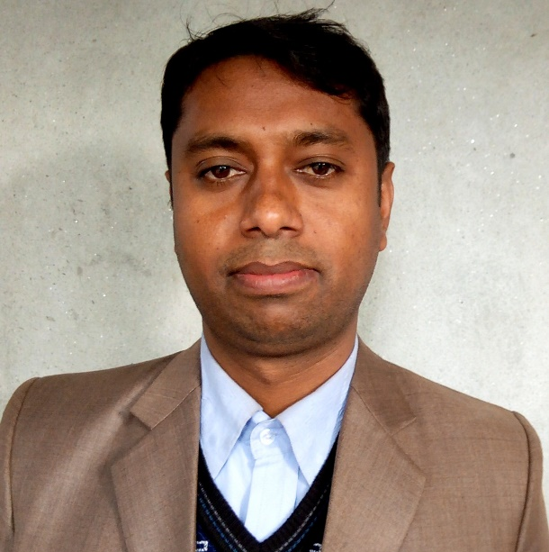
Welcome to the world of HHR PPT Presentation.

Slide 2
Identity
Md. Abu Taher
Asst. Teacher
Uttor Jaorani Hachenia Alom madrasa
Bhelaguri, Hatibandha, Lalmonirhat
English 2nd Paper
Class IX-X

Slide 3
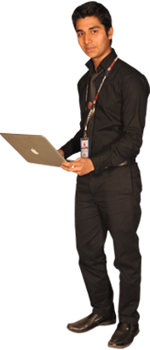
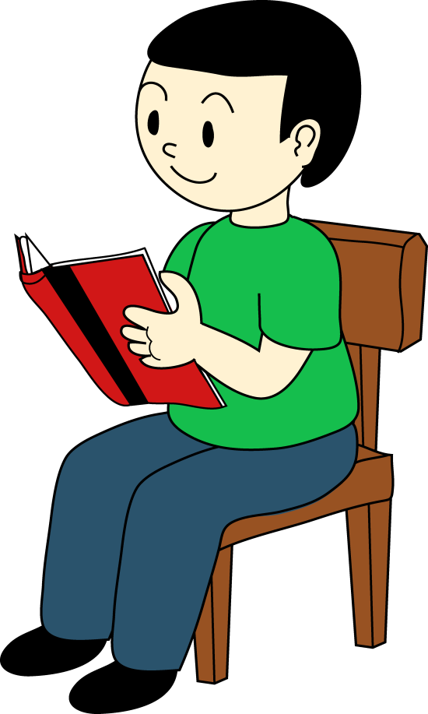
What is followed by the pictures?
Sitting before/front
Sitting after/back

Slide 4
Our Today’s lesson is--
Suffix and prefix

Slide 5
Learning outcomes
After completing this lesson, we will be able to-
identify the definition of suffix and prefix
differ suffix and prefix
use suffix and prefix in the sentence

Slide 6
Follow carefully
Prefix
Suffix
abl
un
able
e
ity
Added before
Added after
Letter or letters added
before any word and
changes its meaning
is called prefix.
Letter or letters added
after any word and
change its form
is called suffix.

Slide 7
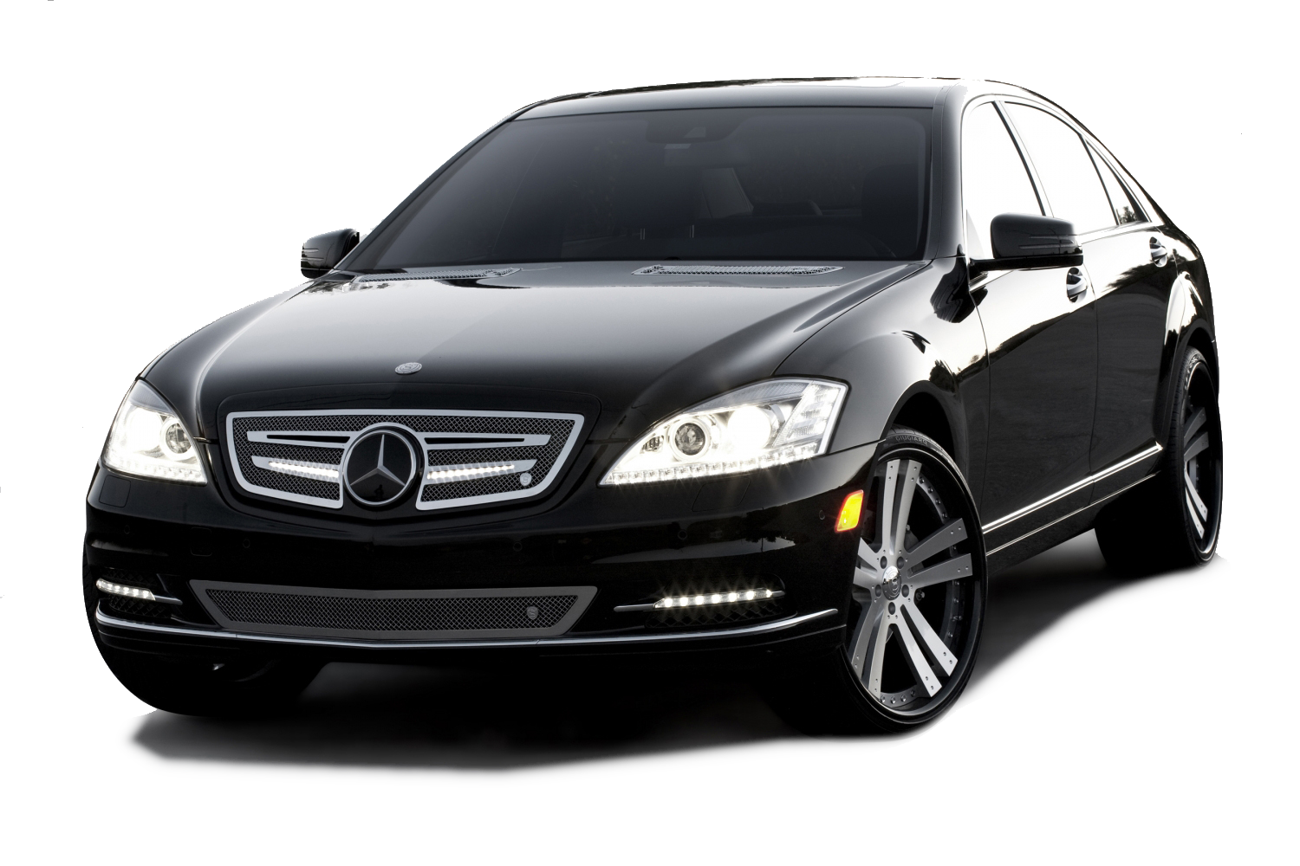
Add suffix or prefix with the word in bracket.
He has no _________ (able) to buy a car.
ability

Slide 8
Practice
a) A dead tiger is -------- (able) to kill the boy.
Fertilize, fertility, fertilizer, fertilization
I want to--------------- the land.
It will increase the -------------- of our land.
There are many types of ---------------- in our country.
----------------- is a very important things.

Slide 9
Practice
1. Beauty , beautiful, beautify, beautifully
He ---------------- the room ---------------.
This is a ----------------- scenery.
They decorate the school ----------------.
The ------------ of the girl attracts me.
Answer: a) beautify, beautifully, b) beautiful, c) beautifully, d) beauty
2. Employ = Employment, employee, employer
This is my ----------------.
He was --------------- as a teacher in this madrasa.
She is an ------------------ .
I am an -------------------- of this office.
Answer: a) employment, b) employed, c) employer, d) employee,

Slide 10
Punish, Punishable, Punishment.
This is hard ----------- crime.
He was ------------- for his bad behavior.
The dead bird was hanged round his nick as -------------.
Answer: a) punishable, b) punished, c) Punishment.
Courage, encourage, discourage, courageous, courageously,
He face the problem -----------------.
We should ----------------- childlabour.
We --------------- them to face the problem.
You are really very -------------.
Your -------------- will help you to do the work.
Ans: a) courageously, b) discourage, c) encourage, d) courageous, e) courage,

Slide 11
Create, Creative, Creator, Creation, Creativity,
Allah has ----------- the whole Universe.
We are facing now ------------- question.
Allah is the only ---------------- of the Universe.
--------------- is the basic things to know.
I have a new -----------------.
a) created, b) creative, c) creator, d) Creativity, e) creation,
Punctual, Punctuality, Punctuation,
---------------- is a great virtue.
We should know about --------------.
He was always ----------------------.
a) Punctuality, b) Punctuation, c) Punctual

Slide 12
Honest, honesty, dishonest, dishonesty,
Rahim is an ------------- man.
--------------- is the best policy.
Nobody likes a --------------- man.
------------ is a curse.
a) honest, b) honesty, c) dishonest, d) dishonesty,
Populate, popular, population, populous
The city is now very -------------.
The ----------- of this country is very large.
Dhaka is a ----------- city.
a) Popular, b) population, c) populous,

Slide 13
Honor, honorable, dishonor,
He was --------------- by every body.
Mr. Akondo is an ----------------- teacher.
We -------------- a liar man.
Comfort, discomfort, Comfortable, Uncomfortable,
The room is ----------------- for living.
We are feeling --------------- here.
This room is -------------- for us.
We feel ------------- to live here.

Slide 14
Satisfy, Satisfactory, Satisfaction, Dissatisfaction.
I want to -------------- to all.
His behavior is ------------- to us.
We need our mind ------------------ to do the work.
His behavior makes us -----------------.
Danger, Endanger, Dangerous, Dangerously,
We should not be worried in -------------------.
He killed the tiger -------------------.
I am staying in --------------------- situation.
It ---------------- us.

Slide 15
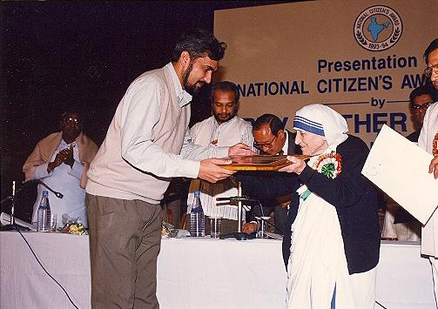
Add suffix or prefix with the word in bracket.
Mother Teresa was rewarded for her ________ (human).
humanity

Slide 16
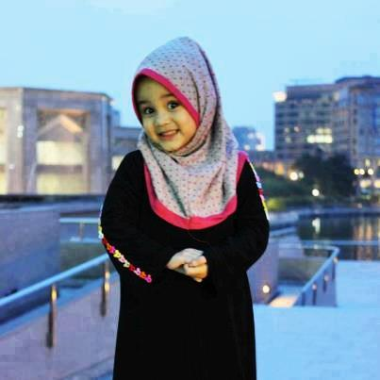
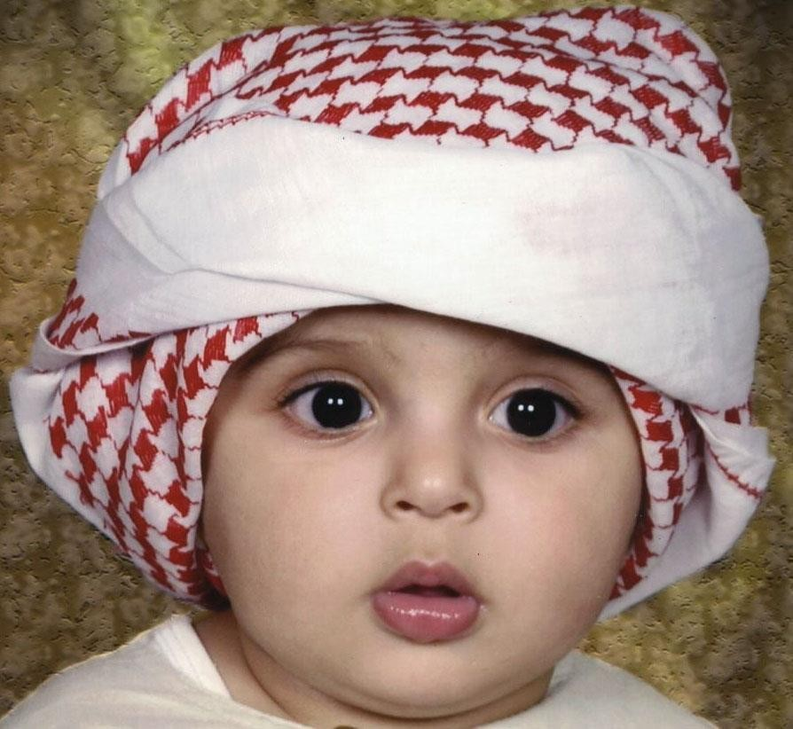
Add suffix or prefix with the word in bracket.
Our parents always __________(courage) us to put on these dress.
encourage

Slide 17
Add suffix or prefix with the word in bracket.
What a beautiful __________(perform) he displayed!
performance

Slide 18
Class activities
The books of famous(a) -------(write) are put on sale in the book fair. Most of the (b) -------------( visit) buy books of different © ----------- (publish). Almost no visitor returns from the fair without making any purchase. The (d) ----- (buy) like to buy at a fair price. Our book fair is always (e) ------------ (crowd). As (f) ---------(vary) books are (g) ------------- (play) in a fair, the (h) --------(buy) get a scope to choose books after a long search. This facility is (i) ------------ (available) in any place other than a book fair. A book fair is always (j) ------------ (come) to the students.
Check your answer
a) Writers b) visitors d) publishers e) crowded f) various g) displayed h) buyers i) unavailable j) welcome

Slide 19
Our(a) ---------(free) fighters are the (b) -----------------(war) who took part in our liberation in 1971. The©------------- (dependence) of our motherland was (d) --------------(dear) to them than their lives. They joined the war (e) ------------ (willing). They had no (f) ------------ (might) weapons with them. But They had strong moral courage. Our freedom fighters from the civilians were (g) ------------- (main) the guerilla (h)-------------- (fight). Our guerilla freedom fighters attacked the enemy from an(i) ------------- (known) place and then (j) ------------ (appeared).
Check your answer
a) Freedom b) warrior c) independence d) dearer e) willingly f) mighty g) mainly h) fighters i) unknown j) disappeared.

Slide 20
Our (a) ---------------- (child) memories are full of (b) ------------- (beauty) and sad incedents. For example, I can © ------------- ( easy) remember the (d) ---------------- (memory) incidents of my school life. Our teachers told us to read (e)--------------( attentive). We always tried to follow their (f) -------------- (instruct). Now at our mature age, we realize how (g) ------------- (effect) their advice was. Therefore, we are (h) ------------- (high) grateful to them. This was the role of our teachers in building our character and (i) --------------- (moral) which is not (j) -----------(deny).
Check your answer
a) Childhood b) beautiful c) easily d) memorial e) attentively f) instruction g) effective h) highly i) morality j) deniable.

Slide 21
Individual work
Complete the text adding suffixes, prefixes or the both with the root words given in the parenthesis.
In the past people did not have developed (a) _______ (communicate) facilities. They used to make (b) _______ (move) to short distant places on foot. Nowadays, they go by rickshaw," taxi or by other kinds of (c)_______ (motor) vehicles. As a result, they do not undergo physical (d) _______ (exert) -— which is good for health. The ultimate result is that many a man is now getting diabetics. The (e) _______(suggest) is that we should form the habit of walking. Walking (f) _______ (able) us to (g) _______ (joy) the beauty of nature. It also helps us have physical (h) _______ (fit). But some people are (i) _______ (different) to walking. They give (j) _______ (prefer) to vehicles.
Check your answer
(a) communication; (b) movement; (c) motorized; (d) exertion; (e) suggestion; (f) enables; (g) enjoy; (h) fitness; (i) indifferent; (j) preference.

Slide 22
Good (a) ------------- (behave) forms an important part of our education. Our (b) ------------- (learn) remains © -------------- (complete) if we do not learn good behavior. In (d) ------------ (deal) with others, we must show respect ( e) ------------ (proper). We should have a sense of (f) ---------------- (polite) in our conduct with others. The (g) --------------- (signify) of good conduct in life is (h) --------------(real) great. People are (i) ------------- (delight) to help a man with good conduct. (j) ---------(Actual) a man of manners is a gentleman in true sense of the term.
Check your answer
a) Behavior b) learner c) incomplete e) properly f) politeness g) significance h) really i) delighted j) Actually

Slide 23
Home work
Differentiate the suffix and prefix of the word of the following passage after adding suffix and prefix.
Smoking produces (a) ___ (danger) effects on man. By smoking a man, incurs both physical and (b) ___ (economy) loss. The butt end of a cigarette often causes a (c) ___ (devastate) fire. Smoking is a kind of (d) ___ (addict). Those who become (e) ___ (addict) to drug first begin smoking which is the initial step to addiction. We should (f)____(smoking) (g) ___ (aware) among our people. It is (h) ___ (possible) ___ to stop smoking by giving (i) ___ (punish). (j) ___ (out) effort from everybody is essential to minimize smoking.

Slide 24
This is all for today.
Allah Hafez.

