Slide 1
You are most welcome to my class.
Notes:
This is a wonderful picture, related to exclamatory sentence. So I select it as the welcome slide. You may change it.

Slide 2
English 2nd Paper
Grammar
Class VIII--X
Notes:
I select this classical background to draw the attention of the students to the presentation in my identity & class.

Slide 3
How dangerous the sea is!
The sea is so dangerous.
Notes:
I have tried to make the students understand about exclamatory through a surprising video.

Slide 4
Our today’s topic is--
Transformation of sentence
Part-3 (Assertive to Exclamatory)
Notes:
Lesson declaration

Slide 5
Learning outcomes
After completing this lesson, we will be able to-
identify assertive sentence
identify exclamatory sentence and its classifications
change from assertive to exclamatory sentence
Notes:
Basic things of assertive and exclamatory are focused in this lesson.

Slide 6
We enjoyed a very exciting show.
What an exciting show we enjoyed!
Notes:
Leading to the main lesson by the video and example.

Slide 7
The tiger is a ferocious animal.
Assertive sentence
What a ferocious animal the tiger is!.
Exclamatory sentence
Notes:
Different formation of assertive and exclamatory are focused in this slide.

Slide 8
Structure of Assertive Sentence
(a) Subject + verb +a/an + adjective +noun
(‘very/so/too/great’ may have or not after verb)
(b)Subject +verb +adjective
(‘very/so/too/great’ may have or not after verb)
It is a very interesting story. / It is an interesting story.
It is very interesting./ It is interesting.
Notes:
Actual formation of assertive sentence and use of adverb are shown here with example. In the assertive sentence adverb is not exclusively needed. It is a must while changing an exclamatory into assertive.

Slide 9
Structure of Exclamatory Sentence
(a) What + a/an + adjective +subject + verb +!
( adverb ‘very/so/too/great’ will be omitted)
(b) How +Adjective +Subject+ Verb +!
( adverb ‘very/so/too/great’ will be omitted)
Note: Assertive with a/an begins with ‘What’
Assertive without a/an begins with ‘How’
What an interesting story it is!
How interesting it is!
Notes:
Actual formation of exclamatory sentence is shown here with example. In the exclamatory sentence adverb is not needed at all. It is a must while changing an exclamatory into assertive.

Slide 11
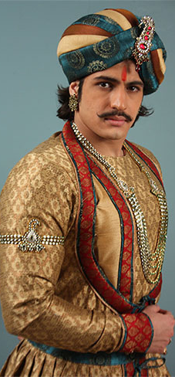
Class Activities
Change the sentences into Exclamatory
Akbar was a very powerful king of India.
He was very handsome.
There was an aristocratic throne for him.
It looked very gorgeous.
He was indeed a successful king.
Notes:
As all the grammatical items are contextual now-a-day, I have to set the sentences like above for evaluation.

Slide 12
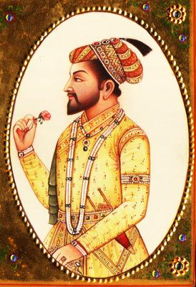
Had I the wings of a bird!
I wish I had the wings of a bird.
If I were a king!
I wish I were a king.
I wish< If/Had +subject +Extension +!
Notes:
How to change assertive with wish shown here.

Slide 13
Activities at home
The Padma is a very big river.
It is so deep.
The river contains a vast water.
The water of the river is very useful for the people.
It is beneficial for cultivation.
The fishermen enjoy fishing in the river very cheerfully.
The fish of this river is really tasty.
I wish I had a boat.
I wish I were a fisher man.
I like the river very dearly.
Notes:
Students will solve it at home and will show the teacher in the next class.

Slide 14
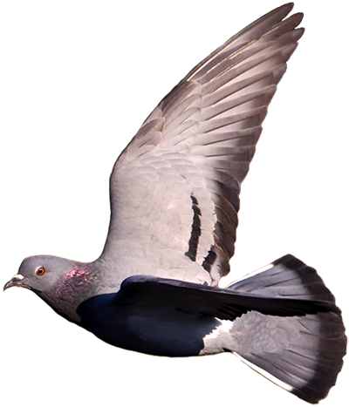
Inviting to part-4
May Allah keep you safe and sound.

