Slide 1
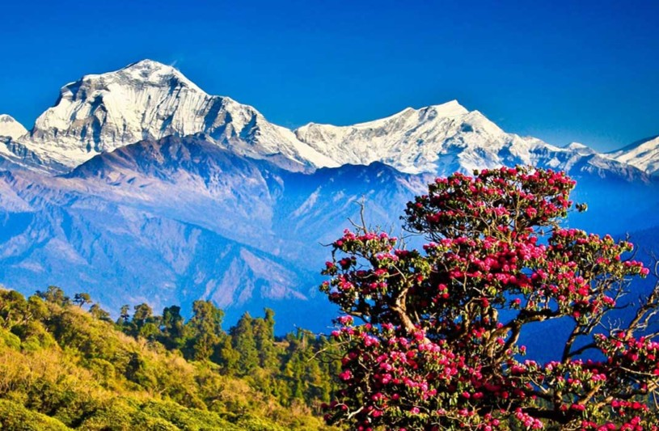
Welcome

Slide 2
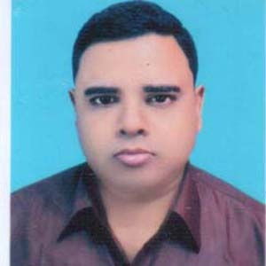
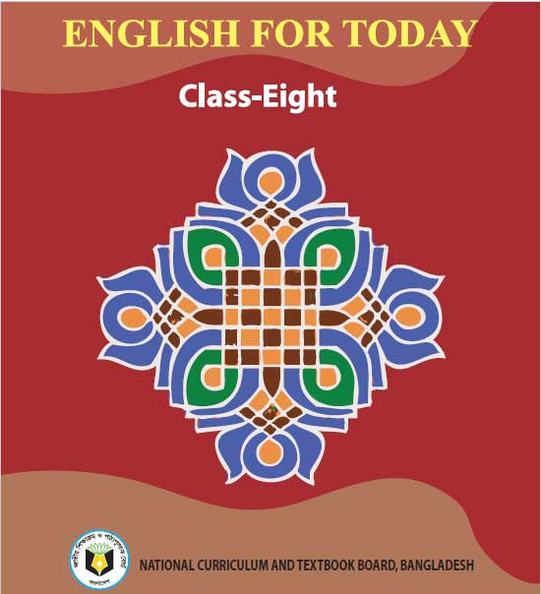
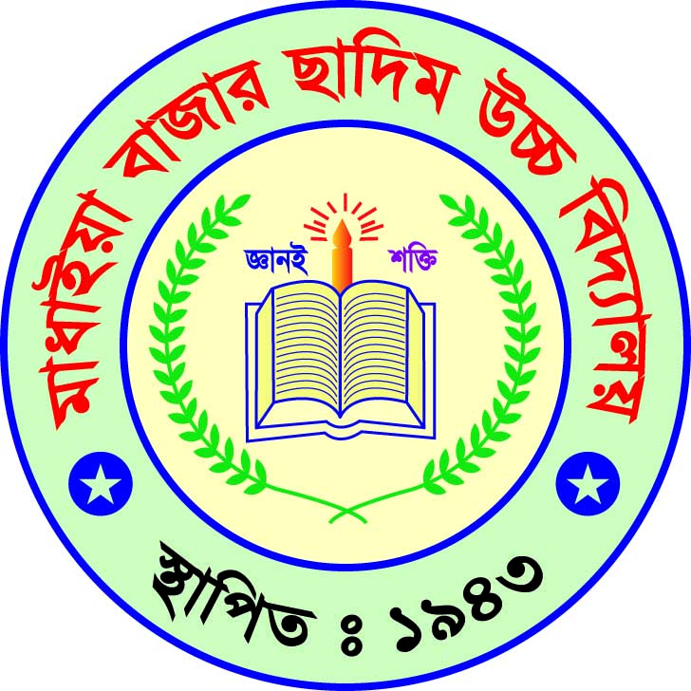
Introduction
Abdul Aziz
Assistant Teacher (English)
Madhaia Bazar Sadim High School
E-mail : azizabidpur@gmail.com
Mobile : 01921767310
Class –Nine
English First Paper
Unit -06, Lesson -05
Bhutan : The land of happiness

Slide 3
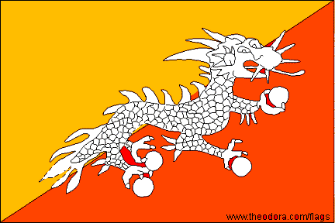
Look at the picture and talk about it
Pair Work
It’s a flag. It’s Bhutan’s national flag. A flag symbolizes
a country’s identity.
Notes:
s

Slide 4
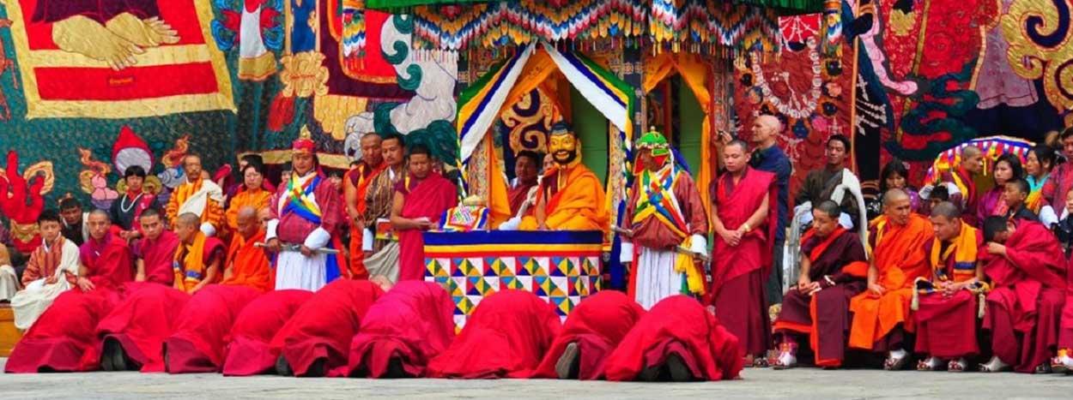
So , Our today’s topic
Bhutan: The land of happiness

Slide 5
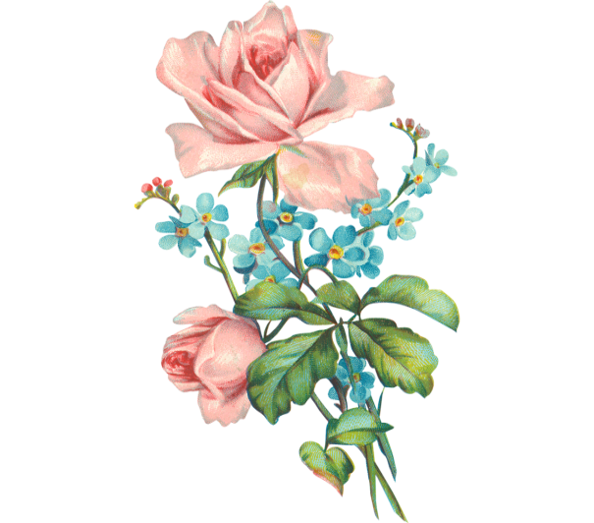
Learning Outcomes
After the end of the lesson, students will be able to-
Talk about Bhutan
Infer vocabulary
Ask and Answer Questions.

Slide 6
Key words
Almost or quite surrounded by land
Landlocked
প্রায় বা সম্পূর্ণ স্থলবেষ্টিত
Higher at one end than theother
Slope
ঢালু জায়গা
বেষ্টিত/আবৃত
Bounded
Surrounded
Located
Situated
অবস্থিত
Unique
Uncommon, second to none
অদ্বিতীয়,অনন্য

Slide 7
Key words
ঐতিহ্য
Tradition
custom
Belief
Faith,trust
বিশ্বাস
Evolve
প্রকাশ করা
Unfold,unravel
Exchange
Change one thing for another
বিনিময় করা
Festivals
Celebrations
উৎসব

Slide 8
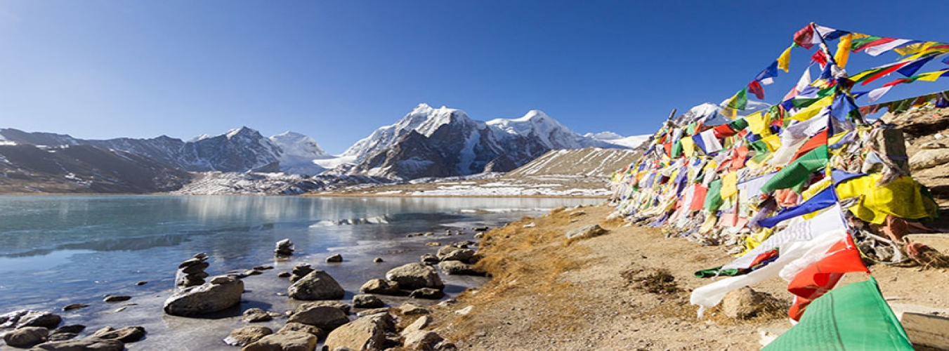
Read the text.
Bhutan is called the Jewel of the Eastern Himalayas. This small, landlocked country is located along the southern slopes of the Himalayas range, bounded by Tibet in the North and India from the other sides. The official name of Bhutan is “Druk –yul” which means land of the thunger dragon. It earned this name because of the fierce stormes that often roll in from the Himalayas.

Slide 9
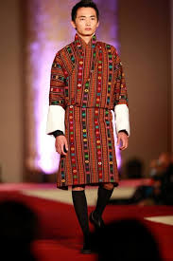
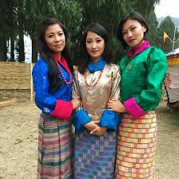
The country has an area of 38,394 sq.km. and a population of 716,896. Since it is cut off from the rest of the world by the Great Himalayas, a Unique culture and tradition based on gentle Buddhist belief have evolved There over time.
Bhutanese men wear Gho- a knee length robe – and Women
wear Kira- a sheet like cloth piece.

Slide 10
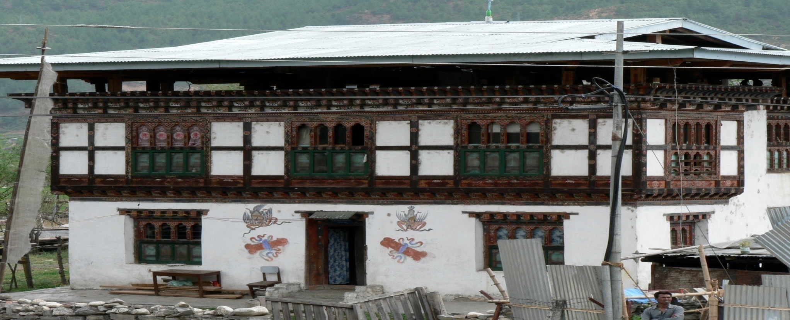
Bhutaneese houses are built from mud and stone, with wooden shingle roof. The Bhutanese never use iron nails in their buildings. Usually, the Bhutanese build each other’s houses by exchanging labour within the community. Different Festivals are celebrated all year round in Bhutan. Colorful masks are used in the festivals which reflect the rich Bhutanese culture. Dances are performed by the Buddhist monks protect the valleys and ward off evil spirits.

Slide 11
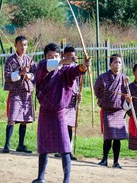
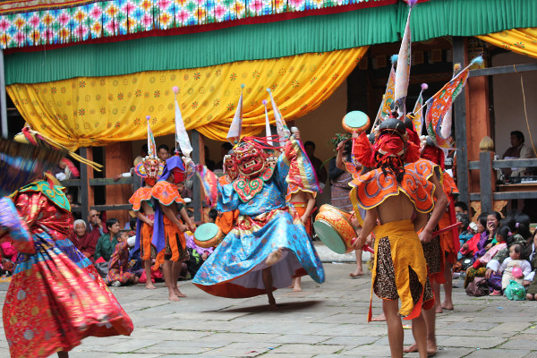
The main religious festival is called Tshechus. The teachings of lord Buddha are enacted through mask dances for three to five days in the country yard of the monasteries. People attend these events in their best clothes, carrying picnic baskets. Another major festival is called Losar. It is celebrated on Lunar New Year. People cook special dishes and wear new clothes. It is a time for family get-together. Men play archery or darts while women sing and dance.

Slide 12
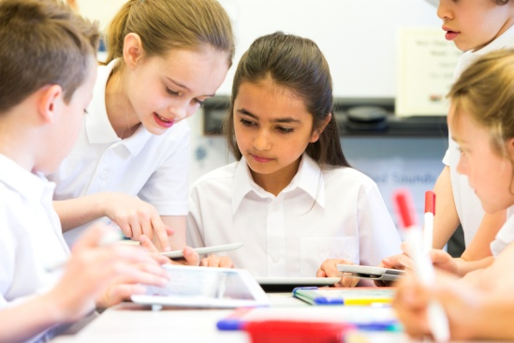
Group Work
Choose the correct answer from the alternatives
The word ‘Jewel’ means_____
Pearl b) gemstone c) paragon d) masterpiece
2. The word ‘reflect’ means_____
a) To ride b) to mirror c) to wave d) to stretch
3. The word ‘darts’ means_____
a) mingling b) mixing c) throwing d) floating
4. The word ‘earned’ means_____
a) brought b) netted c) reaped d) obtained

Slide 13
Individual Work
Write short answer to the following questions
What is the main religion of Bhutan?
The main religion of Bhutan is Buddhism.
What is the main festival of Bhutan?
The main festival of Bhutan is Tshechus.
When is Losar celebrated?
Losar is celebrated on Lunar New Year.

Slide 14
Individual Work
Fill in the gaps from the text.
official
Druk-yul is the a) _____ name of Bhutan. It is called the b)_____ of the Eastern Himalays. People of Bhutan follow c)________. They build wood houses d)______ using iron nails. They observe different festivals all the year round. Tschechus is their e)_________ religious festival.
Jewel
Buddhism
by
main

Slide 15
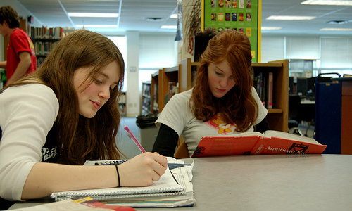
What is called the Jewel of Eastern Himalays?
What is the name of their major festival?
What is the land area of Bhutan?
Bhutan is called the jewel of Eastern Himalays
Losar is the major festival of Bhutan.
The land area of Bhutan is 38,396 sq.km.

Slide 16
Write a short paragraph on
“Bhutan and its beauties”

Slide 17
