Slide 1
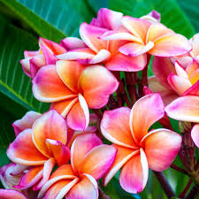
Welcome

Slide 2
ASMA HUQ
ASST. TEACHER,
ENGLISH
MOTIJHEEL GOVT. GIRLS’ HIGH SCHOOL

Slide 3
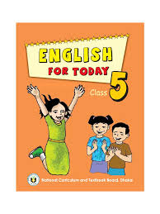
Class : Five
Subject : English
Unit : 19

Slide 4
LOOK AT SOME PICTURES
AND
THINK ABOUT THEM

Slide 5
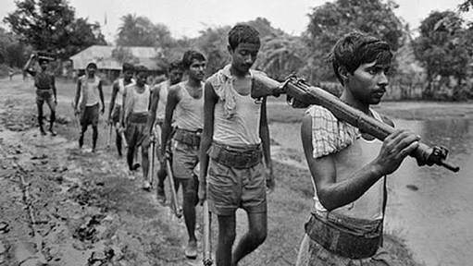
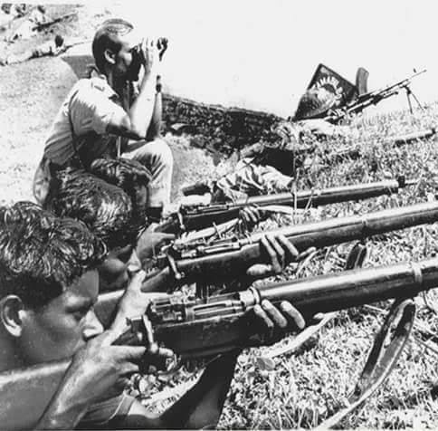
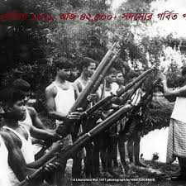

Slide 6
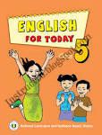
TODAY
OUR LESSON IS
The Liberation War Museum
Unit: 19
Page : 74

Slide 7
Learning outcomes:
Students will be able to-
1. understand questions about object.
2. understand and enjoy simple stories.
3. say sentences with proper intonation.
4. read , dialogues,stories,letters and other texts.

Slide 8
Vocabulary
A tour/journey made by the students to study in natural environment (মাঠ ভ্রমণ)
Field trip
A place where old things and documents are kept (জাদুঘর)
Museum
An official paper that can be used as proof of something (দলিল)
Document
A person possessing highly developed intellect (বুদ্ধিজীবী)
Intellectual

Slide 9
A person who shows a new way
to someone
(পথ প্রদর্শক)
Guide
To display for the public (জনসাধারণের জন্য প্রদর্শন করা)
Exhibit
Announcement
(ঘোষণা)
Declaration
A person who visits a place (পরিদর্শক)
Visitor

Slide 10
Now Let us see some pictures inside the Liberation War Museum.

Slide 11
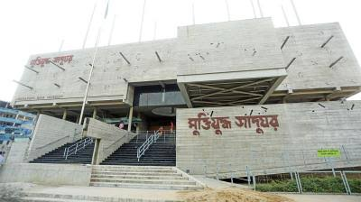

Slide 12
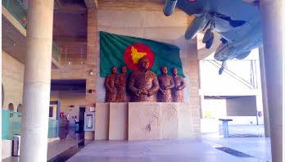

Slide 13
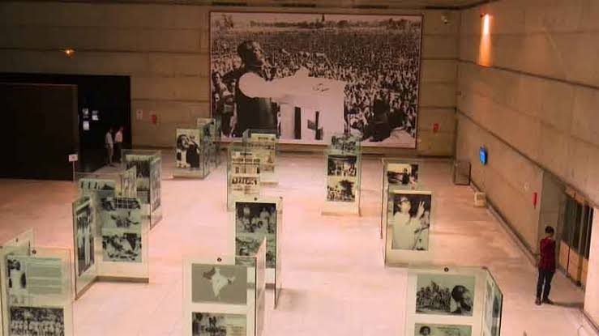

Slide 14
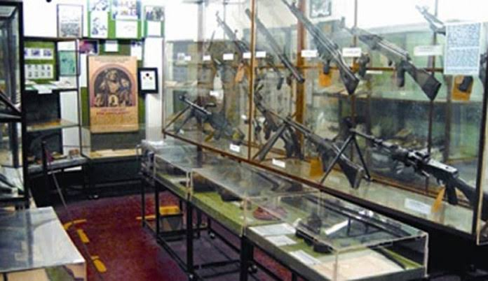

Slide 15
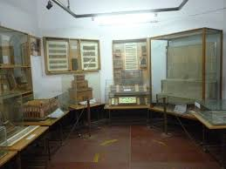

Slide 16
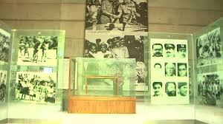

Slide 17
Students’ silent reading

Slide 18
FILL IN THE GAPS WITH THE WORDS GIVEN IN THE BOX
looked | is | great
declaration | guide | museum
a) Our Lberation War ----- a great war.
b) A ----- was waiting for the students.
c) The ----- of independence was at Gallery 3.
d) The students ----- at the martyrs personal belongings.
e) They left the ------ at 12.30 .

Slide 19
Write’ True’ for the correct statements
and ‘False’ for the incorrect statements.
a) Our Libaration War Museum is situated at Agargaon, Dhaka.
b) The name of the magazine is ‘The Rainbow’
c) The students felt silent at Gallery 4.
d) The class went to the Libaratoin War Museum on 14 February.
e) There are 4 permanent galleries in the Liberation War Museum.

Slide 20
Answer the questions
1. How many permanent galleries are there in the Liberation War Museum?
2. What personal belongings did the students see in “Gallery 4 - Our victory,Our values”?

Slide 21
Write a short composition about “The Liberation War Museum” in at least 5 sentences.
HOME WORK

Slide 22
Thank you

