Slide 1
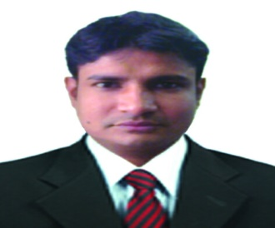
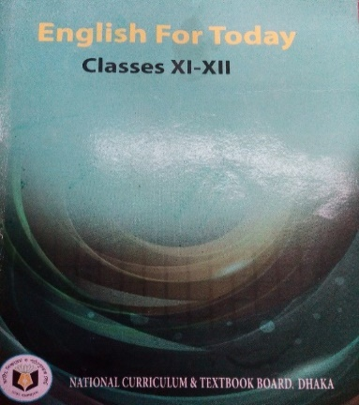
Sree Pradip Chandra Das
Lecturer in English
Ziarkandi Hafij Uddin Fazil Madrasah
Gouripur
Titas,Cumilla
IDENTITY
Class: XI-XII
Subj: English 1st Paper
Time: 45 minutes
Date: July 30, 2020

Slide 2
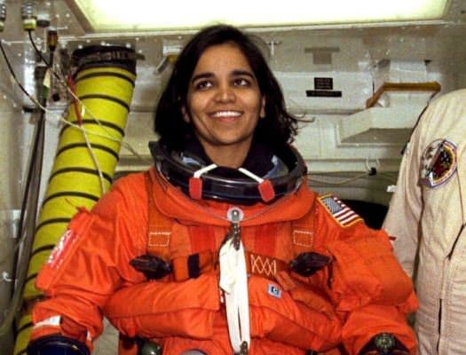
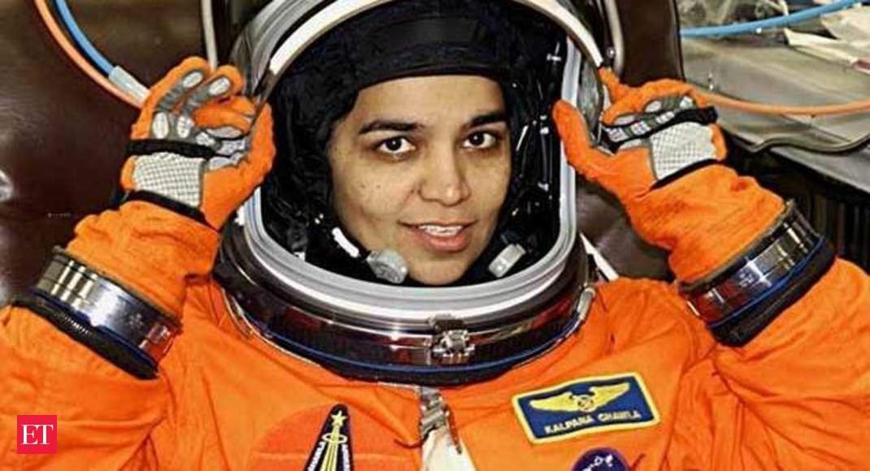
Look at the picture and think about this

Slide 3
Can you guess what may be the topic today?
Kalpana Chwala (Part-Two)
Two Women(Lesson-Three)
People or Institutions Making History(Unit-One)

Slide 4
Learning Outcomes:
After the lesson the ss will be able to-
→ say the meaning of some new words.
→ say about the tragedy of Kalpana Chawala .
→ tell something about the space craft.

Slide 5
Let’s diccuss about the meaning of some words ---
Given Words
Their meanings
To organize a particular activity
conduct
To use something effectively
deploy
Broken into parts
disintegrated
ill-fated
One who is unfortunate
malfunction
Inability to work
penetrate
Manage to enter into

Slide 6
A. Read the multiple choice questions below and find the answers from the text in next slide:
i . “Shuttle” means-----
a) bus b) space-ship
c) truck d) steame
“Scheduled” stands for ----
a. routined b. programme
c. routineless d. program
“Retrieve” denotes-----
a. repain b. remark
c. remorse d. regain
iv. The term “external” refers to
a. exterior b. internal
c. interior d. important
v. What is meant by “launch”--- .
a. sending a spaceship into space
b. sending a launce into space
c. launching weapons
d. launching boat

Slide 7
Kalpana Chawala’s first space mission (Mission STS 87) began on 19 November, 1997 with six other astronauts on the Space Shuttle Columbia. On her first mission that lasted for 15 days, 16 hours, 34 minutes and 4 seconds, she travelled 6.5 million miles. She was responsible for deploying the Spartan Satellite which however malfunctioned, necessitating a spacewalk by Winston Scott and Tako Doi, two of her fellow astronauts, to retrieve the satellite.
In 2000 she was selected for her second space mission STS 107. This mission was repeatedly delayed due to scheduling conflicts and technical problems. On 16 January 2003, Kalpana Chawla finally started her new mission with six other space crew on the ill-fated space shuttle Columbia. She was one of the mission specialists. Chawla’s responsibilities included the microgravity experiments, for which the crew conducted nearly 80 experiments studying earth and apace science, advanced technology development, and astronaut health and safety.
After a 16 day scientific mission in space, on 1 February 2003, Columbia disintegrated over Texas during its re-entry into the Earth’s atmosphere. All the crew in Columbia including Chawla died only 16 minutes prior to their scheduled landing. Investigation shows that this fatal accident happened due to a damage in one of Columbia’s wings caused by a piece of insulating foam from the external fuel tank peeling off during the launch. During the intense geat of re-entry, hot gases penetrated the interior of the wing, destroying the support structure and causing the rest of the shuttle to break down.

Slide 8
A. Read the multiple choice questions below and find the answers from the text in next slide:( work individually)
i . “Shuttle” means-----
a) bus b) space-ship
c) truck d) steame
Ans. b) space-ship
“Scheduled” stands for ----
a. routined b. programme
c. routineless d. program
Ans. a) routined
“Retrieve” denotes-----
a. repain b. remark
c. remorse d. regain
Ans. d) regain
iv. The term “external” refers to
a. exterior b. internal
c. interior d. important
Ans. a) exterior
v. What is meant by “launch”--- .
a. sending a spaceship into space
b. sending a launce into space
c. launching weapons
d. launching boat
Ans. a) sending a spaceship into sapace

Slide 9
B. Read the questions below and answer them from your understanding of the comprehension in the previous slide. (work in pairs)
a) What happened to the fate of Kalpana Chawla ?
b) What was the cause behind the accident?
c) Who died in that mishap?
d) Why has the space shuttle Colombia been called ill-fated?
e) What is the duration of Kalpana’s first mission in space?

Slide 10
Kalpana Chawala’s first space mission (Mission STS 87) began on 19 November, 1997 with six other astronauts on the Space Shuttle Columbia. On her first mission that lasted for 15 days, 16 hours, 34 minutes and 4 seconds, she travelled 6.5 million miles. She was responsible for deploying the Spartan Satellite which however malfunctioned, necessitating a spacewalk by Winston Scott and Tako Doi, two of her fellow astronauts, to retrieve the satellite.
In 2000 she was selected for her second space mission STS 107. This mission was repeatedly delayed due to scheduling conflicts and technical problems. On 16 January 2003, Kalpana Chawla finally started her new mission with six other space crew on the ill-fated space shuttle Columbia. She was one of the mission specialists. Chawla’s responsibilities included the microgravity experiments, for which the crew conducted nearly 80 experiments studying earth and apace science, advanced technology development, and astronaut health and safety.
After a 16 day scientific mission in space, on 1 February 2003, Columbia disintegrated over Texas during its re-entry into the Earth’s atmosphere. All the crew in Columbia including Chawla died only 16 minutes prior to their scheduled landing. Investigation shows that this fatal accident happened due to a damage in one of Columbia’s wings caused by a piece of insulating foam from the external fuel tank peeling off during the launch. During the intense geat of re-entry, hot gases penetrated the interior of the wing, destroying the support structure and causing the rest of the shuttle to break down.

Slide 11
Q. Work in groups and Make a list of five events happening in Chawla’s life.

Slide 12
The list of five events happening in Chawla’s life :
Ans.
a. first space mission in 1997
b. Travelling 6.5 million miles in first mission
c.being selected for second space mission STS 107
d. mission on the ill-fated space shuttle Columbia
e. died only 16 minutes prior to scheduled landing

Slide 13
Work individually and Summarize the text in your own language.

Slide 14
Kalpana Chawala’s first space mission (Mission STS 87) began on 19 November, 1997 with six other astronauts on the Space Shuttle Columbia. On her first mission that lasted for 15 days, 16 hours, 34 minutes and 4 seconds, she travelled 6.5 million miles. She was responsible for deploying the Spartan Satellite which however malfunctioned, necessitating a spacewalk by Winston Scott and Tako Doi, two of her fellow astronauts, to retrieve the satellite.
In 2000 she was selected for her second space mission STS 107. This mission was repeatedly delayed due to scheduling conflicts and technical problems. On 16 January 2003, Kalpana Chawla finally started her new mission with six other space crew on the ill-fated space shuttle Columbia. She was one of the mission specialists. Chawla’s responsibilities included the microgravity experiments, for which the crew conducted nearly 80 experiments studying earth and apace science, advanced technology development, and astronaut health and safety.
After a 16 day scientific mission in space, on 1 February 2003, Columbia disintegrated over Texas during its re-entry into the Earth’s atmosphere. All the crew in Columbia including Chawla died only 16 minutes prior to their scheduled landing. Investigation shows that this fatal accident happened due to a damage in one of Columbia’s wings caused by a piece of insulating foam from the external fuel tank peeling off during the launch. During the intense geat of re-entry, hot gases penetrated the interior of the wing, destroying the support structure and causing the rest of the shuttle to break down.

Slide 15
Evaluation
Based on your reading of the passage make short notes in each of the boxes in the flow chart showing the activities of Chawla’s life.No.1 has been done for you.)
1
2
3
4
5
6
Deploying the Spartan Satellite

Slide 16
Ans.
The flow chart showing the activities of Kalpana Chawla:
jstarst
starting first space mission in 1997
Travelling 6.5 million miles in first mission
being selected for second space mission STS 107
Taking responsibilities of microgravity experiments
conducting the crew to 80 experiments

Slide 17
Home Work
Make ten open-ended Questions from the passage.

Slide 18
Thank you all

