Slide 1
Welcome

Slide 2
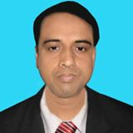
Introduction
Mohammad Abdul Malek
Assistant Teacher (Computer)
Kazi abdul majed academy
Pangsha, Rajbari.
Mob-01717002151
Email.abdulmalek1972p@gmail.com
Website. www.teachersnews24.com
Class: Eight
Subject: English 1st Paper
Time: 50 minute

Slide 3
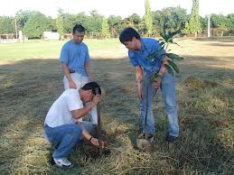
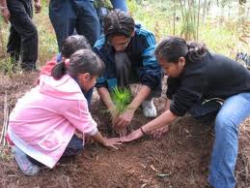
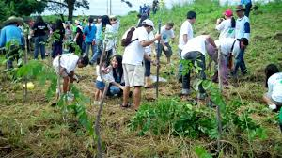
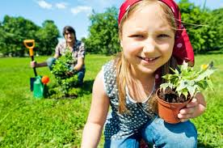
What do you see in the pictures ?
Why are they planting trees ?
What do we call them who love trees?

Slide 4
Today our lesson is ‘’A man
who Loves trees’’
Unit -5 , Lesson -4

Slide 5
Learning outcomes :
By the end of the lesson students will be able to …
use new vocabularies.. profession, sapling, passion, gigantic, mission.
read the text and find out information.
infer the meaning from contest.
write answers to question.

Slide 6
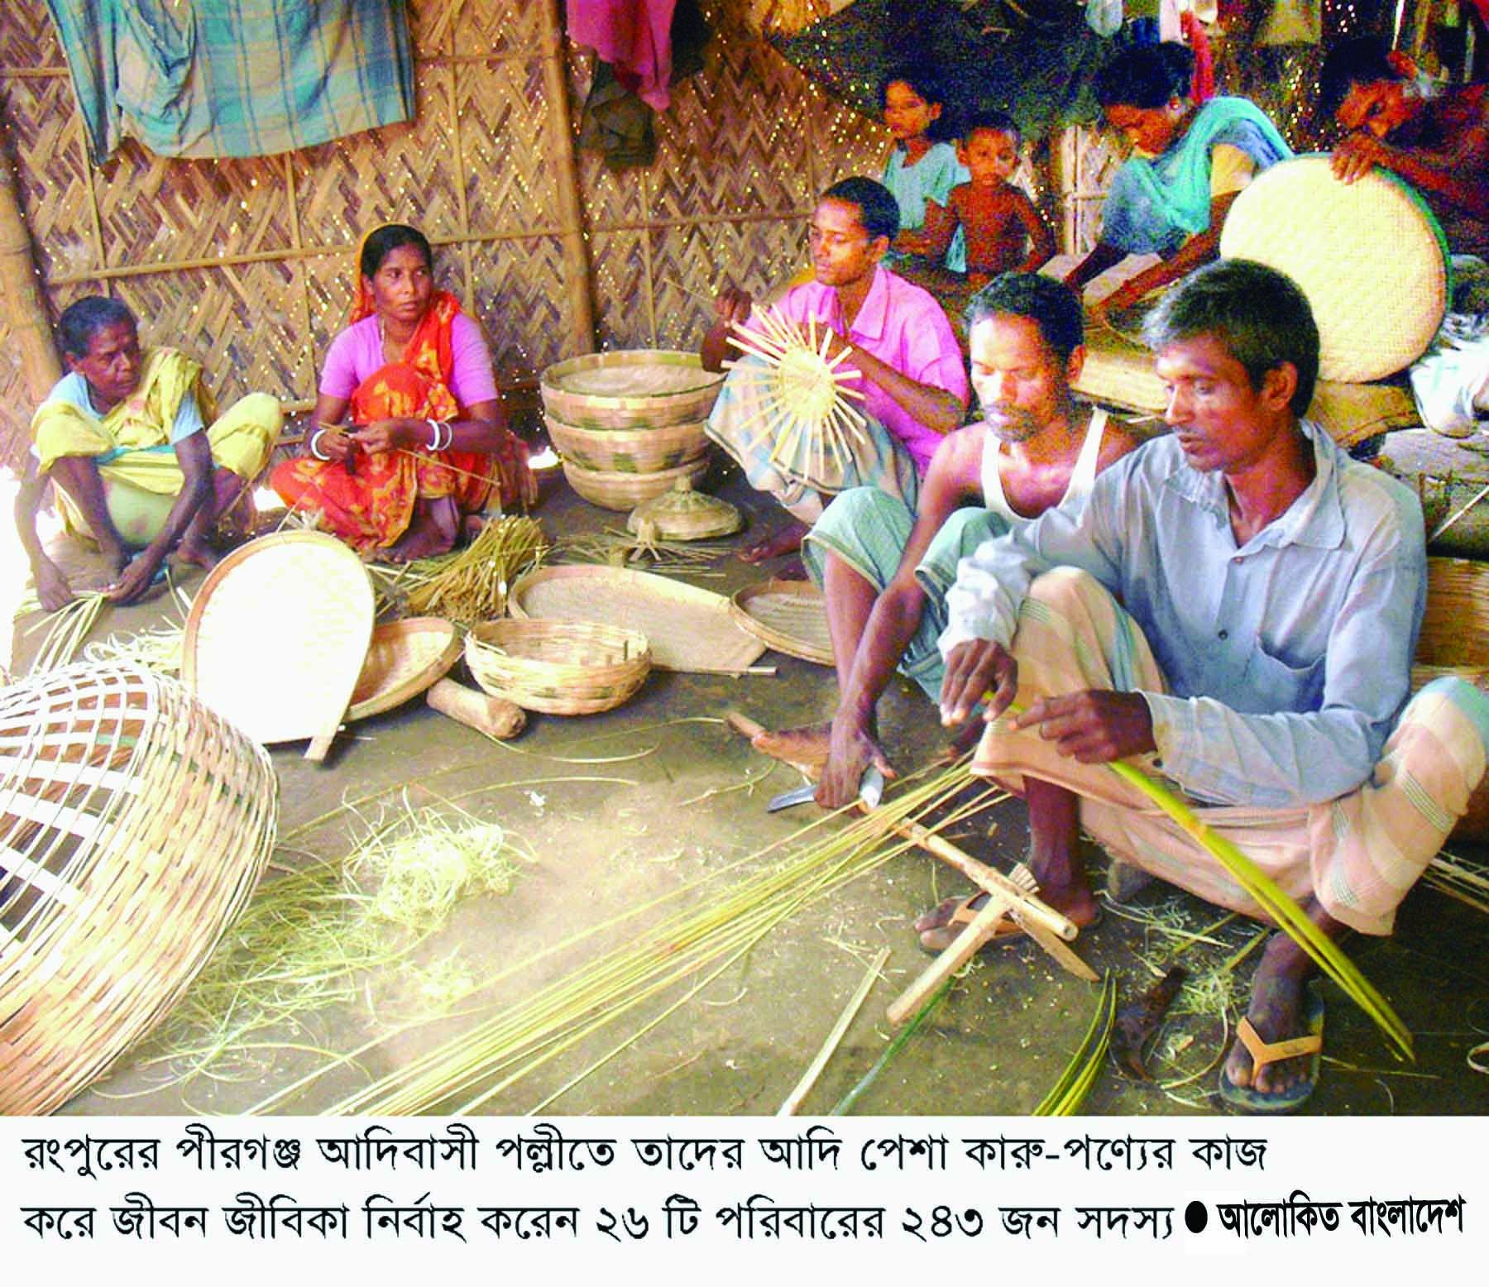
Vocabularies
Profession
A type of work that
needs Special
training or education.
পেশা
Making basket is their profession.
Syn- Occupation, opp- Unemployed.

Slide 7
Sapling
A young tree.
চারা গাছ
We plant sapling
Syn- seedling

Slide 8
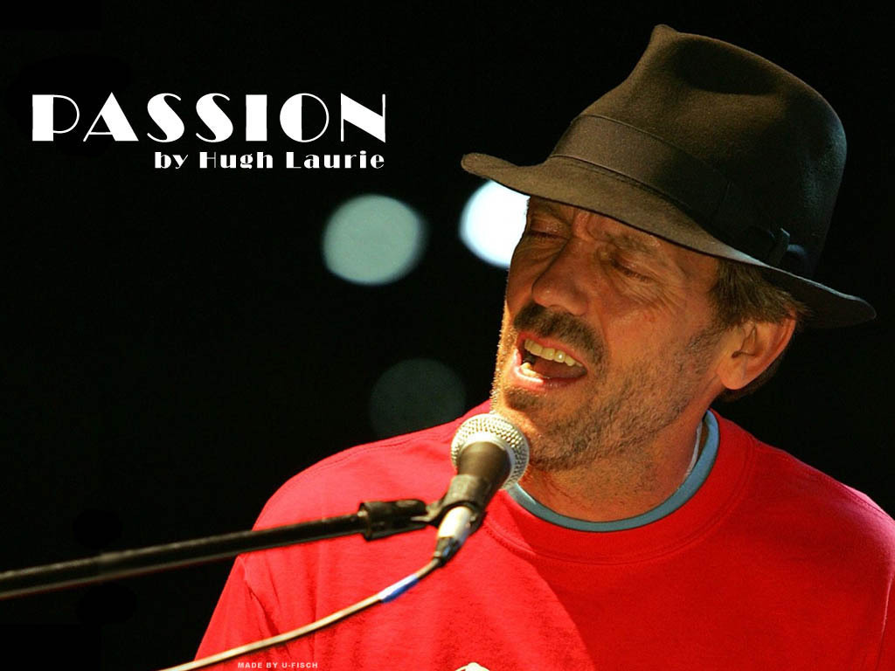
Passion
Having strong feeling
About something
প্রবল আকাঙ্খা
Syn.-Obsession , opp. – indifference.
He has strong passion for music.

Slide 9
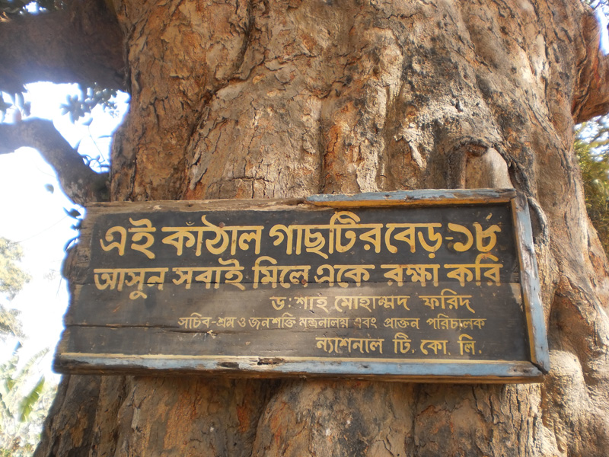
Gigantic
Very big
বিশাল
Syn.- massive ,opp.- small.
A sapling becomes a gigantic tree.

Slide 10
Mission
Project
প্রকল্প
Syn. operation
Their mission is to plant trees.

Slide 11
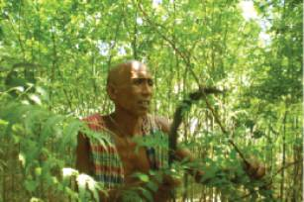
Place of birth
Shibgonj,
Chapai Nababgonj
Hair dresser
by profession
Nature
lover
63 years
old
Planted
A lot of trees.
Kartik Poramanik

Slide 12
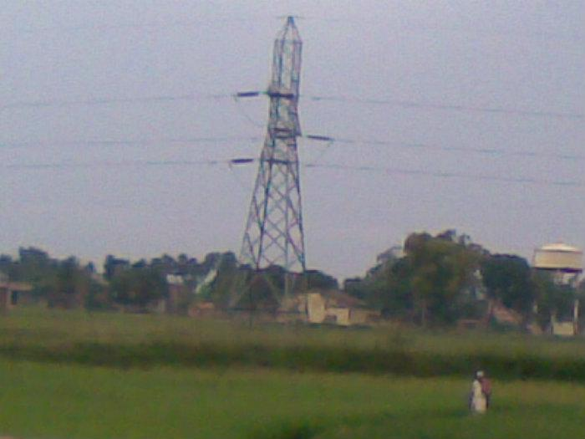
Picture of Tarapur village
The village is in Chapai Nababgonj district under Shibgonj thana.
The village is near the border of India.

Slide 13
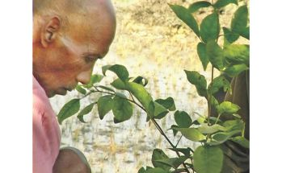
Kartik used to go different houses for his job.
At times he would get tired in the scorching
Sun, but there were no trees for taking rest.
Thinking people suffering in the heart, Kartik
began his tree planting mission.

Slide 14
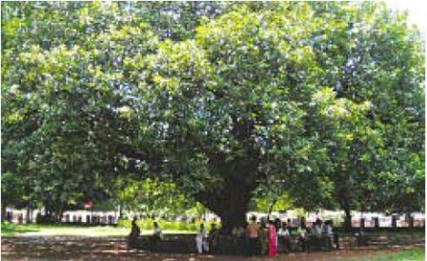
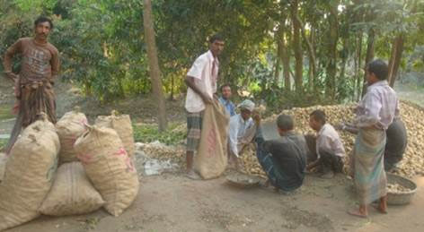
Kartik started planting trees at 10. He has
planted hundreds of trees with his own
money in his village . Many of them
are now 35-40 years old.

Slide 15
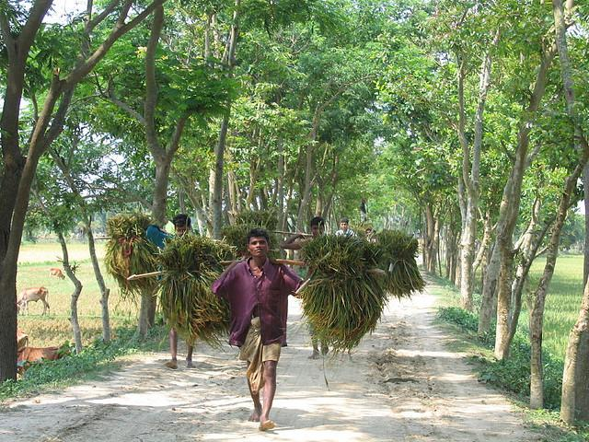
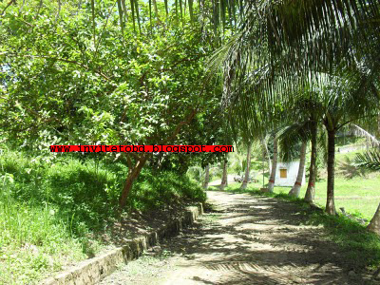
Kartik has planted trees beside the
roads, in and around the bazar, schools
and colleges, open fields and many
other places.

Slide 16
At times it so happened that Kartik would go
To water his plants at 10 or 11 pm. People
asked him, “Kartik, are you mad ?’’ Kartik
replied, “I have to work the whole day for my
family. So I come late at night.

Slide 17
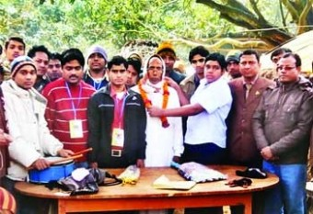
Kartik has received reward.
A man , who can hardly sign his
name, is leaving his signature
all around in nature.

Slide 18
Group work
Read the text again and answer the
following Question.
Who is Kartik Poramink ?
How do you understand that he is a
nature lover?
3.Why did he plant trees?
4.What do you understand by the saying:
A man , who can hardly sign his name, is
leaving his signature all around in nature?

Slide 19
Choose the best answer.
1.Kartik was a ……………by profession.
a) Cultivator b)tree planter
c) Day labourer d)hair dresser.
2. Some of his trees are ………years old.
a) 15-20 b)25- 35 c)35-40 d)40-45
3. Some of Kartik trees are big and ….
a) Great b)gigantic c)enormous d) kingly

Slide 20
Home work
Write a short paragraph on Kartik
Poramink and about his activities.

Slide 21
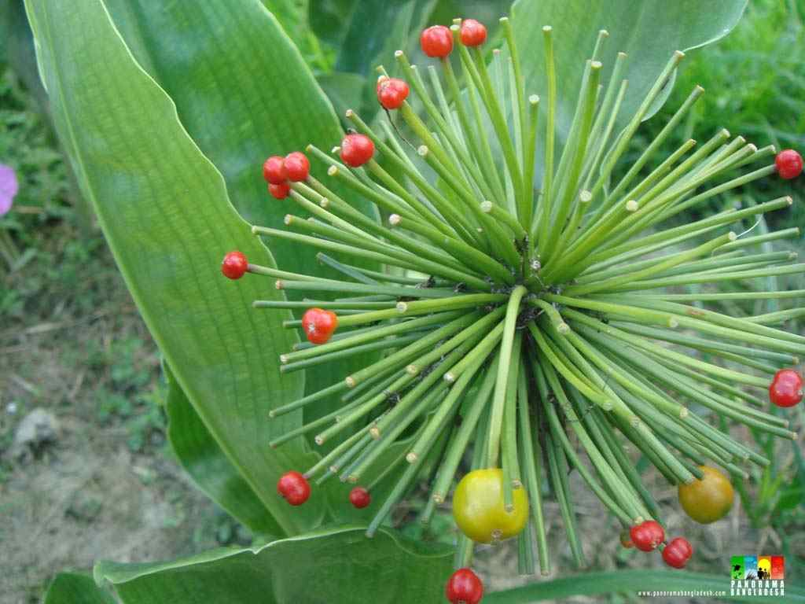
Thank you

