Slide 1
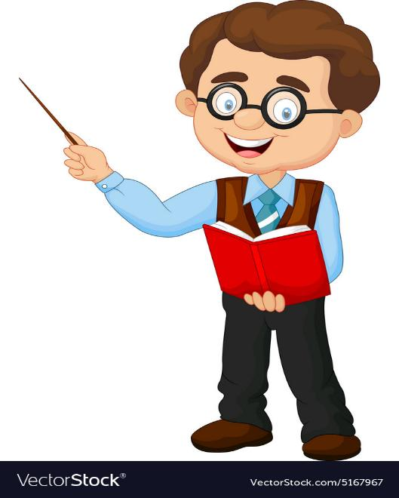
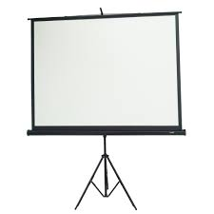
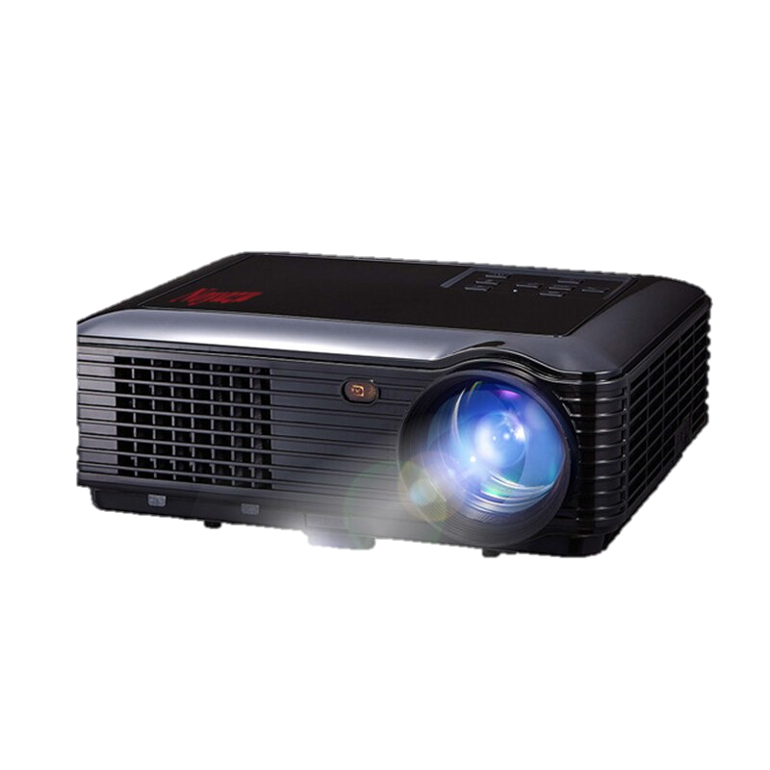
WELCOME TO FAKIRHAT ONLINE SCHOOL

Slide 2
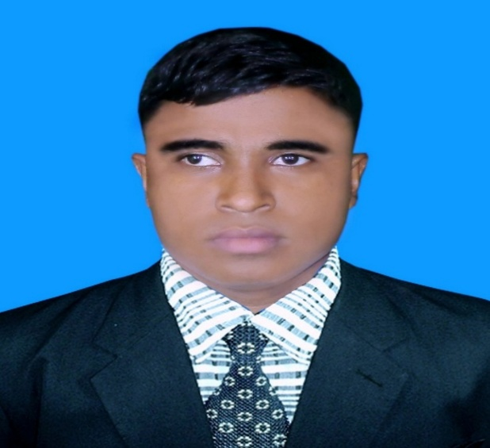
Teacher’s Identity A. Sukur Ali Khan B.A hons.M.A In English Assistant Teacher(English)
Naldha Secondary School
Naldha,Fakirhat,Bagerhat. Mobile no-01922-360720
Class : Six
Subject : English Second Paper.
Top[ic : Use of Capital Letters.

Slide 3
A B C D E F G H I J K L M
What do you see in the screen ?
Answer: Some capital letter.

Slide 4
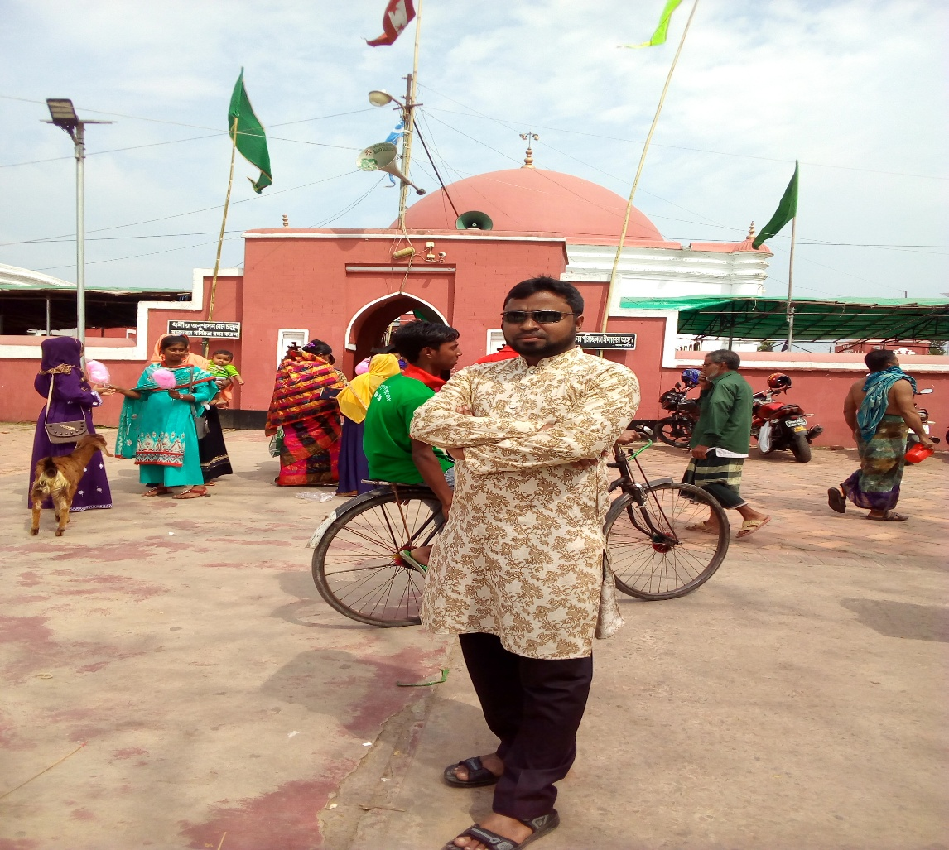
What can you see in the picture ?
A picture of a young man
A. Sukur Ali Khan is a handsome young man. He is a debater, anchor , reciter and a rover. He is a university student, He has another two named Jarif and Tasin. He is now studying honours in Political Science. He worked as a social worker at Bagerhat in Bangladesh.

Slide 5
Dear students guess what kind of grammatical rules we will discuss about today.
Use of Capitalization

Slide 6
Learning Outcomes:
After the end of the lesson the learners will be able to…
1.Write the name of any thing using the rules of capitalization
2. Rewrite a passage using the rules of capitalization
3. Enable to use of Capital letters.

Slide 7
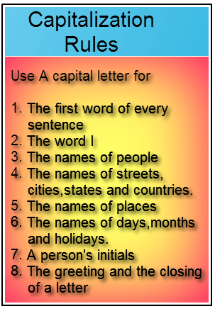
THE RULES OF CAPITALIZATION

Slide 8
Look at the sentences carefully and solves the mistakes.
Mobile
mobile phone is a
wonderful invention
of information
techonology. we can
Communicate and
talk to others.
We
The frist word’s first alphabet ofa sentence will be capital letter.

Slide 9
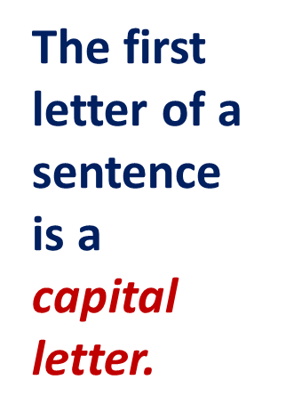
T
his is an outstanding art work.

Slide 10
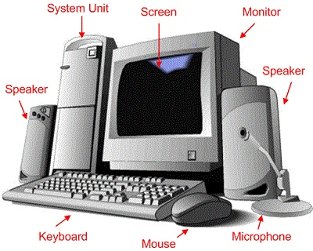
T
his is an extra-ordinary invention

Slide 11
Find out the problem and correct it.
The two women are
walking on Khulna
road .
Khulna
Road.
The name of roads,streets, towns,villages,countries and
geographical features first letter will be capital letter.

Slide 12
Look at the sentences carefully and correct the mistakes.
Salma
salma is in class six.
she goes to agrani
school . she comes
first in her class.
She
Agrani
School
She

Slide 13
Proper noun
A.Sukur Ali Khan is an Assistant teacher.
In case of a proper noun the first letter will be capital.

Slide 14
Look at the sentence carefully and correct the mistakes.
may day is
Observed on may
1st all over the world
today.
May Day
May
Frist letter of day of week, months, special festivals will be capital letter.

Slide 15
Look at the sentence and correct the error.
Mr.Michael phelps
is american.
American.
Frist letter of nouns and adjective referring to nationality will be capital letter.

Slide 16
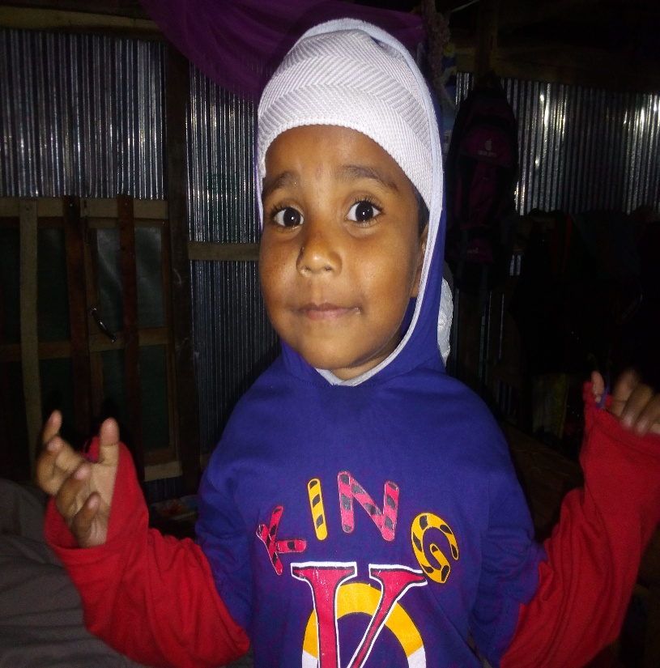
Look at the sentence and correct the error.
Tasnim delivers
his speech in bangla .
Bangla
Any language first letter will be capital letter.

Slide 17
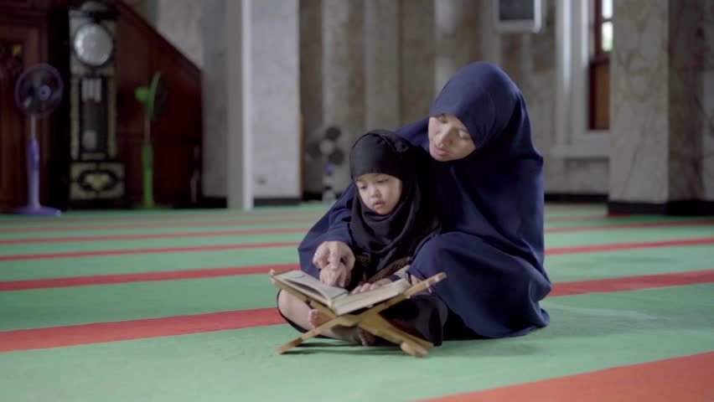
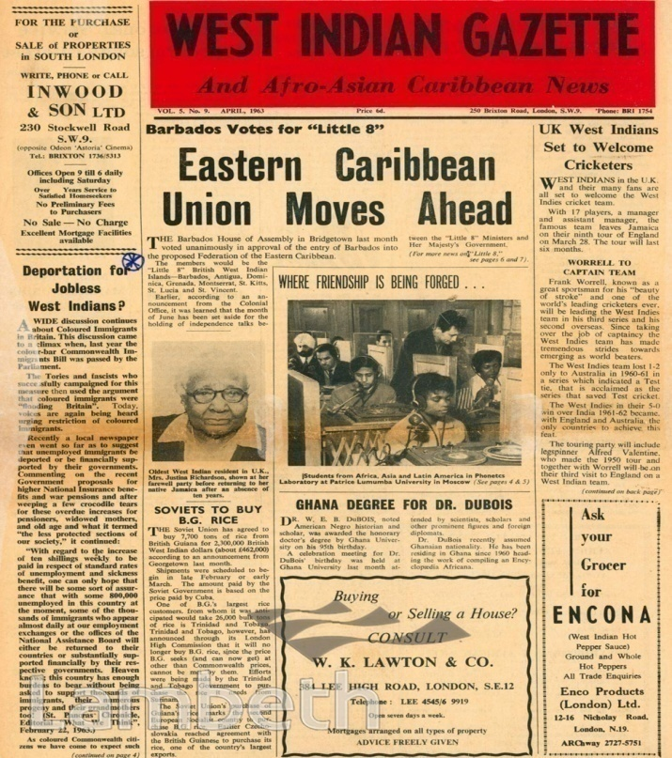
Mother reads the daily in the morning.
Holy Quran
The first letter of the holy religious book is a capital letter
Indian gazette
The is the first newspaper of Asia.
The first letter of a newspaper is a capital letter

Slide 18
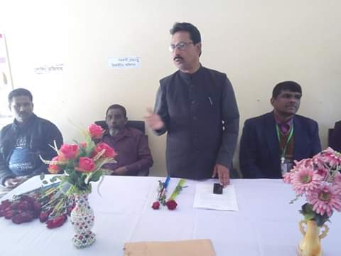
Look at the sentence and correct the error.
Mr. Kazi Md Mohasin delivers his speech in house programme at naldha
secondary school..
Naldha
Secondary School
Institution first letter will be capital letter.

Slide 19
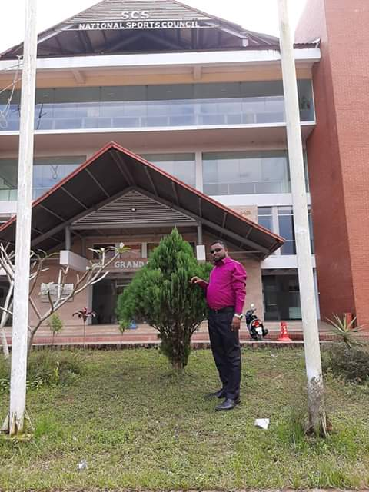
Look at the sentence and correct the error
I , A.Suklur Ali Khan
am an assistance teacher of Naldha Secondary School.
First person singular:“I” is always spelt capital letter.

Slide 20
Look at the sentence and correct the error
A republic usually elects a president.Mr Rahman, president of NHRC, will adress the assembly.
President
Mizanur Rahman
Tittle starting alphabet will be capital letter.

Slide 21
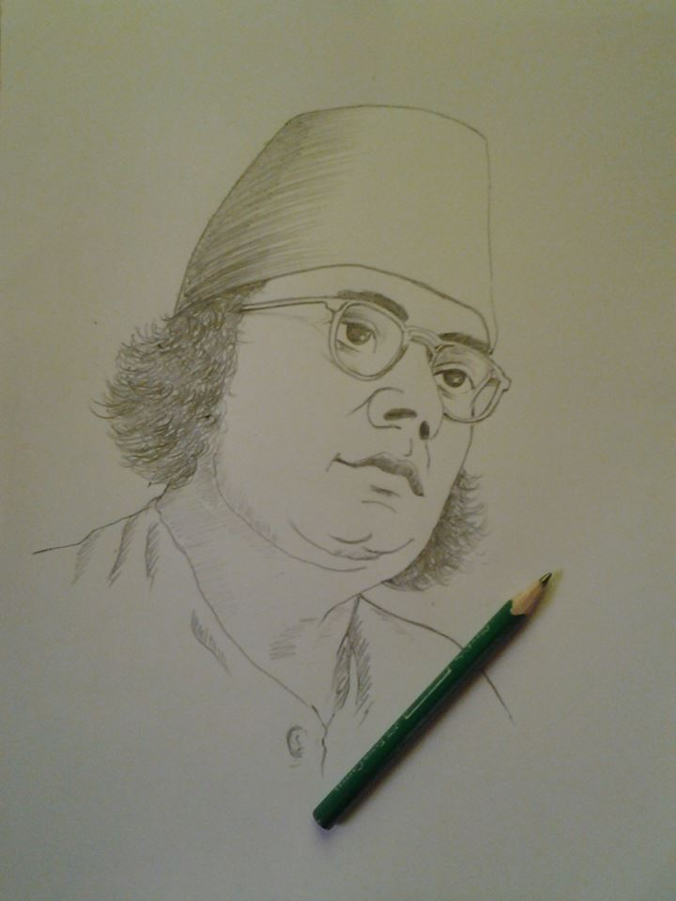
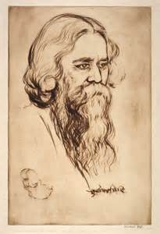
Group Work
Discuss the pictures within the groups . Now write 5 sentences about these pictures using the rules of capitalization . ( picture 1 for G-A & 2 for B ) .

Slide 22
Below some words usually first letter will be capital letter when they pefer to a particular institution.
Committee,
Government
School
Union
University

Slide 23
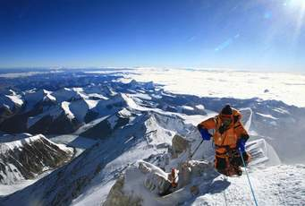
Evaluation
Rewrite the passage using the rules of capitalization where necessary..
musa ibrahim is the first bangladeshi who reached the mount everest .m t everest is the pick of the himalaways. He had a dream to win mount everest .to make his dream real. he tried heart and soul. Finally his dream came true.
M
I
B
M
E
E
H
M
E
H

Slide 24
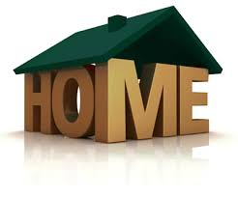
Home Work
Use capital letter where necessary.
the eiffel tower a great and magnificent building was named after gustave eiffel a frenchman who built the tower. he graduated from the central school of engineering in paris. the eiffel tower a great and magnificent building was named after gustave eiffel a frenchman who built the tower. he graduated from the central school of engineering in paris.

Slide 25
Class Over
Bye. See you again tomorrow.

