Slide 2
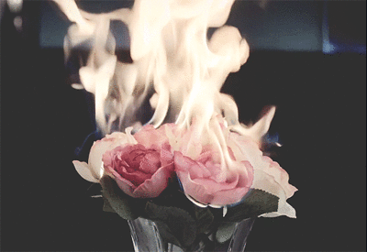
WELCOME
TO
ALL

Slide 3
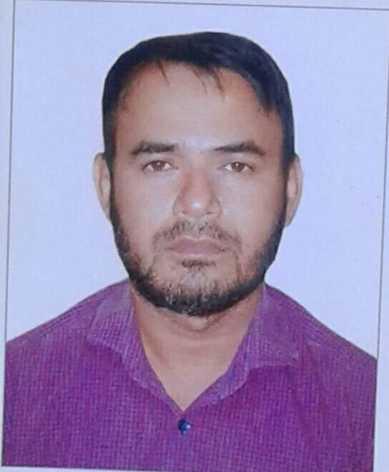
TEACHER’S INTRODUCING
MD SHAMSUNNOOR
HEAD TEACHER
MURERGAON GOVERNMENT PRIMARY SCHOOL COMPANIGANJ, SYLHET.
Email address- shadmanheya@gmail.com
Contact No- 01712307039

Slide 4
IDENTITY of lesson
SUBJECT : ENGLISH
CLASS : TWO
UNIT : 20
Lessons : 4-6
Title : mr. shape
Time : 40 minutes

Slide 5
Learning Outcomes:
By the end of the lesson students will be able to…..
Speaking :
1.1.2 Say simple words and phrases with proper sound and
stress.
Reading:
1.4.1 Read words and phrases with the help of visual clues and
simple sentences.
Writing :
4.1.2 Write numbers up to 10 in figures and in words.

Slide 6
Let`s we play a video.

Slide 7
Lesson declaration
Todays Lesson is Mr. Shape

Slide 8
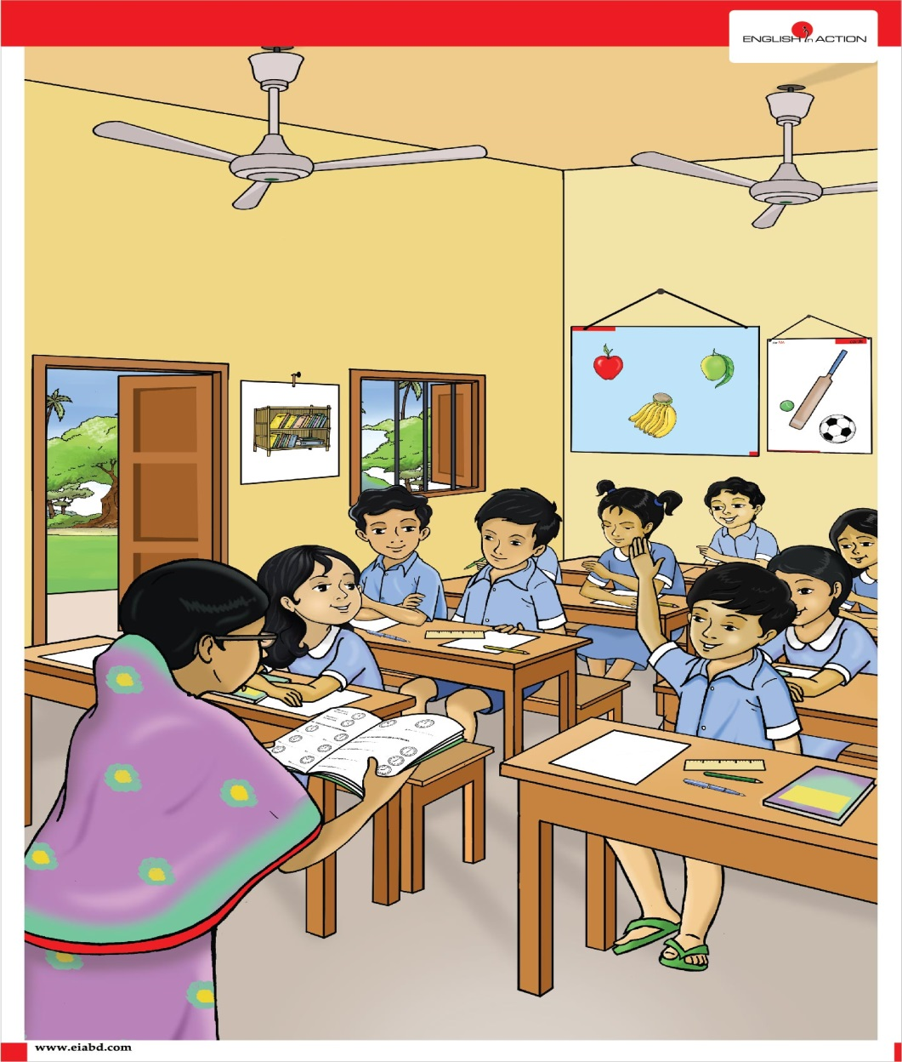
Teacher`s Activities -
Teacher will shaw some shapes and ask learner`s what’s the name of it’s ?

Slide 9
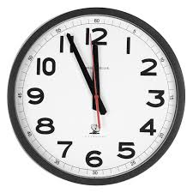
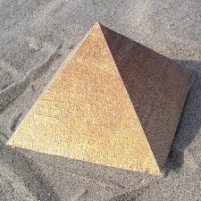
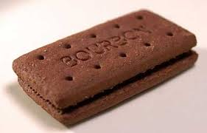
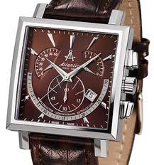
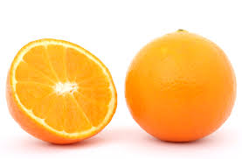
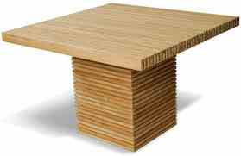
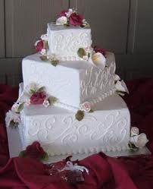
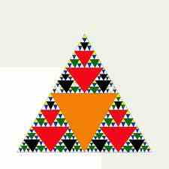
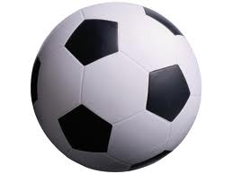
Showing Picture(Say about Picture)

Slide 10
Names of the shapes
Circle
Triangle
Square
Rectangle

Slide 11
Now, we will know how to draw a shape.
Circle

Slide 12
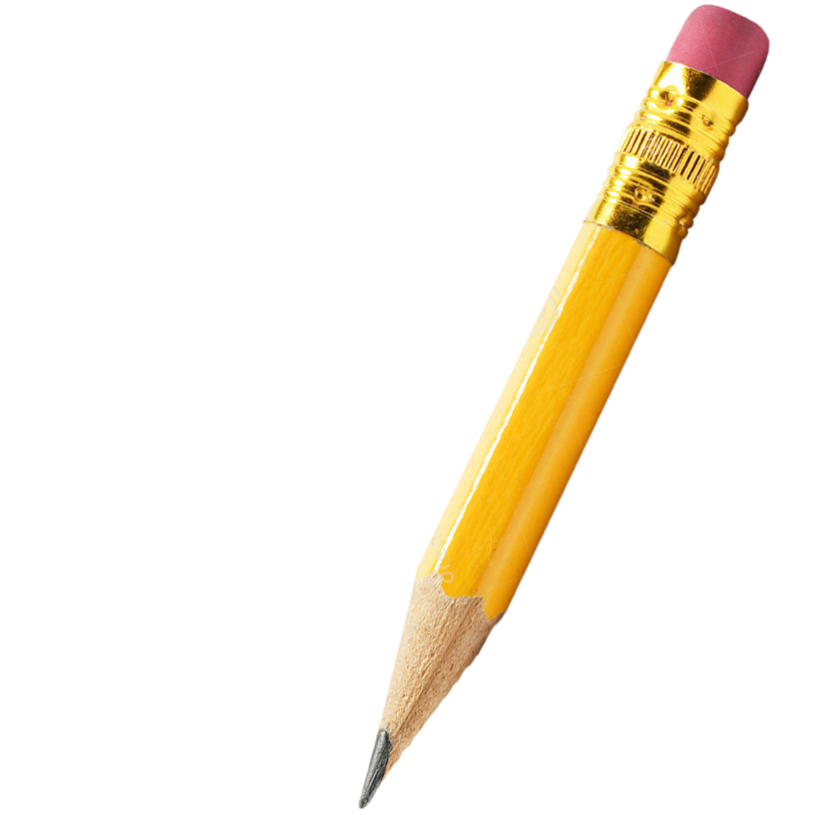
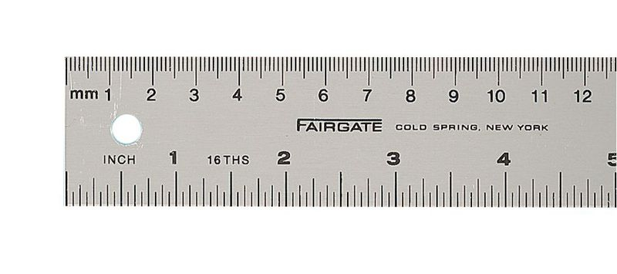
Now, we will know how to draw a shape.
Triangle

Slide 13
Now, we will know how to draw a shape.
Square

Slide 14
Now, we will know how to draw a shape.
Rectangle

Slide 15
Look, listen and say.
How many circles are in Mr. shape ?
Answer : 5 circles .
How many triangles are in Mr. shape ?
Answer : 3 triangles .
How many squares are in Mr. shape ?
Answer : 3 squares .
Mr.Shape
How many rectangles are in Mr. shape ?
Answer : 4 rectangles .

Slide 16
Look, Count and Write
5
circles
3
tiangles
4
rectangles
3
squares
Mr.Shape

Slide 17
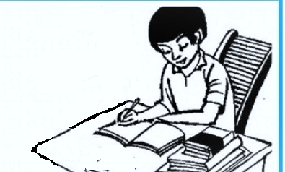
Individual work:
শামছুন নূর
What’s shapes in Mr. Shape ?

Slide 18
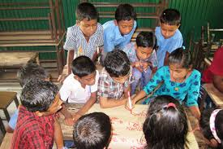
GROUP WORK
GREEN GROUP
YELLOW GROUP
Draw this shape
Draw this shape
BLUE GROUP
Draw this shape

Slide 19
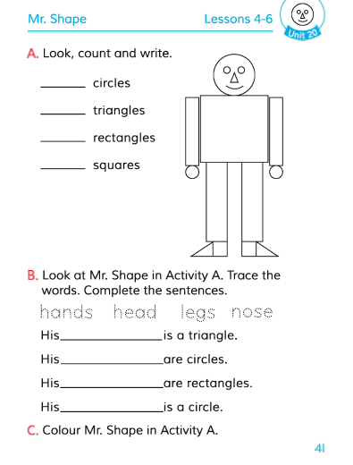
Connected with English Books.
Open your English Book page at 41.

Slide 20
Checking Learning
Look at Mr. Shape in activity. Trace the words. Complete the sentences.
hands
head
legs
nose
1. His
is a triangle.
2. His
are circles.
3. His
are rectangles.
4. His
is a circle.

Slide 21
Homework
Fill in the blanks.
1. circles.
2. triangles.
3. rectangles.
4. squares.

Slide 22
GOODBYE
THANKS A LOT

Slide 23
END

