Slide 2

Welcome

Slide 3
Presentation by
Aung Shing Thoing
Assistant Teacher of
Thaikhong Para Govt. Primary School
Thanci, Bandarban.

Slide 4
Introduction of lesson
Class : Three
Unit : 25
Lesson : 4-5
Lesson title : What songs do they make?
Time : 40 minutes

Slide 5
Learning outcomes
By the end of the lesson the students will able to-
Listening : 3.2.1 understand simple questions about
familiar objects.
Speaking : 1.1.1 repeat words, phrases and sentences
after the teacher with proper sounds and stress.
Reading : 1.4.1 read and match words and sentences with
pictures.
Writing : 3.1.2 to write words, phrases and sentences
using non-cursive small letters.

Slide 6
Let’s watch a videos

Slide 7
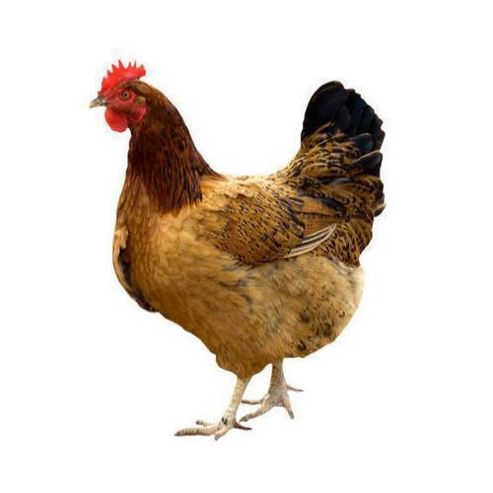
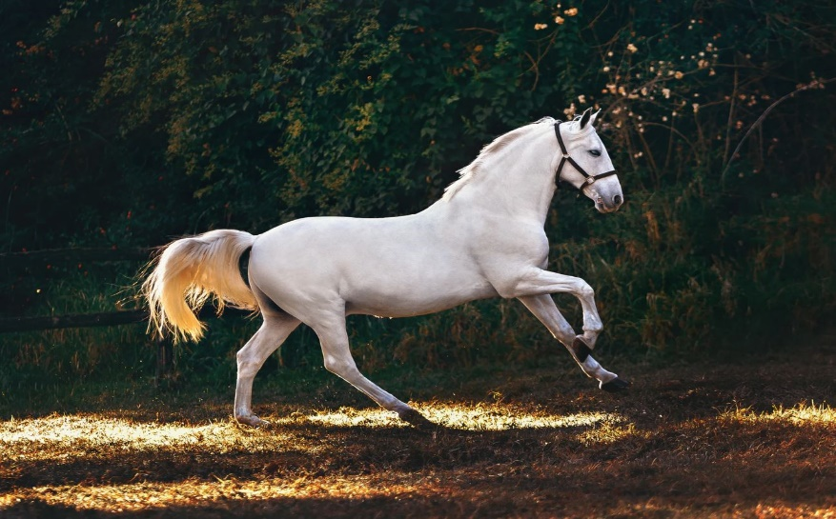
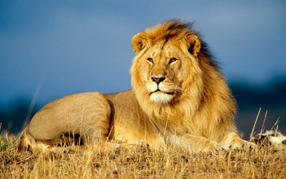
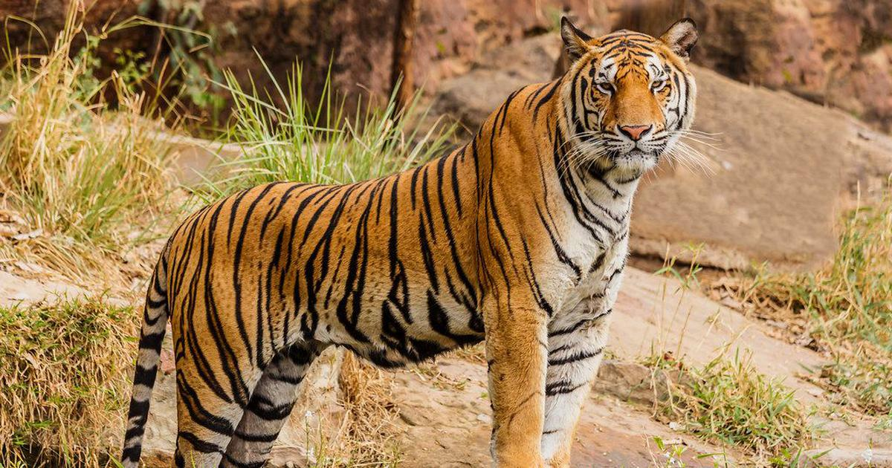
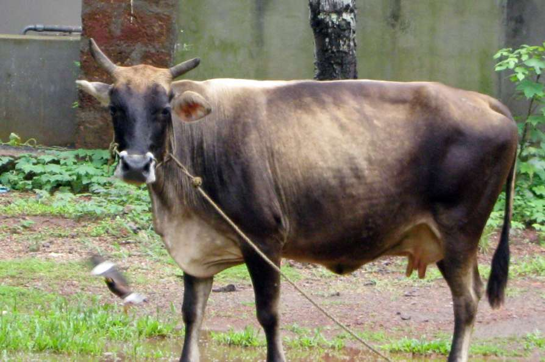
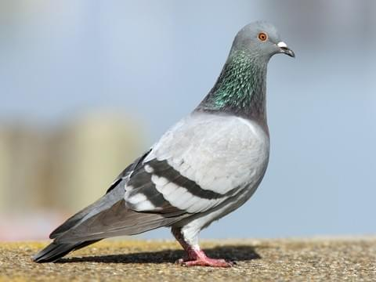
Today we will learn to call some animals
We will now look at some pictures

Slide 8
Whole Class Work

Slide 9
Pair Work
A | B
Hen | coos
Horse | moos
Lion | growls
Tiger | roars
Cow | neighs
Pigeon | clucks

Slide 10
Group Work
All of you divide into two group
A ____________________________
A ____________________________
A ____________________________
A ____________________________
A ____________________________
A ____________________________

Slide 11
One day one word
Again(আবার) = We’ll see you again tomorrow.

Slide 12
Checking Learning
True/False
1. A hen moos.
False
2. A horse coos.
False
3. A lion roars.
True
4. A tiger growls.
True
5. A cow clucks.
False
6. A pigeon coos.
False

Slide 13

Home Task
1. Today’s reading will be brought in the notebook.

Slide 14

Thanks you all students

