Slide 1
Welcome
Dear
Students

Slide 2
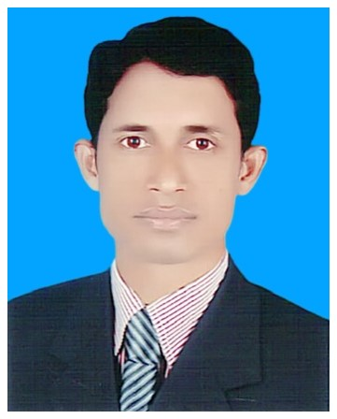
Mohammod Abdul Hannan
Assistant Teacher
Chunghor G.P.S
Kulaura
Moulvibazar.

Slide 3
Lesson Identity
Class - Five
Subject - English
Unit:10 (My home district.)
Part of lesson - Kishoreganj is
a small….home district.
Page - 38-39.

Slide 4
Learning Outcomes:
Listening
3.3.1 understand questions about objects around them.
3.4.1 understand statements made by the teacher and students.
Speaking
1.1.1 say words phrases and sentences with proper sounds and stress.
1.1.2 say sentences with proper intonation.
Reading
1.5.1 read words phrases and sentences in the text with proper pronunciation.
1.6.1 recognize and read statements, commands, greetings, questions and answers.
Writing
8.1.1 to make sentences using words and phrases, following instructions.

Slide 5
Previous knowledge
Answer the following questions.
1. Can you tell the name of Mamun’s home district?
Ans: The name of Mamun’s home district is Kishoreganj.
2. How many Upazilas are there in Kishoreganj?
Ans. There are 13 Upazilas in Kishoreganj.
3. What’s the name of the largest Eid ground?
Ans. The name of the largest Eid ground is Solakia.

Slide 6
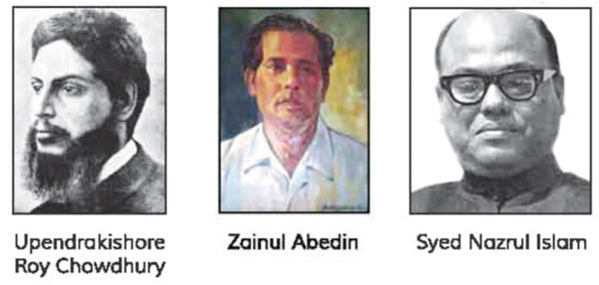
Let’s see pictures
Upendrakishore
Roy Chowdhury
Zainul Abedin
Syed Nazrul Islam

Slide 7
MY HOME DISTRICT

Slide 8
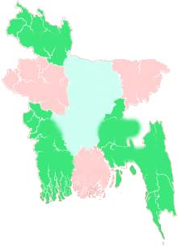
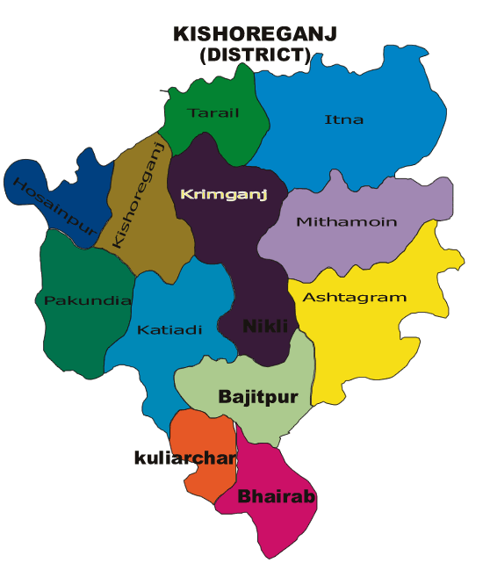
Kishoreganj
145km
Dhaka
Kishoreganj is Mamun’s home district
Now, we will learn about My home district.

Slide 9
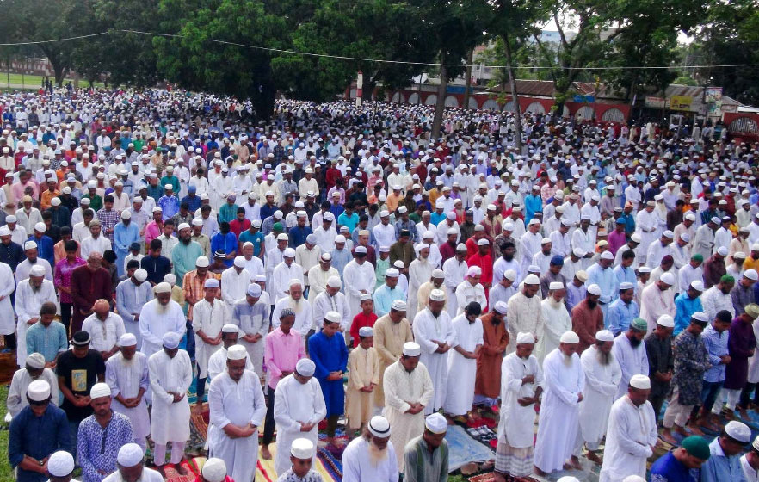
Word meaning and sentence making
Celebrate – উদযাপন করা –To do something special or enjoyable on an occasion.
People from many districts come to this place to celebrate Eid.

Slide 10
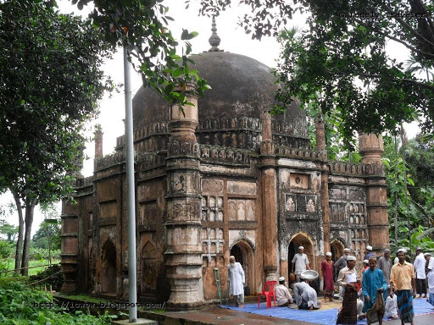
Mosque –মসজিদ –The prayer house of the Muslims.
Shah Muhammad Mosque
You can see the Shah Muhammad Mosque at Egaroshindhur.

Slide 11
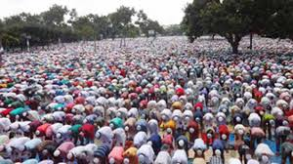
Eid fairground –ঈদের মাঠ –The field or ground where the Eid prayer is performed.
Eid fairground
The largest Eid fairground is in the Kishoreganj town.

Slide 12
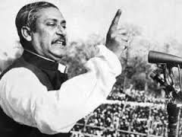
Well-known - mycwiwPZ - Familiar
Bangabandhu Sheikh Mujibur Rahman is a well-known leader in the world.

Slide 13
Famous –বিখ্যাত –Known about by many people.
Kishoreganj is also the home district of some famous people.

Slide 14
Landlord – জমিদার -The owner of land or a house.
He was a great landlord.

Slide 15
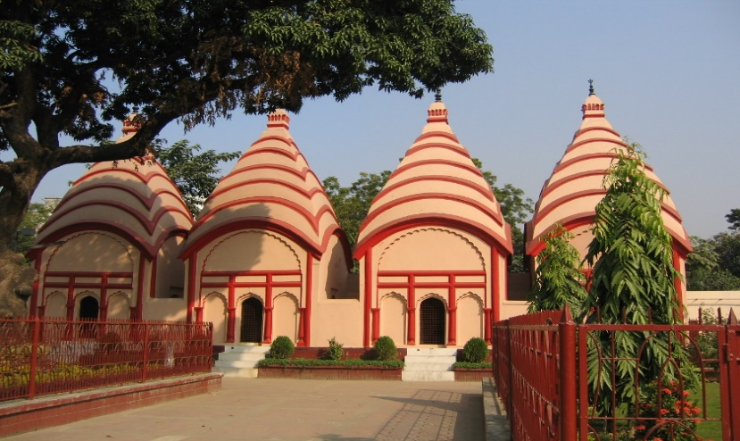
Temple – মন্দির - The prayer house of the Hindus.
The Hindus go to temple for their prayer.

Slide 16
Teacher’s reading
Open your English book page at 38-39.
Point your finger under the lines and listen what I read.

Slide 17
Let us know some information about Kishoreganj.
Municipality: 8
Upazila: 13
Union: 108
Village: 1745

Slide 18
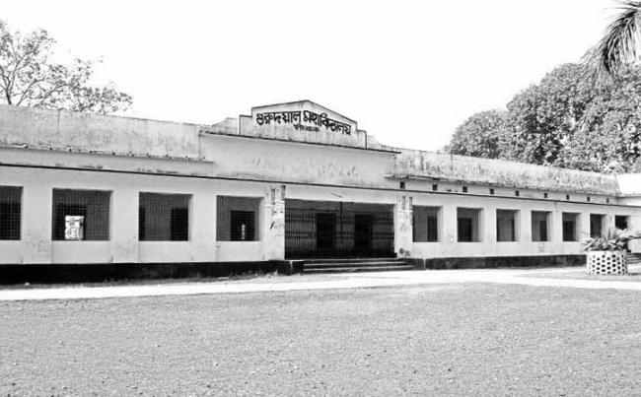
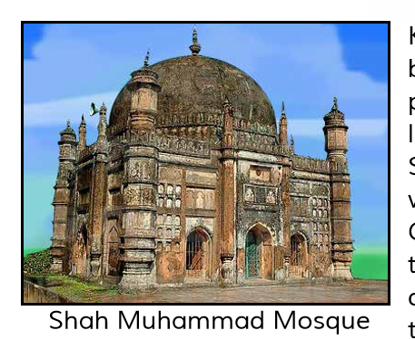
Let’s know some important places of Kishoreganj district again.
Government Gurudayal College

Slide 19
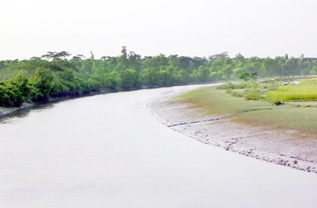
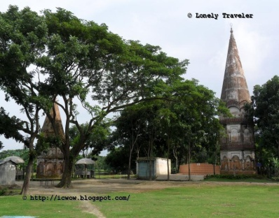
Fuleshwari River
Shiva Temple of chandrabati

Slide 20
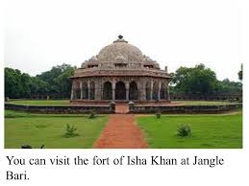
Fort of Isah Khan

Slide 21
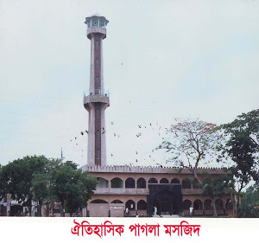
Pagla Mosque

Slide 22
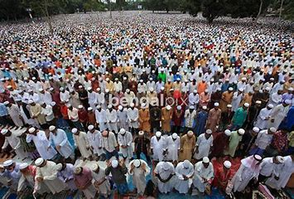
Solakia Eid Ground

Slide 23
Now discussion through question and answer:
1. What is the name of the college mentioned in the passage?
Ans. Government Gurudayal college.
2. Where can you see the Shiva Temple of Chandrabati?
Ans. Near the Fuleshwari river.

Slide 24
3. Who are two famous people from this town?
Ans. Two famous people from the town are great painter Zainul Abedin
and Syed Nazrul Islam, the first acting president of Bangladesh.
4. Who is the first women poet of Bangla literature?
Ans. Chandrabati is the first woman poet of Bangla literature.

Slide 25
5.How far is kishoreganj from Dhaka ?
Ans. Kishoreganj is about 145
kilometres from Dhaka .
Kishoreganj
145km
6.How did kishoreganj get its name?
Dhaka
Ans. Kishoreganj got its name from the name of an old landlord known as Brojakishore Pramanik or Nandakishore Pramanik.

Slide 26
Home work
Write a short composition at least in five sentences about
your Home district.

Slide 27
Thank you
See you next.

