Slide 1
Welcome

Slide 2
Introduction of the teacher
ID no:14
Safia Easmin
Assistant teacher
20 No.Ellenga Govt.Primary school
Kalihati,Tangail.

Slide 3
Introduction of the lesson
Class:4
Subject:English
Unit:1
Lesson:4
Lesson title:About me
Todays lesson:Look,listen and sing.

Slide 4
Learning Outcomes:
1.1.1 recognize sound differences in the context of words.
1.1.1 repeat after the teacher and say words,phraces and
Sentences with proper sound,stress and intonation.
1.4.1 read words,phrases and sentences in the text.

Slide 5
Greeting song:
Hello,hello..

Slide 6
What are they doing?

Slide 7
Lesson Diclaration
About me

Slide 8
Hello,hello,hello!
How are you?
I’m very well,thank you.Thank you.
And how are you?
I’m very well,too.
Thank you,thank you.

Slide 9
Now practice the song with me.

Slide 10
Now try to new word
Hello
Thank
Very
How.

Slide 11
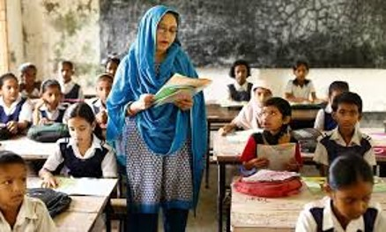
Teachers readings

Slide 12
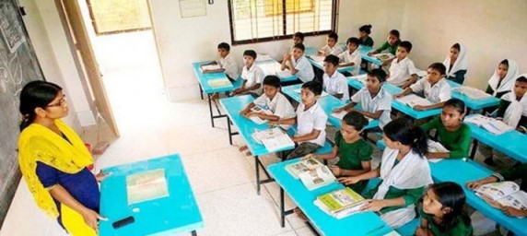
Student silent reading

Slide 13
Open your text book page no-3

Slide 14
Discussion about questions:
1.How are you?
2.Who are you?
3.What’s your name?

Slide 15
Group work
New words practice.

Slide 16
Pair work
Practice hello,hello song

Slide 17
Hello,hello song.

Slide 18
Thanks

