Slide 1
Dear Students, Welcome
To
My Presentation

Slide 2
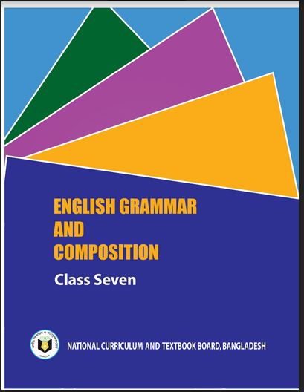
Identity
Habibur Rahman
Asst. Teacher
Barohit High School
Ishwargonj, Mymensingh
Contact No: 01724102270
Email: habibur.dcd6@ gmail.com
Class :Seven
Lesson:13
English Grammar & Composition
Date:08/07/2020

Slide 3
Look at the picture and the sentence.
Q: How does the flower look?
A: The flower looks very beautiful.

Slide 4
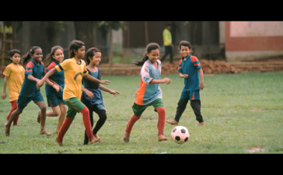
Look at the picture and the sentence.
Q: What are the children doing in the field?
A: The Children are playing football in the field.

Slide 5
Look at the sentences.
1.The flower looks very beautiful.
2.The Children are playing football in the field.
What is the parts of speech of the words in the circles?
Verb

Slide 6
Our Today’s topic is-
Right forms of verbs

Slide 7
Learning outcomes
After completing the lesson the students will be able to –
write the sentences using right forms of verbs.
fill the gaps with right forms of verbs (with clues).

Slide 8
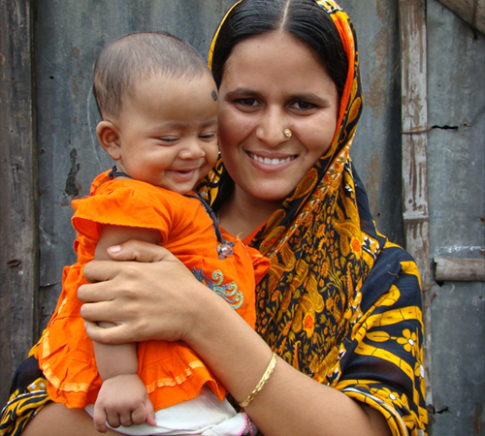
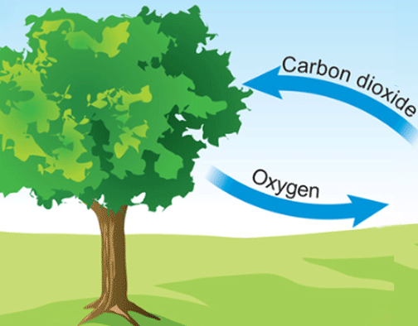
Look at the pictures and the sentences.
Every mother loves her child.
Ice floats on water.
Trees give us oxygen.
If the sentence is Universal truth or Habitual fact, it will be Present Indefinite Tense.
Do the sentences express universal truth?
Can you tell why the sentences are present simple?
Which tense is expressed by the sentences?
Present Indefinite Tense

Slide 9
Structure of the Present Indefinite Tense:
Subject + মূল Verb এর present form + Object + other words.
(i) Subject 3rd Person Singular number হলে, মূল Verb এর সাথে ‘s/es’যোগ করতে হয়।
(ii) Verb এর শেষে s, ss, sh, ch ( যার উচ্চারণ ‘চ’-এর মত ), x, z, ও o থাকলে ‘es’ যোগ করতে হয়।
(iii) Verb এর শেষে ‘y’ থাকলে তার আগে Consonant থাকলে ‘y’ এর স্থলে ‘I’ বসিয়ে ‘es’ যোগ করতে হয়।
(iv) Verb এর শেষে ‘y’ থাকলে তার আগে Vowel থাকলে শুধু ‘s’ যোগ করতে হয়।

Slide 10
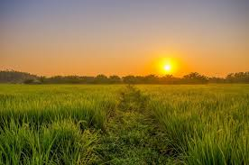
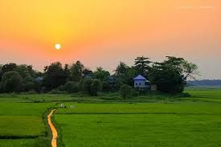
Give answers using right forms of verbs.
The sun _____ (rise) in the east. It ____ (give) us light. It _____ (be) the most important source of energy for life on Earth. The sun _____ (set) in the west.
rises
gives
is
sets

Slide 11
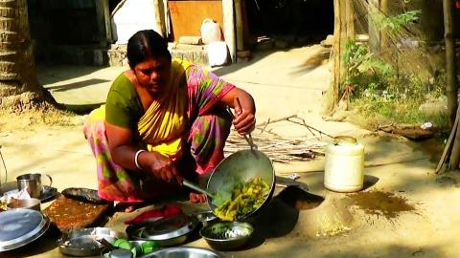
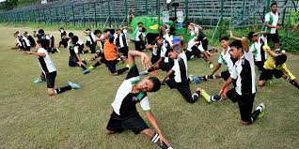
Look at the pictures and the sentences.
My mother cooks food for us every day.
They exercise regularly.
If in the sentence there is everyday/always/regularly/
occasionally/usually/often/sometimes/generally , the sentence will be Present Indefinite Tense.

Slide 12
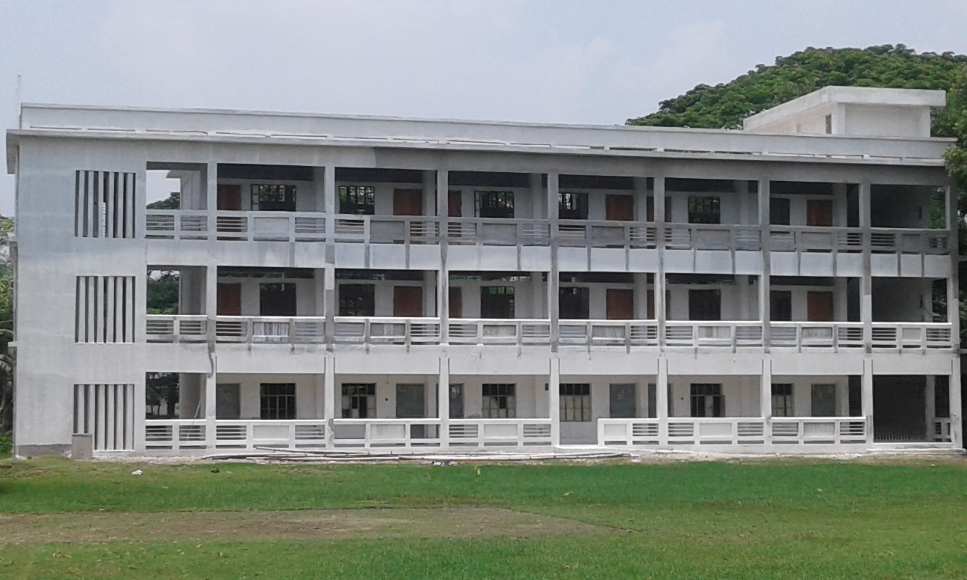
Give answers using right forms of verbs.
Barohit High School
Ishwargonj, Mymensingh
1. The boy ____ (go) to school regularly.
goes
2. He ____ (study) attentively everyday.
studies
3. He always ____ (speak) the truth.
speaks
4. He and his parents often ____ (visit) their relatives.
visit

Slide 13
Look at the sentences.
Now, I am teaching you.
They are watching Television at this moment.
Present Continuous tense.
If in the sentence there is now/at this moment/at this time , the sentence will be Present Continuous tense.
Can you tell why the sentences are present continuous tense?
Which tense is expressed by the sentences?

Slide 14
Structure of the Present Continous Tense:
Subject +am/is/are + মূল Verb এর present form এর সাথে ing + Object + other words.
I-এর পরে ‘am’ বসে। He, she, it এবং অন্যসব 3rd person ও singular number এর পরে ‘is’ বসে। We, you, they ও plural subject এর পরে ‘are’ বসে।
Example:
The teacher is talking to the class.
He is going to school.
c) You are making a noise.

Slide 15
নিম্নের Verb গুলির সাধারণত Present Continuous Tense হয় না।
love, see, believe, understand, feel, seem, look, hear, smell, taste, think, expect, assume ইত্যাদি।
Example:
I see a bird. ( Not I am seeing a bird)
I hope you are well. ( Not I am hopping you are well)

Slide 16
Give answers using right forms of verbs.
1. The wheel ----- (move) on the line at this moment
is moving
2.The boys ------ (play) in the field now.
are playing
3. Mina ------ (make) a cup of tea at present.
is making
4. They ------ (pluck) mangoes now.
are plucking

Slide 17
Look at the sentences.
I have seen him recently.
He has gone out just now.
Have you ever been to Cox’s Bazar?
If in the sentence there is just /just now /already/ recently/lately/yet/ever, the sentence will be Present Perfect tense.
Can you tell why the sentences are present perfect tense?
Which tense is expressed by these sentences?
Present Perfect Tense

Slide 18
Give answers using right forms of verbs.
Now, Match the answers.
1. He already (go) home.
Ans: He has already gone home.
2. The train just (reach) the station.
Ans The train has just reached the station.
3. They (go) out just now .
Ans: They have gone out just now.
4. Have you (hear) the name of poet Nazrul.
Ans: Have you heard the name of poet Nazrul?

Slide 19
Look at the pictures and the sentences.
It has been raining for two hours
He has been doing the work since morning.
If in the sentence there is for/since+ time the sentence will be Present Perfect Continuous Tense.
Can you tell why the sentences are present perfect continuous tense?
Which tense is expressed by the sentences?
The Present Perfect Continuous Tense

Slide 20
Give answers using right forms of verbs.
1. The boy (play) football since morning.
Ans: The boy has been playing football since morning.
2. They (watch) TV for an hour.
Ans. They have been watching TV for an hour.

Slide 21
Evaluation (Orally)
teaches
1. Mr. Habib ---------- (teach) us English.
gives
2. The moon ------ (give ) us light.
3. The population of Bangladesh
-----------(increas) rapidly.
are increasing
love
4. I ------(love) my country
5. I have already ------ (do) my homework.
done
has been sleeping
6.He ---------------(sleep) for three hours.

Slide 22
Recall these rules and practice more and more.

Slide 23
Thank you everybody.
Stay Home; Stay Safe.
Good wishes for all of you.
Allah Hafez.

