Slide 1
Welcome
to
everybody

Slide 2
Identity of the teacher
Mohammad Faruk Ahmed Mazumder
Assistant teacher
Malora Government Primary School
Shahrasti , Chandpur .
Email:farukt1979@gmail.com

Slide 3
Identity of the Lesson
Subject : English
Unit:10 (My home distrct)
Lesson: 1-2 ( A. My home
…………………..the town)
Time:40 minutes
Date:

Slide 4
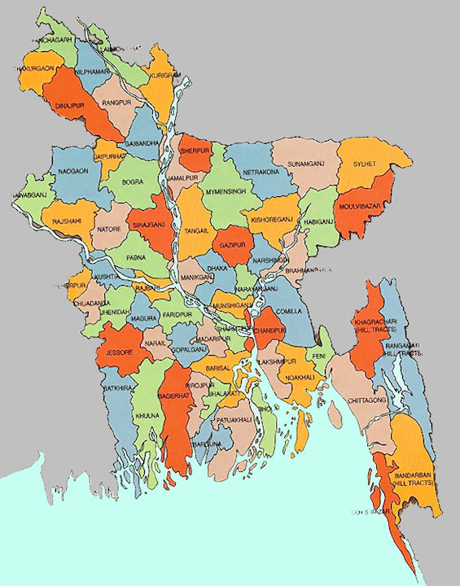
Look at the picture and think about these:
Map Of Bangladesh
1.Which place is circle marked in the map?
2.What other place map is showing inside the Bangladesh map?
The Bay of Bengal

Slide 5
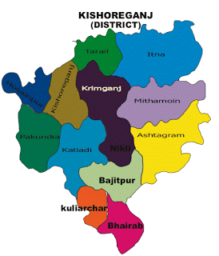
Today we are going to start a new lesson.
My Home District

Slide 6
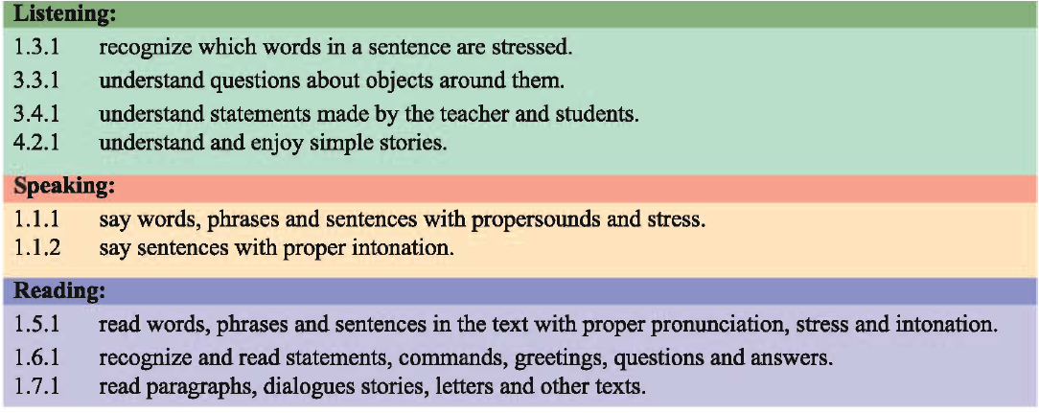
Learning outcomes
At the end of the lesson , students will be able to-

Slide 7
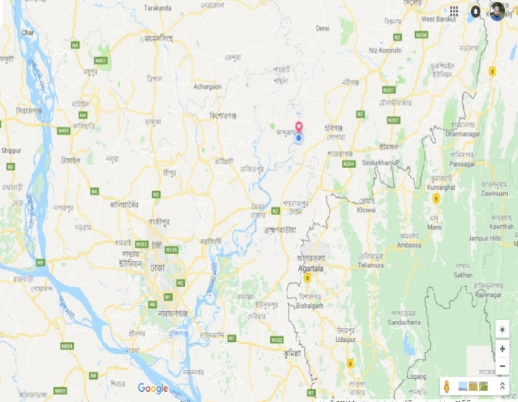
My
Home
District
145 km
My home distrct is Kishoreganj.
It is about 145 kilometres from Dhaka . It is a district headquarters.

Slide 8
The district has
8 municipalities,
13 upazilas,
108 unions
and
1745 villages.

Slide 9
The name Kishoreganj comes from the name of an old landlord known as Brojakishore Pramanik or Nandakishore Pramanik.

Slide 10
The area of Kishoreganj municipality is about 10 square kilometres.

Slide 11
The river Narasunda flows through the town.

Slide 12
New words and word meaning:
Headquarter
Central office.
সদর দপ্তর
Landlord
Owner of many
land.
জমিদার
Incorporated
town
পৌরসভা
Municipality
Village
Rural area
গ্রাম

Slide 13
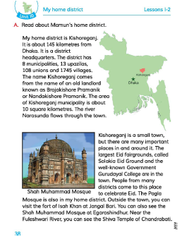
Everybody
take your EFT book
and
open page at 38

Slide 14
Teacher’s reading
My home district
The name Kishoreganj comes from the name of an old landlord known as Brojakishore Pramanik and Nandakishore Pramanik.
The area of Kishoreganj municipality is about 10 square kilometres .The river Narasunda flows through the town.
My home district is Kishoreganj. It is about 145 kilometres from Dhaka. It is a district headquarters. The district has 8 municipalities,
13 upazilas, 108 unions and 1745 villages.

Slide 15
Students group reading one student read by turn and others will listen.

Slide 16
Students individual reading

Slide 17
Fill in the gap with suitable words given below.
through
Solakia
district
landlord
municipality
Pair work
a) Nandakishore Pramanik is a …………..…….
b) Kishoreganj is a ……………..headquarter.
c) The river Narasunda flows …………..…..the kishoreganj town.
d) The area of Kishoreganj …………………… is about 10 square kilometres.

Slide 18
Assessment
a. What is the name of your home district?
b. How does the name ‘Kishoreganj’ come from?
c. How many villages are there in Kishoreganj district?

Slide 19
Home work
Write at least five sentences about your home district .

Slide 20
Thank you

