Slide 1
Welcome
to
everybody

Slide 2
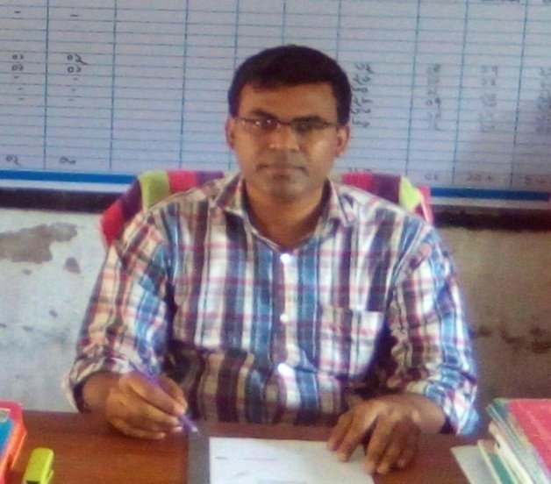
Identity of the teacher
Mohammad Faruk Ahmed Mazumder
Assistant teacher
Malora Government Primary School
Shahrasti,Chandpur.
Email:farukt1979@gmail.com

Slide 3
Identity of the Lesson
Subject:English
Unit:10(My home distrct)
Lesson: 1-2(A. Kishoregonj is…………..of Chandrabati)
Time:40 minutes
Date:

Slide 4
Dear students,answer the following questions about previous lesson-
1.What did the title of the previous lesson?
2. How many upazilas are there in Kishoreganj district?
3. How does the name Kishoreganj come from?

Slide 5
Yes, Today we will again read about
My Home District

Slide 6
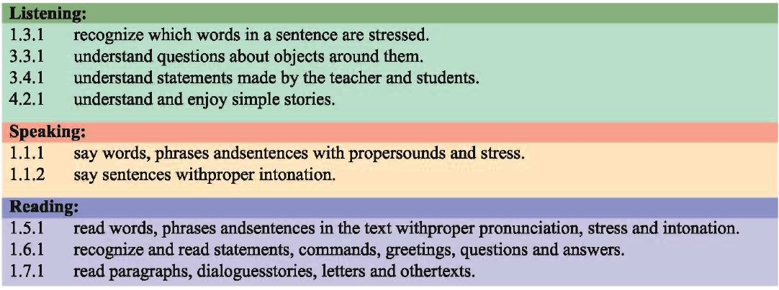
Learning outcomes
At the end of the lesson , students will be able to-

Slide 7
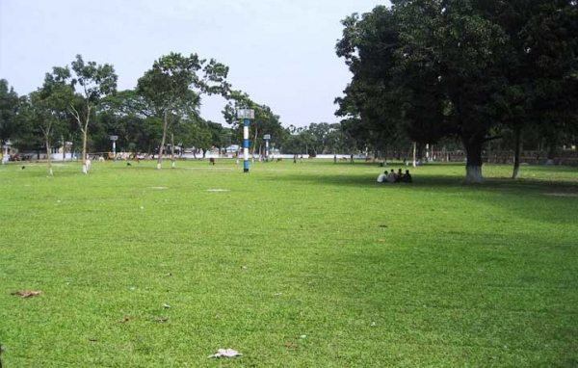
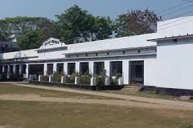
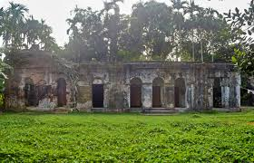
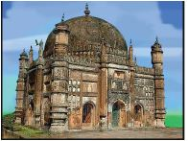
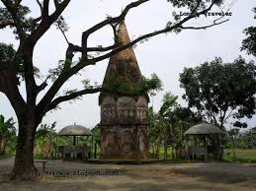
Look at the pictures and think about these:

Slide 8
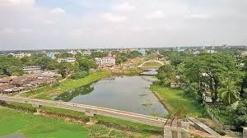
Kishoreganj is a small town.
But there are many important
places in and around it.

Slide 9
Solakia Eid Ground
Govt. Gurudayal College
The largest Eid fairgrounds, called Solakia Eid Ground and the well-known Government Gurudayal College are in the town . People from many districts come to this place to celebrate Eid.

Slide 10
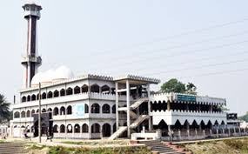
The Pagla Mosque
The Pagla Mosque is also in my home district.

Slide 11
Out side the town , you can visit the fort of Isah Khan at Jangal Bari.

Slide 12
You can also see the Shah Muhammad Mosque at Egaroshindhur.

Slide 13
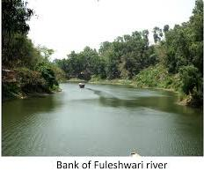
Near the Fuleswari River , you can see the Shiva Temple of Chandrabati .

Slide 14
New words and word meaning
Important
Significant
গুরুত্বপূর্ণ
Fair
Exhibition
মেলা
Well-known
Known to all
পরিচিত
Celebrate
Dignify, Glorify
উদযাপন করা

Slide 15
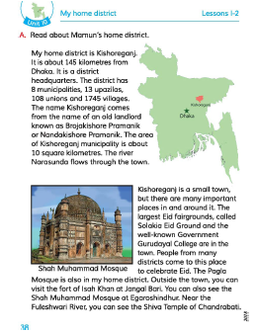
Everybody
take your EFT book
and
open page at 38

Slide 16
Teacher’s reading
My home district
Kishoreganj is a small town . But there are many important places in and around it. The largest Eid fairgrounds, called Solakia Eid Ground and the well-known Government Gurudayal College are in the town . People from many districts come to this place to celebrate Eid.
The Pagla Mosque is also in my home district. Out side the town , you can visit the fort of Isah Khan at Jangal Bari. You can also see the Shah Muhammad Mosque at Egaroshindhur. Near the Fuleswari River , you can see the Shiva Temple of Chandrabati .

Slide 17
Students group reading one student read by turn and others will listen.

Slide 18
Students individual reading

Slide 19
Fill in the gap with suitable words given below.
small
largest
upazila
Fuleshwari
important
celebrate
a) There are many ………………………….…..places in Kishoreganj district .
Pair work
b) Solakia is the ………………..Eid Fairground in Bangladesh
c) Kishoreganj is a …………………..…………………town.
d) Many people come to ………………….........for Eid prayer.
e) The Shiva Temple of Chandrabati is near the…………………………..…..river

Slide 20
Assessment
1.What is the name of the largest Eid ground in Bangladesh?
2. What are things you can see inside the kishoreganj town?

Slide 21
Home work
Make a list of important places of Kishoreganj District.

Slide 22
Thank you

