Slide 1
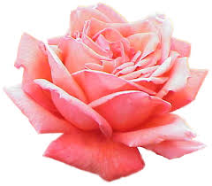

Slide 2
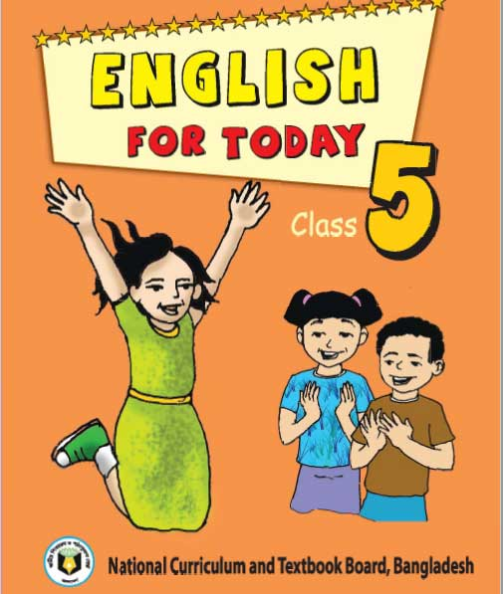
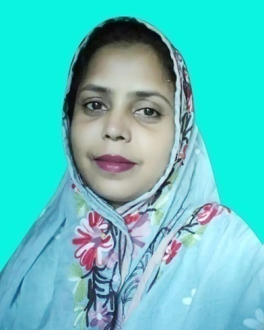
Presented by
Class: Five
Subject: English
Unit: 21(It was a great day)
Lesson: Last -----our tents.
Time: 45 minute
Mira Rokeya Khatun
(Assistant teacher)
Rarishal govt.primary school.
Lakhai, Habigonj.

Slide 3
Learning outcomes
tBy end of the lesson students will be able to --
1
1. Read the text with correct pronunciation,
spelling and intonation.
2
2. Make sentences by using words.
3
3. Write a short paragraph by answering a set of
questions

Slide 4
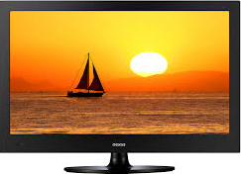
Let’s watch a video.
Click here to watch video.
Discuss with students about video.
Do you understand what may be our today’s lesson?

Slide 5
Our today’s lesson
It was a great day

Slide 6
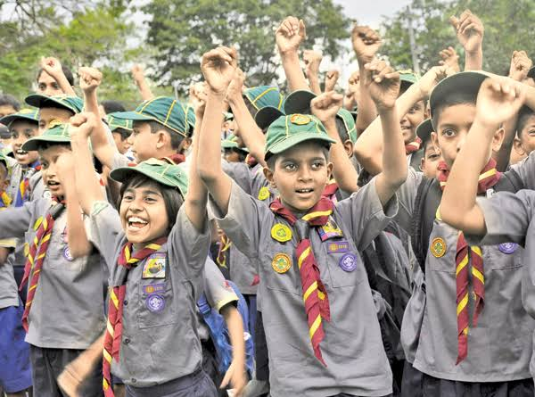
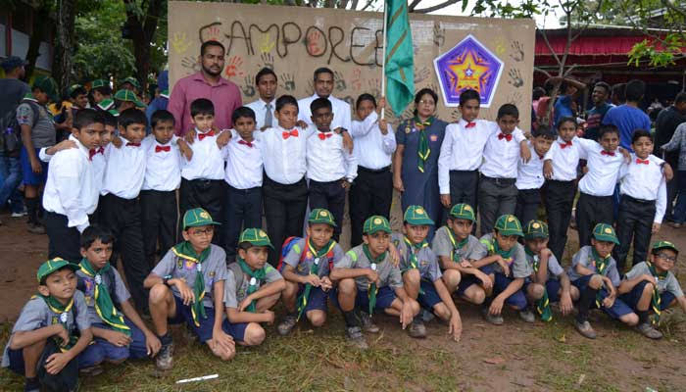
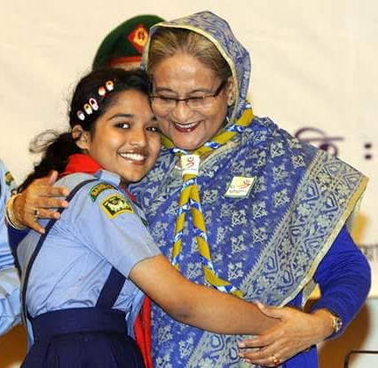
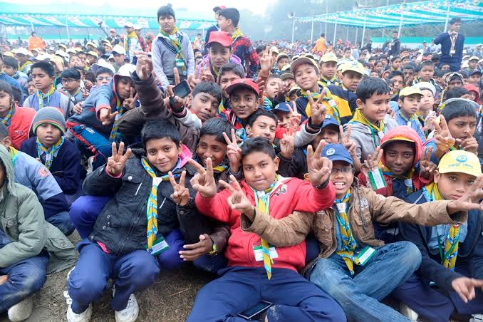
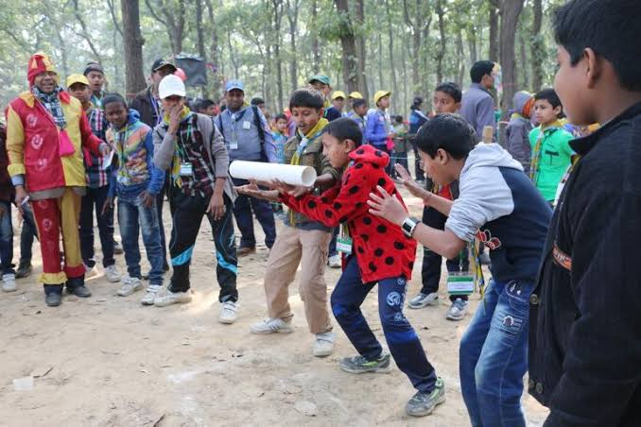
Cub camporee

Slide 7
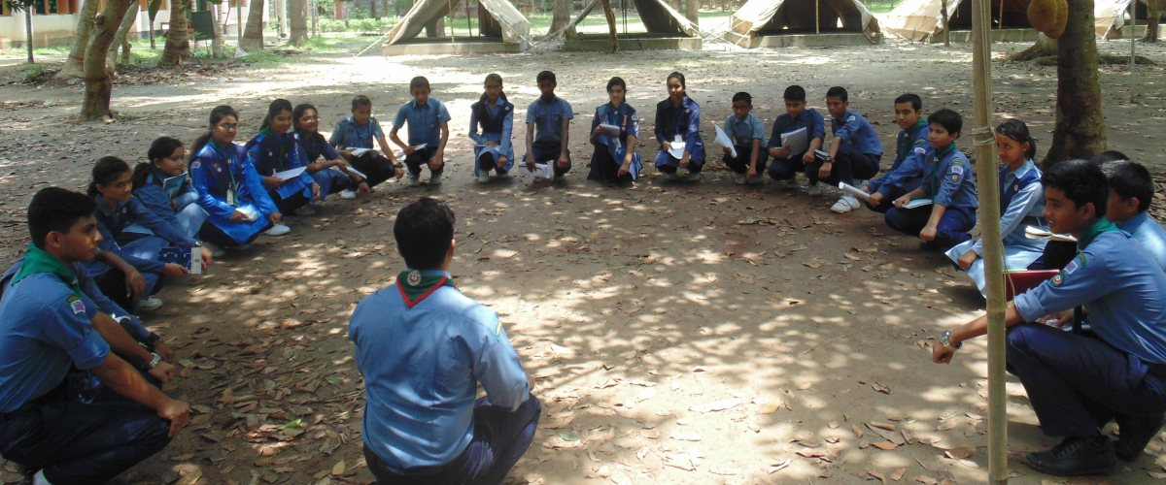
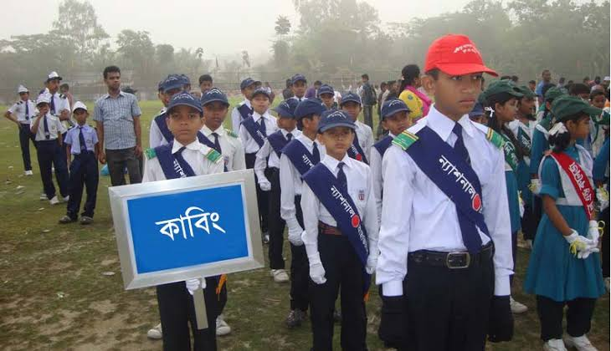
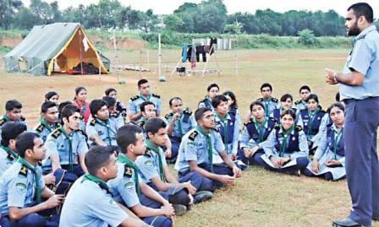
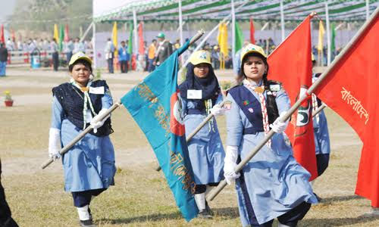
Cub camporee
Last January I went to a cub camporee.

Slide 8
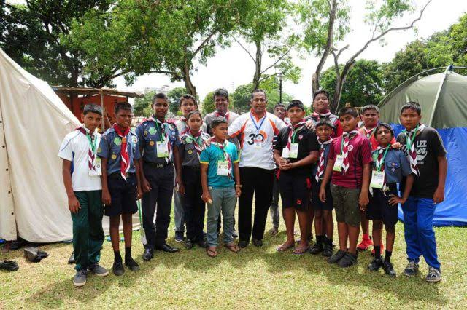
What is cub camporee?
A camporee is a gathering of cubs from different parts of Bangladesh.

Slide 9
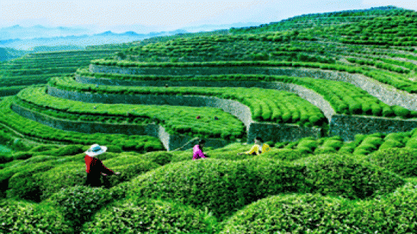
Sreemangal
Do you know the place?
The cub camporee took place in Sreemangal under Moulvibazar district.

Slide 10
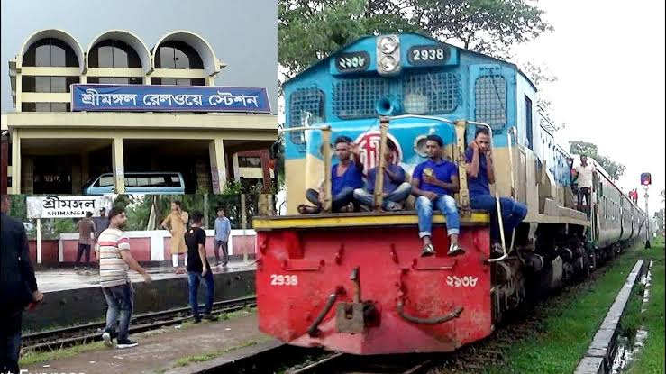
To get there, we travelled from Dhaka to Sreemangal by train.

Slide 11
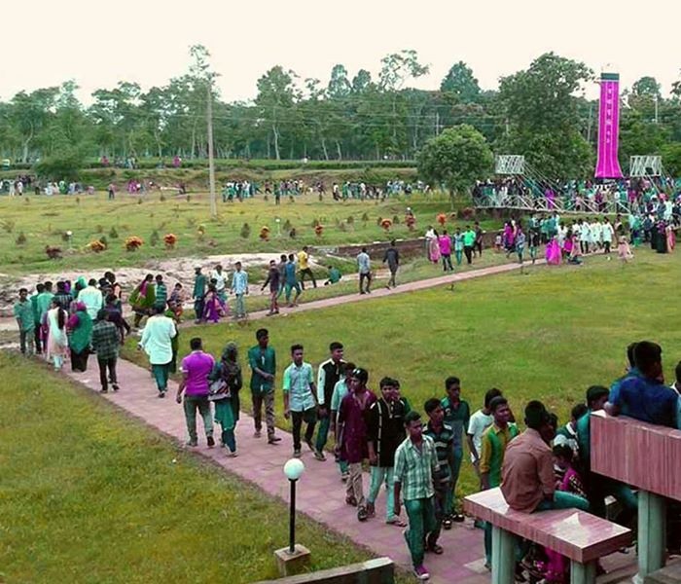
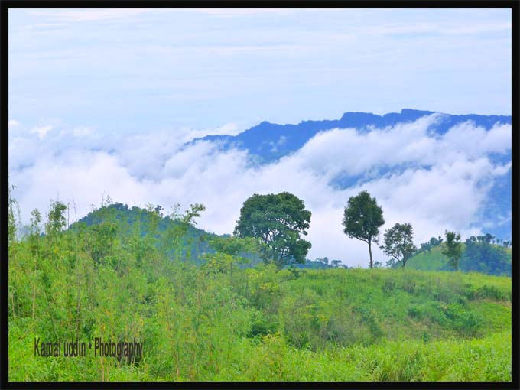
We walked to our camp from the train station.
The weather was nice..

Slide 12
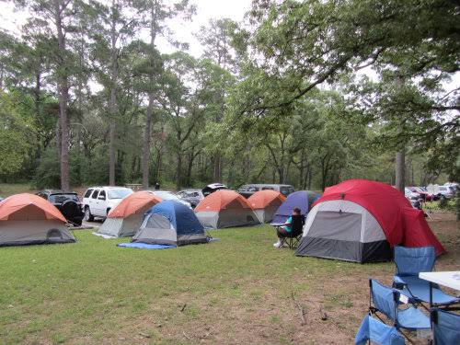
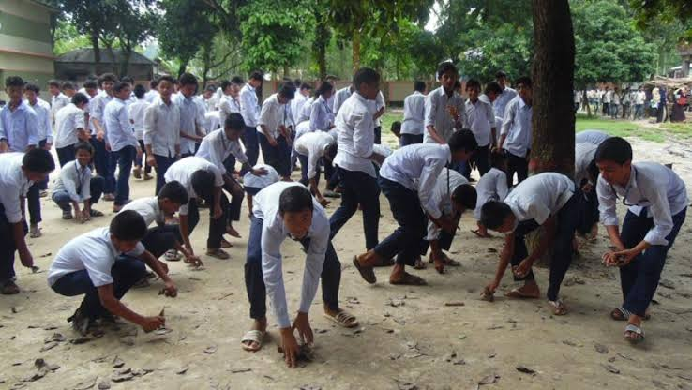
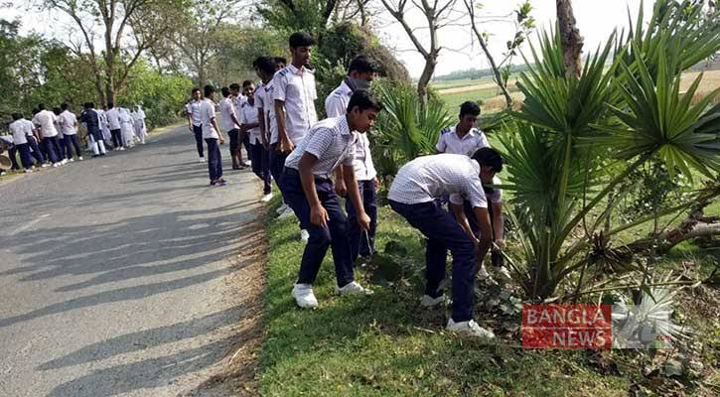
At the camp,we cleaned up area.
Set up our tents.

Slide 13
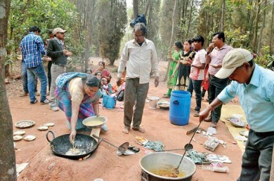
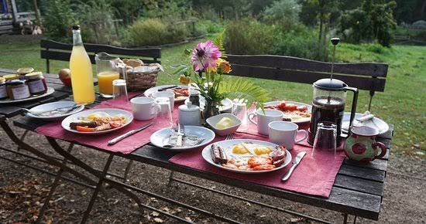
Prepared our breakfast.

Slide 14
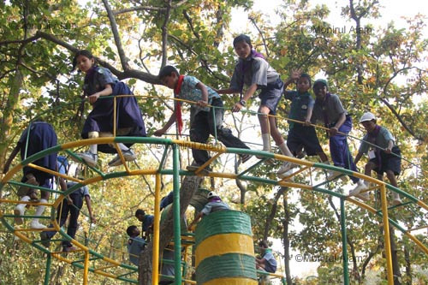
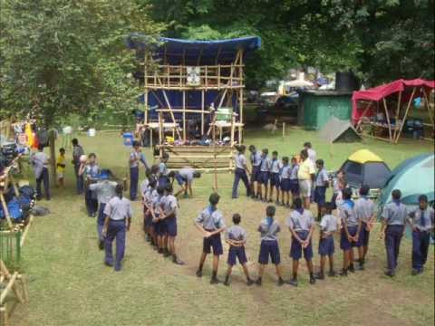
We play games.

Slide 15
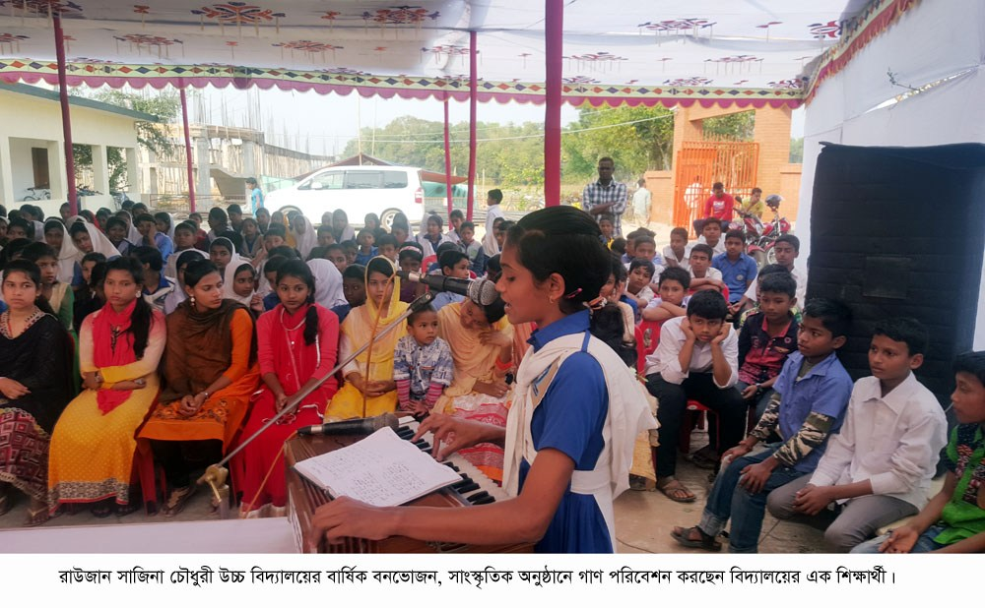
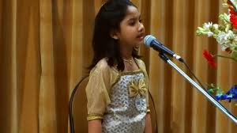
In the afternoon and evening , We sang a song and recited poems.

Slide 16
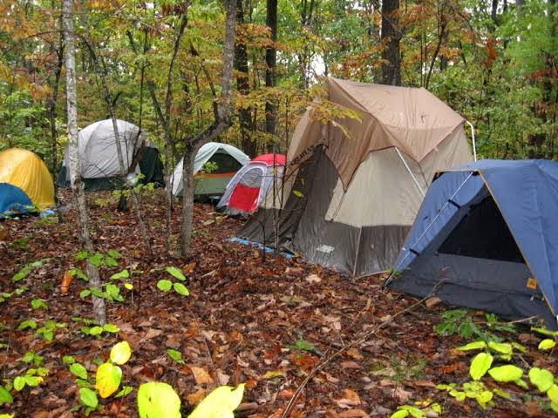
At night, we slept in our tents.

Slide 17
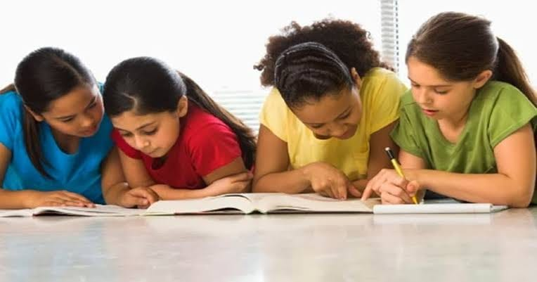
Pair work
Write a short composition on “Cub camporee” at least five sentences by answering the following questions.
What is a cub camporee?
(b) Have you ever been to a cub camporee?
(c) What did you do in the morning of the first day?
(d) How did you enjoy your program?
(e) How did you end your program?

Slide 18
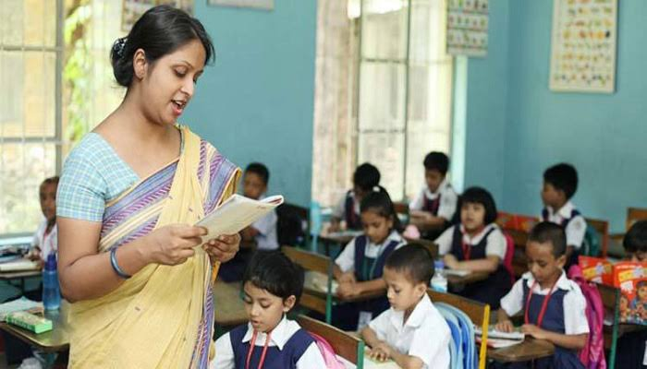
Teacher’s loud reading and discuss the lesson.

Slide 19
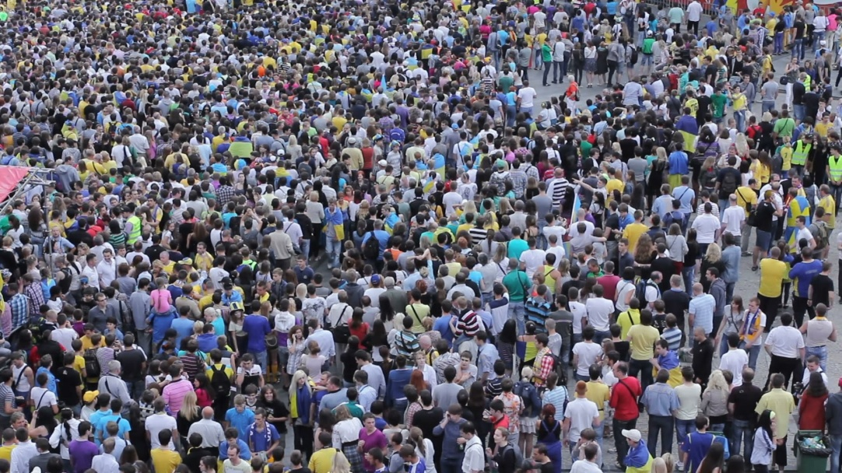
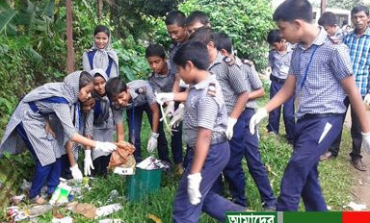
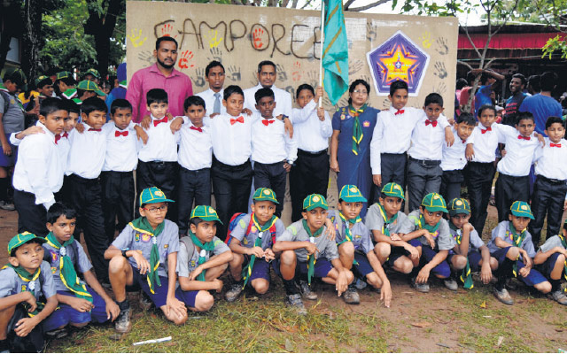
New words with sentences by using picture
To come together
clearing
Council
Cleaning
Camporee
Gathering
I went to a cub camporee.
They are cleaning the camp.
They are gathering from different places of Bangladesh.

Slide 20
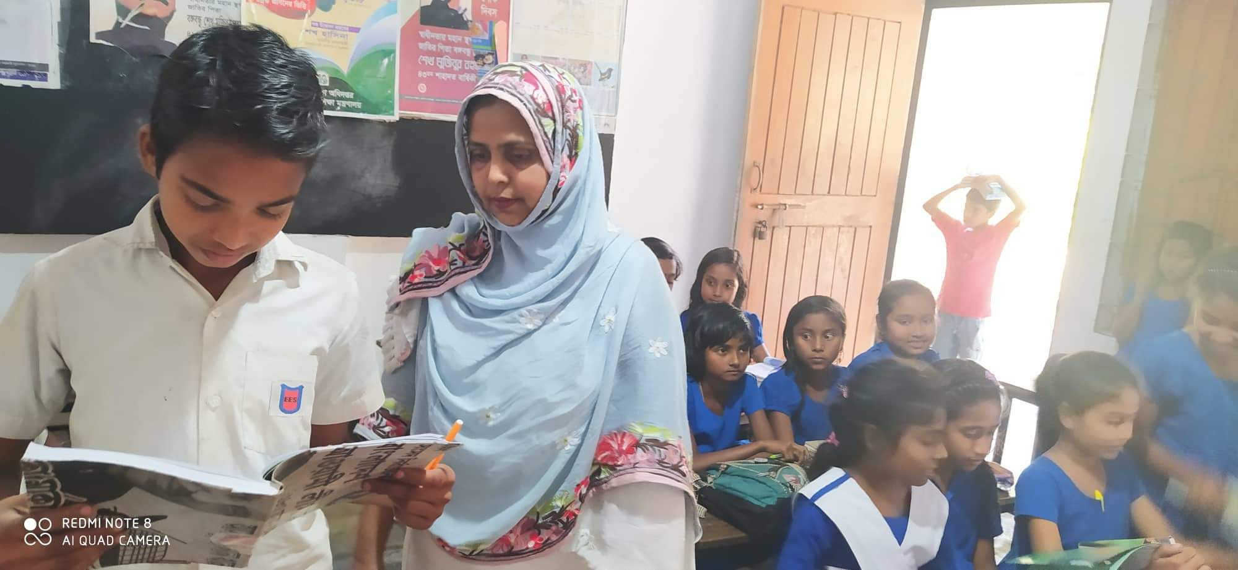
Student’s loud reading help by teacher.

Slide 21
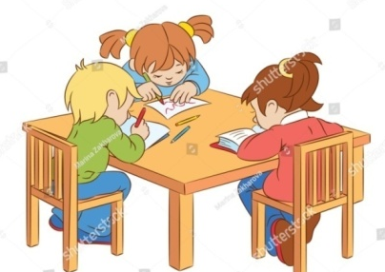
Group work
G -1. How did the team go to sreemamgal?
G-2. What did the team members do after breakfast?
G – 3. What did they do in the evening?

Slide 22
Evaluation
Match the answer
Write only the answer on the answer paper
1.When did the speaker go to a cub camporee?
✓
(a) Last january
(b) Last march
(c) Last may
(d) Last december
2. The team had---------
✓
(a) 9 members
(b) 11 members
(c) 10 members
(d) 100 members
3. What did they do at first ?
✓
(a) Cleaning
(b) Walking
(c) Cooking
(d) Firing
4.When did they reach?
✓
(a) In the evening
(b) In the morning
(c) At noon
(d) At night

Slide 23
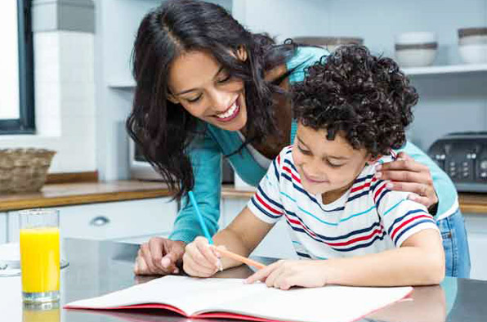
Home
work
You will write five sentences about your holiday’s activity.

Slide 24
