Slide 2
Identity-
Md.Ahsan Habib
Assistant Teacher (English)
SPPM High School
Chhatak,Sunamgonj.
E-mail:ahsanpress@gmail.com
Class:Eight
Sub:English Grammer
Time: 40 Min

Slide 3
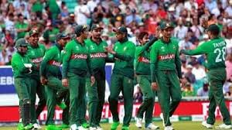
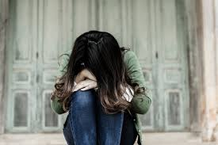
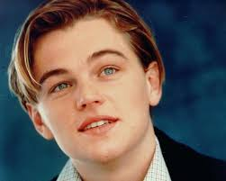
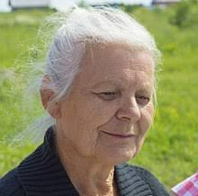
HAPPY MOMENT
SAD
YOUNG
OLD

Slide 4
LESSON INTRODUCE:
TODAY’S TOPIC-
ADJECTIVE

Slide 5
Learning Outcome
After this lesson the students will be able….
To define adjective.
To say the features and kinds of adjectives.
To write the different kind of adjectives properly.
To make sentence using adjectives.
To Find out adjectives from the sentences .

Slide 6
BIG
NOUN
Or Pronoun
ADJECTIVE
BALL
SMALL
BALL

Slide 7
Definition
A word qualifies or describes a noun or a pronoun is called adjective

Slide 8
Adjective of Quality
Adjective of Quantity
Predicate adjective
Personal Adjective
Possessive adjective
Demonstrative of adjective
Indefinite adjective
Interrogative adjective
Comparative adjective
Superlative adjective

Slide 9
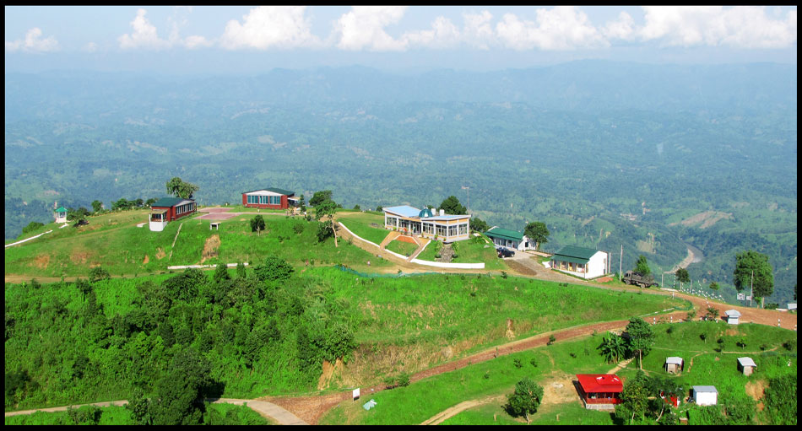
Definition
A beautiful place
ADJECTIVE
NOUN
Descriptive adjective or adjective of quality:
Descriptive adjectives are those adjectives which describe nouns or the noun phrases.

Slide 10
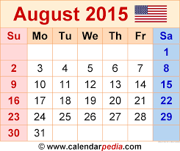
Definition
Sunday is the first day of the week.
Another Example: little, second, one,
Adjective of quantity:
Adjective of quantity talks about the quantity of the noun being talked about and provides answer to the question of 'how much'.

Slide 11
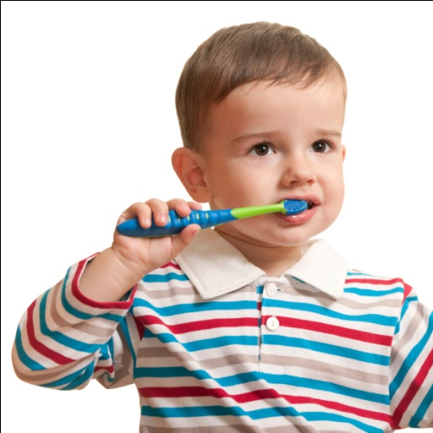
Definition
That child is young.
Another Example: cool, dry, heavy etc.
Predicative adjectives:
Preducative adjectives are those which follow a linking verb and not placed before a noun

Slide 12
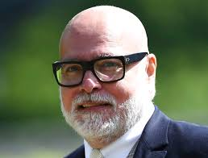
Definition
Auntie
Uncle
The day after tomorrow, you can visit Auntie Sajeda Begum and Uncle Zaman Ahmed.
Personal adjective:
Personal adjective titles are adjectives where the titles such as, Mr., Master, Miss, Mrs., Uncle, Auntie, Lord, Dr, Prof. and so on, are used as adjectives to describe the position of the noun.

Slide 13
Definition
This is his house
Another Example: her, their, my, your, our, etc.
Possessive adjective:
Possessive adjective is used where the sentence shows possession or belongingness.

Slide 14
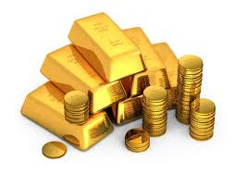
Definition
These gold are valuable.
Another Example: This, That, Those etc.
Demonstrative adjectives:
Demonstrative adjectives are used when there is a need to point specific things.

Slide 15
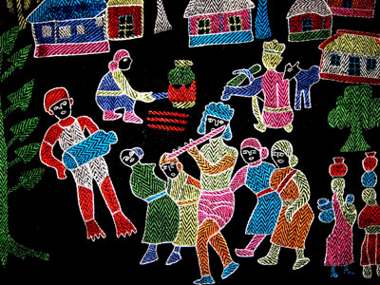
Definition
Many children like flower.
Another Example: any, much more etc.
Indefinite adjectives:
Indefinite adjectives are used when the sentence has nothing to point out or specify.

Slide 16
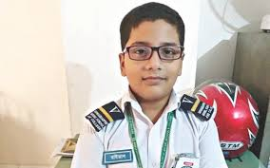
Definition
Whose son is he?
Another Example: which, why, whom etc.
Interrogative adjective:
An Interrogative adjective modifies a noun or a noun phrase and is similar to the interrogative pronoun.

Slide 17
Comparative adjectives:
Comparative adjectives are those which imply increase or decrease of the quality or quantity of the nouns. It is used to compare two things in a clause.
BIGGEST
Another Example: sharper, shorter, longer etc.
BIGGER
The ball is smaller than any other balls.
BIGGEST

Slide 18
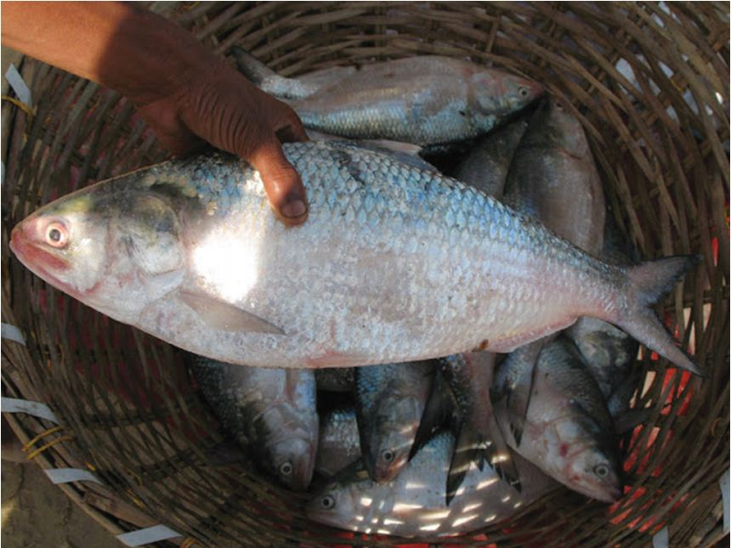
Definition
Ilsha fish is the most expensive fish of all fishes in our country.
Another Example: sweetest, brightest, sharpest etc.
Superlative adjectives:
Superlative adjectives express the greatest increase or decrease of the quality; it conveys the supreme value of the noun in question.

Slide 19
Pair Work
Find out proper adjectives from below the sentences
Honey is sweet.
Gold is more valuable than any other metal.
Which pen do you like?
Many children like dinosaurs.
This is the most interesting subject for me.
Is there any water in the bottle?
The classes on Monday will be presented by Dr. Mary and Prof. Kate.

Slide 20
Evaluation
Fill in the blanks with suitable adjective from following the lines---
which
their
younger
Cool
little
these
tallest
dry
Marry is the ………….. Of all the student. The detective is …………. than the thief. ……….. leaves turn color first? ………… mangoes are sour. Have you seen ……….. house? The weather will be ………… and ………. . He has ……….. Intelligence.

Slide 21
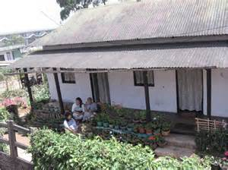
Home work
Make 20 sentences to use proper adjectives

Slide 22
Thanks to all

