Slide 1
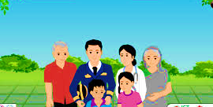
Wellcome to my English class.

Slide 2
Good morning students
How are you today ?

Slide 3
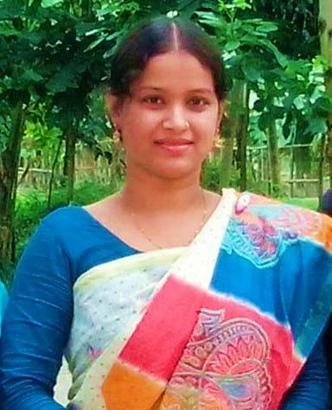
Teacher’identy
Kamrunnaher
Assistant teacher
Sreerampor purbopara govt.prymary school.
Raipura-Narsingdi

Slide 4
Lesson’s identy
Class: Four
Subject : English
Unit : 3 Family
Lesson 1-2 (B)

Slide 5
Learning outcomes-
Reading
1.4.1 Read words,phrases and sentences in the text.
1.5.1 Read words phrases and sentences in the text with proper pronunciation,stress and intonation.
1.7.1 read short paragraphs, dialogues and simple letters.
5.1.1 read silentlywith understanding paragraphs,stories and other texts.

Slide 6
Everybody stand up. Now we will sing the greeting song hello hello….start

Slide 7
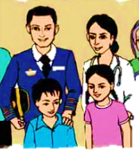
Let’s see a picture ?
Do you understand by looking at the pictures ?
Mother
Father
What is their relationship?
Son
Daughter
Father , Mother , Daughter and Son usually make a family.

Slide 8
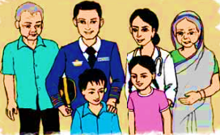
Today we are going to start a new lesson.
The name of the new lesson is-
Family.

Slide 9
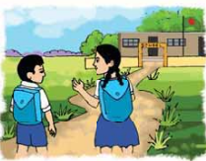
Who are they ?
They are Farzana and Jamil.
Now we will know about Farzana and Jamil’family
At first I will read then you will read with me.
Farzana and Jamil are from Kushtia.They go to chachua primary school.Farzana is in nine years old.She is in class 4.Jamila is seven years old.He is in class 2.They like school and they are good students.

Slide 10
Group work
1.Where did Farzana and Jamil come from ?
2.How old are they ?
3.Where do they read?

Slide 11
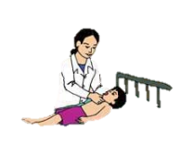
Who is she ?
Farzana and Jamil’mather is Rehana Parvin.She is 33 years old.She works at a hospital in Kushtia.She is a doctor.She takes care of many patients everyday.She likes her job very much.

Slide 12
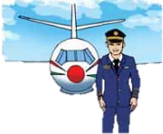
Whom do you see this picture ?
Aziz Ahmed is Farzana and Jamil’s father. He is a pilot of Biman Bangladesh Airlines.He flies to other countries.He travels to India,Thailand and China often.He loves to travel.He is 39 years old.

Slide 13
Pair work
1.Who is Rahena Parvin ?
2.What dose Rehana parvin do ?
3.Where dose Aziz Ahmed travels for works?

Slide 14
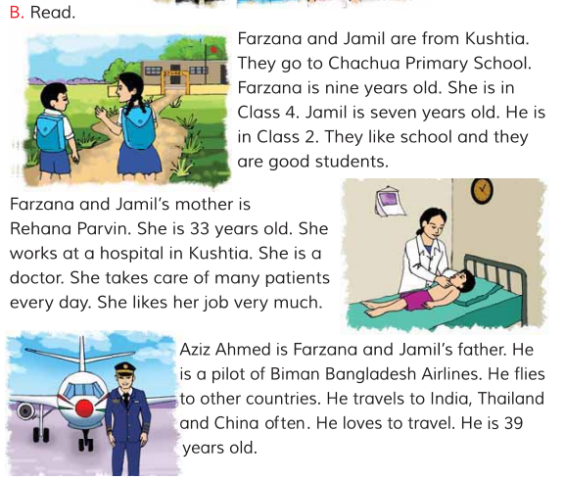
Now open your english book at page no 6 and read silently.

Slide 15
Find out new word ?
patient
রোগী
Take care
যত্ন নেওয়া
Airline
বিমানপথ
Travel
ভ্রমণ করা

Slide 16
One day one word
Job –
(জব)-
পেশা-
I love my job

Slide 17
Assesment
Write five sentences about this passage.

Slide 18
Home work
Write a paragraph about your family.

Slide 19
Thank you, that’s all for today
Goodbye, see you tomorrow.

