Slide 1
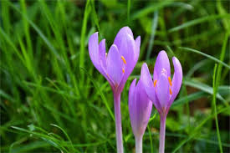
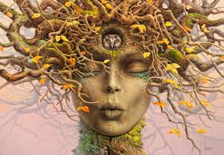
Welcome to All.
Assalamu alaikom. This is Nuruddin Assistant Teacher,
Kasirgathi government Primary School, Biswambarpur, Sunamganj. Hello every one. How are you? I think that all are fine by the grace of almighty Allah. I am also fine.

Slide 2
Today I would like to discuss a interesting topic which called “Silent language of nature.”

Slide 3
The silent language of nature-
Human body is formed according to the consciousness of the human mind. Animals and trees-plants-flowers-fruits-vegetables-crops-food-diet-like organs are being produced in the world. For the health of certain organs of the body, seeing the similarity, if food-diet-medicinal plants and animals are taken as food, the respective organs become healthy.

Slide 4
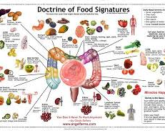
E.g. Ginger, Barbati, Tamarind, Bean, Monkey stick, Sajna, beans, Arahar Kunch fish, Cattle bhuri. The intestines work properly when you eat these.

Slide 5
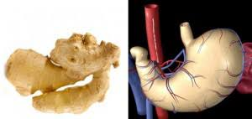
Herbs that are similar to stomach are gourd, papaya, mango, pumpkin, animal stomach. Playing these cures stomach upset.

Slide 6
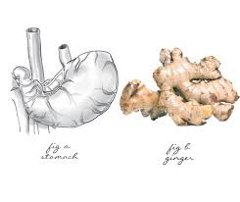
Heart: - Tomato has four chambers like heart and red color like the color of heart. That is why it is helpful in curing heart disease. Other heart-like herbs are strawberries, garlic, black grapes, sherifa, almonds, heart nuts, etc.

Slide 7
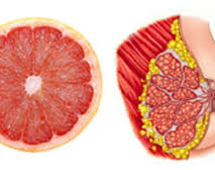
Medical scientists have found anti-breast cancer ingredients in Oranges, Cauliflower, Cabbage, Pomegranate, Quince, Kadbel, Broccoli, Noni, Grapefruit, Bilati gab and Makal fruit. Their resemblance to the breast indicates that silent language of nature.

Slide 8
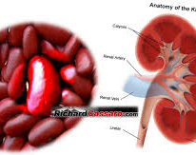
Increases Kidney function Bean seeds, Kidney beans, Kastrilata seeds, Sage mushrooms etc. These look like Kidneys.

Slide 9
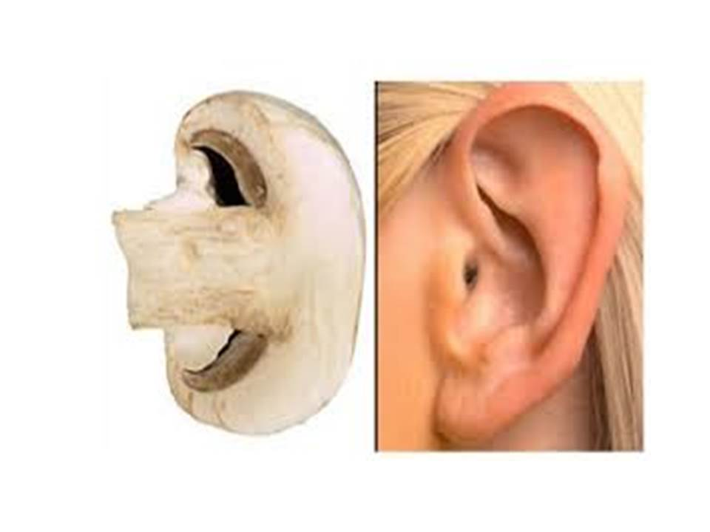
Due to its resemblance to the human ear, earwax, sage mushrooms, oyster mushrooms, oyster shells, snails, etc. are used to make ear medicine.

Slide 10
Similar to banana, clove, ginseng, shimul root, radish, carrot, cucumber, ling mushroom and butch, these solve the problem of penis.

Slide 11
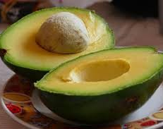
The testicles are similar to Sharifa, Khorma dates, Blackberries, Jackfruit seeds, Raisins, Ashwagandha, litchi, Alkushi seeds, white etc. These are useful in resolving testicular problems.

Slide 12
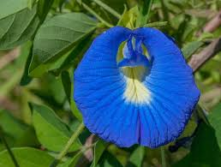
Similarly, Aparajita flowers, Wheat, barley, Cardamom, Nilotpal, Gram, fenugreek, Jain, banyan leaves, etc. have been found to be very beneficial for the health of the reproductive system.

Slide 13
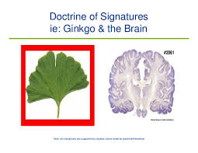
The structure of the betel nut is like the brain. Soaking raw betel increases the driving power of the brain. Other brain-like herbs are walnut, coconut, nutmeg, palm, almond, animal brain, Rudraksha, Thankuni and Gingobiloba leaves.

Slide 14
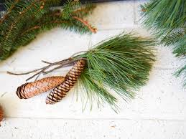
The hair is similar to coconut, palm fiber, onion, garlic, saffron, corn hair, cockroach, spirulina, black-haired, golden, butternut squash and Jatamangsi. These are therefore useful for maintaining the health of the hair, including the prevention of hair loss.

Slide 15
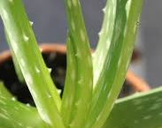
The skin is similar to orange peel, cinnamon, raw turmeric, cucumber, pomegranate, Aloevera, gram, sesame seeds, sandalwood, etc.

Slide 16
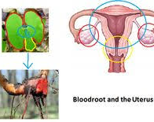
There are similarities between pineapple and womb. Raw pineapple is effective in removing postpartum uterus. However, pineapple is contraindicated in pregnant women. This leads to abortion.

Slide 17
Ok viwers, No more today

Slide 18
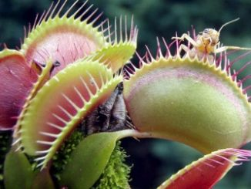
Thanks for watching

