Slide 1
Welcome to all.

Slide 2
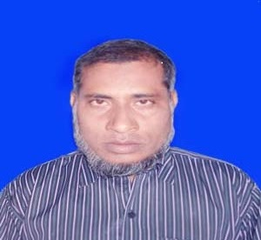
Introduction
Sub: English2nd.
Class: Seven
Time:40min.
MD. NAZRUL ISLAM
ASSISTANT TEACHER
K.K.H.S, PORSHA ,NAOGAON
Email-nazrul.kkhs@gmail.com

Slide 3
Look at the following sentences.
Karim reads in class seven. Every day he goes to school in time. He never mixes with bad boys. He helps the weaker students in his class to understand any thing.So he is loved by his climates and his teachers.
What kind of parts of speech the Words written in red letters ?
Preposition

Slide 4
Today our Topic is PREPOSITION

Slide 5
Learning outcomes
By the end of the lesson students will be able to …
Identify General Preposition- under, on, in……etc.
Use General Preposition.

Slide 6
Prepositions are words which are used before nouns or pronouns to show their relationship with other words in a sentence.

Slide 7
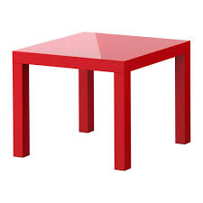
On
The ball is………………the table.
Under
_{The ball is…………………the table}

Slide 8
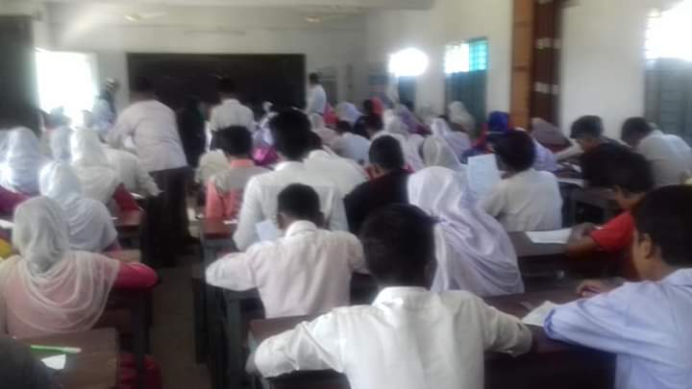
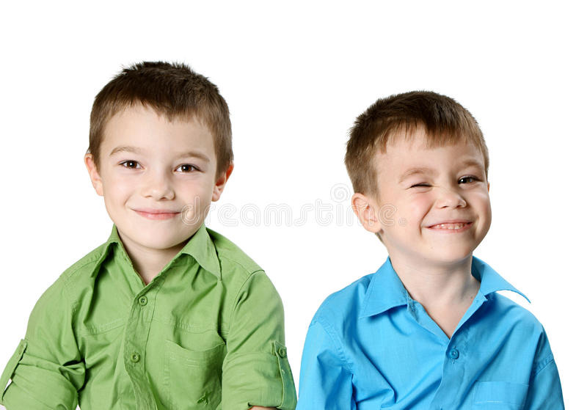
in
There are many students ……….. The class.
by
Karim sat.........Rahman.

Slide 9
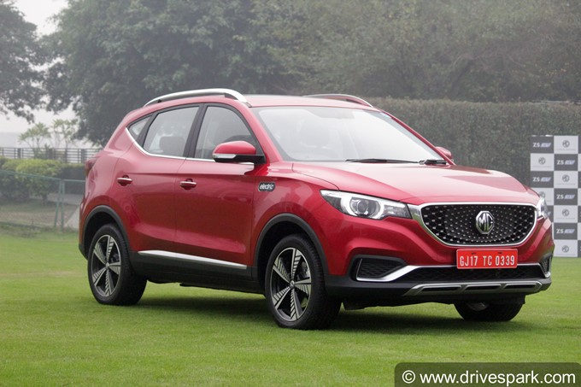
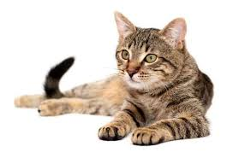
Through
The car is going .…………..the road.
In front of
The cat sat………….......The car.

Slide 10
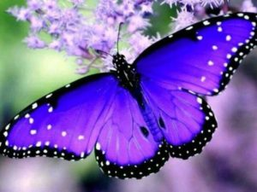
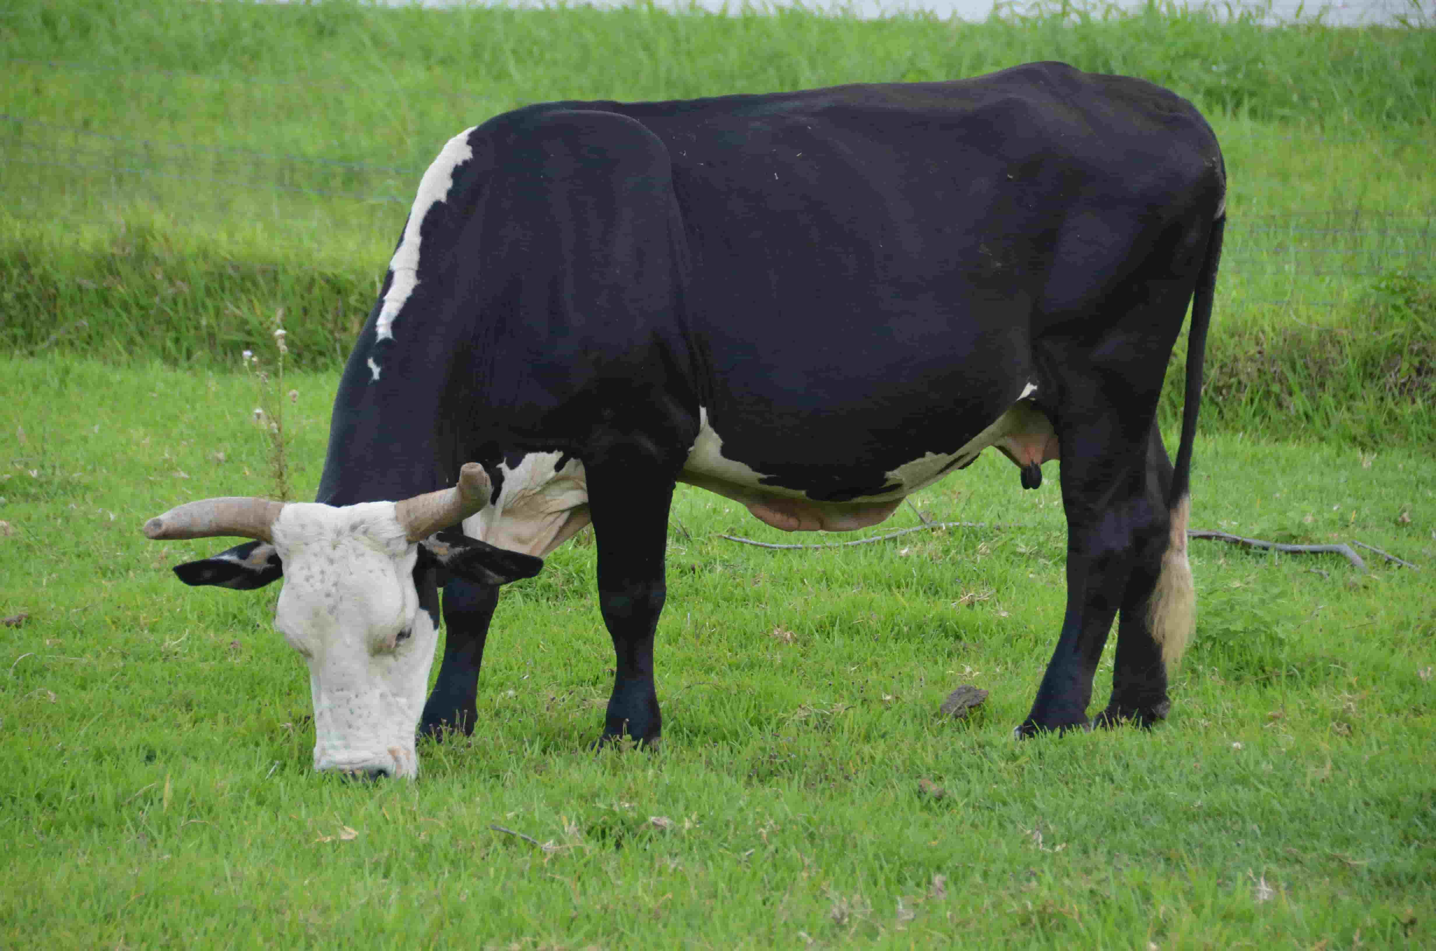
from
The butterfly is collecting honey ...............
flowers.
On
The cow lives ........grass.

Slide 11
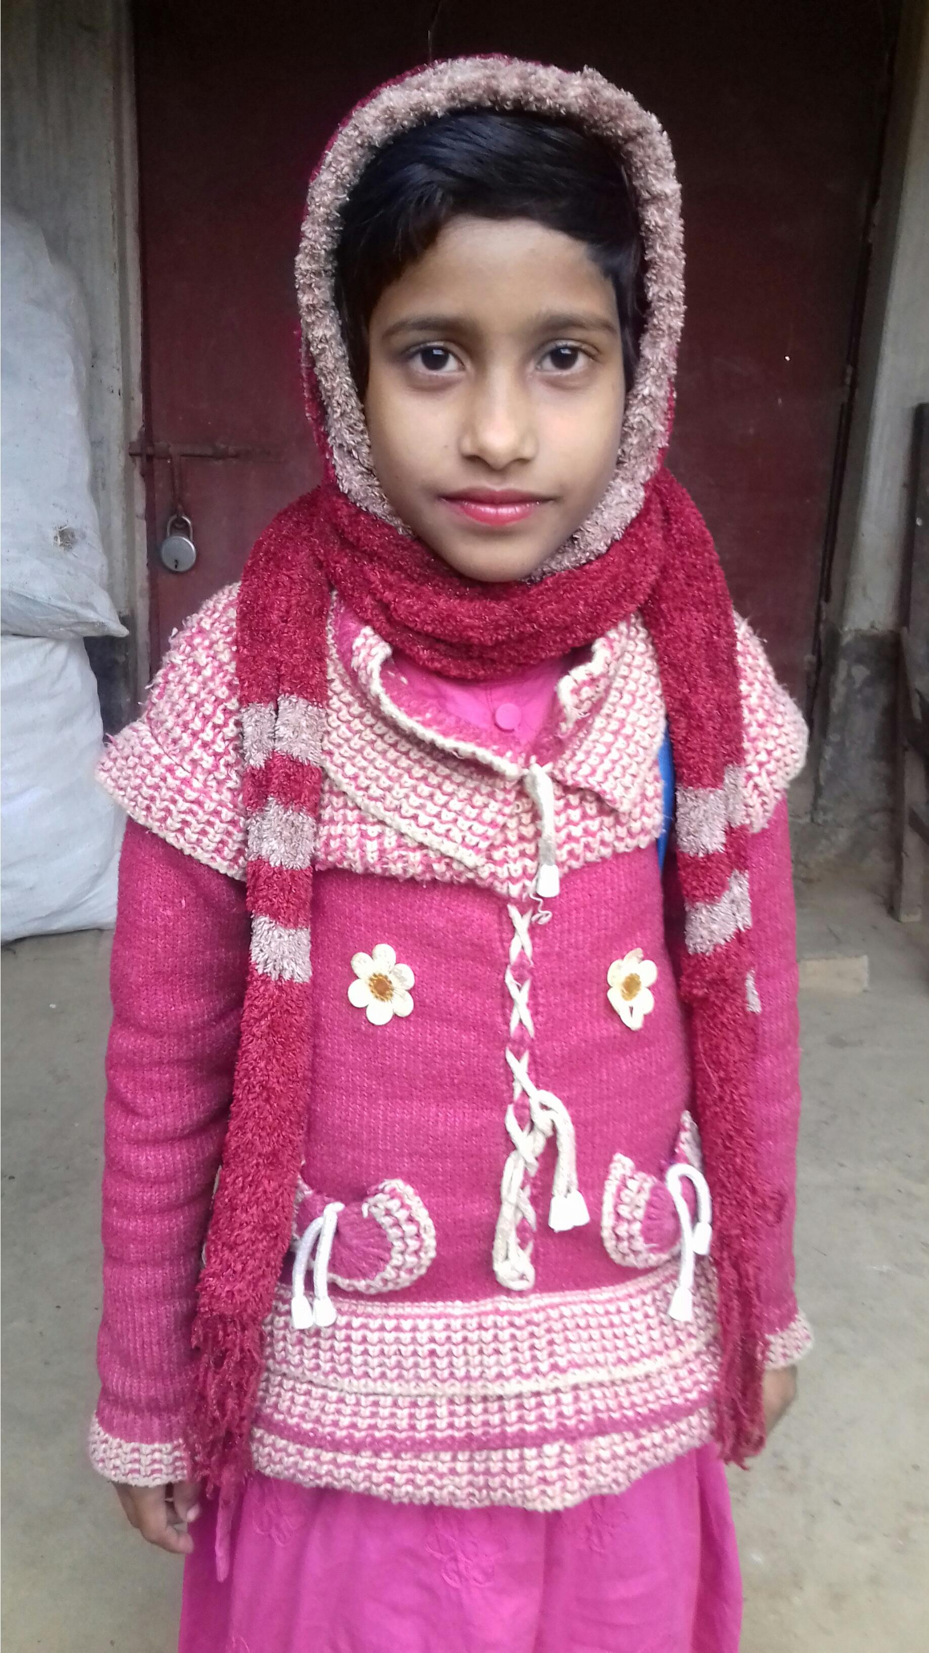
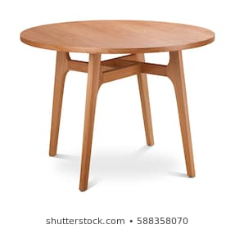
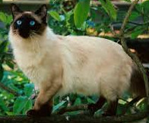
Over
The bird flew ………… Eva’s head.
Beside
The dog sat…………the table.

Slide 12
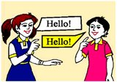
with
The girl stands…………The boy.
world
Around
The world moves……………..the sun.

Slide 13
Individual work
On
a) The book is ………….………. The table.
b) I am walking……………….. The forest .
c) The cat sat………………….. Table .
d) Rena sat …………. Me .
e) He has come …………. Village .
Through
Under
By
From

Slide 14
Home Work
Read the passage and fill up the blank using preposition.
Yesterday, I went…….. School…….bus. My friend Rena was………… me. She sat……..me.
I have a red pen……….in my pocket.

Slide 15
Thanks to all.

