Slide 1
Wel-come

Slide 2
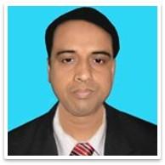
IDENTITY
Mohammad Abdul Malek
Assistant Teacher (Computer)
Kazi Abdul Majed Academy
Pangsha, Rajbari. Mob- 01717-002151
E-mail: abdulmalek1972p@gmail.com
Website. www.teachersnews24.com
Class: xi
Subject: English

Slide 3
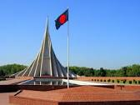
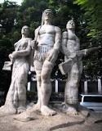
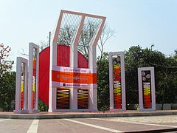
Oporajeo Bangla
The National Memorial
Central Shahid Minar

Slide 4
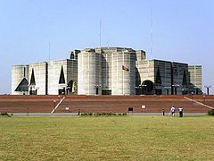
Jatiyo Sangshad Bhaban

Slide 6
Learning Outcomes
By the end of the lesson, the students will be able to…
Learn some new synonym.
Speak about what Jatiyo Sangshad Bhaban is.
Tell about its background.

Slide 7
Synonym
Capital
Center
Architect
Designer
Parliament
Senate
Location
Place
Complex
Multipart

Slide 8
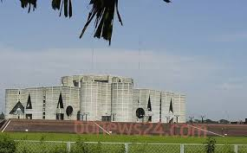
Deigned by Louis I.Kahn
One of the largest Parliament in the world
Situated in Sher-E-Bangla Nagar
350 seats
50 seats reserved for women
200 acres
Construction began in 1961
Construction finished in 28 January 1982

Slide 9
Symbol
of
The Jatiyo Sangsod Bhaban

Slide 10
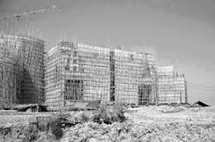
Under construction

Slide 11
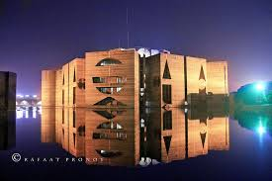
The parliament building at night

Slide 12
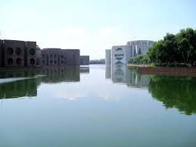
Lake beside the Sangsad Bhaban

Slide 13
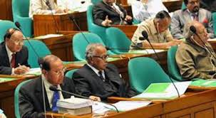
Inside the Sangsad Bhaban when Sangsad is running

Slide 14
Group work
Write at least five monuments name

Slide 15
Evaluation

Slide 16
Where is it situated?
Who was the designer?
When did its construction begin?
When did its construction finish?

Slide 17
Homework:
Write minimum 10 lines about The Jatiyo Sangsad .

Slide 18
Thanks

