Slide 1
English 1st paper For Class- 9
Farjana Anwar
Assistant Teacher( English)
Ikkshu Gabeshawana High School,
BSRI, Ishwardi, Pabna

Slide 2
English For Today
Class-9
Unit – 6, Lesson – 1
Nepal, the land of Everest

Slide 3
Learning outcome :
After studying the lesson students will be able to:
listen for information
read and understand text
write answers to questions
select and write headings

Slide 4
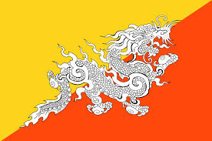
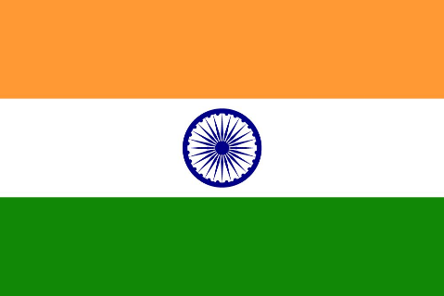
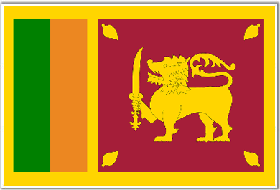
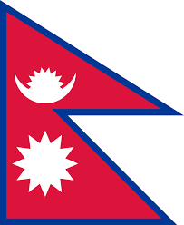
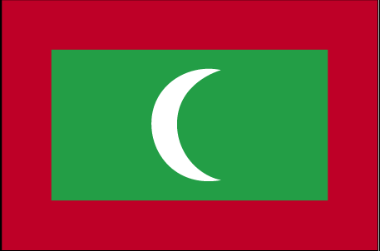
Bhutan
India
Sri lanka
Nepal
The Maldives

Slide 5
Can you tell me how these countries are related with Bangladesh?

Slide 6
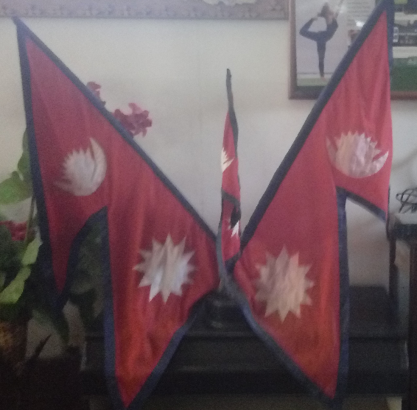
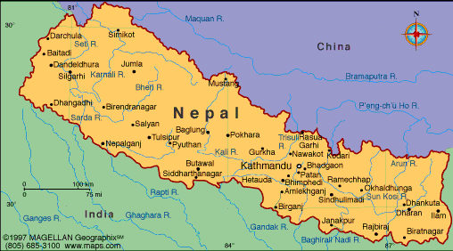
Nepal, the land of Everest

Slide 7
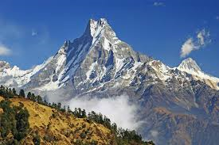
Sublime
(adj)
Word meaning
Majestic, impressive
Example : The kingdom of Nepal is a small land of sublime beauty.

Slide 8
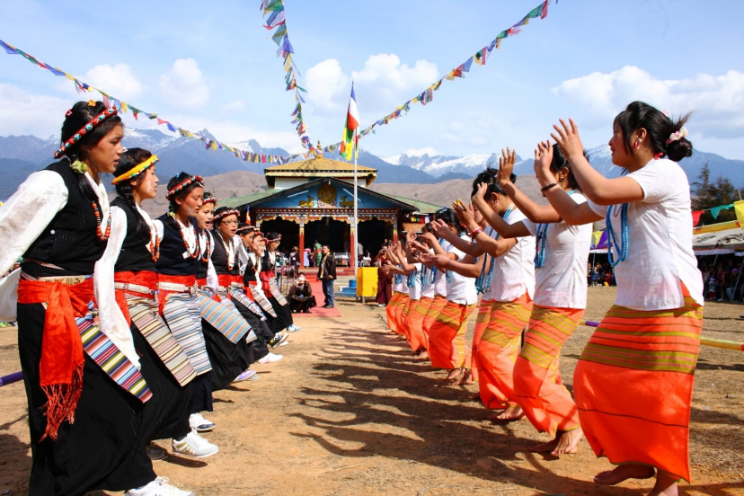
Heritage
(Noun)
Meaning: A practice or set of values that is passed down from preceding generation through families.
Example : Nepal is a rich country with cultural heritage.

Slide 9
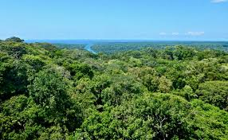
Tropical
(Adj)
Meaning : From or similar to hot and humid climate.
Example: Southern Nepal is a tropical low land area.

Slide 10
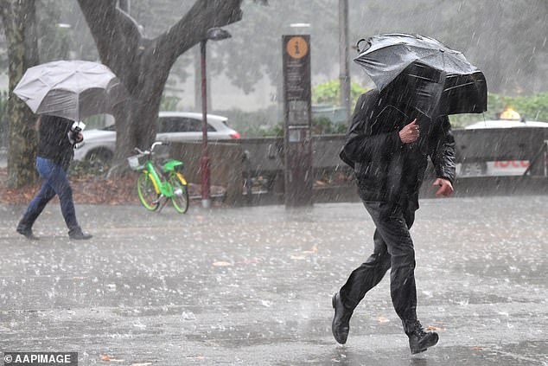
Drench
(Verb)
Meaning : wet thoroughly; soak
Example: I fell in the stream and was drenched.

Slide 11
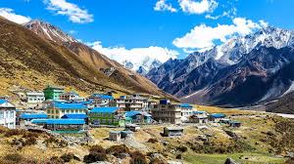
Valley
(Noun)
Meaning : a low area of land between hills or mountains, typically with a river or stream flowing through it.
Example: Pokhara is a very famous valley in Nepal.

Slide 12
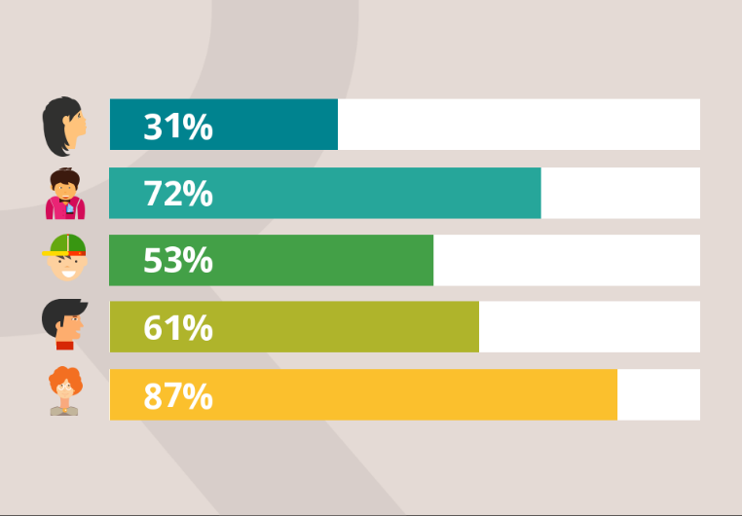
Demographic
(adj)
Meaning : relating to the structure of populations.
Example: The demographic feature of Nepal is complicated by dozens of ethnic groups.

Slide 13
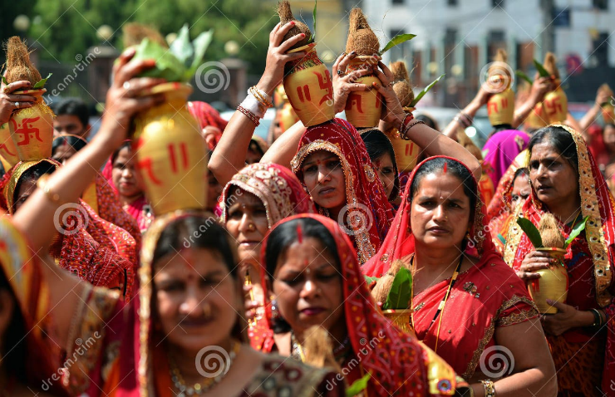
Introduction:
Nepal is known as the Land of Everest. It is also known as the only Hindu Kingdom in the world. It is very rich in its scenic beauty.

Slide 14
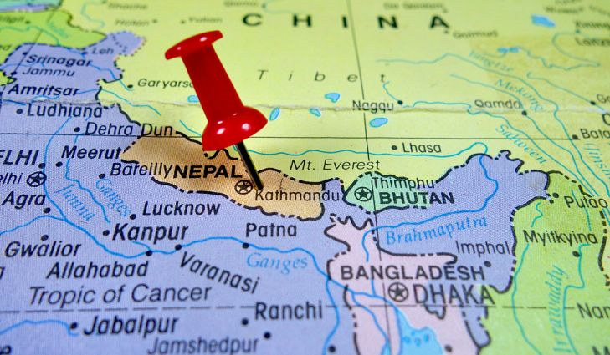
Land area:147,181 square kilomters
Southern part is known as Tarai Plain which is a tropical low land. It has hot summer and warm winter.

Slide 15
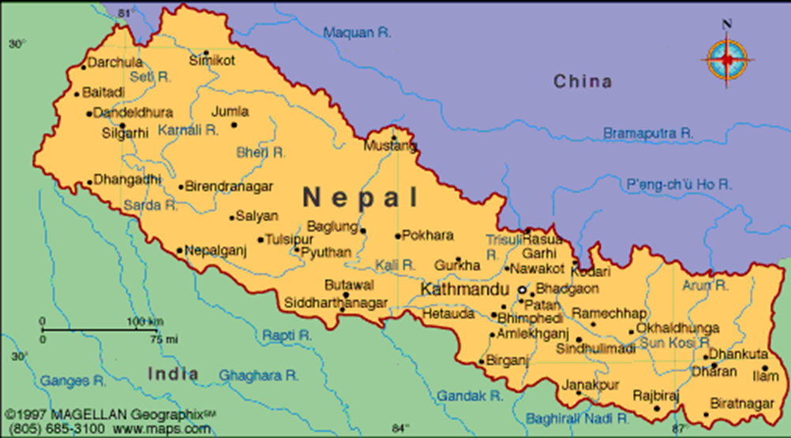
Central part is a hilly area including the Kathmandu and Pokhara Valley. It has temperate climate and is influenced by the monsoon.

Slide 16
Northern part is the slope of the main section of the Himalayan range. This part of Nepal has some of the highest peaks of the world including Everest.

Slide 17
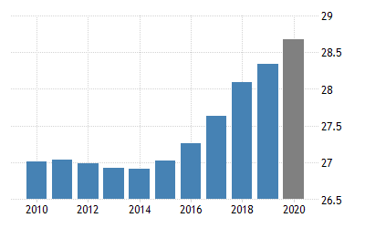
Population:
Nearly 29000000
Kathmandu: The capital city,
Less than one million inhabitants

Slide 18
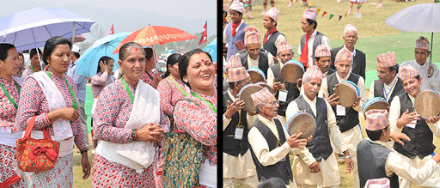
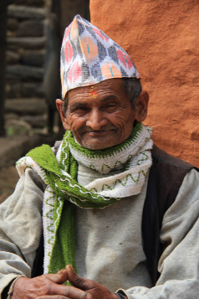
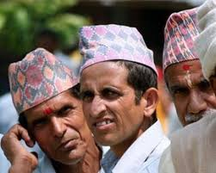
Casts &Ethnic groups: Total:103
Chetri
Bahun

Slide 19
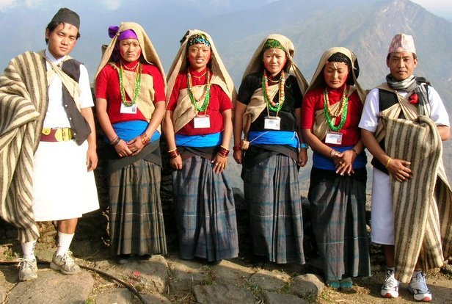
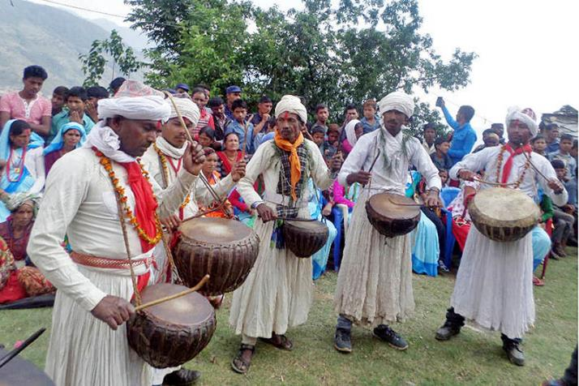
Other ethnic groups:
Gurung
Damai

Slide 20
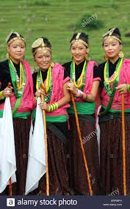
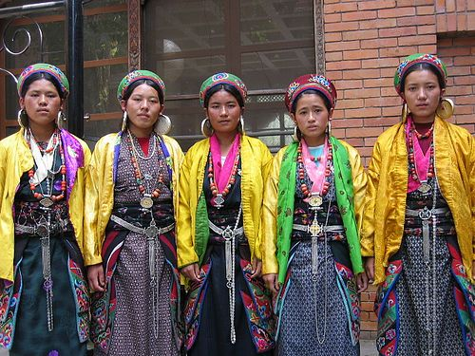
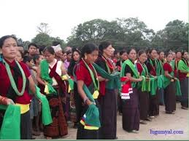
Other ethnic groups:
Magar
Tharu
Tamang

Slide 21
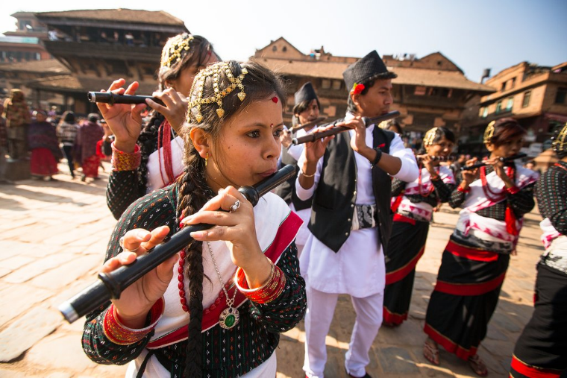
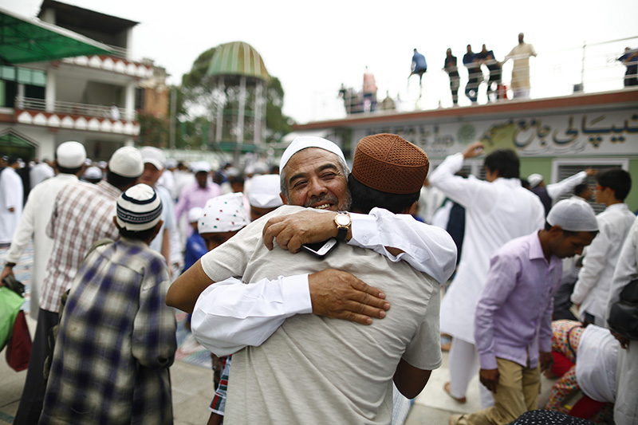
Other ethnic groups:
Newar
Muslim

Slide 23
Evaluation
Fill in the blanks with correct information:
Description | Name/ Number
Only Hindu kingdom | a)
b) | Tarai Plain
Major ethnic groups | c)
Northern part covers | d)
e) | Nepali
Nepal
Southern Part
Chetri and Bahun
Himalayan range
Most spoken language

