Slide 1

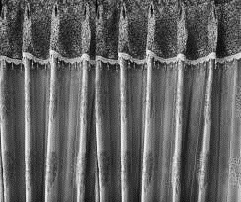



From the Directorate of Technical Education Bangladesh
Wel Come to
Nanyang Polytechnic International,
Singapore
Notes:
Ending slide.

Slide 2
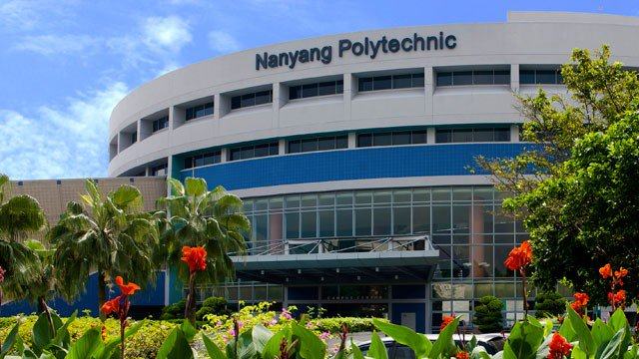
Nanyang Polytechnic International,
Singapore

Slide 3




About myself
Md.Habibur Rahman
Instructor(Physics)
Kishoreganj Technical school & college
Mobile: +8801715342934
Email: mhabibur21@gmail.com

Slide 4


Short Lesson Plan
T | Step |  | Activities | Materials | Time
1 | Preparation |  | Class formatting | Digital Class Room | 2min
2 | Attention |  | Greetings and contracts | Digital Content (D.C) | 2 min
3 | Lesson declaration |  | Creates an effect by displaying the image | Digital Content | 2 min
4 | LOC | Knowledge base | Video and image display, discussion and solo work | D.C, Textbooks and white board with marker pen | 6 min
 |  | Understanding base | Video and image display, discussion and work in pairs | D.C, Textbooks and white board with marker pen | 9 min
 |  | Application base | Picture display, discussion and teamwork | D.C, Textbooks and white board with marker pen | 12min
5 | Evaluation |  | Short and multiparty questions | Digital Content | 7min
6 | Homework |  | Writing and brief discussion | Digital Content | 2min
7 | Student Questions |  | Image display, short discussion | Digital Content | 2 min
8 | Finishing the lesson |  | Thank you | Digital Content | 1min
Click here to view the lesson plan

Slide 5


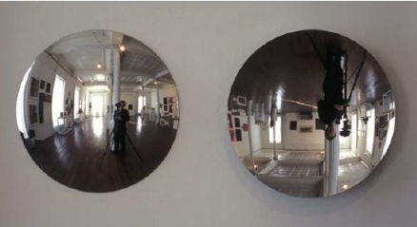
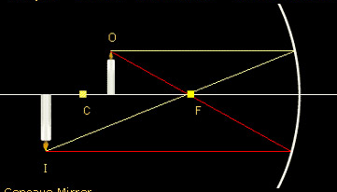

See some pictures
The gentle man is viewing his own picture in plane mirror
The child is viewing his own
picture in the mirror
Ray diagram in concave mirror for real mage
If any object is placed in front of a mirror, then the image of the object created in the mirror due to the constant reflection of light from the object.
What do they say in physics?
In physics these are called image.

Slide 6
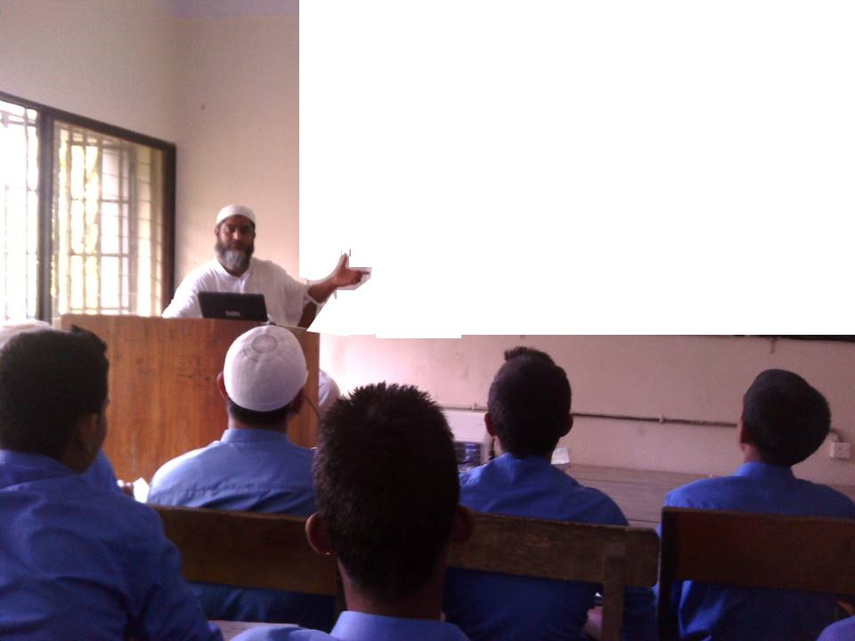
JOB NAME
To Demonstrate Practical Teaching and Learning Physics (TLP) of STEM in the Classroom Using Multimedia System.

Slide 7
Today’s topic
To Form and demonstrate an image using a concave mirror.

Slide 8
LEARNING OUTCOMEs
By the end of this session we will be able to
Explain what is Concave mirror ?
Explain what is called an image?
How many types of images are there?
What are they?
How real image is formed in a concave mirror? Demonstrate with the help of ray diagram.

Slide 9


Lesson equipments
Concave mirror
Symbol of Concavemirror
Reflection of light on concave mirror
Concave mirror: If the concave surface of a sphere acts as the reflector, that is if regular reflection of light takes place from the concave surface of the spherical mirror, then it is called a concave mirror.

Slide 10
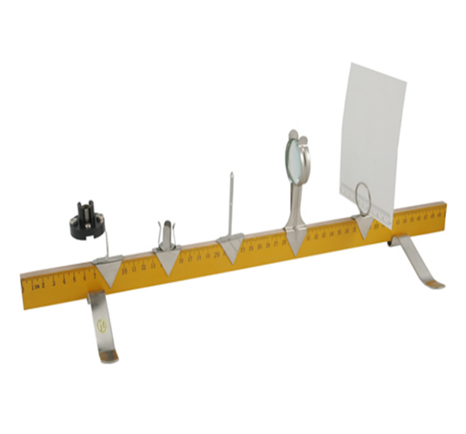

Lesson equipments
Optical bance with stands
Burning candle

Slide 11
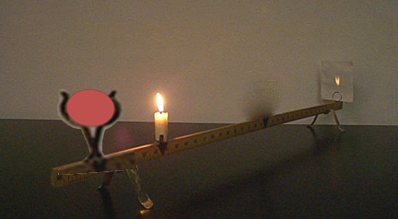
Image formed in a concave mirror
Image
Concave mirror
Object

Slide 12

Real image formation process
Concave mirror
Object
Image
C
F
Position of image: Out of centre of curvature
Shape: The image is smaller than the object
Nature: Real and revese

Slide 13
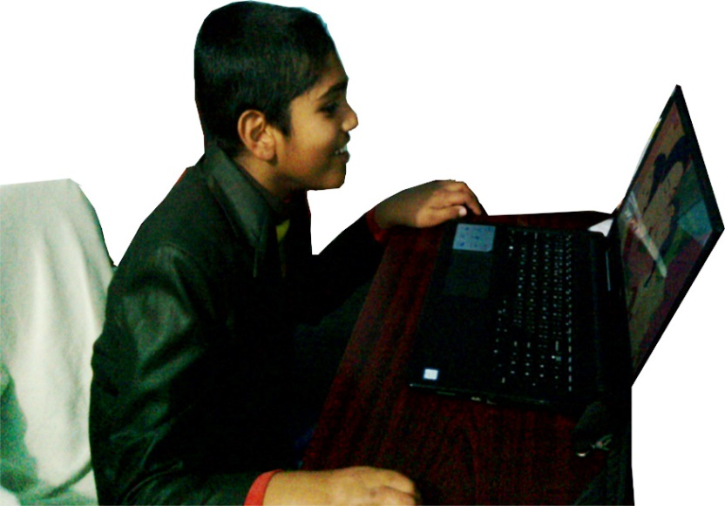
Work in single
If you can not,
click here
When the object is situated between the pole and the principal focus in a concave mirror then demonstrate formation of image with the help of ray diagram.

Slide 14

The object is situated between the pole and the principal focus.
C
C
F
P
F
Object
Image
Image behind the mirror
Image is virtual and erect
Image is larger than the size of the object

Slide 15

Work in pairs
If you can not, click here
When the object is situated in the centre of curvature in a concave mirror then demonstrate formation of image with the help of ray diagram.

Slide 16
The object is situated in the centre of curvature
Object
C
C
P
F
F
Image
Image is Centre of curvature
Image is real and inverted
Image is equal to object

Slide 17


Work in group
If you can not, click here
When the object is situated between the principal focus and Centre of curvature in a concave mirror on the optical bench then demonstrate
formation of image with the help of ray diagram.

Slide 18
Image formed in a concave mirror on the optical bench
Image
Concave mirror
Object

Slide 19
Real image formation process
Concave mirror
Object
Image
C
F
Position of image: Out of Centre of curvature
Shape: The image is smaller than the object
Nature: Real and revese

Slide 20
Multiple choice questions
Tick (√ ) the correct answer
1. Where convex mirrors are used?
a. cars b. torch light
c. solar oven d. Radar
√
2. What is the angle of reflection here?
a) 0° b) 90°
c) 180° d) 45°
√
45°

Slide 21
Lesson evaluation
What we have learned
What do you mean by mirror.
What do you mean by an image.
What is the real image.
What is the virtual image.

Slide 22


Home work
  Explain formation of images in mirrors by drawing action line of light rays.
How real image is formed in a concave mirror? Demonstrate with the help of ray diagram.

Slide 23
May Allah bless you all.
Notes:
Ending slide.

Slide 24

THANKS A LOT
Md.Habibur Rahman
Instructor(Physics)
Kishoreganj Technical school & college
Mobile: +8801715342934
Email: mhabibur21@gmail.com

