Slide 1
Welcome everybody

Slide 2
Teacher’s Identity
Mst. Zakia Sultana
Head Teacher
Pouta Govt. Primary School
Adamdighi, Bogura

Slide 3
LESSON’s Identity
Class: One
Subject: English
Lesson Title: Commands
Unit: 5, Lesson : 1-3
Activity: Look, listen and say.

Slide 4
Learning outcomes
Listening: Follow simple commands and instruction.
Speaking: Repeat after the teacher simple words and phases.

Slide 5
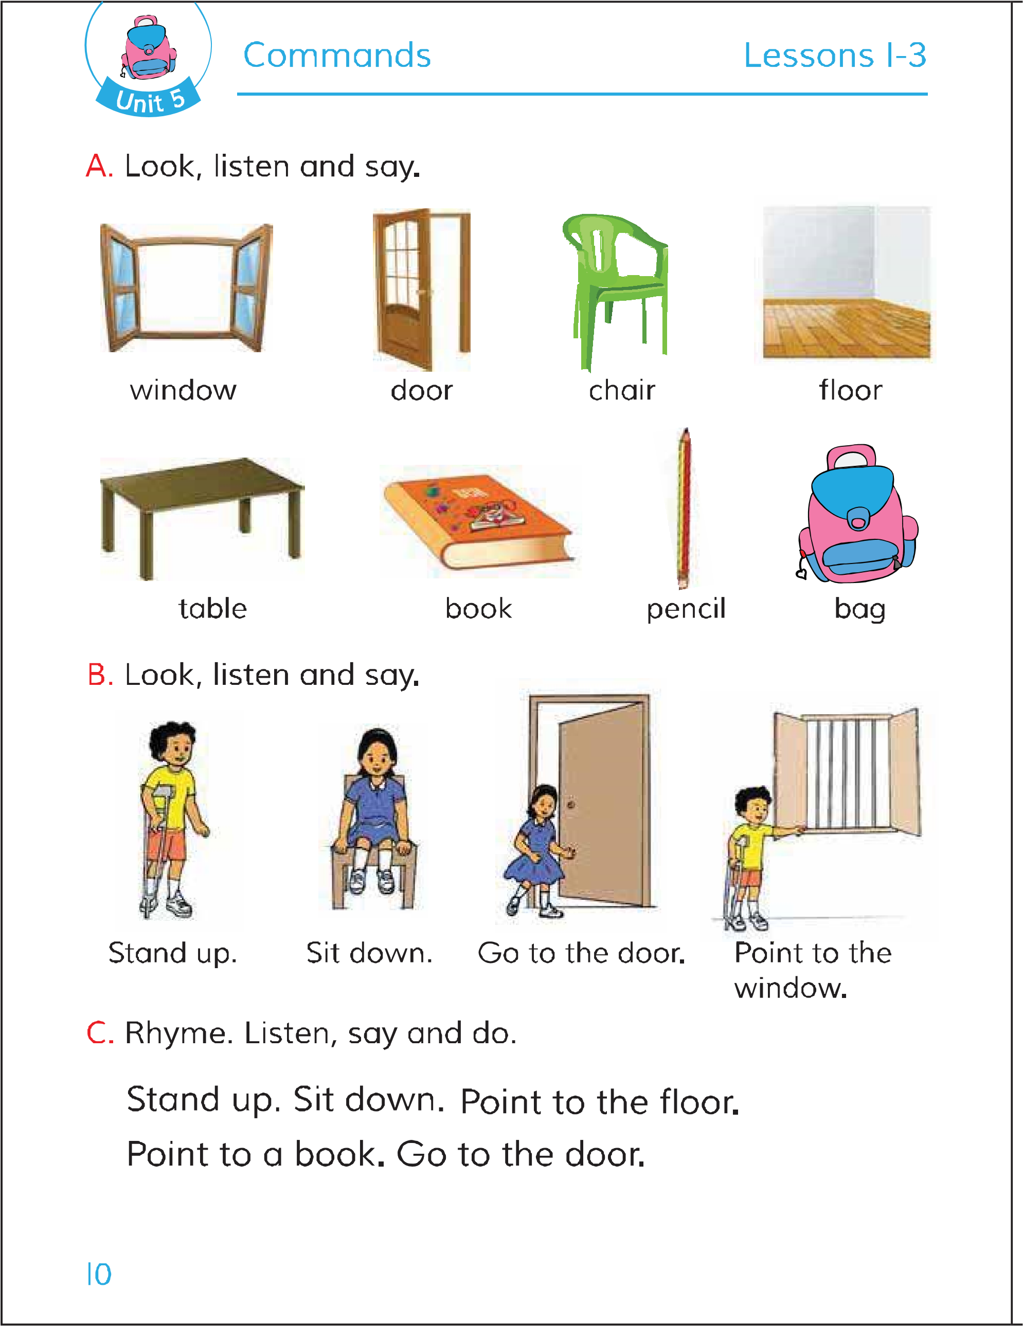
Look and think about the pictures

Slide 6
Now open your book page at 10.

Slide 7
Lesson Declaration
Commands

Slide 8
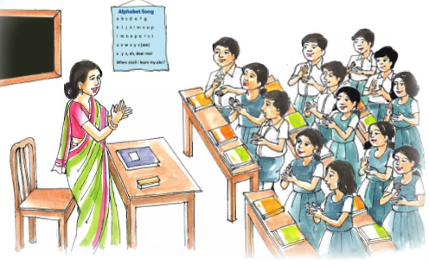
Students read and say with their teacher.

Slide 9
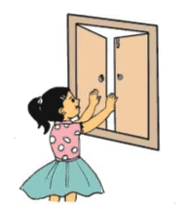
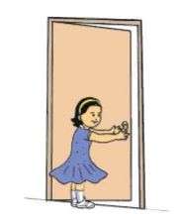
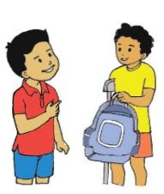
Showing picture:
(Say about the picture)
Open the window.
Close the door.
Show me your bag.

Slide 10
What is this?
This is a window

Slide 11
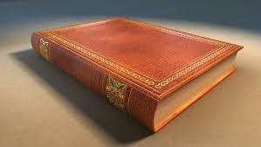
What is this?
This is a book.

Slide 12
What is this?
This is chair.

Slide 13
Stand up

Slide 14
Sit down

Slide 15
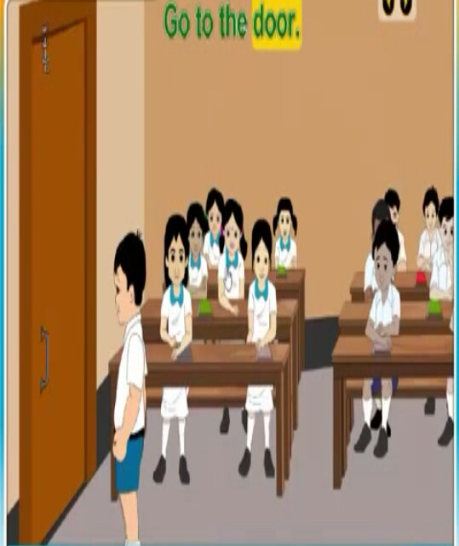
Go to the door.

Slide 16
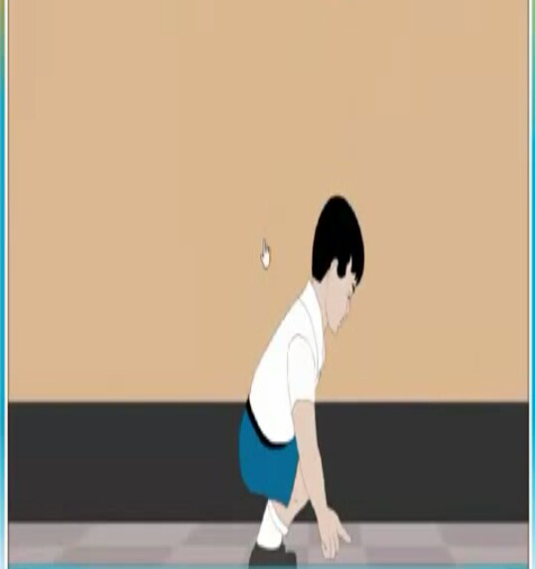
Point to the floor.

Slide 17
PAIRS WORK
Open the window.
Close the door.
Show me your bag.

