Slide 1
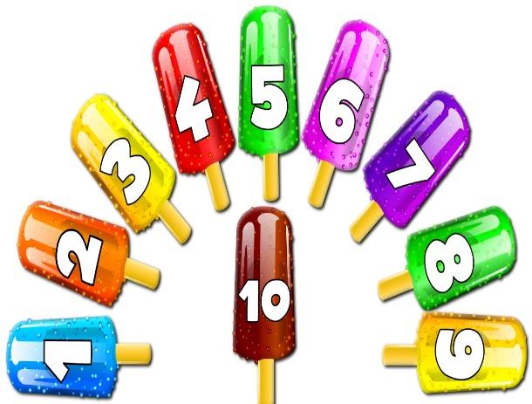
To my class

Slide 2
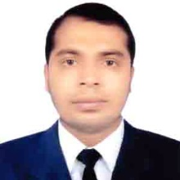
Teacher’s Identity
Misbahul haque
Assistant Teacher
Lontirmati government primary school
Kanaighat,Sylhet.
Mobile No:01715453647
Email:mhhaque520@gmail.com

Slide 3
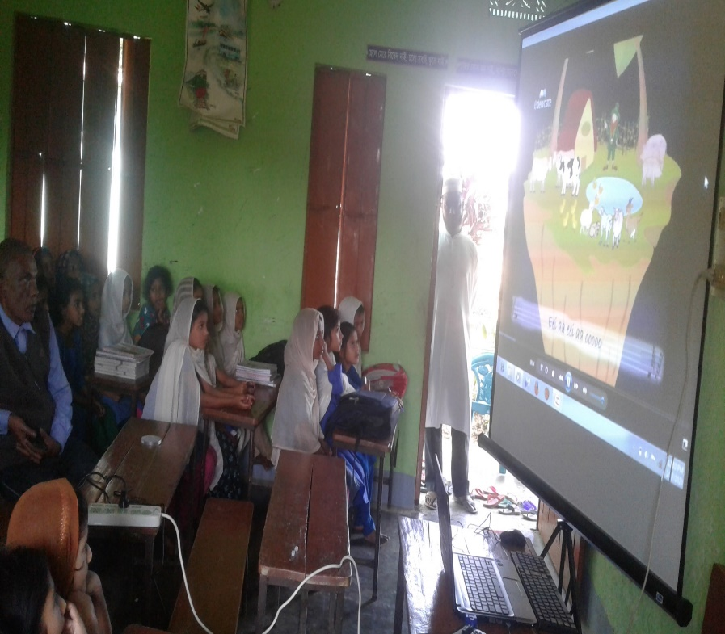
Let’s watch a video

Slide 4
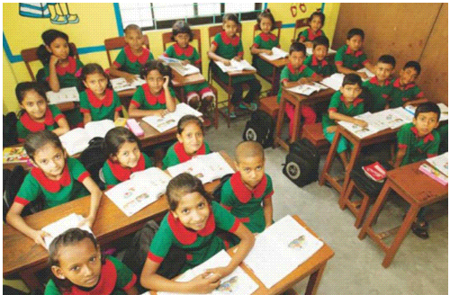
Introduce of the class
Class : One
Section : A
Total students:50
Present students:45
Absent students:05
Date:16/06/2020

Slide 5
Lesson’s introduction
Subject : English
Unit :04
Lesson :1-3
Lesson’s name : Numbers
Activity : A
Page : 08
Time : 45 minutes

Slide 6
What do you see in this picture?
Numbers

Slide 7
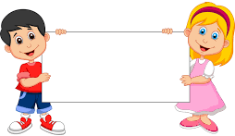
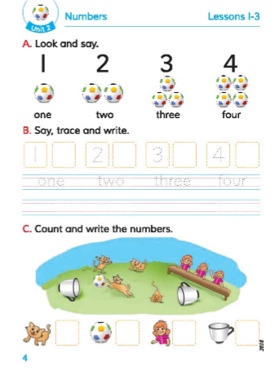
Lesson declaration
Numbers

Slide 8
Learning outcomes
Students will be able to..
Reading: 2.1.1 Recognize and read cardinal numbers up to 10.
Writing: 2.1.1 Write cardinal numbers up to 10 in figures.

Slide 9
How many Pencil is there?
1
One

Slide 10
How many Apples are there?
2
Two

Slide 11
Open at page 8 of your book and look at the activity A
Listen carefully and repeat after it.

Slide 12
Count the numbers by using
fingers:
1
2

Slide 13
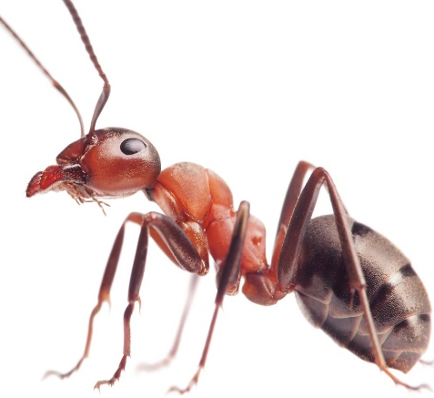
Match the following numbers
1
2

Slide 14
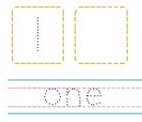
Writing number
Follow how to write ‘1’ :
1

Slide 15
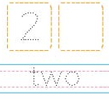
Writing number
Follow how to write ‘2’ :
2

Slide 16
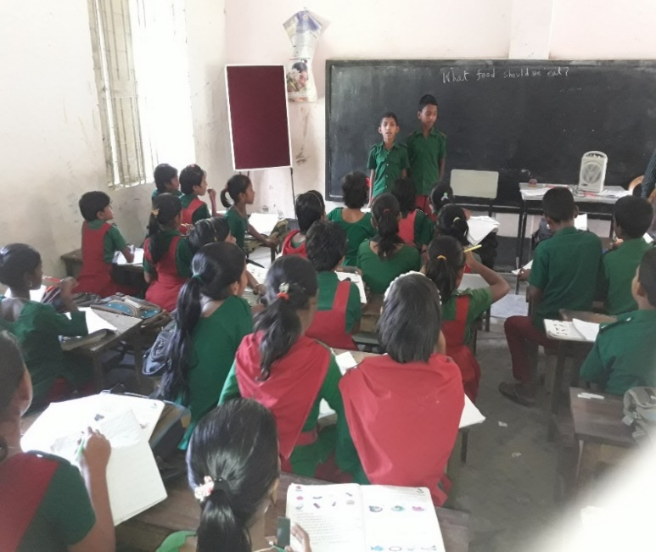
Chain drill
Everybody say loudly
1
2
One
Two

Slide 17
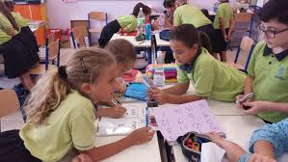
Group work
All the students will be divided in three Groups:
Group-1.Rose
Group-2.Tulip
Group-3.Lily
Every group members will say the following numbers loudly: 1, 2

Slide 18
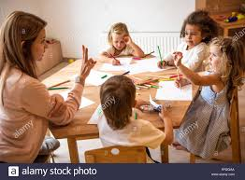
Pair work
Students will be divided in pair.Every pair will count the following numbers by using their fingers.
1,2

Slide 19
Evaluation
Count and write the numbers:
1
2

Slide 20
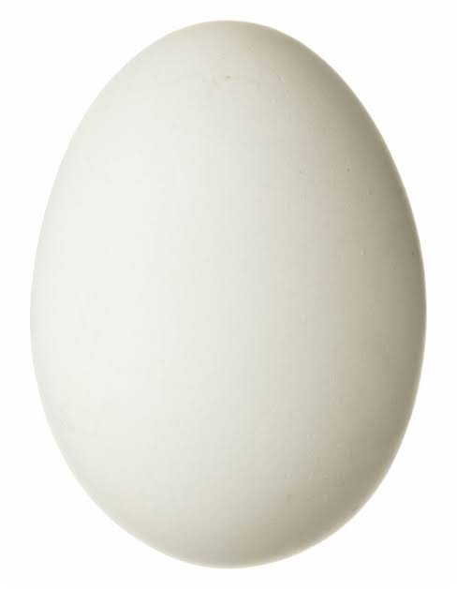
One day one word
Egg -ডিম

Slide 21
That’s all for today.See you again tomorrow.

