Slide 1
Welcome

Slide 2
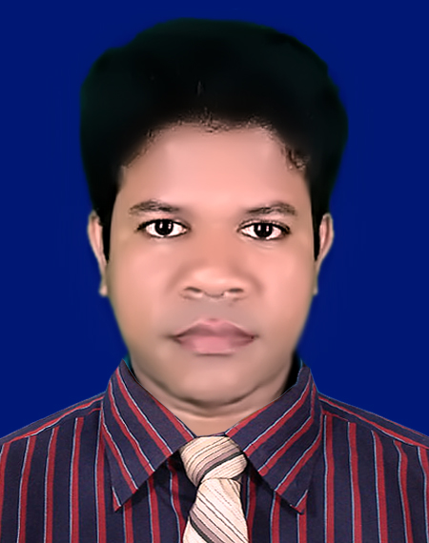
IDENTITY
Azizul Fakir
Assistant teacher
Dighijan Secondary School
Nazirpur, Pirojpur.
Email: azizul.nk@gmail.com
Mobile: 01710745128
Unit – Three
Lesson – 3
50 mins

Slide 3
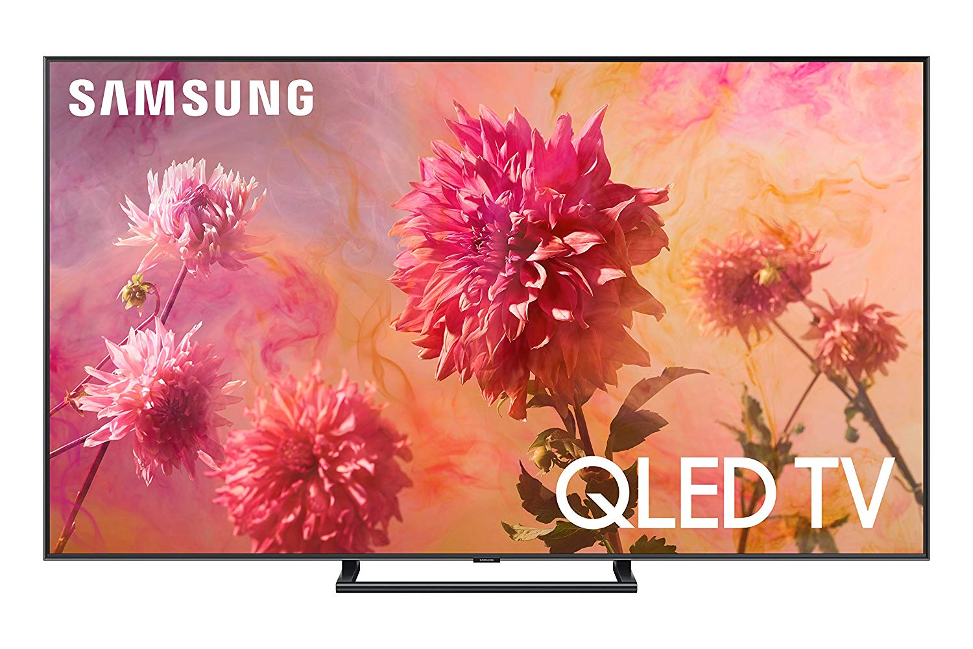
Dear students, lets watch a video.
Dear students what the video about?

Slide 4
Our topic?
Hygiene
Unit – 3
Lesson - 3
So

Slide 5
Learning outcomes
After completing the lesson students will be able to
1
infer meaning from the context
2
write answers to the questions
write true/false from the information
3
complete the sentences
4
listen for information to the CD
5

Slide 6
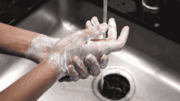
keyword
hygiene
Part of speech - noun
Meaning
cleanliness
The word ‘hygiene’ means the practice of keeping ourselves clean.

Slide 7
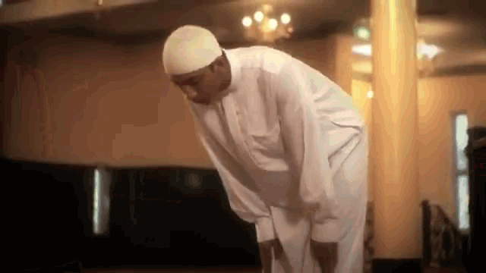
keyword
godliness
Part of speech - noun
Meaning
devotion to god
Hygiene is thought to be next to godliness

Slide 8
keyword
achieve
Part of speech - verb
Meaning
attain
We cannot achieve anything physically, mentally or spiritually if we are unclean in our body, mind and soul.

Slide 9
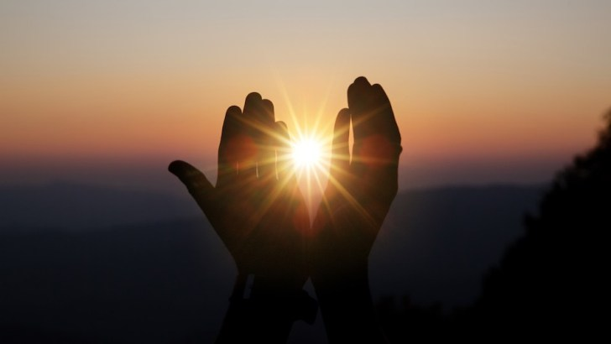
keyword
spiritually
Part of speech - adverb
Meaning
religiously
We cannot achieve anything physically, mentally or spiritually if we are unclean in our body, mind and soul.

Slide 10
keyword
soul
Part of speech - noun
Meaning
essence
We cannot achieve anything physically, mentally or spiritually if we are unclean in our body, mind and soul.

Slide 11
Open at page 22 in your text book and read the passage carefully.
The word ‘hygiene’ means the practice of keeping ourselves clean. It also means to keep our home and work place clean. It is important for our good health.
Hygiene is thought to be next to godliness. It is because we cannot achieve anything physically, mentally or spiritually if we are unclean in our body, mind and soul. No body likes an unclean person either. So we must follow the rules of hygiene.

Slide 12
First, we must keep our body clean. We should have a bath every day and wash our hair regularly. This will keep the body and hair free from dirt and bacteria.
Secondly, we should wash our clothes regularly. Dirty clothes gives off bad smell and invite germs. It is also important to wash our hands before meals and after using the toilet. We should brush our teeth twice a day, after breakfast and supper. We must also cut our nails regularly. Our drinking water must be safe. We can get safe water by boiling and filtering.
Finally, we should keep our surroundings and environment clean.
If we do and follow all the above things properly, we will be able to lead a healthy and happy life.

Slide 13
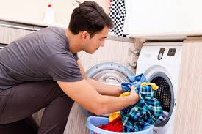
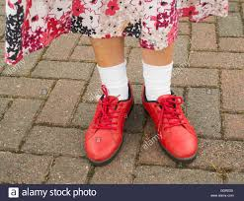
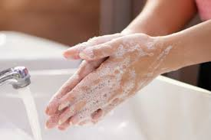
Look the pictures carefully.
Dear students, what do you see in the pictures?
Dear students, keeping healthy what should we do?
Washing clothes
Wearing socks and shoes
Washing hands
When we go out, we should wear socks and shoes to protect germs.
We should wash our hands till 20 seconds to safe ourselves from covid 19.
We should wash our clothes regularly

Slide 14
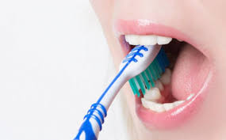
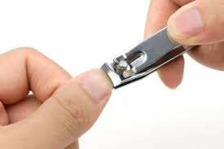
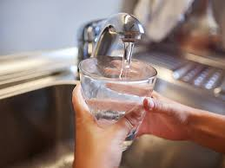
Look the pictures carefully.
Dear students, what do you see in the pictures?
Dear students, keeping healthy what should we do also?
Brushing teeth
Cutting nail
Safe drinking water
We should brush our teeth twice a day.
We must also cut our nails regularly.
Our drinking water must be safe.

Slide 15
We should wash our clothes regularly. Dirty clothes gives off bad smell and invite germs. It is also important to wash our hands before meals and after using the toilet. We should brush our teeth twice a day, after breakfast and supper. We must also cut our nails regularly. Our drinking water must be safe. We can get safe water by boiling and filtering.

Slide 16
Answer the following questions.
Individual works 4mins.
Q1. What can be a hotbed of germs?
Q2. How many times should we brush our teeth a day?
Q3. What kind of water should we drink?
Check your answer
Ans1. Dirty clothes can be a hotbed of germs.
Ans2.We should brush our teeth twice a day, after
breakfast and after supper.
Ans3. We should drink safe water.

Slide 17
True or false? If false, give the correct information.
Pair works 5mins.
1. Cleanliness is a part of good health.
True
2. Cleanliness is very important for mental health.
True
3. We need to wear socks and shoes to look smart.
False
Corr:
We need to wear socks and shoes to protect our feet from dust and germs.
4. We need to brush our teeth before meals.
False
Corr:
We need to brush our teeth after meal.
5. We must keep ourselves clean.
True
6. We can have pure drinking water from tube wells.
False
Corr:
We can get pure drinking water by boiling and filtering.

Slide 18
Complete the following sentences.
Group work
6 mins
If we are healthy, we --------------------------------------------
We must be clean so that ----------------------------------------
You must exercise to --------------------------------------------
Nobody likes an ------------------------------------------------
If we obey the laws of hygiene, we --------------------------------
Check your answers
If we are healthy, we will lead a happy life .
We must be clean so that we can maintain good health.
You must exercise to keep your body fit.
Nobody likes an unclean person.
If we obey the laws of hygiene, we will be able to lead a healthy and happy life

Slide 19
Tick the best answer.
The word ‘hygiene’ is related with -----
i. is truthfulness ii. happiness iii. cleanliness iv. religion
(b) Hygiene is important for ----
i. doing work ii. getting job iii. earning money iv. good health
(c) Who is not liked by anyone?
i. a rich man ii. a thief iii. an unclean person iv. a healthy person
(d) What does the word ‘important’ mean?
i. developed ii. significant iii. good iv. authorized
(e) We should brush ------ a day.
i. once iii. twice iv. 3 times iv. 4 times
(f) Hygiene is ----- godliness.
i. as important as ii. more than iii. nearer to iv. equal to
(g) Cutting our nails regularly is a -----
i. fashion ii. must iii. style iv. bad habit
$$$$
$$$$
$$$$
$$$$
$$$$
$$$$
$$$$

Slide 20
Listen to the CD
Evaluation
Now fill the passage from your listening.
Hygiene means (a) ---- ourselves and our surroundings clean. It is very important to (b) ----- good health. Taking bath everyday, (c) ---- clothes, brushing teeth, cutting nails regularly are the (d) ----of the rules of hygiene. Our drinking water must be (e) ----. Last of all, we should ensure a clean environment.

Slide 21
Check your answers
Hygiene means (a) keeping ourselves and our surroundings clean. It is very important to (b) maintain good health. Taking bath everyday, (c) washing clothes, brushing teeth, cutting nails regularly are the (d) parts of the rules of hygiene. Our drinking water must be (e) pure. Last of all, we should ensure a clean environment.

Slide 22
Homework
Stay home
Stay safe
Write the summery of the text you have read.

Slide 23
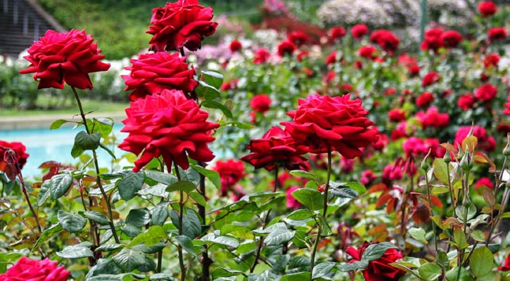
Thanks

