Slide 2
Welcome

Slide 3
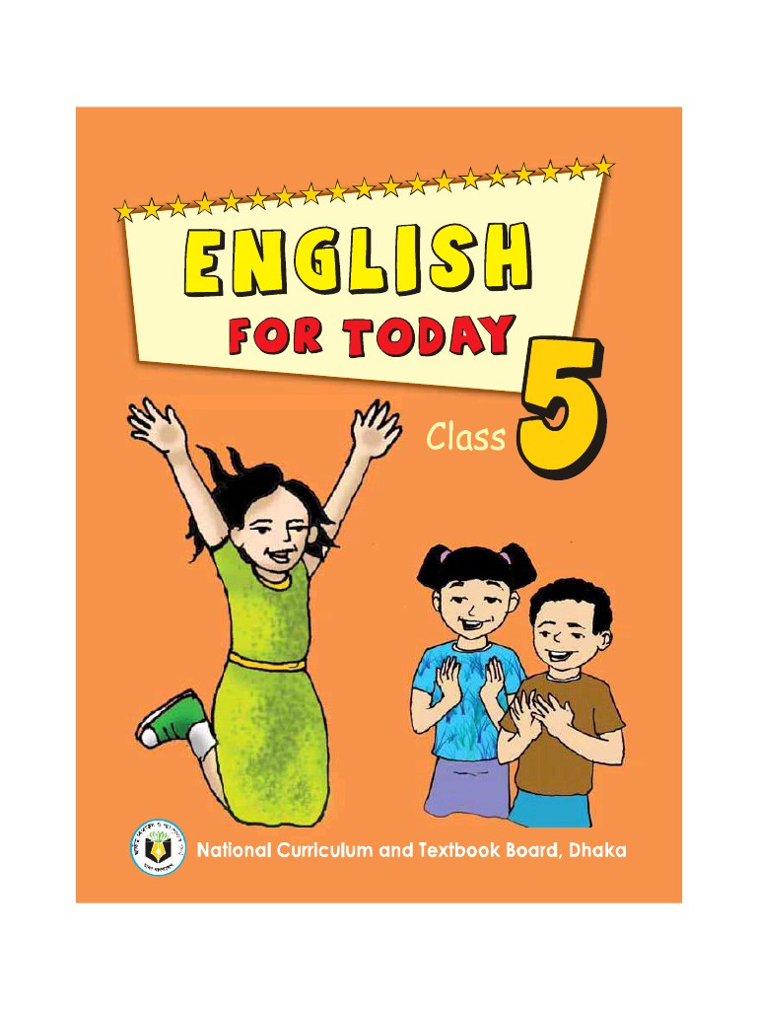
Identity
Khalidur Rahman Manik
Ass: Teacher
Khasgaon GPS
Chhatak Sunamganj.
EFT
Class:5
Unit:19
Activity: A (P:2)

Slide 4
Good morning students.
How are you today?
Let’s sing the good morning song.

Slide 5
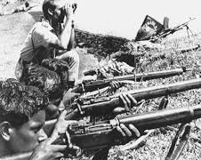
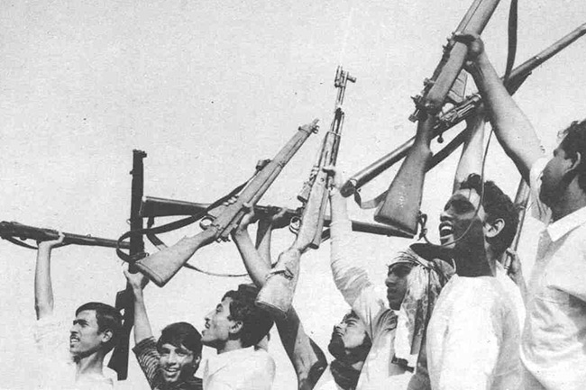
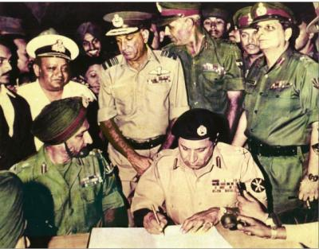
Look at the pictures.
What are the pictures about?
Can you guess what’s our today’s lesson?
Ans: The pictures are about our Liberation War.

Slide 6
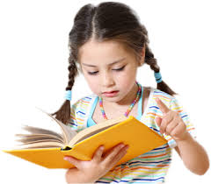
Our Today’s lesson is…
A visit to the Liberation War Museum.

Slide 7
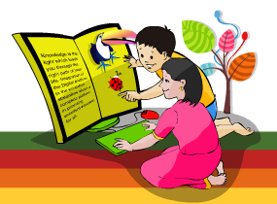
Learning outcomes.
Students will be able to…
understand and enjoy simple stories;
say words, phrases, and sentences with
proper sounds and stress;
talk about people, objects, events etc;
read paragraphs, dialogues, stories,
letters and other texts.

Slide 8
Listen to the audio carefully.
Listen to the audio again.

Slide 9
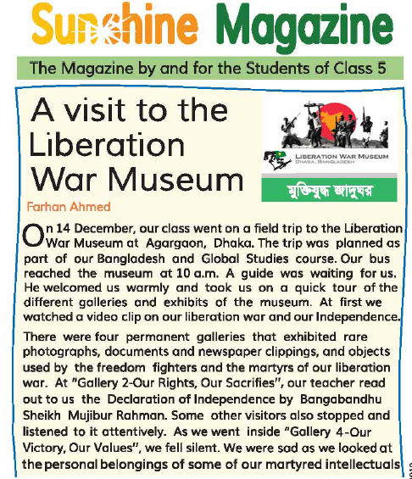
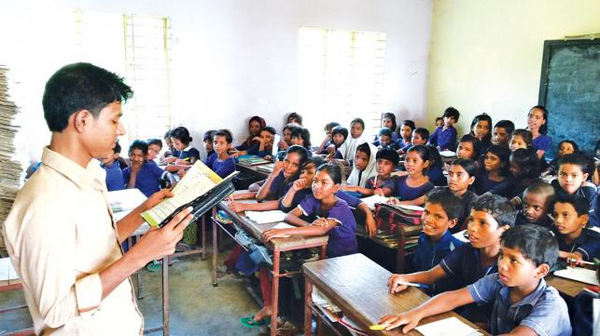
Teacher’s reading
I’ll read the text and you will follow me very carefully.

Slide 10
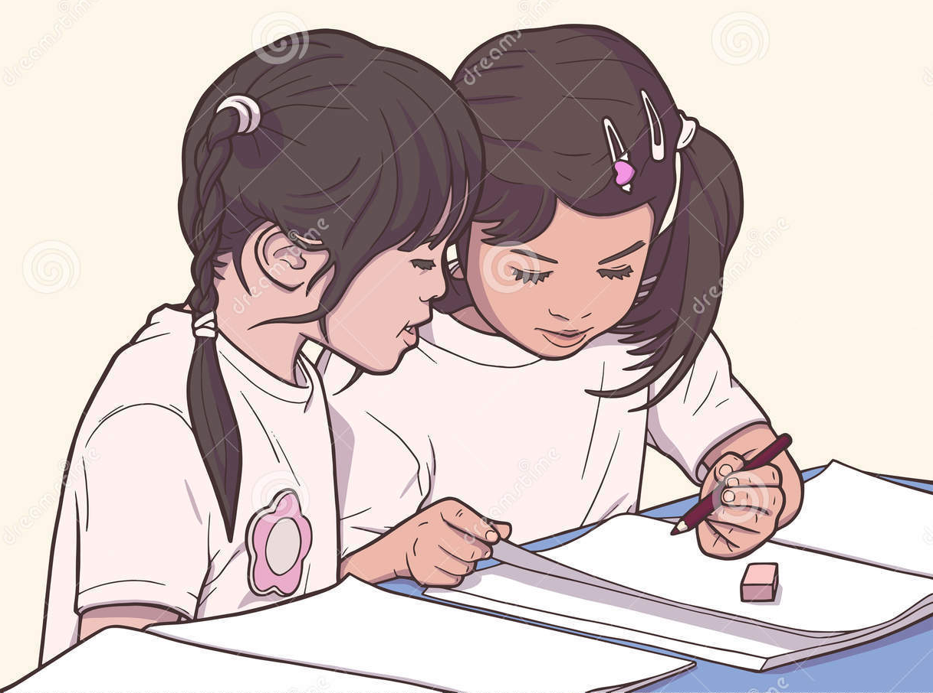
Individual Work
Match the words of column A with their meaning in column B.
Column A | Column B
a) Martyr | 1) Warrior
b) Document | 2) Who died for his country
c) Listen | 3) Announcement
d) Fighter | 4) A piece of written information
e) Declaration | 5) To show something
 | 6) To hear
 | 7) Liberation

Slide 11
Students’ silent reading.
Read the text silently and answer the following questions.

Slide 12
Pair Work
Write “True” or “False”
a) The class went on a field trip to Cox’s Bazar.
F
b) A student read out the Declaration of Independence.
F
c) The student fell silent at gallery 2.
F
d) The students reached the Museum at noon.
F
T
e) The video clip was on our Liberation War.
T
f) They left the museum at 12:30.

Slide 13
Group Work
Answer the following questions in a sentence or sentences:
How many galleries are there in the Museum?
Who read out the Declaration of Independence?
When did they leave the Museum?
What kind of video film they watched there?
How was the experience?

Slide 14
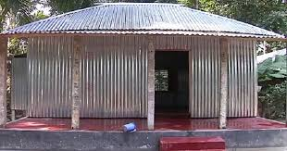
Homework
Write a short composition about
“ The Liberation War Museum”
in 5 sentences.

