Slide 1
Welcome

Slide 2
About me
Mohammad Mohiuddin
Headmaster
Eastern Refinery Model High School
North Patenga , Chittagong
Mobile: 01815-118149
Email: md.muhi69@gmail.com

Slide 3
Let’s we see some sentence
I went to my uncle’s home.
আমি আমার চাচার বাড়িতে গিয়েছিলাম।
I am going to my uncle’s home.
আমি আমার চাচার বাড়িতে যাচ্ছি।
I shall go to my uncle’s home.
আমি আমার চাচার বাড়িতে যাব।
.

Slide 4
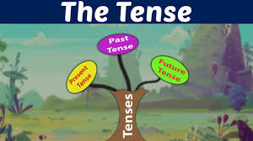
So, our today’s lesson is “Tense”

Slide 5
What is Tense?

Slide 6
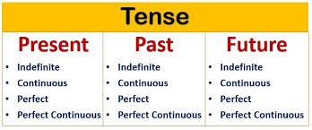
Kinds of Tenses

Slide 7
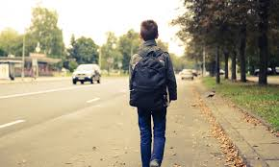
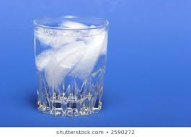
1. Past Indefinite Tense
Structure:
Subject + Present form of Verb + ….
Rana usually walks to school.
The sun rises in the west
Ice floats on water

Slide 8
1. Past Continuous Tense

Slide 9
Structure of Present Continuous Tense:
Subject + am/is/are + -ing Verb
The boy is playing guitar.
The boys are swimming
in the pond.

Slide 10
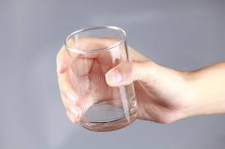
3. Present Perfect Tense
Structure:
Subject + have/ has + Past participle form of verb
Present perfect definition: The present perfect tense is a verb tense used to express actions that occurred at a non-specific time.
I have drunk a glass of
water.

Slide 11
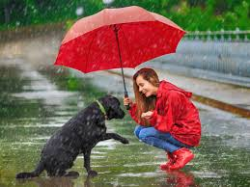
1. Present Perfect Continuous Tense
Structure: Subject + have/has + been + -ing Verb
+ period of time/ point of time
The present perfect continuous is a verb tense which is used to show that an action started in the past and has continued up to the present moment
It has been raining since morning

Slide 12
Past Indefinite Tense Structure: Subject + Past form of Verb
The past indefinite tense, also known as simple past tense, is used to indicate a finished or completed action/task that occurred/happened at a specific point in time in the past.
Bangladesh became independence in 1971.

Slide 13
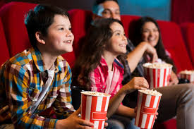
Past Continuous Tense
Structure: Subject + was/were + -ing Verb
The Past Continuous Tense is used to describe actions that began in the past and often continued for a short period of time after the action started.
We were watching a nice movie yesterday night.

Slide 14
Past Perfect Tense Structure: Subject+ had + past participle form of verb
The past perfect tense is used to show that something happened before another action in the past. It can also be used to show that something happened before a specific time in the past.
The patient had died before the doctor came

Slide 15
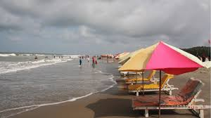
Past Perfect Continuous Tense
Structure: Subject + had been + - ing verb
The past perfect continuous tense shows that an action that started in the past continued up until another time in the past.
We visited cox’s bazar last Monday.
We could not go out because it had been raining all day long.

Slide 16
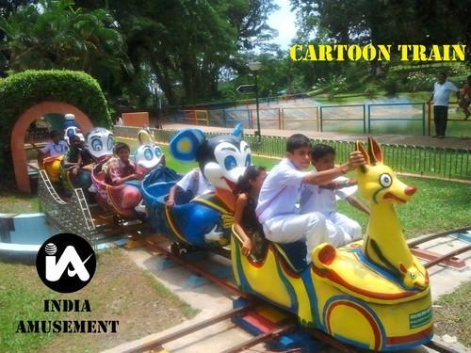
Future Indefinite Tense
Structure: Subject + shall/will + Present form of Verb
Simple Future (Future Indefinite) is used when an action is promised/thought to occur in the future.
We shall go to children’s park tomorrow.

Slide 17
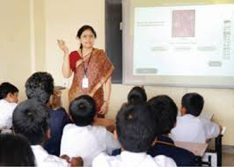
Future Continuous Tense
Structure: Subject + shall be/ will be + - ing verb
The future continuous tenseis a verb tense that indicates that something will occur in the future and continue for an expected length of time.
She will be teaching us English
this time tomorrow.

Slide 18
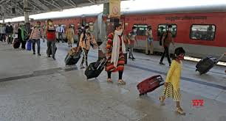
Future Perfect Tense
Structure: Subject + shall/will + have + Past Participle form of verb
The future perfect tense expresses action that will be finished at some point in the future.
He will have reached the
station by this time.

Slide 19
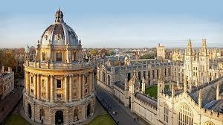
Future Perfect Continuous Tense
Structure: Subject + shall/ will + have been + -ing verb.
The future perfect continuous, also sometimes called the future perfect progressive, is a verb tense that describes actions that will continue up until a point in the future.
Oxford University
We will have been studying at this
glorious university for three years

Slide 20
Group work
saw | walk | permit | Hear | want | live
visit | revolve | write | Hand | Teach | Rehears
1. When I opened my eyes, I - -------- a strange sight. 2. Every morning she --------- up early and gets ready for work. 3. If I knew what he wanted, I would not ----------- this. 4. I haven’t ---------- anything from her in a long time. 5. The headmaster ---------- to talk to you. 6. Jane --------- with her parents. 7. We are --------- Greece next month. 8. The moon ---------- around the earth. 9. She has --------- a novel. 10. All students have---------- in their work. 11. I have been -------- English for twelve years. 12. The students are ---------- their dialogues.

Slide 21
HOME WORK
Use right form of verbs:
1. He ran fast lest he __________ (miss) the train.
2. It ___________ (rain) since morning.
3. If I were a bird , I ______________ (fly) .
4. If I were a king, I _____________ (help) the poor.
5. Had I been a king , I __________ (help) the poor.
6. He ______________ ( go) out just now.
7. ___________ you ever __________________ ( be) to Dhaka ?
8. I _____________ ( see) him recently.
9. Have you ever _________________ ( be) to Cox’sbazar.
10. I ______________ ( work ) there recently.

Slide 22
That’s all for Today

