Slide 1
Welcome to my online class
Alpana Nasrin
Bangshal Girls’ High School
Bangshal ,Dhaka--1100
Assistant Teacher (English)

Slide 2
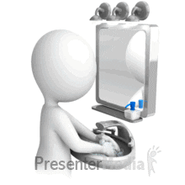
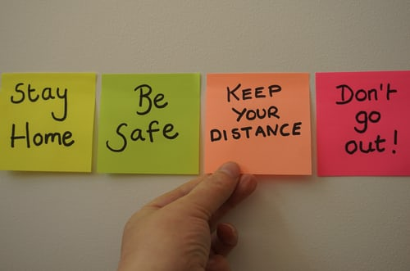

Slide 3
Lets’ watch a video

Slide 4
So, our todays lesson is :
w
English First Paper
Unit :7 ,Lesson :4
Topic :The beginning(about Mother Teresa)
Page : 99

Slide 5
After learning this lesson ss will be able to:
describe people
say about mother Teresa’s missions for humanity
ask and answer questions
write statements finding out true/false
Chose the best answer

Slide 6
Key words/vocabs:
Word Eng meaning
Decent --- moderate.
siblings --- brother or sister.
Humanity------------the quality of being humane.
Missionary -------------a person who is sent to mission.
Convent-------a community of person devoted to religious life under a superior.
Devote-------dedicate by a solemn or formal act .

Slide 7
Evaluation
1 What does ‘servant of humanity’ mean in the text?
a) becoming a slave. b) to work in other people’s house.
c) to be oppressed by others. d )to serve the needy.
2 Why did Mother Teresa want to be a missionary? Because she heard
a) the voice of her neighbours discussing it. b) a voice in her dream.
c) heard a voice within herself. d) heard the voice of her parents talking about it.

Slide 8
3 Mother Teresa set out to join the missionary of the Sisters of Loreto in the year
a )1927. b). 1928. c) 1929 d). 1930.
4 Mother Teresa took her first vows at the age of
a ) 18. b.) 19. c) 20. d.) 21.

Slide 9
Home work
B Read the text in A again and answer the questions in one or two words or in a sentence if necessary.
1 Where did Mother Teresa’s ancestors come from?
2 Where was her father’s home?
3 Why did she want to become a missionary?
4 What makes her different from other girls at such an early age?
5 What did Mother Teresa do in the first seventeen years in India?

