Slide 1
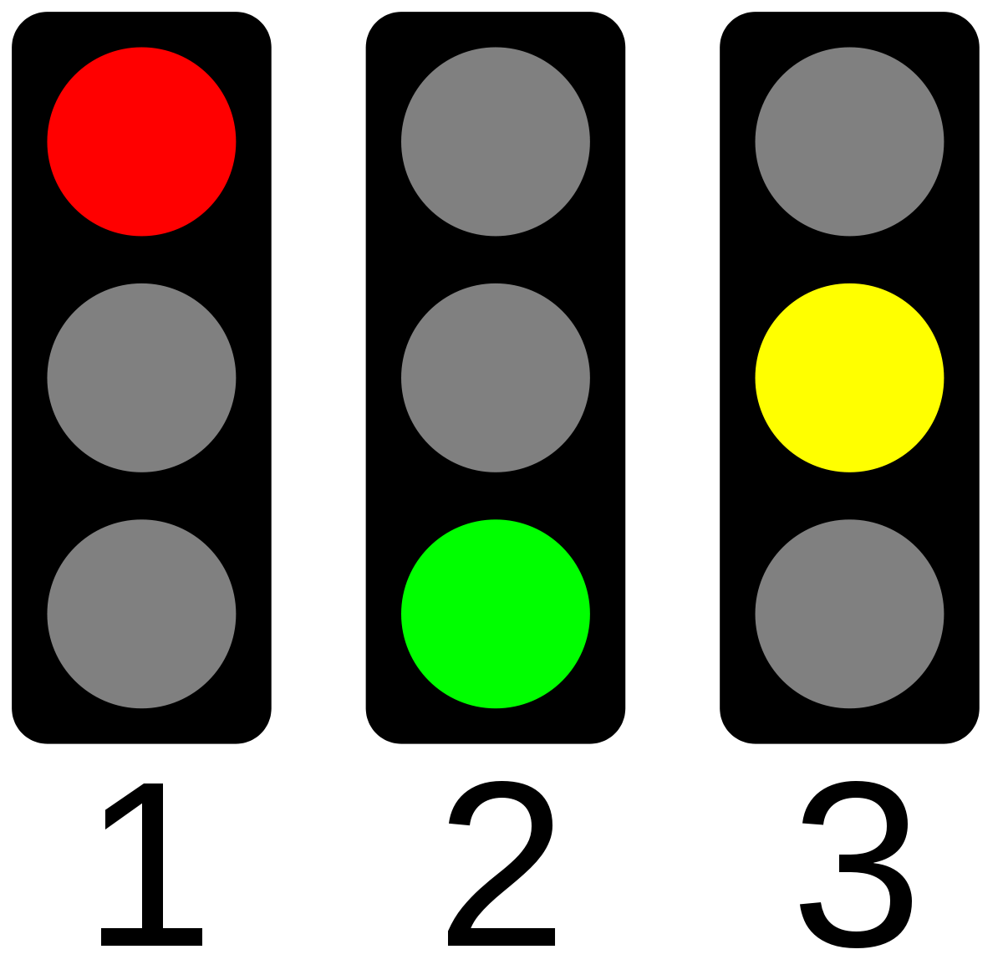
Welcome

Slide 2
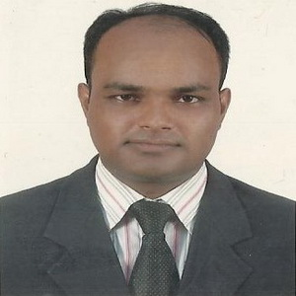
TEACHER IDENTITY
Md. Abdul Kader
Assistant Teacher
Borni Govt. primary School,
Companiganj, Sylhet.
Class : Four
Subject : English for today
Unit: 8
Lesson: 1-2 (Traffic lights)
Time: 40 minutes
LEASON IDENTITY

Slide 3
GREETING
Teacher
Good morning, students
Good morning, teacher
Student’s
How are you today ?
Teacher
Fine
Student’s

Slide 4
Let’s Enjoy a song……

Slide 5
Ok! Dear student’s Today’s lesson is ….
Traffic lights

Slide 6
Learning outcome
At the end of the lessons students will be able to-
Listening: 1.1.1 recognize sound differences in the context of
words
Speaking: 1.1.1 repeat after the teacher and say words, phrases.
Reading: 1.4.1 read word, phrase and sentence in the text.
Writing: 3.1.1 write words, phrases, and sentences using non
cursive capital and small letters.

Slide 7
See the Traffic light.
Think and ask some questions.
1.What is Traffic light?
2.How many colours are there in a Traffic light?
3.What is the meaning of red colours?
4.What is the meaning of yellow colours?
5.What is the meaning of green colours?

Slide 8
Look and say those answers
1.A visual signal for controlling traffic.
2.There are three colours in the traffic light.
3.Red colour mean stop and stop right away.
4.Yellow colour mean slow down and wait for the green.
5.Green colour mean go but look both ways

Slide 9
Now students we’ll recite the poem traffic lights

Slide 10
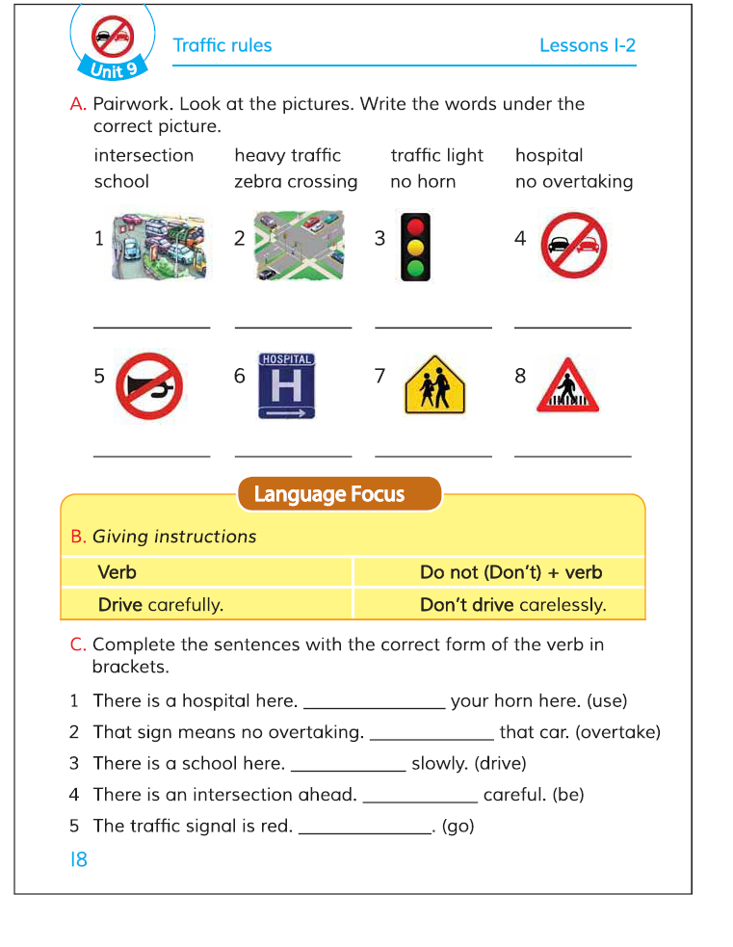
Open at page 18. Look at the pictures. What can you see in the pictures?

Slide 11
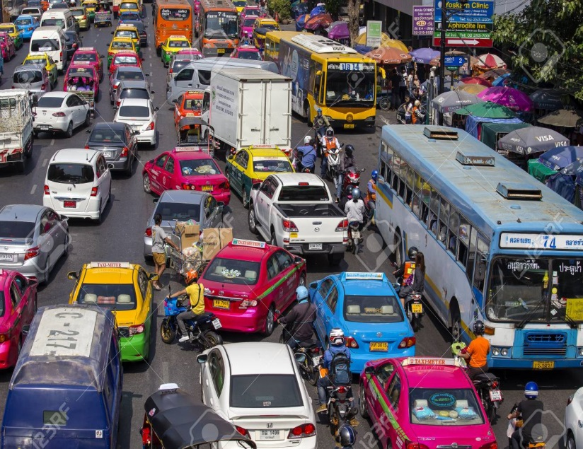
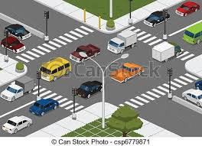
Students look and say after me.
Heavy traffic
Intersection

Slide 12
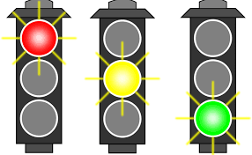
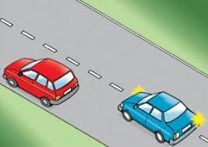
Students look and say after me.
Traffic light
No overtaking

Slide 13
Students look and say after me.
No horn
Hospital

Slide 14
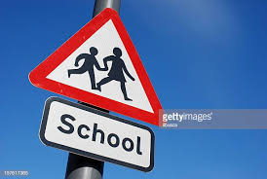
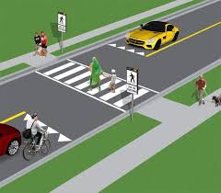
Students look and say after me.
School
Zebra crossing

Slide 15
So those pictures are traffic rules.

Slide 16
W.C.W.
We are going to play a game now.
Follow me. Listen and do.
“Stand up”
“Don’t sit down.”
“Stand up”
“Don’t sit down.”
Ok, Thanks to all.
Email: dhalder785@gmail.com

Slide 17
Pair work. We use “Do not” to make negative instructions.
Close the book.
Do not close the book.
Open the window.
Do not open the window.
Make a circle.
Do not make a circle.

Slide 18
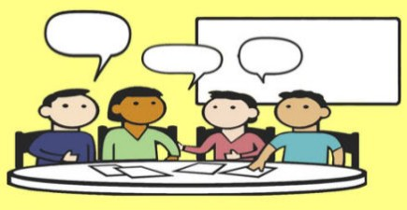
Do you know close, open, make are verbs. We have used “Do not” before verb to make negative sentences.
( Do not + verb)
Now use “Do not” and make negative sentences.
1. Close the box.
2. Cut your nails.
3. Show me your pen.

Slide 19
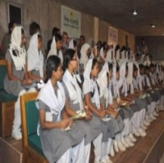
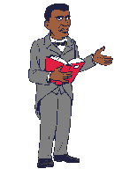
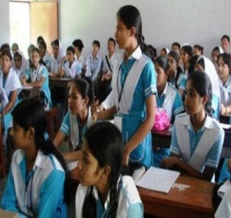
EVALUATION
?

Slide 20
Write negative instructions to use Do not + verb
Go out.
Run in the sun.
Drive carefully.
Make a square.
Open your bag.
Home Work

Slide 21
