Slide 1
12
6

Slide 2
Welcome

Slide 3
Introduction
Swandip Banerjee
Asst Teacher (English)
Pallimangal Secondary School
Sonadanga, Khulna.
Mobile: 01718503573
E-mail:swandipb1@gmail.com

Slide 5
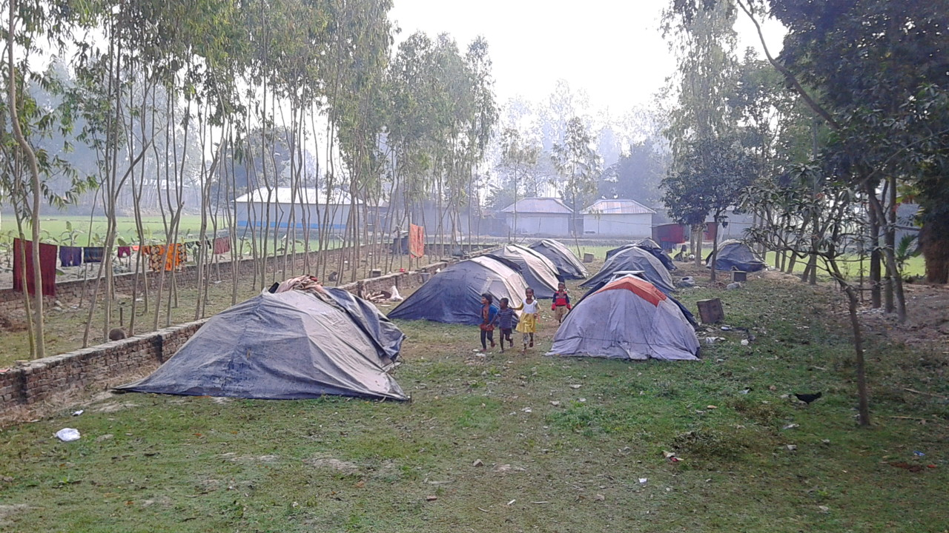
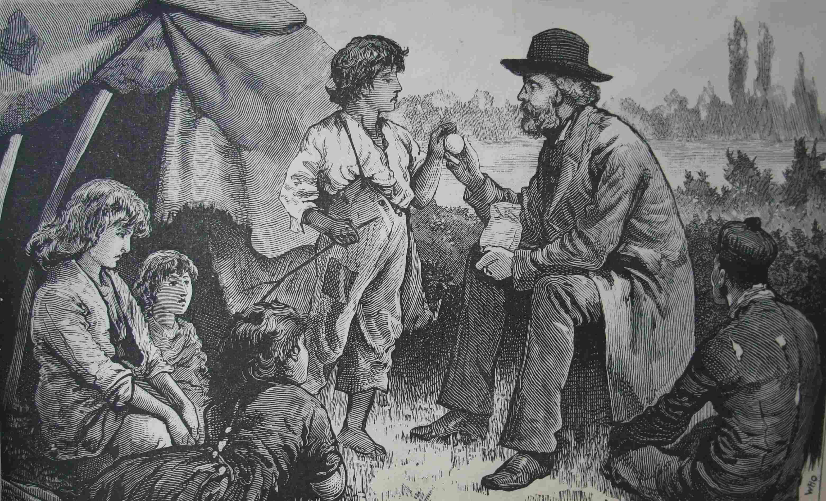
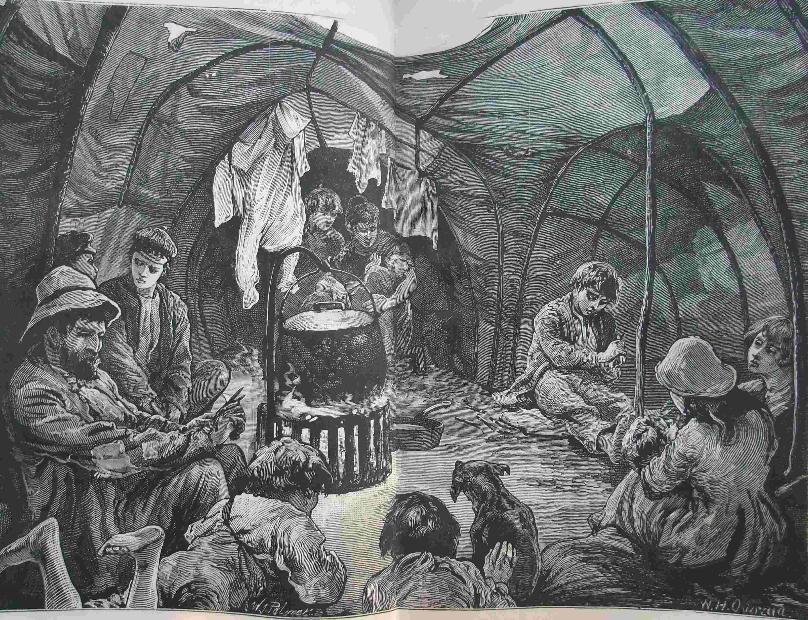
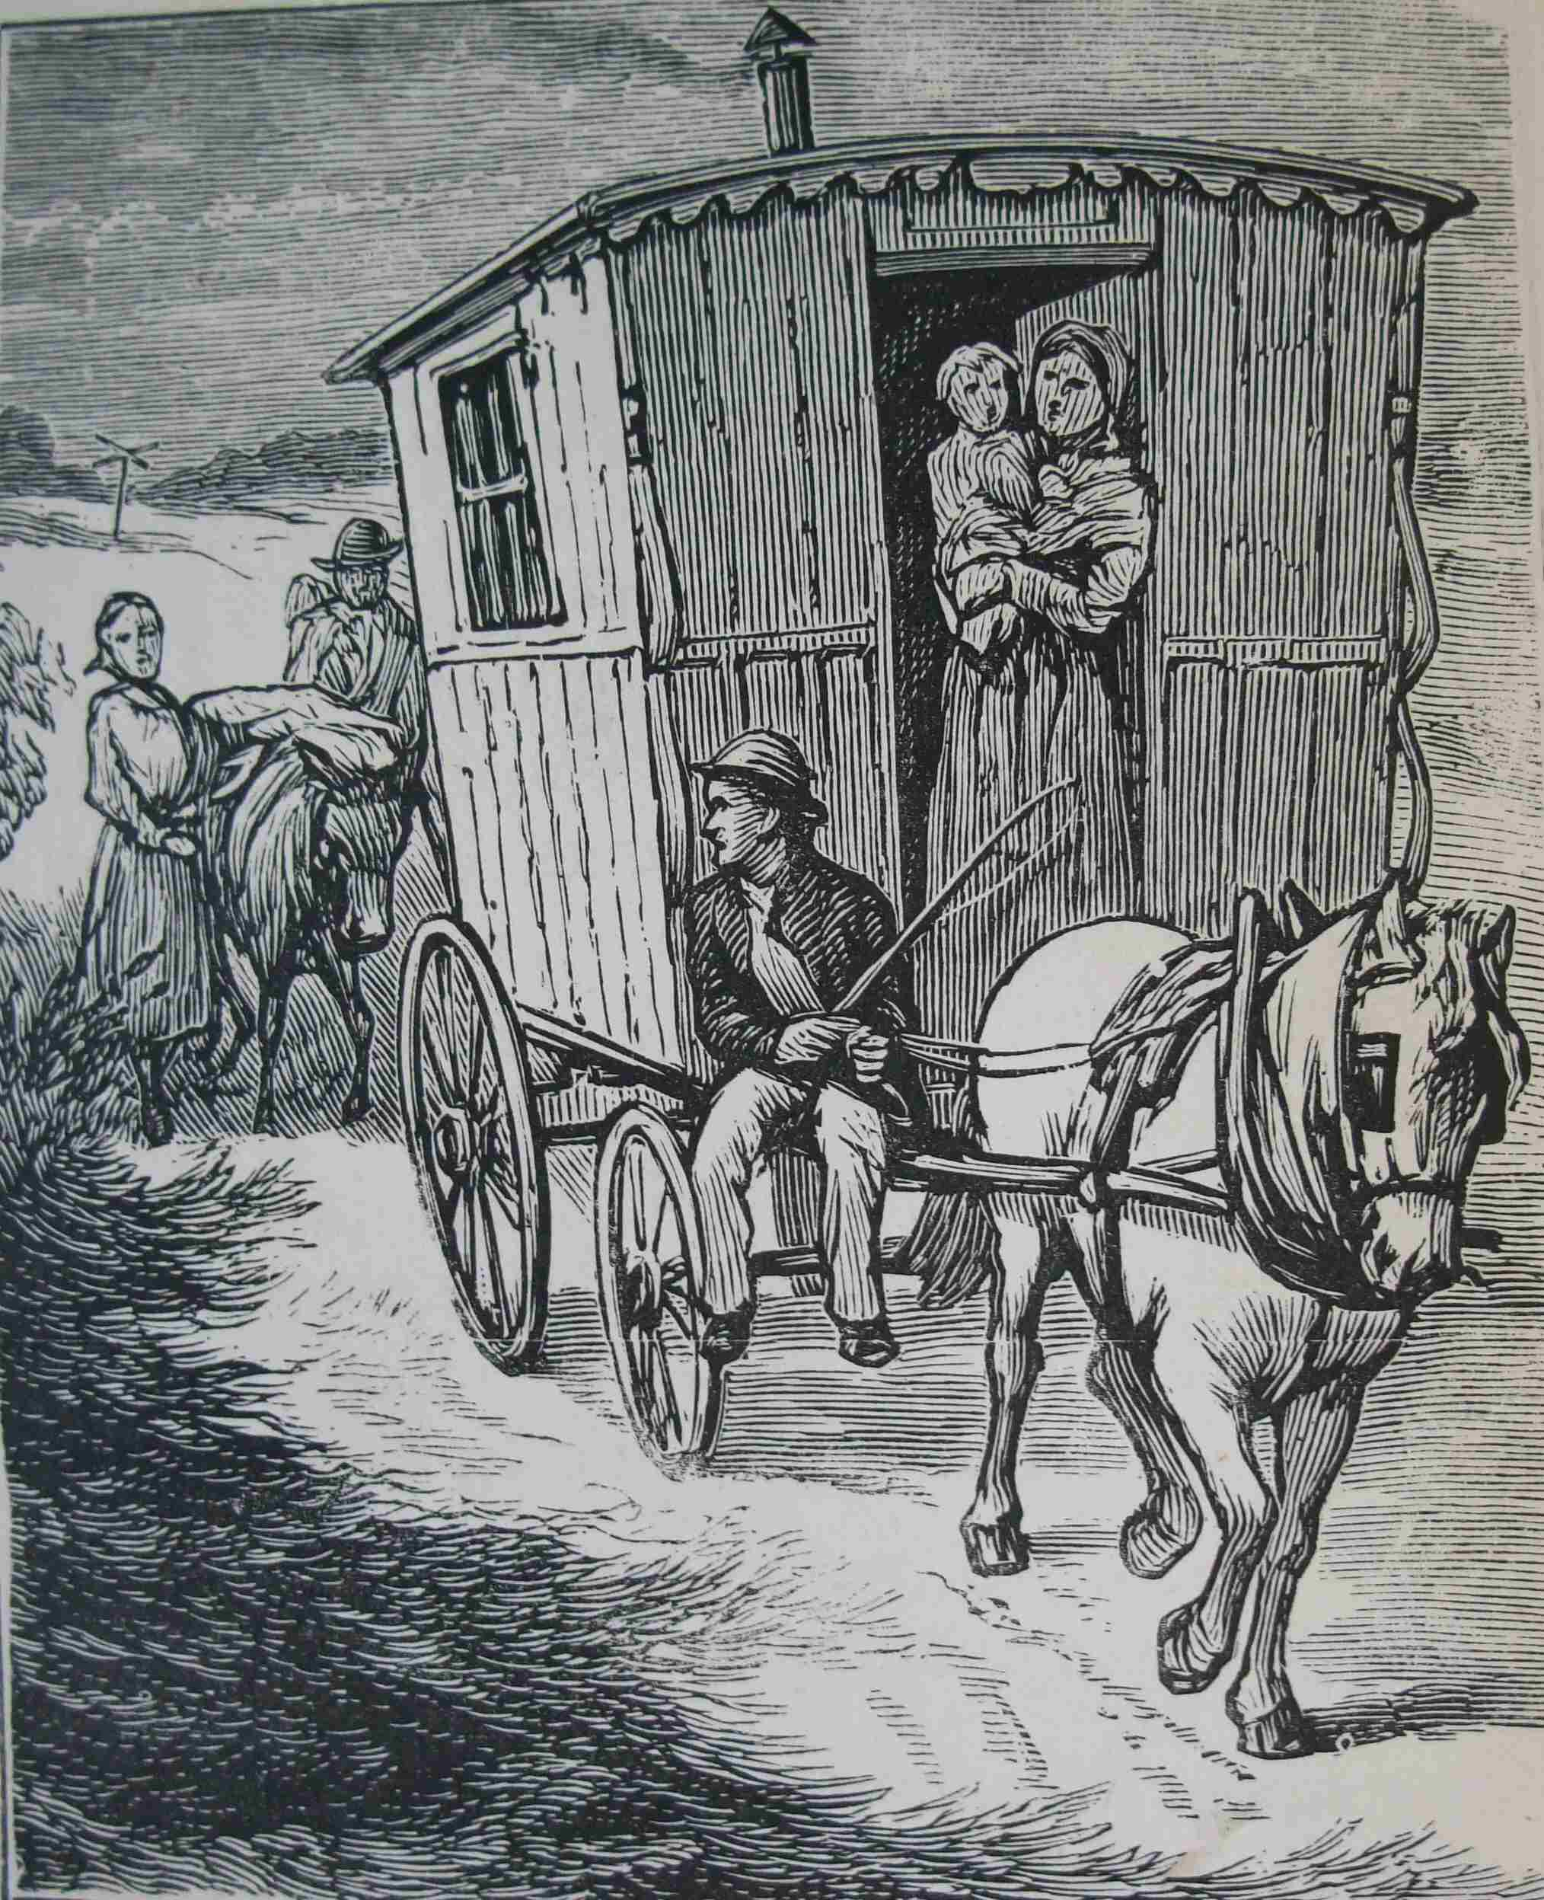

Slide 6
A: Read and answer the following questions.
1. Have you seen any gipsy? If yes, where?
2. Do gypsies live in our country?
3. In what ways are they different from the general people?

Slide 7
Our today’s topic is…
Time, You Old Gipsy Man
Unit: 14 Lesson: 4
A poem by Ralph Hodgson

Slide 8
Learning outcomes
After we have studied the lesson, we will be able to …….
recognize and use English sounds, stress and intonation.
understand and enjoy the poem.
interpret, evaluate and summarise literary texts.

Slide 9
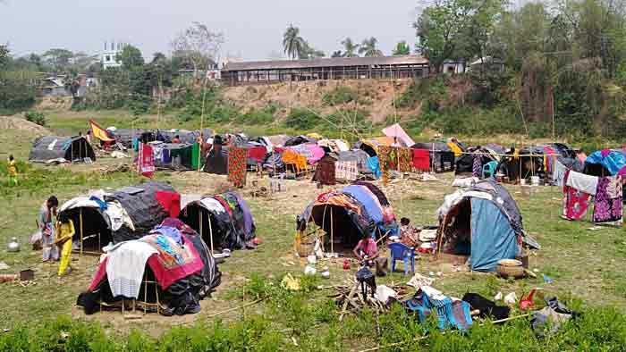
NEW WORDS
Gipsy
People of a race who have not a fixed living place and who travel from one place to another.
Synonym: Nomad

Slide 10
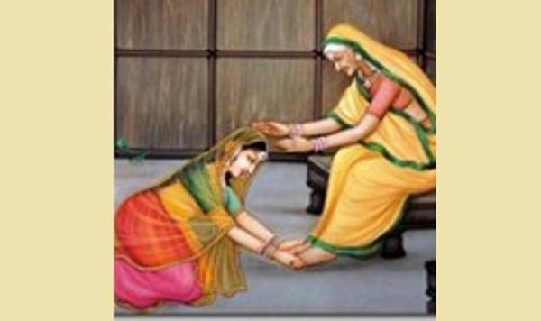
Bow
To move one’s head or top half of one’s body forwards and downwards as a sign of respect.
Synonym: Bend.

Slide 11
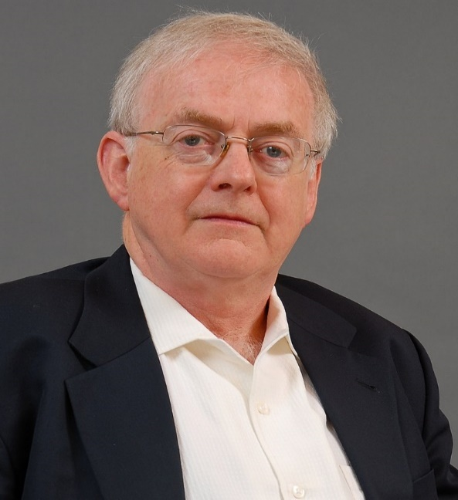
Time, You Old Gipsy Man
Ralph Hodgson
Time, you old gipsy man,
Will you not stay,
put up your caravan
Just for one day?
All things I'll give you,
Will you be my guest?
Bells for your jennet
Of silver the best,
Goldsmiths shall beat you
A great golden ring,
Peacocks shall bow to you,
Little boys sing,
Oh, and sweet girls will
Festoon you with may.
Time, you old gipsy,
Why hasten away?
Last week in Babylon,
Last night in Rome,
Morning, and in the crush
Under Paul's dome;
Under Paul's dial
You tighten your rein—
Only a moment
And off once again;
Off to some city
Now blind in the womb,
Off to another
Ere that's in the tomb.
Time, you old gipsy man,
Will you not stay?
Put up your caravan
Just for one day?
Recitation

Slide 12
Short explanation of the poem.
In this poem, ‘Time, You Old Gipsy Man’ the poet Ralph Hodgson tells about time. He says that time never stays. It always runs and runs. For this, he names the time “Old gipsy man”. To stop the time, he offers the time things such as belts for its jennet of the best silver, a big golden ring etc. He tells time that peacocks will bow, little boys will sing songs, sweet girls will festoon the time with may. He requests the time to put up its caravan just for one day, but the time never stays. It passes and passes. Nobody can stop its ever-busy frigate even for a second. We know how precious thing is time for us. If we don’t use it properly, it will run away and never come back. So, we need to use the time of our life properly.

Slide 13
Evaluation
Why does the poet call time an old gipsy man?
Make a list of things the poet will offer time if it stays just for a day.
What else can you offer time if it stays for a day?

Slide 14
HOME WORK
Write a summary of the poem ‘Time, You Old Gypsy Man’ in no more than 90 to 100 words.

Slide 15
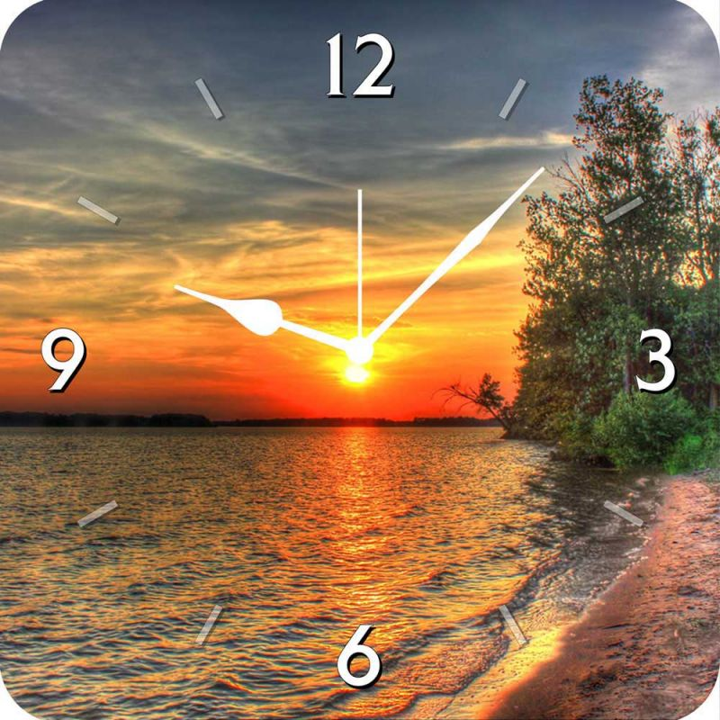
Make the best use of your time.
Thank you.

