Slide 1
White Rose Welcome My Dear Students

Slide 2
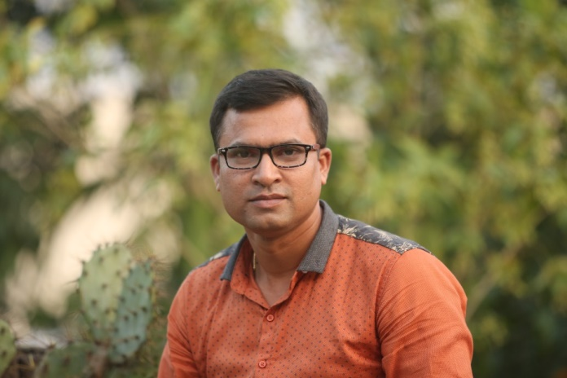
My Identity
Myself :
Professional Identity:
Dhruba Shangkar Ray
Lecturer, English
Digraj Degree College
Mongla, Bagerhat.
Mobile no.- 01711950378

Slide 3
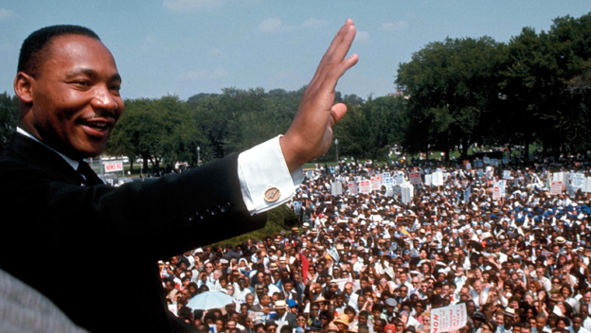
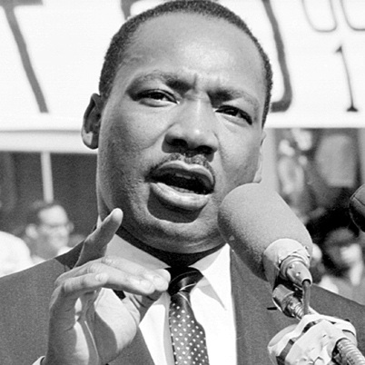
Watch and Think
Do you know him ?

Slide 4
Our Today’s Topic
I Have A Dream

Slide 5
Learning outcomes
At the end of the lesson
The students will be able to….
→know about one of the greatest speeches of all times.
→ expand their vision.
→ learn fellow feelings.
→know how to broaden the outlook.

Slide 6
I Have A Dream
(T)he Negro is steel not free…. the life of the Negro is still sadly crippled by the manacles of segregation and the chains of discrimination. … (T)he Negro lives on a lonely island of poverty in the midst of a vast ocean of material prosperity. …. (T)he Negro is still languishing in the corners of American society and finds himself an exile in his own land. So we have come here today to dramatize a shameful condition……

Slide 7
I Have A Dream
I say to you today, my friends, so even though we face the difficulties of today and tomorrow, I still have a dream. It is a dream deeply rooted in the American dream.
I have a dream that one day this nation will rise up and live out the true meaning of its creed: “ we hold these truths to be self- evident; that all men are created equal.”
I have a dream that one day on the red hills of Georgia, the sons of former slaves and the sons of former slave owners will be able to sit down together at the table of brotherhood.

Slide 8
Individual Work
Closed Questions :
Why did Martin Luther King Jr. have these dreams ?
What according to Martin Luther King Jr. , will be the ultimate benefit if his dreams come true ?
Open Question :
1. Which of the above dreams do you appreciate more ? And why ?

Slide 9
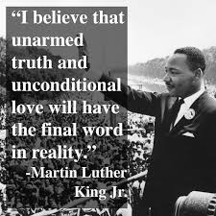
I Have A Dream

Slide 10
What have we learnt ?
From the study of
Martin Luther King Jr. –
→ We, Bangladeshies, can also expand our patriotic zeal.
→ We can make Bangladesh a prosperous country.
→ We can love our fellow-men and do our duties accordingly.
→ respecting such personalities we can also mould our characters.

Slide 11
A Group Work
Group Name :
Bangabandhu, N.Mandela, M.Gandhi, A.Lincon, F.Castro, V.Putin.
Group Work :
Prepare a list of your dreams for your country or the community you belong to and then present it in the class.

Slide 12
I Have A Dream
Evaluation :
Do you think that the dreams of Martin Luther King Jr. have been fulfilled ? Why ? Or, Why not ?

Slide 13
I Have A Dream
Do you have any question regarding this lesson?

Slide 14
Tomorrow’s Topic
Peace And Conflict
Unite 12 ; Lesson 01

Slide 15
Book References
The World’s Greatest Visionary Political Leaders of All Times.
Unending Autobiography Of Bangabandhu.

Slide 16
Home Work
Prepare a project work on “ How do you want to see your country in 2030 , and How can you contribute to this ? “

Slide 17
Thank You For Attending The Session And For your Nice Co-operation.

