Slide 1
Welcome everybody

Slide 2
Teacher’s Identity
Mst. Zakia Sultana
Head Teacher
Pouta Govt. Primary School
Adamdighi, Bogura

Slide 3
Lessons Identity
Class: One
Subject: English
Lesson Title: Numbers
Unit:12, Lesson : 1-3
Activity: Look, listen and say.

Slide 4
Learning outcomes
By the end of the lesson students able to-
2.2.1 follow simple commands and instructions
2.2.1 recognize and read cardinal numbers up to 10 in figures.

Slide 5
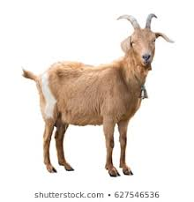
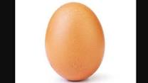
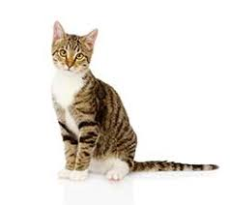
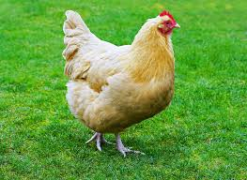
Look at the pictures.

Slide 6
Now open your book page at 24 .

Slide 7
Lesson Declaration
To days our lesson
Numbers

Slide 8
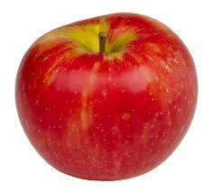
What is this?
It is an apple.

Slide 9
How many apple?
1

Slide 10
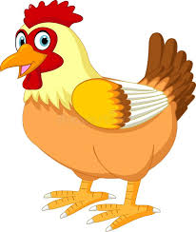
What is this?
It is a hen.

Slide 11
How many hens?
5

Slide 12
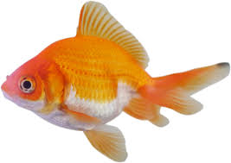
What is this?
It is a fish.

Slide 13
How many ants?
6

Slide 14
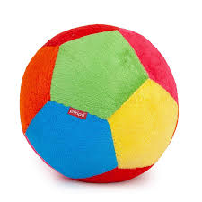
What is this?
It is a ball.

Slide 15
How many balls?
2

Slide 16
What is this?
It is a kite..

Slide 17
How many kites?
4

Slide 18
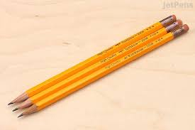
What is this?
It is a pencil

Slide 19
How many pencils?
3

Slide 20
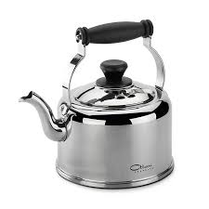
What is this?
It is a kettle.

Slide 21
How many kettles?
7

Slide 22
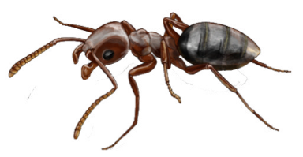
What is this?
It is an ant.

Slide 23
How many ants?
10

Slide 24
Pair work
How many ants and hens say in pair.

Slide 25
Group work
To write the numbers.(1—10).

