Slide 1

Welcome everybody

Slide 2
Teacher’s Identity
Mst. Zakia Sultana
Head Teacher
Pouta Govt. Primary School
Adamdighi, Bogura

Slide 3
LESSON’s Identity
Class: One
Subject: English
Lesson Title: Numbers
Unit: 26, Lesson : 1-3
Activity: Look, listen and say.

Slide 4
Learning Outcome
2.1.1 recognize and read cardinal numbers up to 10.
2.1.1 write cardinal numbers up to 10 in
figures.

Slide 5
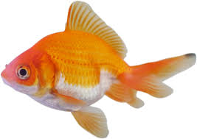
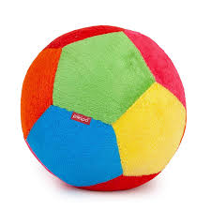

How many item the pictures and count the pictures.

Slide 6

Now open your book page at 52 .

Slide 7

Lesson Declaration
To days our lesson
Counting
1 to 10.

Slide 8

How many apple?
1

Slide 9
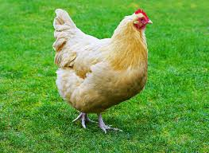
How many hens?
2

Slide 10
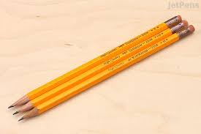
How many pens?
3

Slide 11
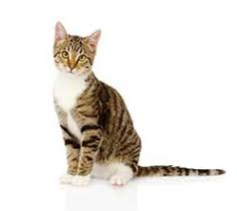
How many cats
4

Slide 12

How many kites?
5

Slide 13
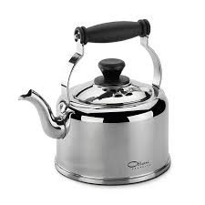
How many kettles?
6

Slide 14

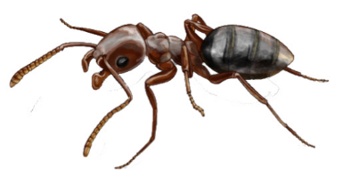
How many ants?
7

Slide 15


How many eggs?
8

Slide 16
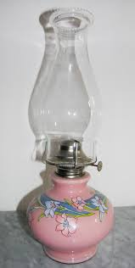
How many lamp?

Slide 17

How many flowers?
10

Slide 18
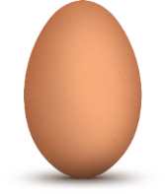

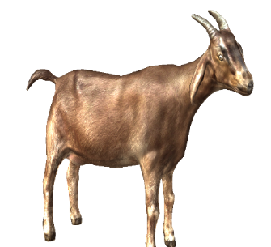


Look , Count and Say.
4
1
5
goat
eggs
balls
2
3
6
bags
dogs
cats

Slide 19
Pair work
How many ants and hens say in pair.

Slide 20


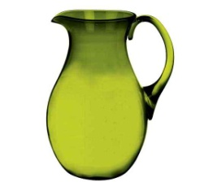





Group work
Maching. (Pictures with numbers)
2
3
4
5
6

Slide 21


