Slide 1
Welcome
English Classes- SD

Slide 2
Shubhashish Das Lecturer in English
English Classes- SD
Govt. Iqbal Memorial Degree College Dagonbhuiyan, Feni

Slide 3
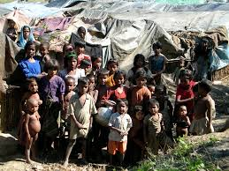
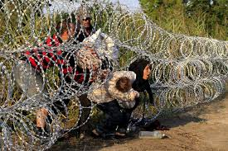
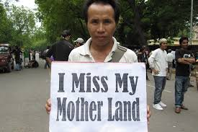
English Classes- SD
Picture: 2
Picture: 1
Picture: 4
Picture: 3

Slide 4
Today’s topic is
English Classes- SD
DIASPORA

Slide 5
English Classes- SD
Learning outcome
The learners will be able to describe >Definition of Diasporas
>The diasporas and their reasons.
>Ways of answering questions.
> Summary writing.

Slide 6
Reading task
English Classes- SD
Read the text and answer the following questions:
What is Diaspora?
Name some renowned diasporas of the world.
What was the reason of Jewish Diaspora?
Why does Palestinian Diaspora draw the attention of the world leaders?
Name one diaspora related to our country.

Slide 7
English Classes- SD
Read the text to answer the questions:
The term ‘Diaspora’ is used to refer to people who have left their homelands and settled in other parts of the world, either because they were forced to do so or because they wanted to leave on their own. The word is increasingly used for such people as a collective group and/or a community. The world has seen many diasporas but scholars have been studying the phenomenon with great interest only in recent decades.
Among the great diasporas of history is that of the Jewish people, who were forced to leave their lands in ancient times. The movement of Aryans from Central Europe to the Indian sub-continent thousands of years ago is also a noteworthy Diaspora, although the causes of this diaspora are unclear. In twentieth century history, the Palestinian diaspora has attracted a lot of attention and been a cause of concern for world leaders because of the plight of Palestinians. There have been massive diasporas in Africa, too, over the centuries, either because of war or because of the ravages of nature. But the chief reason why the phenomenon of diaspora is attracting so much attention now is globalization.

Slide 8
English Classes- SD
DIASPORA means a group of people who have left their own country to live in another country.
some renowned diasporas of the world are Jewish diaspora, Arian diaspora, Palestinian diaspora, diaspora in African countries.
In ancient time the Jewish were forced to leave their own land.
Palestinian Diaspora draws the attention of the world leaders because of the pitiable condition of the Palestinian children and women.
The name of one diaspora related to our country is Rohingya diaspora.

Slide 9
Group work Match the following information
English Classes- SD
A | B
i) Jewish diaspora | a) Unknown reason
ii) Aryan diaspora | b) Forced to leave.
iii) Palestinian diaspora | c) War and natural calamities
iv) Diaspora in African countries | d) war

Slide 10
English Classes- SD
Answers
A | B
i) Jewish diaspora | a) Forced to leave.
ii) Aryan diaspora | b)Unknown reason
iii) Palestinian diaspora | c) war
iv) Diaspora in African countries | d) War and natural calamities

Slide 11
Summary
English Classes- SD
Though diaspora is a very known issue now a days, it has been seen in the history from the ancient time. People have to leave their mother land for many reasons. Sometimes they are forced to leave and in some cases they choose to leave their home land and go the developed country for better living. What might be the reason, they never forget their mother land and own culture. They practise it in the country where they are settled.
In the recent times, globalization is considered the main reason of diaspora through out the world.

Slide 12
Evalution
Describe diaspora in short.
What is the main reason of diaspora in the current world?
What might be the reasons of diaspora?
Why do the African people tend to move away from their mother lands?
What happened in Palestine?

Slide 13
English Classes- SD
Home work
1. Write a paragraph on diaspora.

Slide 14
English Classes- SD
Thank you
Good bye.

