Slide 1
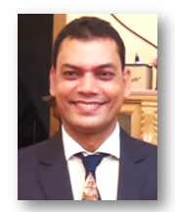
Biplab Das
Assistant Teacher (M.S.S; M.Ed.)
Raozan R.R.A.C Govt. High School.
E-mail: biplabd80@yahoo.com
Class Six
English 1st Paper.
Time:50 Minutes, Date:20 June,2020

Slide 2
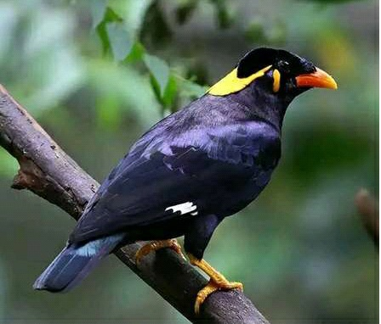
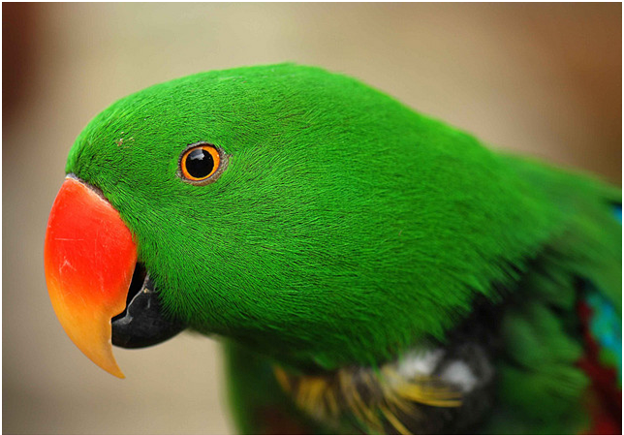
What do you see in the picture?
Do you imagine todays lesson?

Slide 3
Today`s Lesson is…..
Birds of Bangladesh.
(Lesson: 12,Page: 40)

Slide 4
Learning Outcomes:
after completing the lesson students will be able to……
identity a Bangladeshi bird called ‘Blackheaded Oriole (Benebau)
Describe about the ‘Blackheaded Oriole (Benebau)
ask and answer questions.
write a short paragraph.

Slide 5
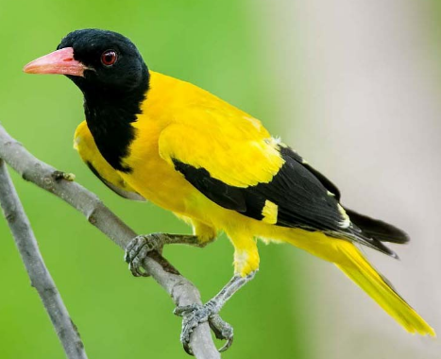
What is the name
of bird?
Blackheaded Oriole (Benebau)

Slide 6
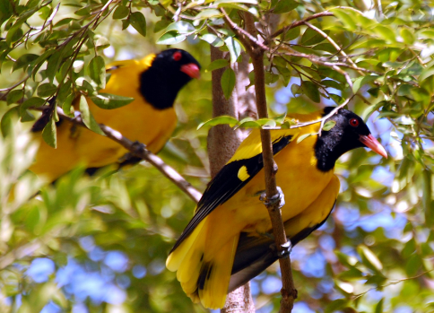
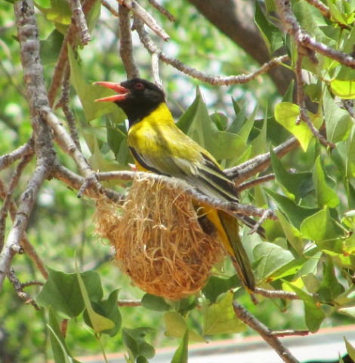
Today we will know about
Blackheaded Oriole (Benebau)

Slide 7
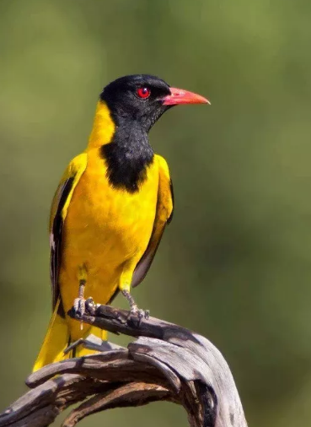
What colour do you see in the bird?
☞ Body is deep yellow.
☞ Head, throat and some parts of wings are black.
☞ Beak is red.

Slide 8
Single Work
☞ How many colour have seen in “Benebau” and
What are they?

Slide 9
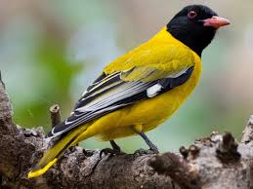
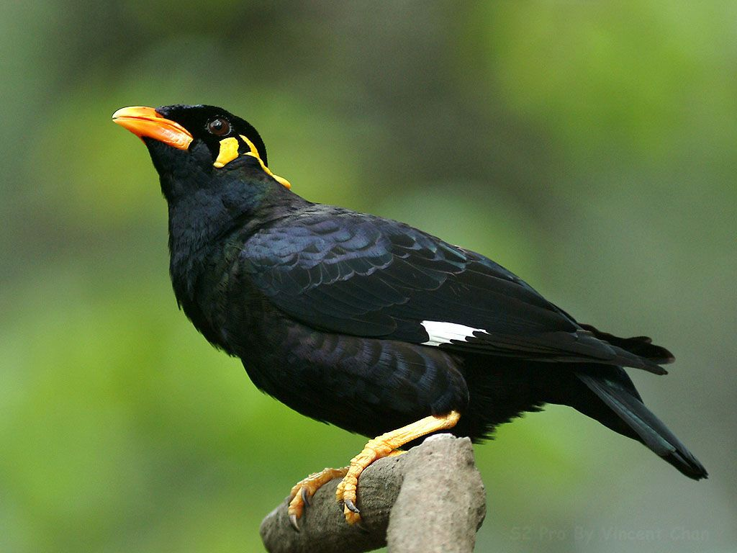
Benebau
Mayna
Benebau looks like a Mayna

Slide 10
More information about Blackheaded Oriole (Benebau)
Do you know the length of “Benebau”?
The length is about 25cm.

Slide 11
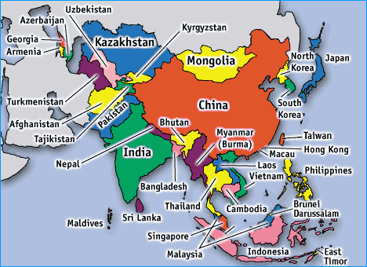
Do you know where is ‘Benebau` is seen?
Bangladesh
India
Srilanka
Myanmar

Slide 12
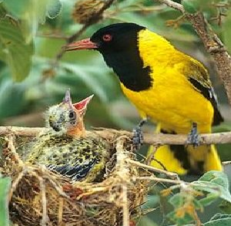
Benebau builds round shaped beautiful nests

Slide 13
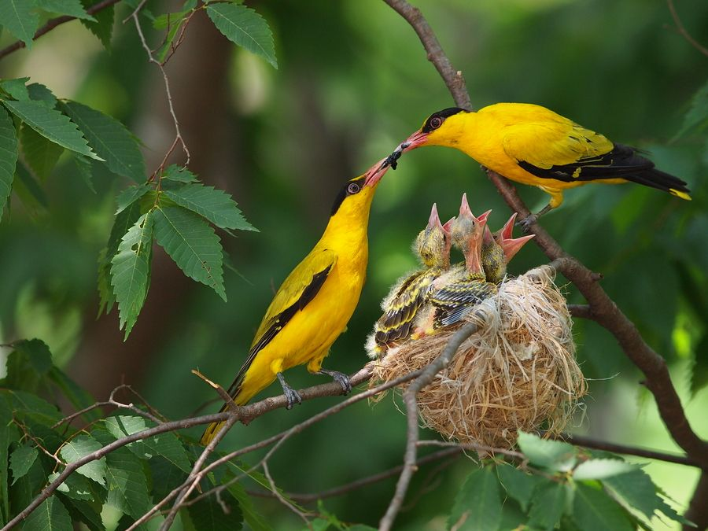
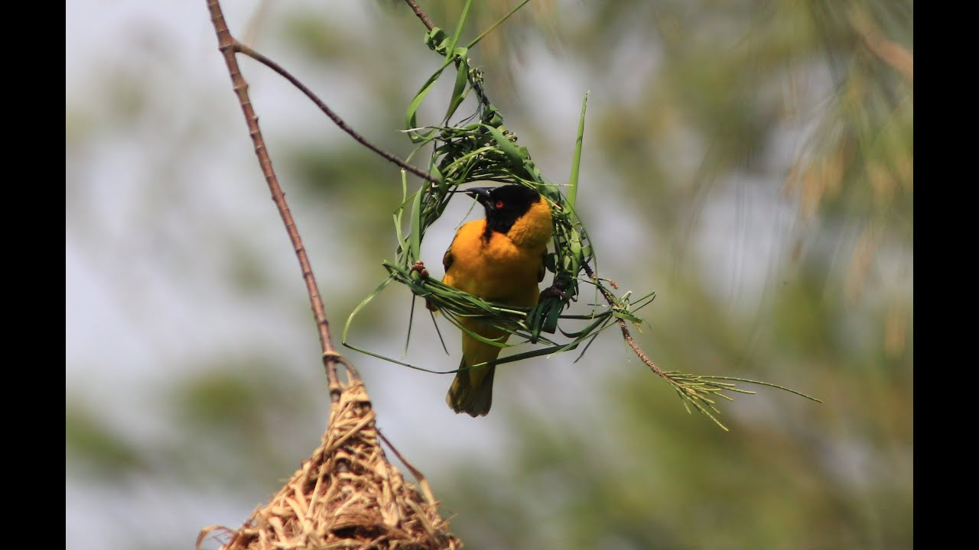
Both the male and the female bird make their nest.

Slide 14
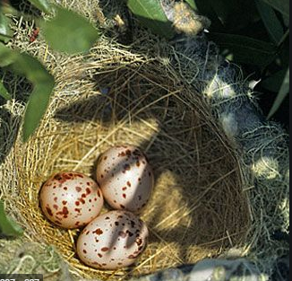
The Blackheaded Oriole lays two to three eggs at a time

Slide 15
Let`s Watch a more video clip.

Slide 16
Silent Reading
Read the text Silently.
(after silent reading you will be given group works)
Teacher will monitor and help the students.

Slide 17
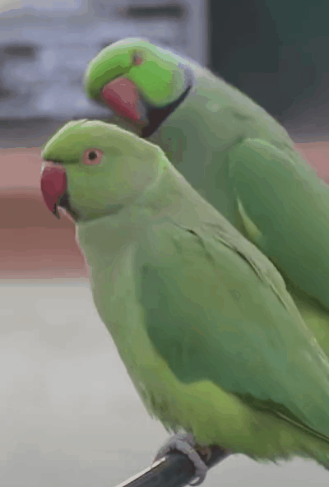
Work in Pairs
Make 5 sentences about following bird.

Slide 18
Group Work
Answer the following questions in groups
1. Where are found Blackheaded Oriole?
Rose
Click on slide in presentation mode.
Lily
Click on slide in presentation mode.
2. How do Blackheaded Orioles make their nest?
Tulip
3. How many eggs lay Blackheaded Oriole?
Click on slide in presentation mode.
Dalia
Click on slide in presentation mode.
4. How looks Blackheaded Oriole?

Slide 19
Work
Make a list some birds of name
what you see and know.

Slide 20
Thanks

