Slide 1
To all

Slide 2
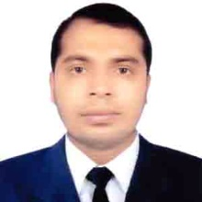
Teacher’s Identity
Misbahul haque
Assistant Teacher
Lontirmati government primary school
Kanaighat,Sylhet.
Mobile No:01715453647
Email:mhhaque520@gmail.com

Slide 3
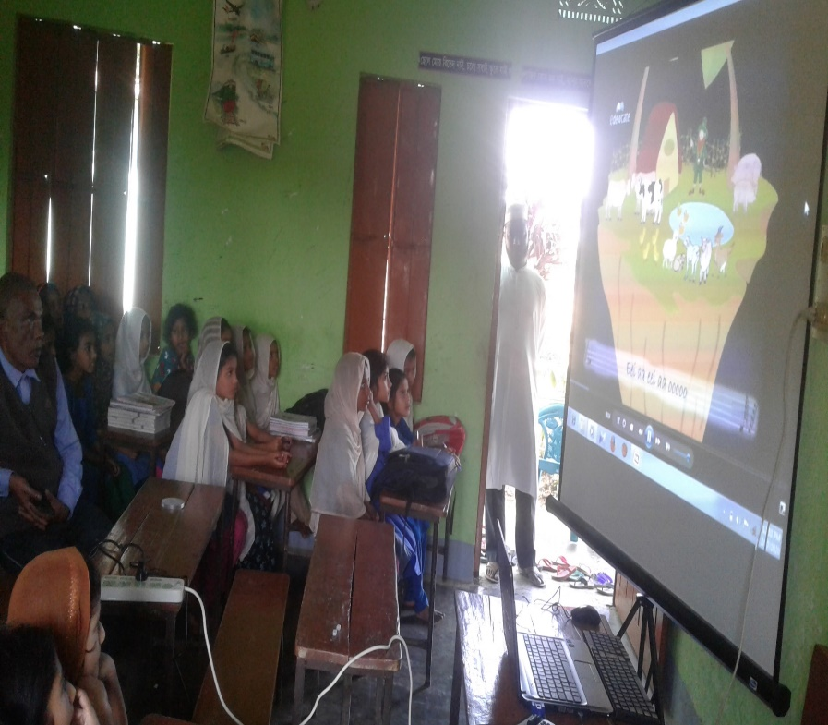
Let’s watch a video

Slide 4
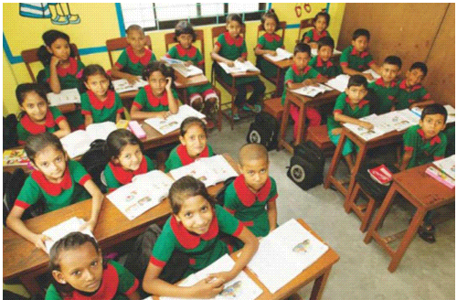
Introduce of the class
Class : One
Section : A
Total students:50
Present students:45
Absent students:05
Date:16/06/2020

Slide 5
Lesson’s introduction
Subject : English
Unit :04
Lesson :4-6
Lesson’s name : Alphabet
Activity :A
Page : 09
Time : 45 minutes

Slide 6
Learning outcomes
By the end of the lesson students will be able to –
Listening: 1.1.1 become familiar with English sounds by listening to common English words.
Speaking:1.1.1 repeat after the teacher simple words and phrases with proper sounds and stress.
1.1.2 say simple words and phrases.
Reading:1.2.1 recognize and read the alphabet both small and capital(non-cursive).
Writing:1.1.1 to practice letter shapes/simple writing patterns,etc.
1.2.1 write non-cursive capital and small letters.

Slide 7
Let’s play a game
I will say a letter.If the letter match with your first letter of name ,you will raise your hand by saying Bingo.
1.Whose first letter of name is ……C

Slide 8
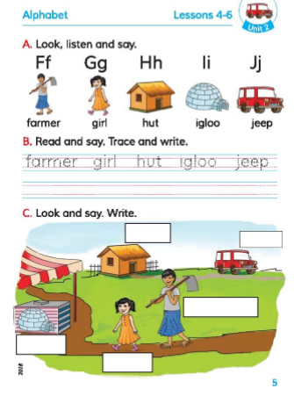
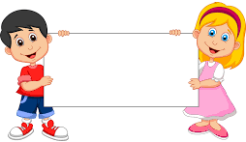
Lesson declaration
Alphabet

Slide 9
What is this?
It is a
Cap

Slide 10
What is this?
It’s a
Cup

Slide 11
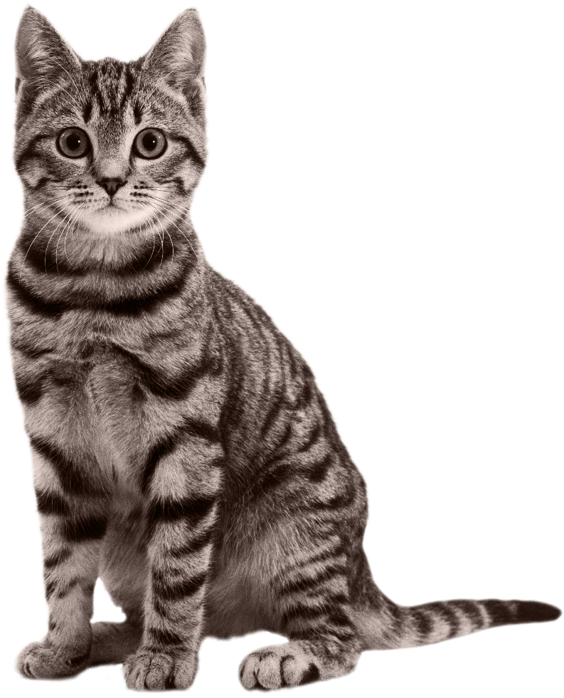
What is this?
It is a
Cat

Slide 12
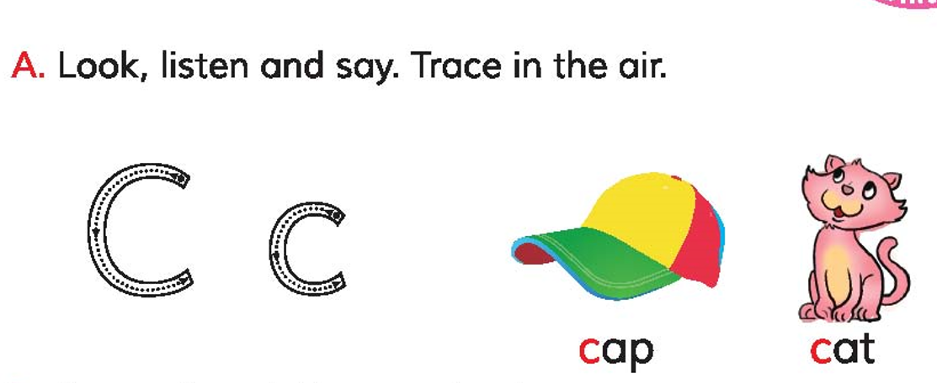
Open at page 9 of your book and look at the activity A
Listen carefully and repeat after it.

Slide 13
What’s the first letter?
What’s the sound of this letters?
Cap
C
c
সি
Capital Letter
Small Letter

Slide 14
What’s the first letter?
What’s the sound of this letters?
Cat
C
c
সি
Capital Letter
Small Letter

Slide 15
Look how to write capital letter ‘C’
Way: half circle.

Slide 16
Look how to write small letter ‘c’
Way: Half circle.

Slide 17
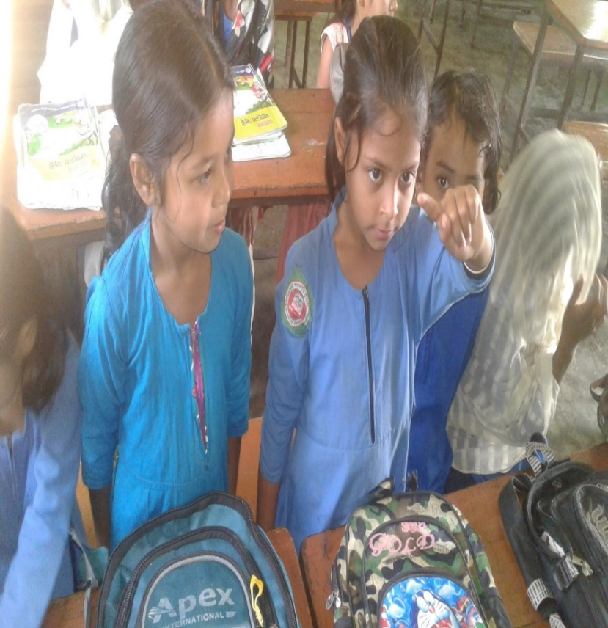
Trace in the air
Everyone try to write the following numbers by moving your fingers in the air: C,c

Slide 18
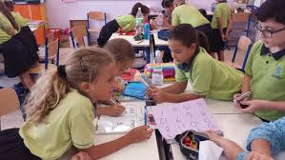
Group work
All the students will be divided in three Groups:
Group-1.Sun
Group-2.Moon
Group-3.Star
Every group members will say loudly: C for Cap
C for Cat

Slide 19
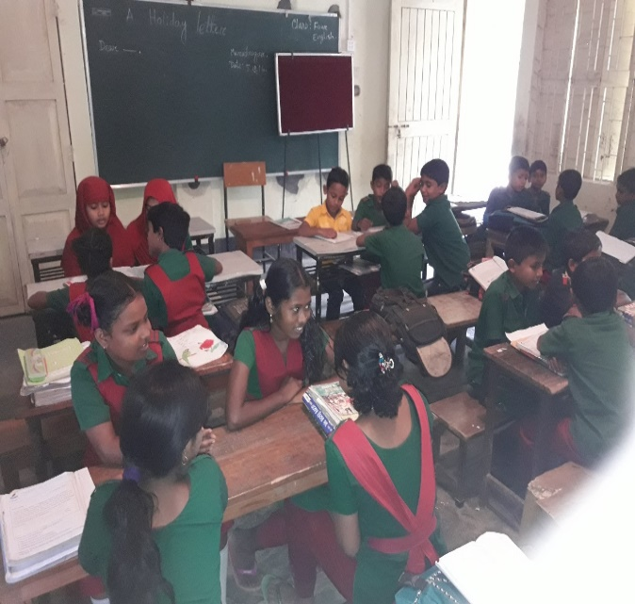
Pair work
Students will sit in pair.Every pair will re-arrange the following letters to make a meaningful word.
1. acp
Cap
2. act
Cat

Slide 20
Evaluation
Fill in the blank:
….ap
C
2) ….at
C

Slide 21
One day one word
Cat- বিড়াল

Slide 22
That’s all for today.See you again tomorrow.

