Slide 1
Welcome to the Class
Media of communication

Slide 2
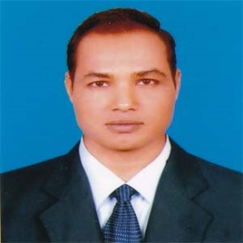
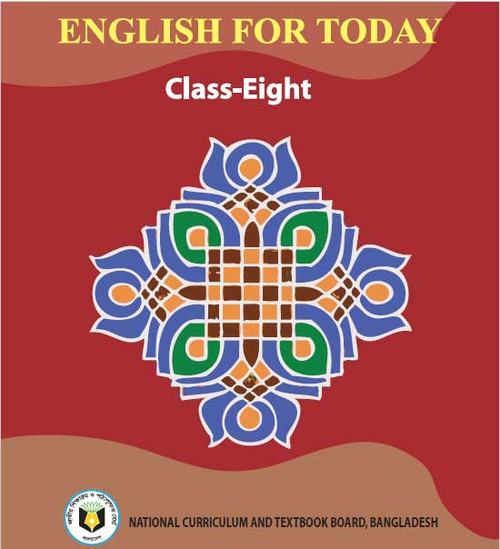
Introduction
Md. Mizanur Rahman
B.A.(Hons.), M.A. in English, B.Ed.
Assistant Teacher
Police Lines School and College, Pabna.
E-mail: mizanplsc@gmail.com
Cell Phone :01737979719
Class: VIII
Subject: English 1st Paper
Unit: Nine ( Things that have changed our life)
Lesson: Six
Lesson Title: Paper has advanced our life.
Class Duration: 40 minutes
Date: 21/06/2020

Slide 3
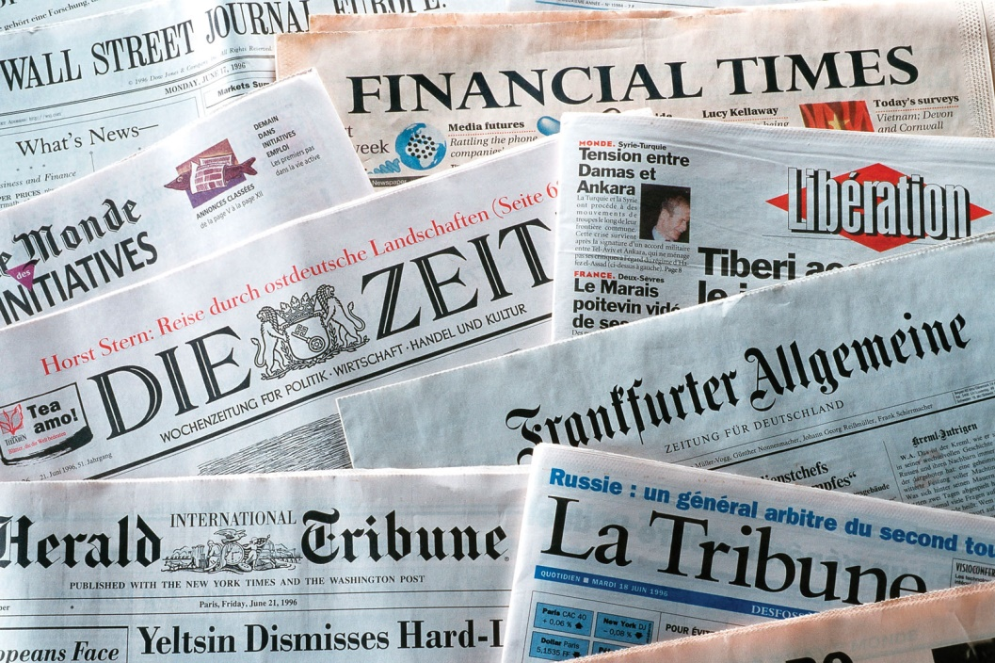
Look at the picture
What can you see in the picture?
Why do we read them?

Slide 4
Today’s Lesson
Paper has advanced our life

Slide 5
Learning Outcomes
At the end of the lesson, the students will be able to:
read and understand text .
write the answer of questions.
complete the sentences.
make ruti or paratah and make a presentation in the class.

Slide 6
Key words presentation
Word : Paper
Noun
Meaning : Thin, flat material used for writing, drawing, etc.
Example : Most of our records in the modern age are on paper.

Slide 7
Word : Communication
Noun
Meaning : the act of communication with people
Example : Communication of ideas is at the centre of civilization.

Slide 8
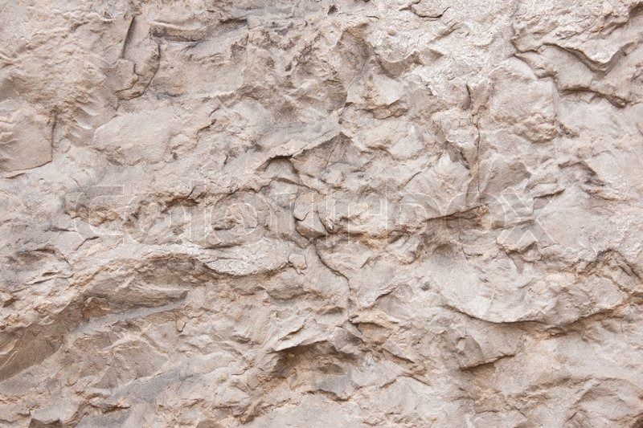
Word : surface of stone
phrase
Meaning : outside of stone
Example : In past , people used the surface of stone for writing.

Slide 9
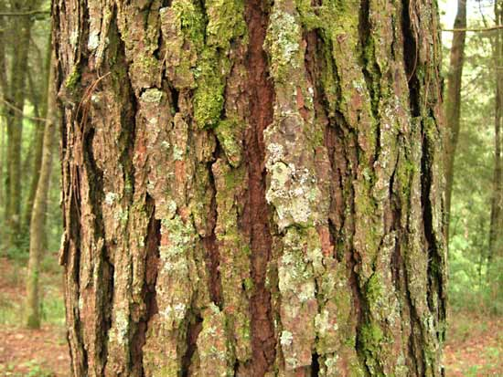
Word : Bark
Noun
Meaning : the hard outer covering of a tree.
Example :Bark was also used for writing in the past .

Slide 10
A. Read the lesson silently.
Communication of ideas is at the centre of civilization. It needs written records. Most of our records in the past are on paper. Though writing was invented very early, paper is a more modern invention.
For long in history, people exchanged ideas through speaking and listening. Then there came the art of writing. But to record thoughts in writing was difficult. Writing materials were not available. People used the surface of stone, metal, wood, bark, leaves, etc. for writing. Those things were not easy to carry. Then for ages, people looked for easy writing materials. Finally, Paper was invented in China in 105 AD.

Slide 11
Before the paper age, knowledge was very restricted. Can you think of that time? There were very few books in the world. Maybe, they were written on stone or on heavy wood plunks or on metal sheets. Suppose, one page was a heavy stone block. So think of a hundred –page book! In our age, you can even carry the entire world of knowledge in digital form in your laptop bag. You can even carry a huge volume of paper encyclopedia. But who could produce and carry tons of heavy stone books and documents in those paperless days? In fact , paper has made publication and the spread of knowledge and information easy. So you can see how paper has changed our life.

Slide 12
Individual Work
B. Answer the following questions
How did people exchange ideas before writing was invented?
Why did people look for easy writing materials?
3. Why was knowledge very restricted in the pre-paper age?
4. Do you think paper has changed our life? Why explain why your answer is ‘yes’ or ‘no’.
5. Where was paper invented and when?

Slide 13
Pair Work
C. Discuss with your partner and make a list of things other than paper on which we can write with pens, pencils, markers, brushes, paint/ pastels etc.

Slide 14
Group Work
D. Listen to the teacher carefully and complete the following sentences.
The person who invented paper is a man.
He took the bark of a mulberry tree and fibers.
This knowledge of was first used in China.
The word ‘paper’ is not
The word ‘paper’ was derived from a kind of Egyptian plant called
Chinese
bamboo
papermaking
Chinese
‘Papyruses’

Slide 15
Evaluation
E. Look at the following boxes first. Listen to the teacher again. Then write in the boxes the series of works Ts’ai Lun’ did in making paper. First one and the last one are done for you.
1.He took the bark of mulberry tree and bamboo fibre.
2. He mixed them
3. He pounded
4. He poured the mixture
5. He let the water
6. He let the thing dry
with water
them with a wooden tool
onto a flat piece of course cloth.
of the mixture drain through.

Slide 16
Home Work
F. Project Work:
On a weekend, observe how ruti or paratah is made in the kitchen. Carefully , take notes of each step taken to make it. Then back in class, share your notes with your partner / group. Finally , write how ruti or paratah is made and make a presentation in the class.

Slide 17
Thanks to all
Paper

