Slide 1
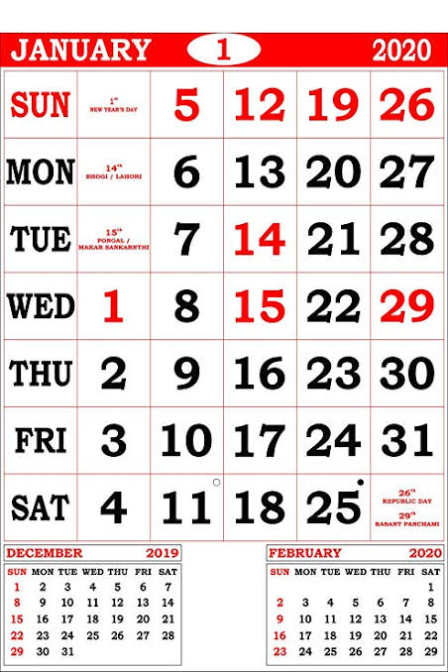
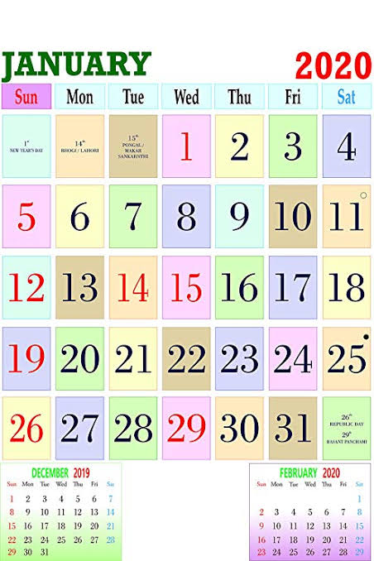
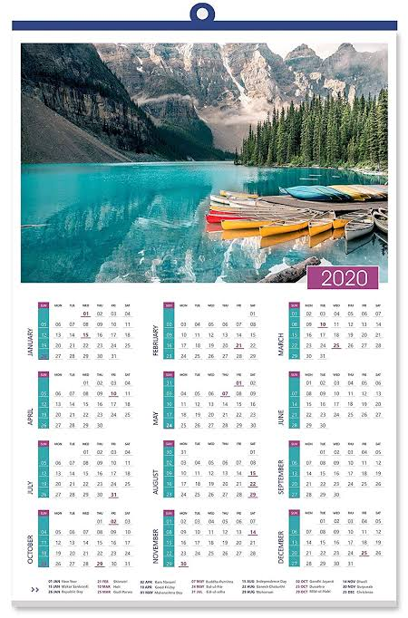

Slide 2
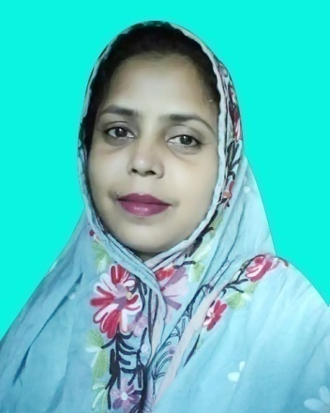
Presented by
Mira Rokeya Khatun
(Assistant teacher)
Rarishal govt.primary school.
Lakhai, Habigonj.
Class: Five
Subject: English
Unit: 5 ( Days in a calendar )
Lesson: 1- 2
Time: 45 minute

Slide 3
Learning outcomes
By end of the lesson students will be able to-
1. Say words, phrases and sentences with proper sound and stress.
2.Read words, phrases and sentences in the text with proper
pronunciation , stress and intonation.
3.Read silently with understanding personal letters and other
texts materials.

Slide 4
Let’s watch a video.
Do you understand what may be our today’s lesson?

Slide 5
Our today’s lesson
Days in a calendar.

Slide 6
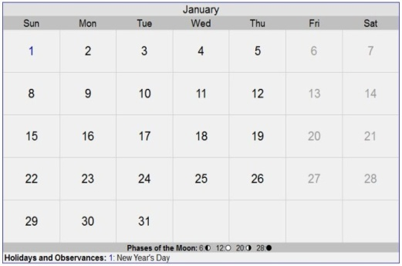
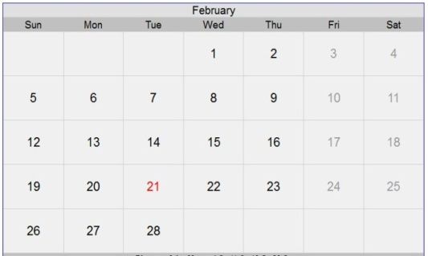
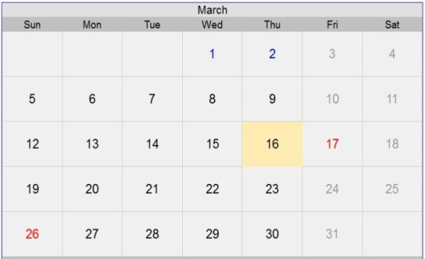
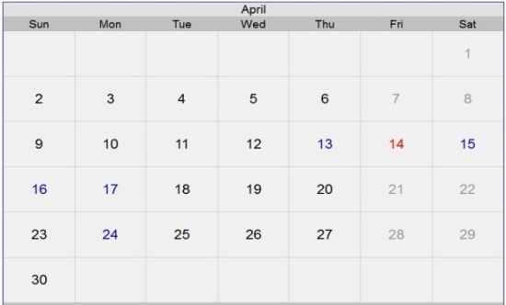
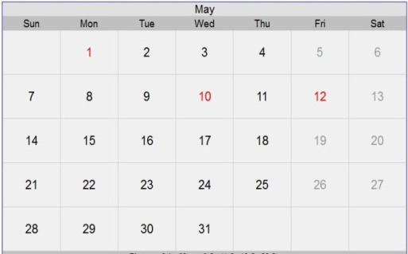
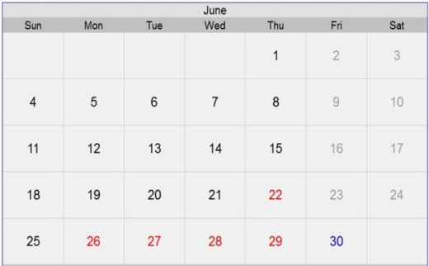
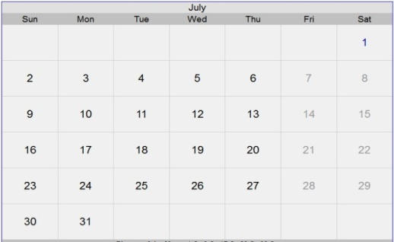
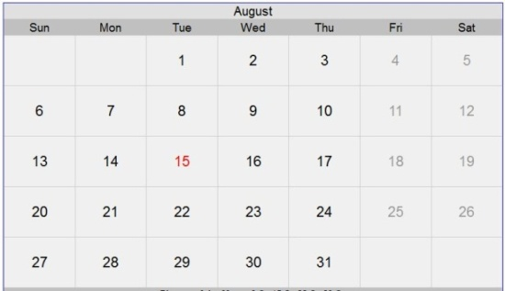
Teacher’s activity
Calendar 2020
January
February
March
April
May
June
July
August
september
October
November
December

Slide 7
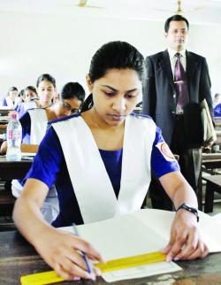
Individual work
1. What is the first month of the year.
2. What is the last month of the year.

Slide 8
Teacher’s activity
There are 60 second
in a minute.
There are 60 minute
in an hour.
Mofakkarul Alam Assistant Teacher Goraduba G.P.S Kendua, Netrokona

Slide 9
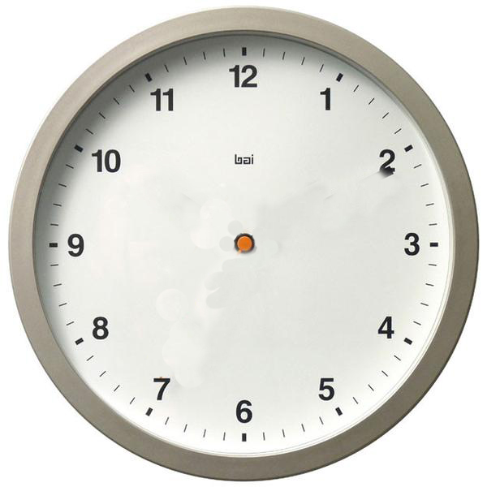
Teacher’s activity
There are 24 hour in a day.

Slide 10
Sunday
Monday
Saturday
Week
Tuesday
Wednesday
Friday
Thursday
There are 7 days in a week.

Slide 11
January
February
March
April
May
June
July
August
september
October
November
December
There are 12 month in a year.

Slide 12
Pair work
1. How many months are there in a year?
2. How many days are there in a week?
3. What month is after may?
. What month is before October?

Slide 13
Teacher’s activity
January = 31
July = 31
February = 28
August = 31
March = 31
September = 30
April = 30
October = 31
May = 31
November = 30
June = 30
December = 31
Total = 365 days
There are 365 days in a year.

Slide 14
Teacher’s activity
January = 31
July = 31
February = 29
August = 31
March = 31
September = 30
April = 30
October = 31
May = 31
November = 30
June = 30
December = 31
Total = 366 days
There are 366 days in a leap year.

Slide 15
Group work
G- 1. Rearranging the days of the week.
Sunday, Tuesday, Thursday, Saturday, Monday, Friday, Wednesday
G- 2. Rearranging the months of the year.
August, June, January, September, February, December,
March, July, April, October, May, November

Slide 16
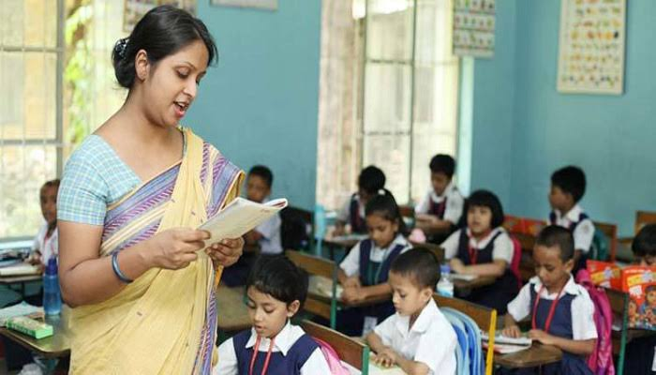
Teacher’s loud reading and discuss the lesson.

Slide 17
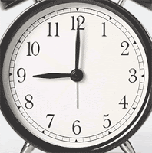
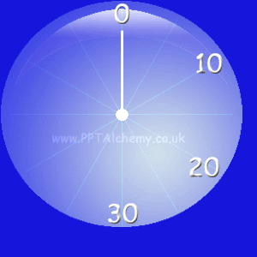
New Words
A period of sixty minute.
Week
The 60th part of a minute.
Hour
A period of seven days.
Second
sat | sun | mon | tue | wed | thu | fri
1 | 2 | 3 | 4 | 5 | 6 | 7
8 | 9 | 10 | 11 | 12 | 13 | 14
15 | 16 | 17 | 18 | 19 | 20 | 21
22 | 23 | 24 | 25 | 26 | 27 | 28
29 | 30
A period of 24 hours.
A period of sixty seconds.
Minute
month
day
A period of 30 days.

Slide 18
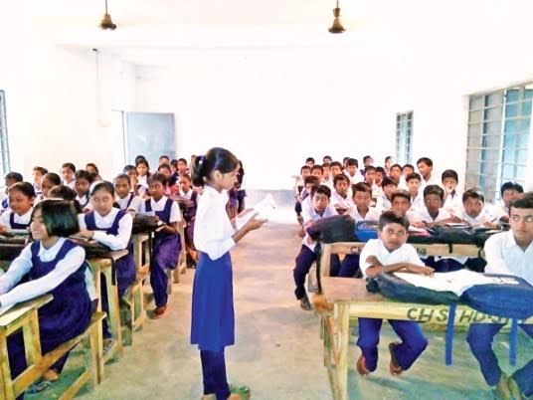
Student’s loud reading help by teacher.

Slide 19
Oral Evaluation
W.C.W
Ask and answer the following questions?
1. How many seconds are in a minute?
2. How many minutes are in an hour?
3. How many hours are in a day?
4. How many weeks are there in a month?
5. How many days are in a year?
6. How many days are in a leap year?

Slide 20
Home work
Write 12 month and 7 days of the week.

