Slide 1
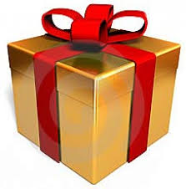
Welcome dear students

Slide 2
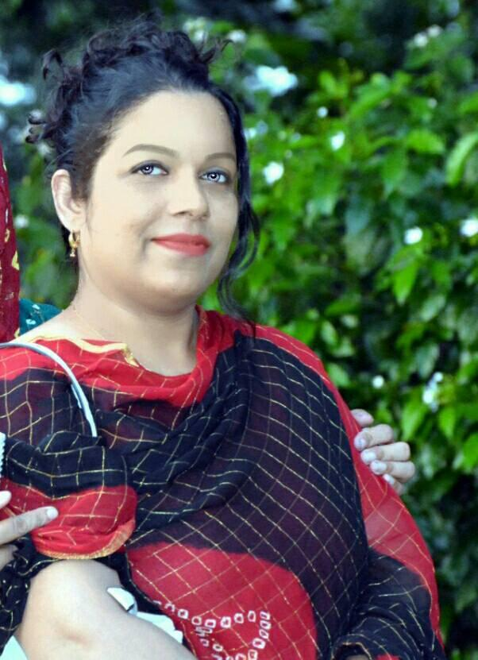
Introduction:
Shamimara begum
Asst. teacher
Town Model Boys Govt.Primary
School Habiganj.
Class:Five
Class :Five
Lesson:
Happy Birthday
Lesson part:
A person’s…….
………..and
Family.

Slide 3
LEARNING OUTCOMES
At the end of the lesson, the students will be able to :
3.4.1: understand statements made by the teacher and students.
6.2.1: talk about people, objects, events, etc.
5.1.1: read silently with understanding stories.
10.2.1: write short and simple composition on familiar objects such as people, place and event.

Slide 4
REFRESHMENT

Slide 5
Today’s our lesson is:

Slide 6
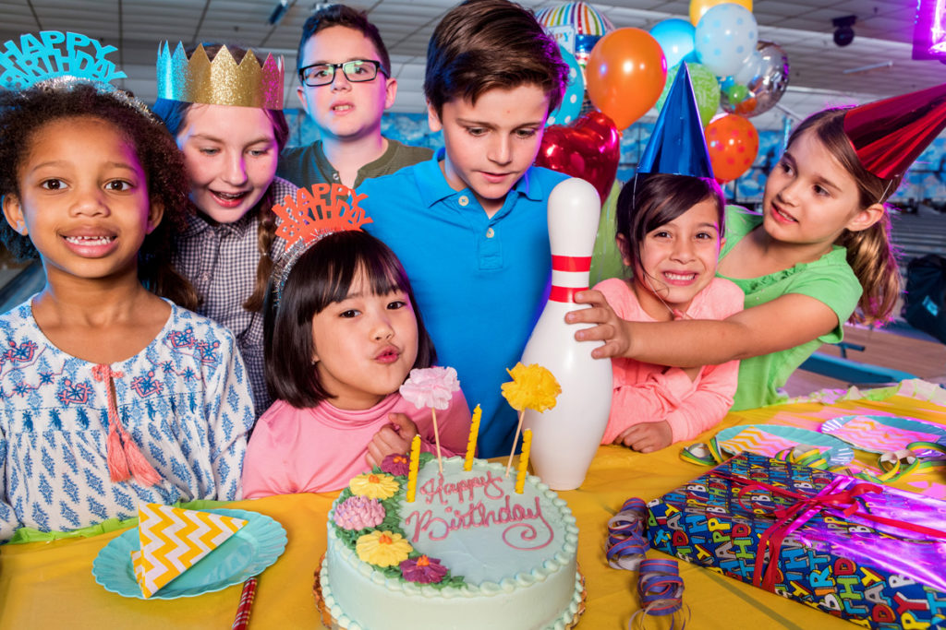
Lets see some picture

Slide 7
This is the date when the person was born.

Slide 8
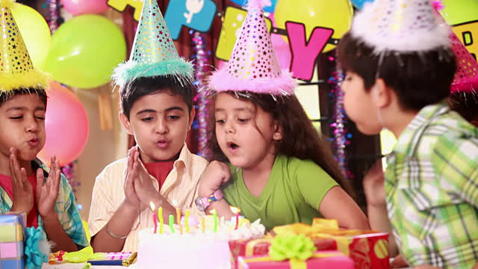
People around the world celebrate birthdays in different ways.
ways of birthday celebrations

Slide 9
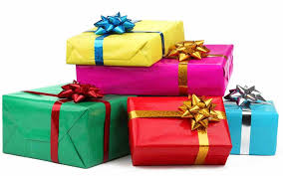
Birthday gift

Slide 10
There are candles on the cake.

Slide 11
People sing a song for the person.
people’s singing

Slide 12
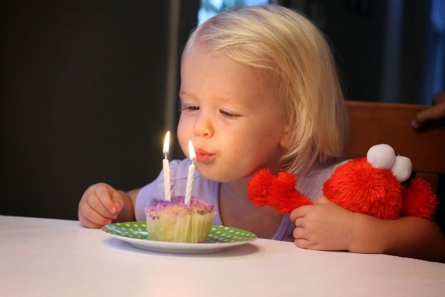
At the end of the song, the person blows out the candles.
blowing out candles

Slide 13
Open your book and read loudly.

Slide 14
INTRODUCING NEW WORDS
around
candle
blowout
special
spend
sing

Slide 15
Pair work:

Slide 16
Read the sentences. Write T for True or F for False.
1. A birthday is the date when a person was born.
T
2. People celebrate birthdays in the same way around the world.
F
3. On a birthday cake, there is one candle for each year of a child’s age.
T

Slide 17
EVALUATION
1. What is birthday ?
2. Who sing a song for the child ?
3. How many candles were there in your
last birthday celebration?

