Slide 1
Good Afternoon

Slide 2
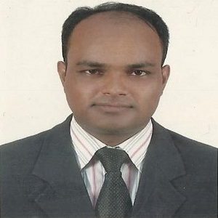
Teacher’s Identity
MD. ABDUL KADER
Assistant Teacher
Borni Govt. Primary School,
Companigonj, Sylhet.

Slide 3
GREETINGS
Teacher
Good morning, students
Good morning, teacher
Student’s
How are you today ?
Teacher
Fine
Student’s

Slide 4
Lesson Identity
Subject: English
Class: Four
Unit : 5
Lesson: 1-2 “Classroom language”
Part of the lesson: Activity A-B (Match the instructions and the pictures).
Time : 40 mins
Date:25/06/2020

Slide 5
Learning Outcomes
Listening:
2.2.1 carry out a set of commands and instructions.
Speaking:
7.1.1 give instructions and commands.
Reading:
6.1.1 read instructions and carry them out.

Slide 6
Let’s enjoy a song…

Slide 7
Lesson declaration
Today's lesson : Today we will learn about “classroom language.”

Slide 8
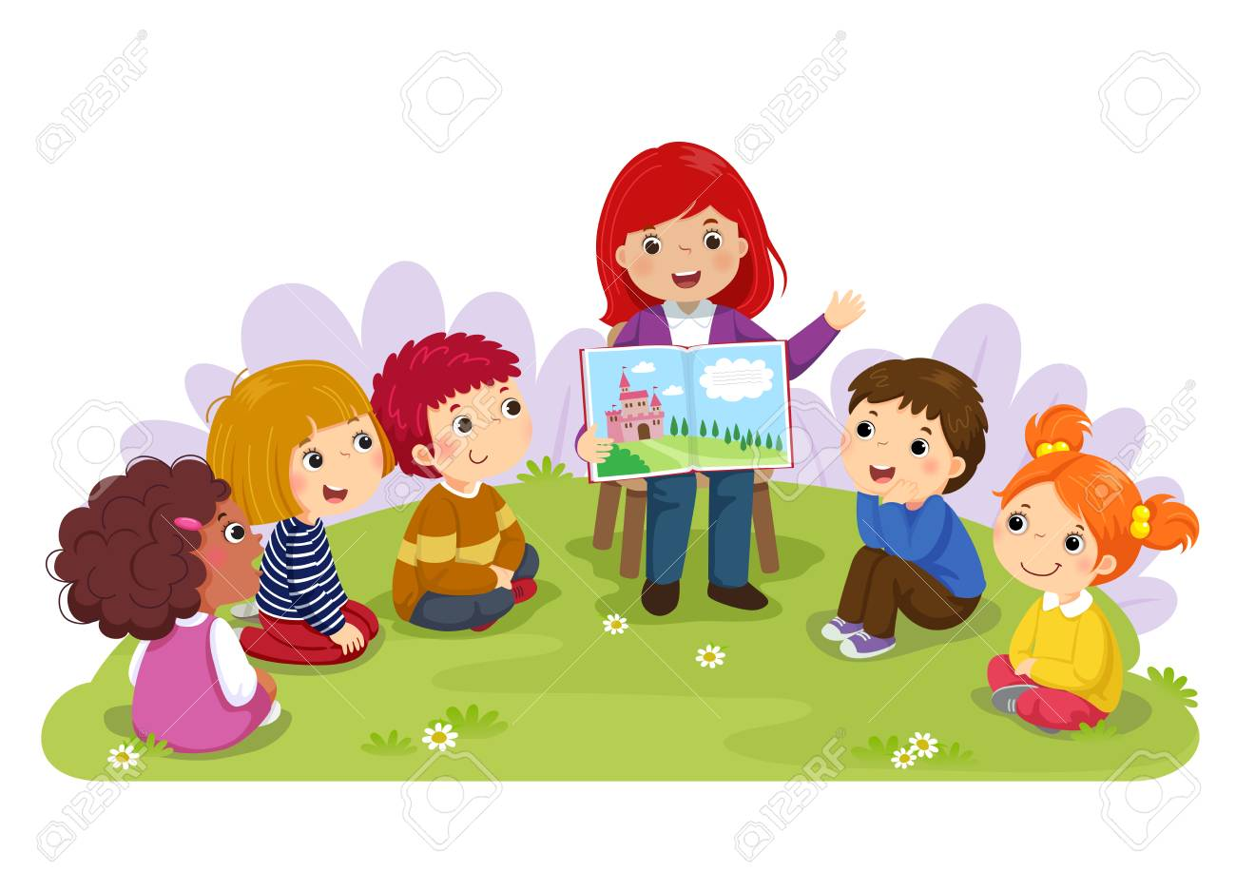
Showing picture
Let’s see some picture…..

Slide 9
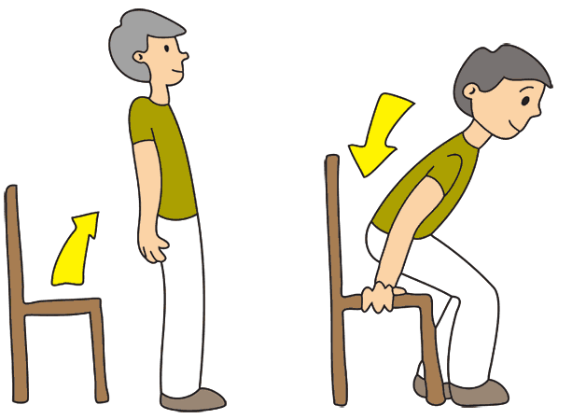
Stand up
Sit down

Slide 10
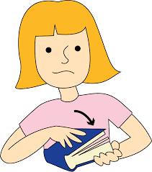
Open your
book
Close your
book

Slide 11
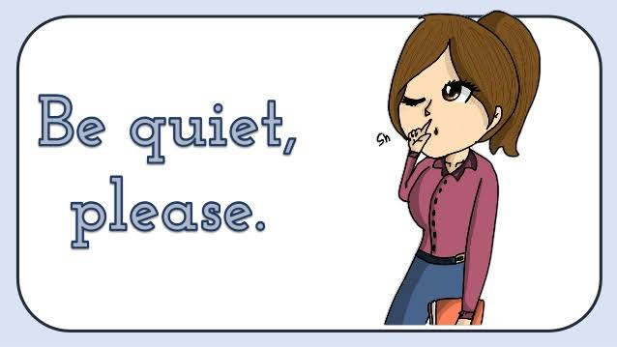

Slide 12
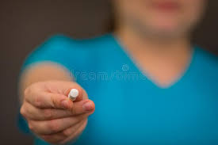
Take the chalk

Slide 13
Draw a circle

Slide 14
Raise your hand

Slide 15
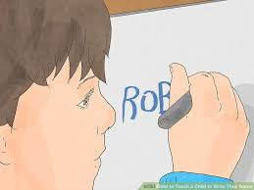
Write your name

Slide 16
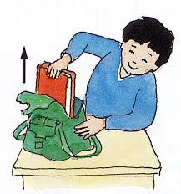
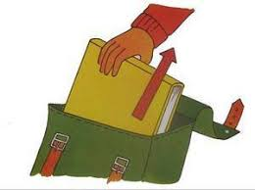
Get your book out

Slide 17
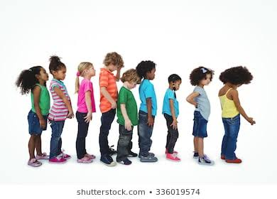
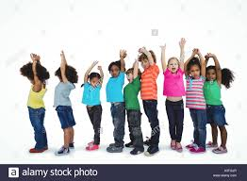
Stand in a line

Slide 18
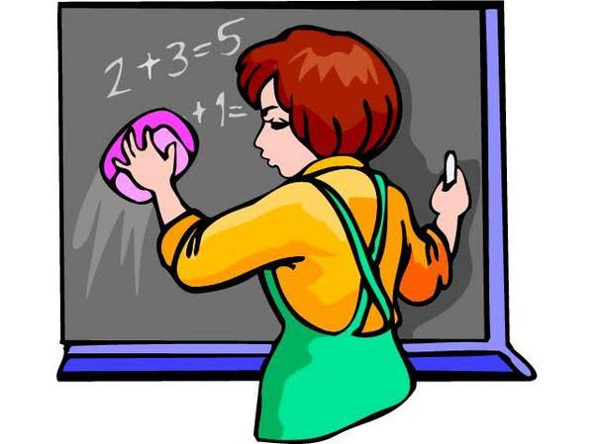
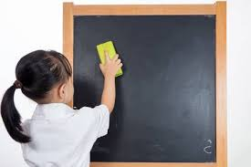
Clean the board

Slide 19
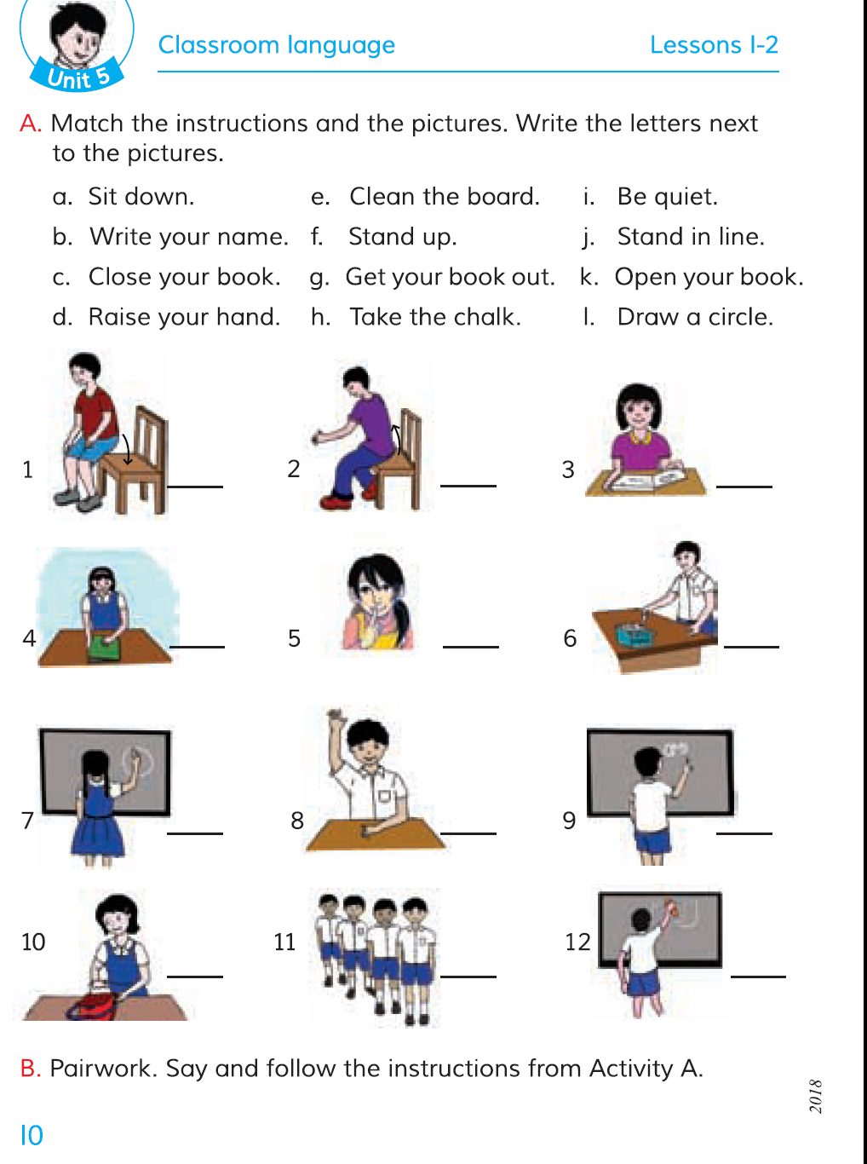
Open your book at page 10

Slide 20
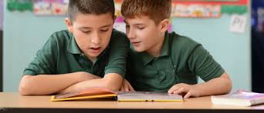
Pair work
( Two students will make a pair)
Each pair will say and follow the previous instructions and write the letters next to the pictures in their book.

Slide 21
Match the Instruction and the pictures
Get your book out
Write your name
Take the chalk
Draw a circle

Slide 22
Clean the board
Stand in a line
Open your
book
Stand up

