Slide 1
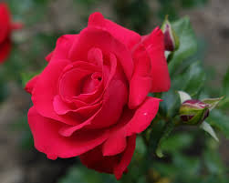
Good morning

Slide 3
What can you see in the picture ?

Slide 4
How many days there in a week?
Seven days
Can you say the names of the days ?
Saturday
Sunday
Monday
Tuesday
Wednesday
Thursday
Friday

Slide 5
Look at the pictures
Reading
Playing

Slide 6
Today we’ll read about Sagar’s week
Unit- 16 . lesson: 1-2 . page no : 32

Slide 7
Let’s know some word meaning
Weekday -
Work day
(কাজের দিন)
Get up -
Wake up
(জেগে ওঠা)
Get dressed-
Put on cloth
(পোশাক পরিধান করা)
Leave -
Go
(যাওয়া)
Start -
Beginning
(শুরু)
Favourite –
Fond of
(প্রিয়)

Slide 8
Word meaning
Weekend-
end of the week / Friday
সপ্তাহান্ত
Visit -
to go to see someone/ look over
দেখতে যাওয়া
Cousin-
child of uncle or aunt
চাচাতো, মামাতো, খালাতো ভাই – বোন
Watch -
observe
মনোযোগ দিয়ে দেখা

Slide 9
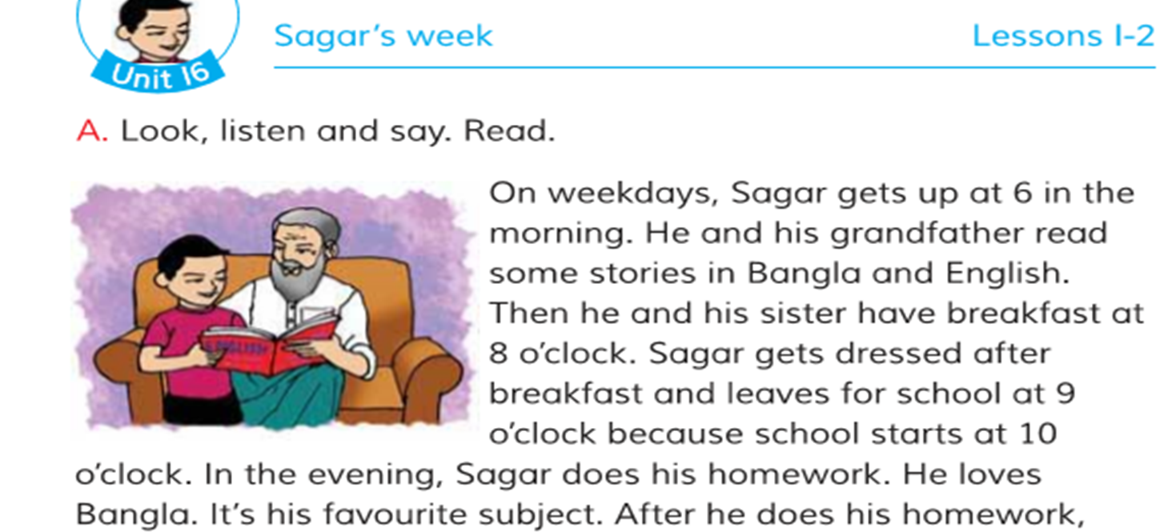

Slide 10
Let’s read the text

Slide 11
Sagar’s activity
6 o’clock -
Gets up
In the morning
8 o’clock -
Has breakfast
9 o’clock-
Leaves for school
10 o’clock -
School starts
In the evening
Does homework & spends time with grandparents .
At night
9 o’clock -
Have dinner with family
10 o’clock-
Goes to bed

Slide 12
Look your text book activity B & C
T
T
F
F
F
F

Slide 13
Answer the following question
1.When does Sagar get up?
2.What does Sagar do after breakfast ?
3.Why does Sagar love Bangla?

Slide 14
Fill in the blanks
gets up
1. Sagar ……… at six o’clock.
breakfast
2.He and his sister have ………….. at eight o’clock.
after
3.He gets dress …….. breakfast.
the evening
4.He does his homework in ………….
Bangla
5.His favourite subject is ……….

Slide 15
Answer the question.
1.Q. When does Sagar get up ?
Ans. Sagar gets up at 6 o’clock .
2.Q. What does Sagar do after breakfast?
Ans. After breakfast he gets dressed and leaves for school.
3.Q. Why does Sagar love Bangla?
Ans . Because Bangla is his favourite subject.

Slide 16
4.Q. When does Sagar spend time with his grand parent?
Ans . After he does his homework .
5.Q. What does Sagar do on weekend?
Ans . On weekend he visits his aunt and uncle .

Slide 17
Answer the questions
1.What does Sagar do in the afternoon on weekend?
Ans . On weekends, he visits his aunt and uncle in the afternoon.
2. What does he do in the park?
Ans . He and Keya play with their cousins in the park.
3.When does he go to bed on weekend?
Ans . On weekends, he goes to bed at 11o’clock.

Slide 18
Now it’s your turn
How do you spend your weekend?

Slide 19
Today’s word
Afternoon
The time from noon to evening
(বিকেল)
I play in the afternoon.
Home work
Write a short composition how do you spend your week . Write in five sentences.

Slide 20
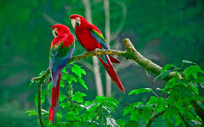
Good bye & have a nice day

