Slide 1
WEL COME

Slide 2
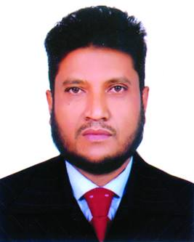
INTRODUCTION
Samaul hoque
Assistant Teacher (English)
Al-Amin Jamea Islamia High School, Sylhet
Mobile : 01712912392
Email: samsul71@yahoo.com

Slide 3
Class : Nine-Ten
Subject : English 2nd paper
Topic : Voice part-1
Period : 2nd
Time : 45 minutes
Date : 27.06.2020

Slide 4
What can you see in the picture ?
She writes a letter.
Subject + verb + object
A letter is written by her.

Slide 5
Today our topic is
Voice

Slide 6
Learning outcomes
Students will be able to …
1. say how many kinds of voice.
2. know the rules of changing voice.
3. change the voice.

Slide 7
Definition of voice
সাধারণ অর্থে Voice অর্থ কণ্ঠস্বর। কিন্তু ব্যাকরণে একে বলা হয় বাচ্য। Verb-এর যে Form দ্বারা কর্তা যখন কাজটি নিজে করে বা অন্যের মাধ্যমে সম্পাদন করিয়ে নেয় এবং কর্তার সঙ্গে কাজের সম্পর্ক দেখায় এবং এইভাবে Verb-এর রূপের যে পরিবর্তন ঘটে তাকে Voice বলে। যেমন:
Types of voice
Voice ২ প্রকার
১। Active: He reads a novel.
২। Passive: A novel is read by him.

Slide 8
যা না জানলে Voice Changing
অসম্ভব
১। Subject থেকে Object এ রুপান্তর
২। Tense অনুযায়ী Be verb
৩। Verb এর Past participle form
4। by (সব সময় নয়) + object
Object +’be’ Verb +Verb 3 + by + Subject

Slide 9
Changing subject into object
Subject | Object
I
me
We
us
You
you
He
him
She
her
They
them
Any name
unchanged

Slide 10
Tense অনুযায়ী Be verb পরিবর্তনের নিয়ম
Active | Passive
Present ind: s+v+ ex | Am/is/are+ v3
Present cont: s+am/is/are+ving+ext | (am/is/are) being+v3
Present perfect: s+ (have/has)+v3+ext | (have/has) been+v3
Present perfect cont: (have/has)been +ving+ext | (have/has) been being+v3
Past ind: s+ v2+ ext | was/were+v3
Past cont: s+ (was/were) ving+ ext | (was/were) being+v3
Past perfect: s+had+v3+ext | had been+v3
Past perfect cont: s+ had been + ving+ext | had been being+v3
Modal auxiliary : (shall/will/can/could/would/may/might/should/must/ought to/dare) | be+v3

Slide 11
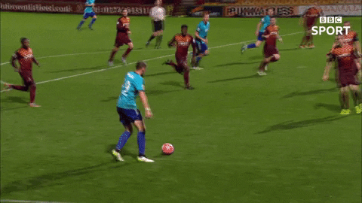
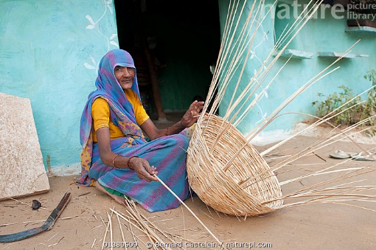
Some examples from Active to Passive
Active =
They are playing football.
Passive =
Football
is being
played
by
them.
Active =
She
made
a basket.
Passive =
A basket
was
made
by
her.
Active =
He
has
caught
fish.
Passive =
Fish
has been
caught
by
him.

Slide 12
Double object হলে
Active: He gave me a gift box.
Passive: A gift box was given me by him
যে কোন একটি object কে sub+ be verb+ v3+ অন্য object+ by + SO
Structure

Slide 13
A car can be driven by him.
He can drive a car.
Model auxiliary verb

Slide 14
Class activities
1. Karim digs the canal.
2. They are making a project.
3. He has broken the glass.
4. He must obey his parents.
5. We were learning our lesson.
6. I should play football.

Slide 15
Home Task
1.They will play football.
2. They will go home.
3. We could help them.
4. He teaches us English.
5. We were reading a book.

Slide 16
THANKS

