Slide 1
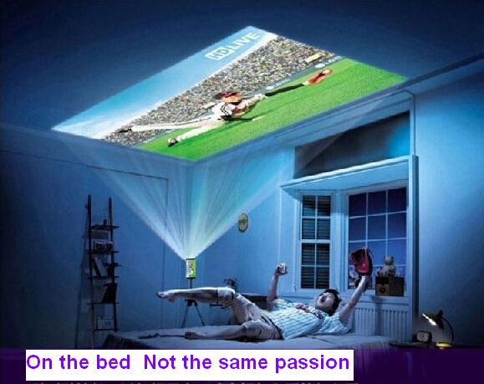
Orthogonal Projection

Slide 2
Teacher’s Information
Md. Hasan-ul-Bari
Lecturer, Mathematics
Millennium Scholastic School & College
Jahangirabad Cantonment, Bogura.
Cell No.: 01716103858, 01769129001
E-mail: hubari1976@gmail.com

Slide 3
Lesson’s Information
Class : IX
Chapter : Three
Subject : Higher Mathematics
Period : 1st
Time: 9:30-10:10 am
Date: 27/06/2020

Slide 4
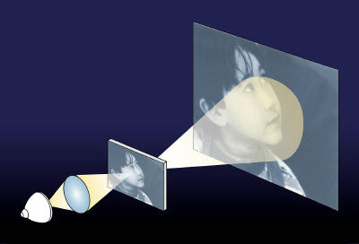
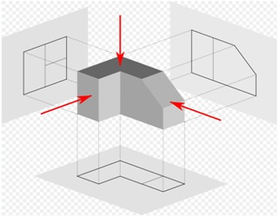
Observe the following images

Slide 5
Today we discuss
Orthogonal Projection

Slide 6
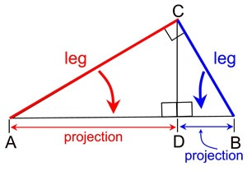
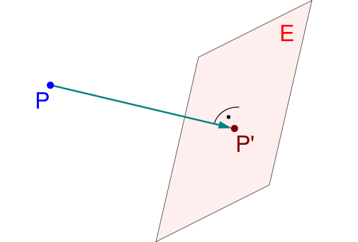
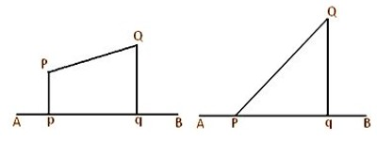
Orthogonal Projection

Slide 7
Learning Outcomes
At the end of the lesson, the students will be able to ----
Define projection.
Explain the concept of Orthogonal
Projection.
Define orthogonal projection of a point.
Define orthogonal projection of a line.
Maths Lab Centre, Bogura. Cell: 01716103858

Slide 8
Projection
A projection is the transformation of points and lines in one plane onto another plane by connecting corresponding points on the two planes with parallel lines. This can be visualized as shining a (point) light source (located at infinity) through a translucent sheet of paper and making an image of whatever is drawn on it on a second sheet of paper. The branch of geometry dealing with the properties and invariants of geometric figures under projection is called projective geometry.
Continue …….

Slide 9
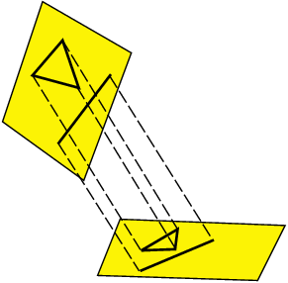
Visualize the image of Projection
Maths Lab Centre, Bogura. Cell: 01716103858

Slide 10
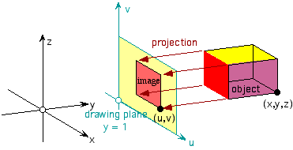
Visualize the image of Projection
Maths Lab Centre, Bogura. Cell: 01716103858

Slide 11
Orthogonal Projection
The term orthogonal is derived from the Greek word ‘orthogonios’ where ‘ortho’ meaning right and ‘gon’ meaning angled. Orthogonal concepts have origins in advanced Mathematics, particularly linear algebra, Euclidean geometry and spherical trigonometry. Orthogonal and perpendicular are used as synonyms.
Orthogonal projection is a two-dimensional graphic representation of an object in which the projecting points/lines are at right angles to the plane of the projection. It is also known as Orthographic projection.
Continue …….

Slide 12
Uses of Orthogonal Projection
It is used in engineering drawing of projecting views of the object being described, such as plan, elevation, side view, etc, at right angles to each other.
Hipparchus used the projection in the 2nd century BC to determine the places of star-rise and star-set.
Continue …….

Slide 13
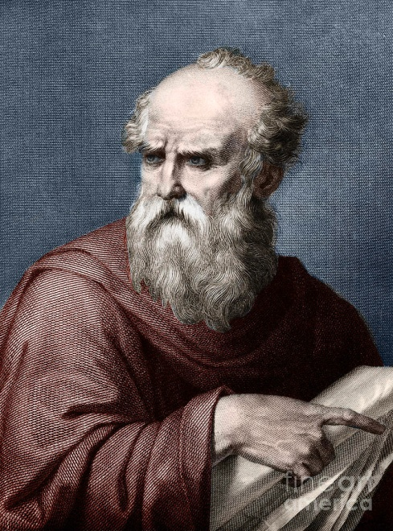
Uses of Orthogonal Projection
In about 14 BC, Roman engineer Marcus Vitruvius Pollio used the projection to construct sundials and to compute sun positions.

Slide 14
Orthogonal projection of a point
Maths Lab Centre, Bogura. Cell: 01716103858

Slide 15
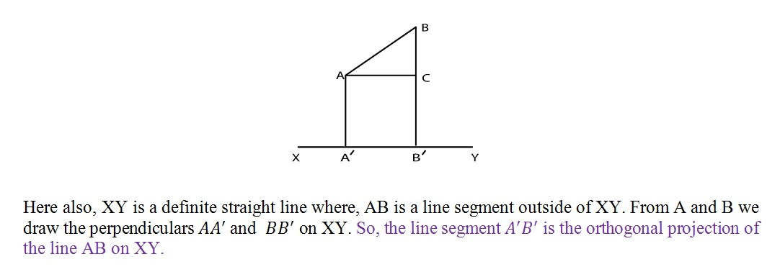
Orthogonal projection of a line
Maths Lab Centre, Bogura. Cell: 01716103858

Slide 16
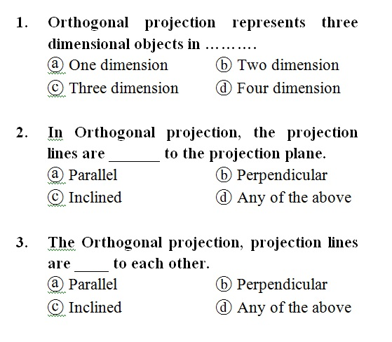
Single Work
Practice

Slide 17
Maths Lab Centre, Bogura. Cell: 01716103858

Slide 18
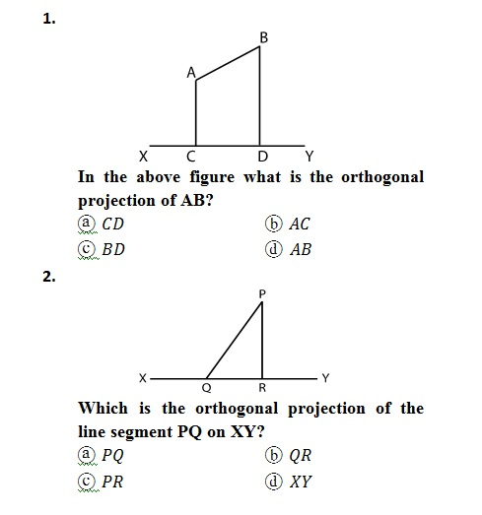
Group Work
Practice

Slide 19
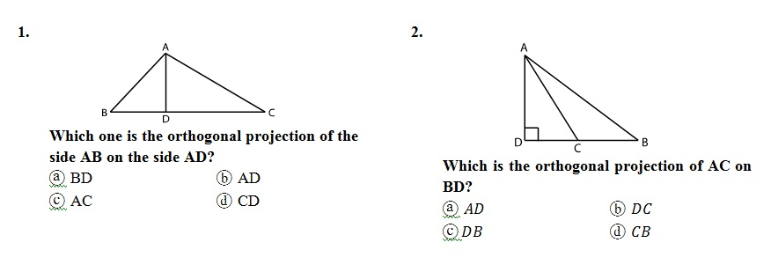
Home Work
Maths Lab Centre, Bogura. Cell: 01716103858

Slide 21
Maths Lab Centre, Bogura. Cell: 01716103858

