Slide 1
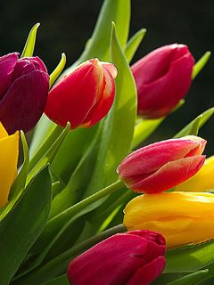
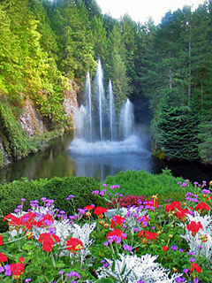
Welcome dear students to my class

Slide 2
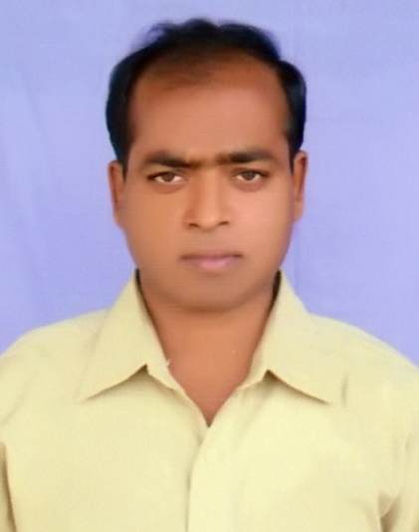
This is to
Md Sazzad Hossain
Assistant Teacher (English)
Santhia Govt. Pilot Model high School,
Santhia, Pabna.

Slide 3
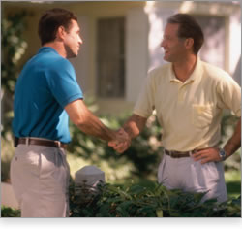
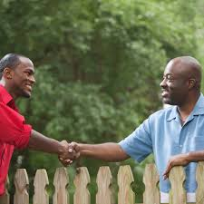
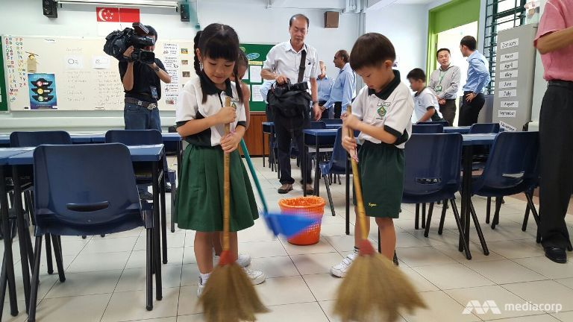
Man cannot live alone in the society, he needs Company = Neighbor = Friend

Slide 4
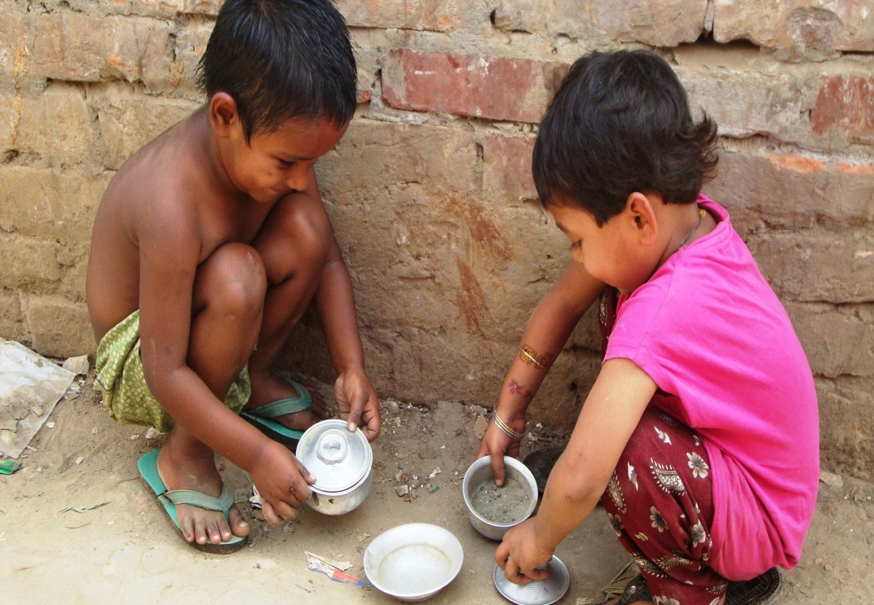
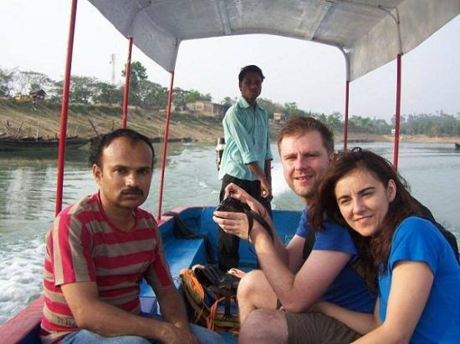
Do you know when Friendship day started?

Slide 5
It was started firs in the USA
In 1935
First Sunday, August
But in Bangladesh
In July 3

Slide 6
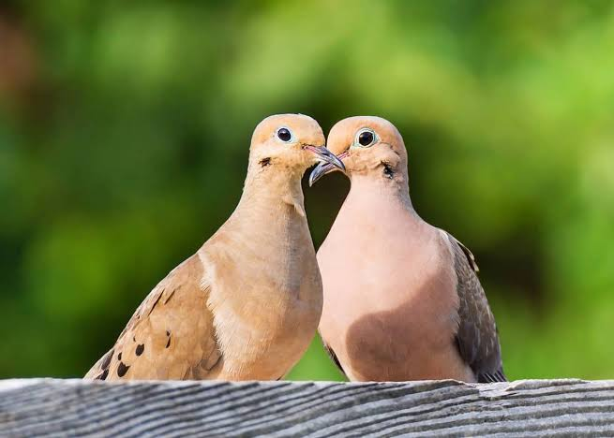
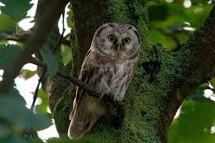
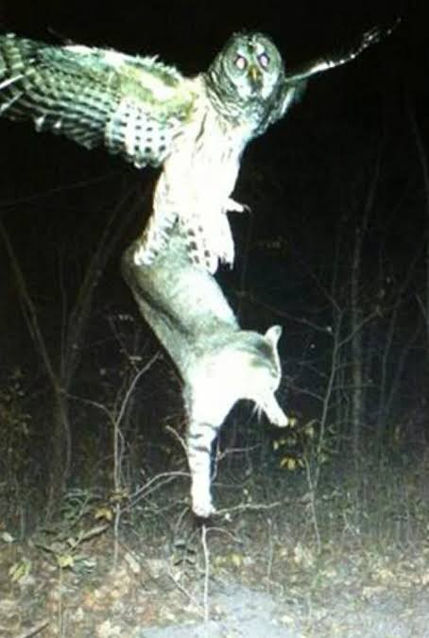
There are some popular symbol to represent friendship like-

Slide 7
Our today’s lesson is
Unit 5
Making a difference
Lesson 5
The Truthful Dove(1)

Slide 8
After we have studied this unit, we will be able to
Read and understand texts through silent reading
Infer meaning from context
Listen from information
Ask and answer questions
Write answer to questions

Slide 9
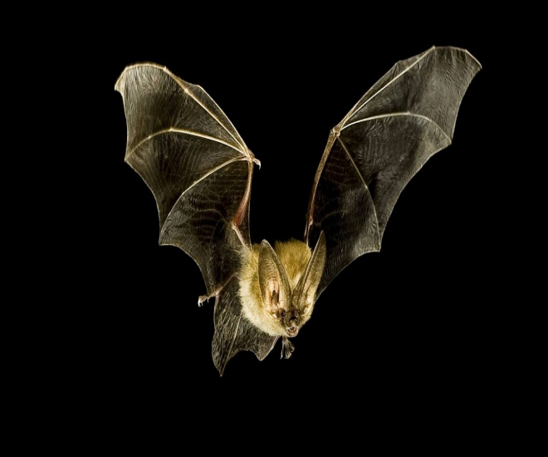
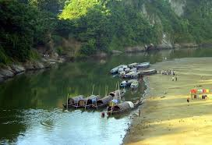
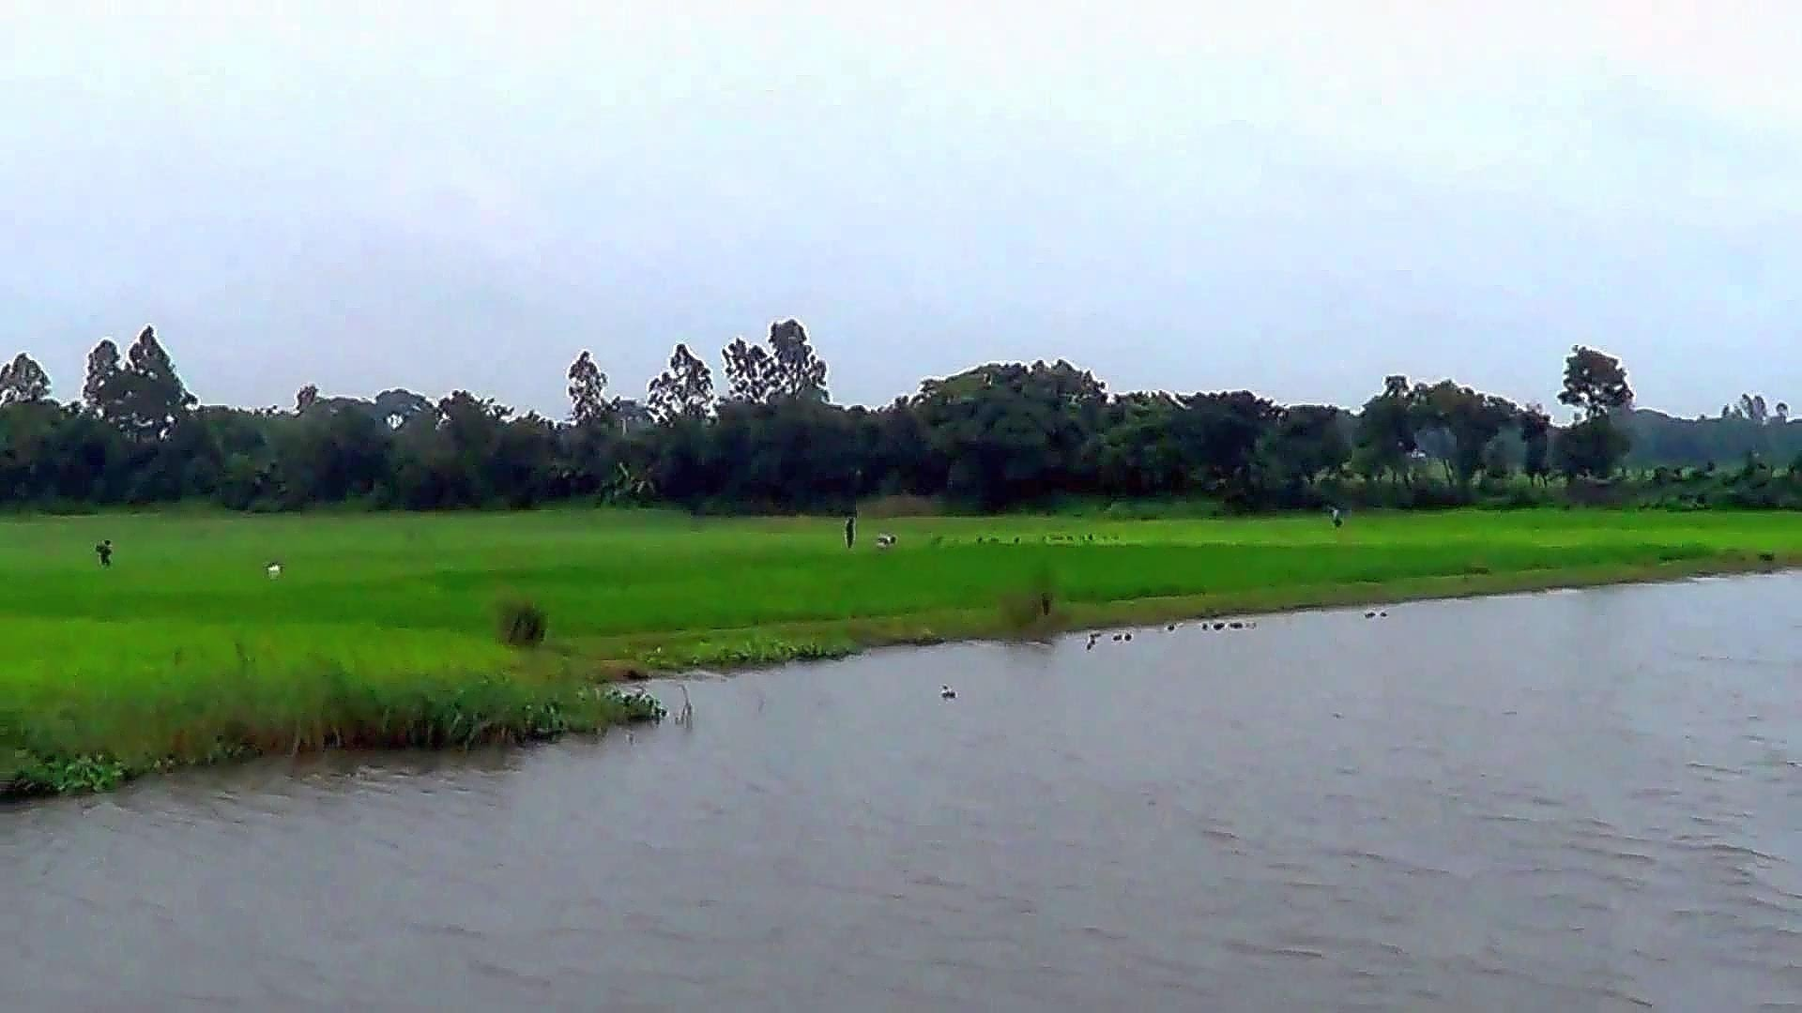
Once upon a time, a dove and a bat were very good friends. One day the two decided to set out on a journey. They flew over the rivers and hills and came to a jungle, Both the friends were very tired , they need to sit down and take a rest. Soon night fell and it was dark all around. A storm rose. It started rain heavily. The dove and the bat started to look for a shelter.

Slide 10
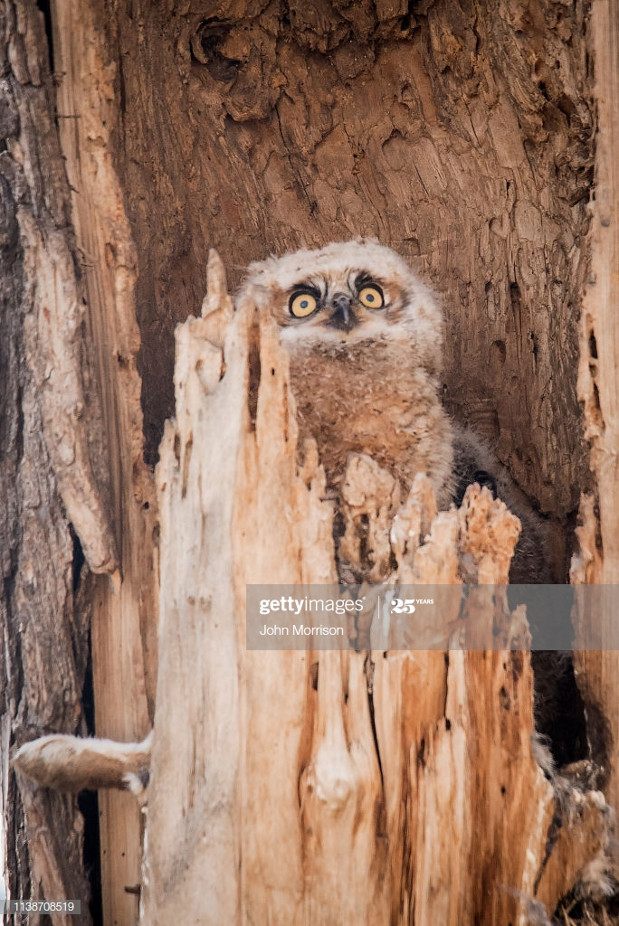
They came upon a century old rain tree. An owl had his nest in that tree. The dove and the bat knocked at the owl’s door. The grumpy owl opened the door. The dove and bat requested him to give them shelter. The owl unwillingly let them in. The two birds were hungry too. They begged for some food.

Slide 11
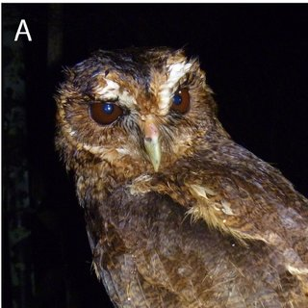
The selfish owl was not happy. However , he shared his dinner with them. The dove was so tired that she could hardly eat. But the bat was sly. He ate greedily. He began to praise the owl with the thought of getting more food. The bat said, “ O wise and brave owl. You are you are the most generous person I have ever seen. You are powerful and mighty.

Slide 12
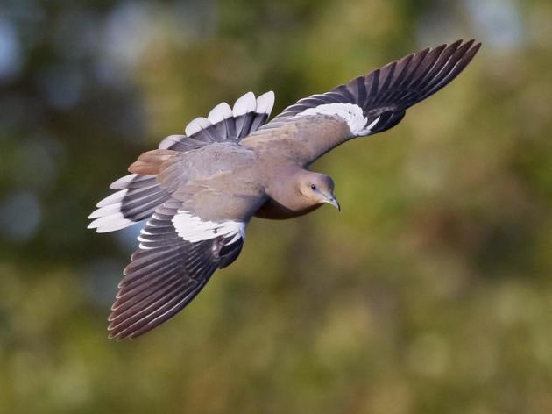
The owl was very pleased at the bat’s flattery. He puffed and ruffled himself, trying to look as wise and brave as possible. Then he turned to the dove and asked, “Now little dove, what do you think about me?

Slide 13
I think you have understand the text through silent reading
Now, choose the correct answer to each question from the given alternative and write the answer with corresponding number in your answer script:
a) The dove and the bat started to look for a shelter – here shelter means
i) area ii) abode iii) protection iv) dwell
b) The grumpy owl opened the door – the antonym of grumpy is---
Amicable ii) petulant iii) hot tempered iv) cranky

Slide 14
c) The owl unwillingly let them in – here unwillingly
i)under duress ii) protest iii) privilege iv) wish
d) They begged for some food -- begged means
i)demanded ii) persisted iii) offered iv) deprived
e) The selfish owl was not happy – antonym of selfish
i)introvert ii) extrovert iii) controversies iv) centre
f) You are the most generous person generous means
i) Sufficient ii) munificent iii) fabricating iv)dominate

Slide 15
g) You are powerful and mighty – mighty means
i) potent ii) strength iii) gross iv) spacious
h)- at the bat’s flattery- here flattery stands for
i)malpractice ii)adulation iii) adopted iv)role
i) “Now little dove --- little means
i) Important ii) worthless iii) respected iv) wise
j) He puffed– puffed means
purified ii) blew iii) wheezing iv)travelled

Slide 16
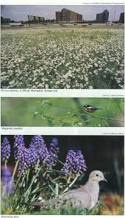
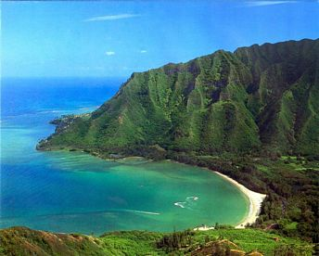
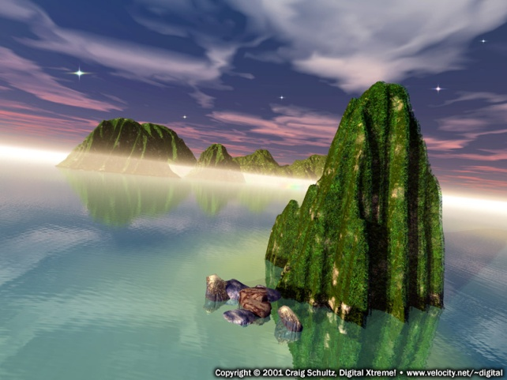
Answer to the following questions:
a)What was the term between dove and bat?
b)How did the friends reach the jungle?

Slide 17
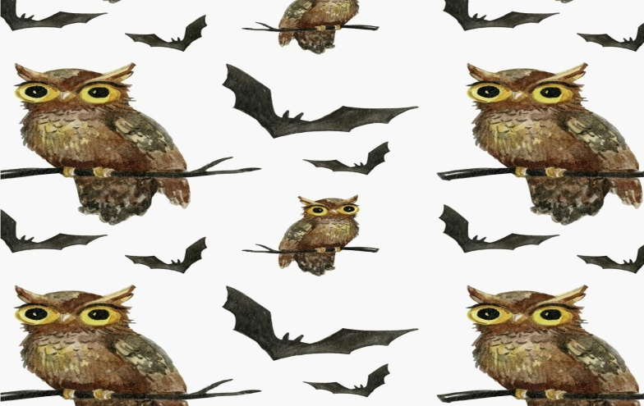
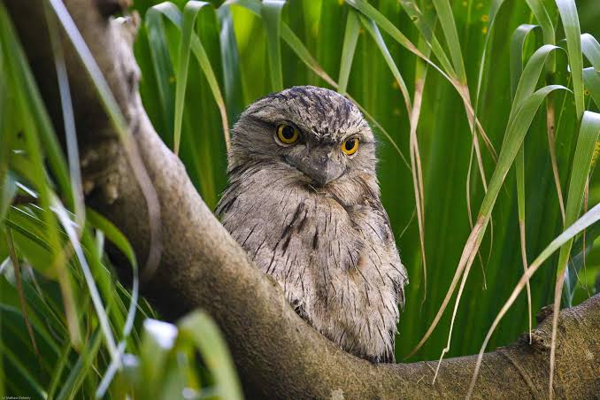
c)What the dove and the bat do to have rest?
d) How was the host?
e) Do you like to call the bat a flatterer? Why?why not?

Slide 18
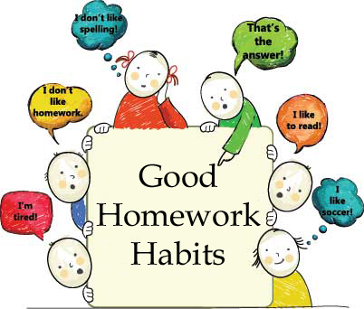
Now dear students, fill in the blanks with the information from the text to make it a complete passage:
Communication of idea is the centre of present civilization that needs a) --- . In early age people share their idea through speaking and b) ---- as writing materials were stone, metal, wood, bark, leaves etc. These materials are not easy to c)----. Before this paper age, knowledge was very restricted and there were very few d) --- in the world. Paper has made publication and the spread of knowledge and e) ----.

Slide 19
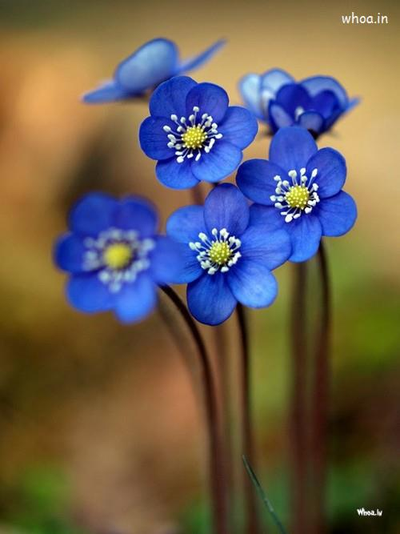
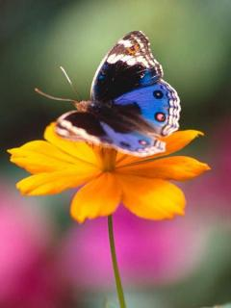
And dear students, that is -

