Slide 3
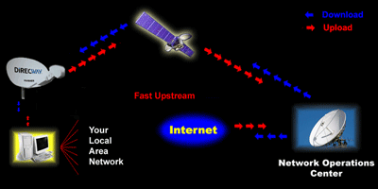

Slide 6
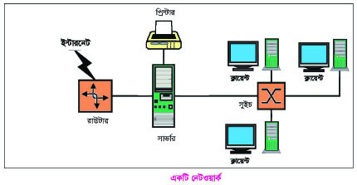

Slide 7
PAN ( Personal Area Network)
LAN ( Local Area Network)
MAN ( Metropolitan Area Network)
WAN ( Wide Area Network)

Slide 8
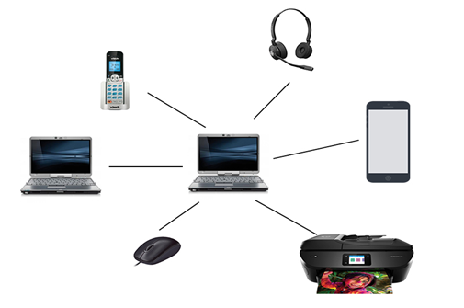
PAN ( Personal Area Network)

Slide 9
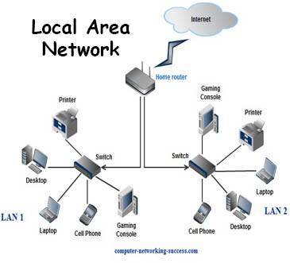
LAN ( Local Area Network)

Slide 10
