Slide 1
welcome

Slide 2
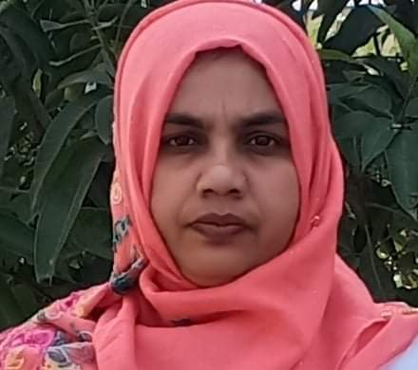
Teacher’s introducing
Name : Azmira akter
Subject :English
Class :One
Unit:22
Lesson:1-3
Time:40minute

Slide 3
Learning outcomes:by the end of unit students will be able to…
1.1.1 repeat after the teacher simple words and phrases
1.1.2 say simple words and phrases.
Listening
1.1.1 become familiar with English sounds by listening to common English words
Speaking

Slide 4
Greeting

Slide 5
What do you see at your village?
With my help the student will say
Tree,hous,cow,cat,hen,pond,goat,sun etc.

Slide 6
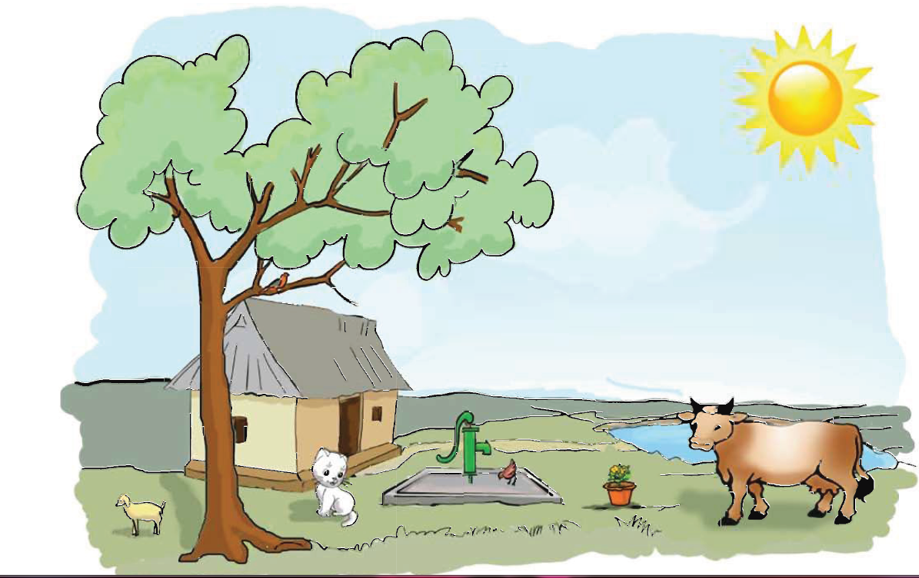
Today’s lesson

Slide 7
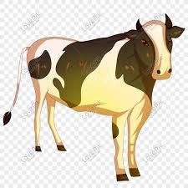
Look at the pictur
It’s a cow
What is this?

Slide 8
Look at the picture
It’s a tub
What is this?

Slide 9
Look at the pictur
It’s tubwell
What is this?

Slide 10
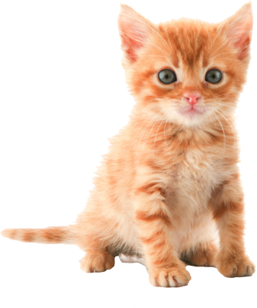
Look at the picture
It’s kitten
What is this?

Slide 11
Matching
tub
Kitten
tubewel
Cow

Slide 12
Open your book at page….
Look and say

Slide 13
Evolution
What is this?
What is this?
It’s a cow
It’s a tub

Slide 14
Evolution
What is this?
What is this?
It’s kitten
It’s tubewel

Slide 15
What we have learn today?
Student say’s
Cow,Tub,Kitten,tubwell

Slide 16
Good bye
bye

