Slide 1
Welcome To English Online Class

Slide 2
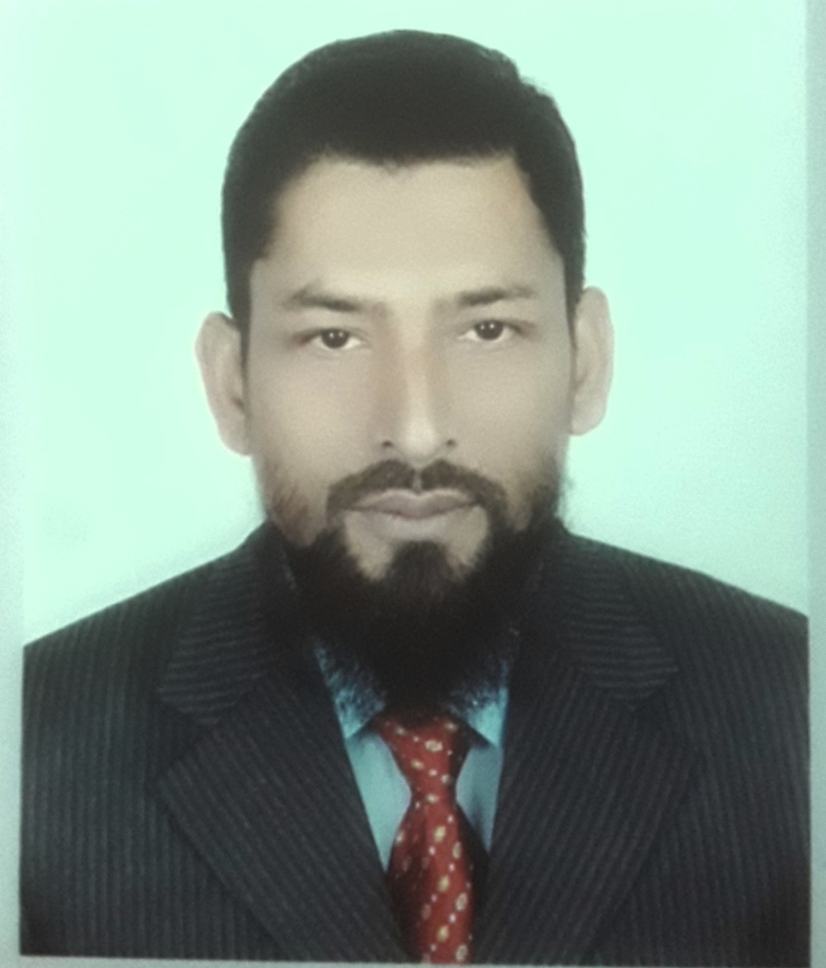
Teacher’s Identity
Class (xi- xii)
Md. Monjur Hossain Khan (Jewel)
Lecturer in English
Shyampur Degree College, Rangpur.
Email:khanmh1977@gmail.com
Mobile:01718865198

Slide 3
Preposition +(verb)
₌Verb+ ing
Example: He reads instead of (play)
Answer: He reads instead of playing. Practice The Following
Hasan did the work after (take) our permission.
I am fond of (eat) sweets.
She is capable of (solve) the problem.

Slide 4
Mind
Worth
Can not help (verb) V+ing
Could not help
a.Would you mind (open) the window.
b.I can not help (do) the work
(verb)
Verb +ing

Slide 5
By
Without + (verb) Verb+ing
Practice the following sentences:
Answer the questions by (write) one point of information.
Without (work) hard ,no one can do better in life.
+ (Verb)
Verb+ing

Slide 6
With a view to
Look forward to + (verb) Verb+ing
Practice the following sentences:
I went to market with a view to (buy) a shirt
I look forward to (hear) from you.
+ (Verb)
Verb+ing

Slide 7
While (verb) Verb + ing
Example:
While (read) in my room, I heard a loud sound.
While (go) to college, I met with one of my old friends.
Verb+ing

Slide 8
While +Subject + (Verb)…, ..…… = was/were + verb+ing
1. While he (walk) in the garden, he was charmed by the scent of the blooming flowers.
2. While the boy (cross) the R.K road, he met an accident.
Answer: was walking , was crossing.

Slide 9
Subject +VT+ Indirect Object+ (verb) = (verb)+ing Example: a. I saw him (go) to the library. b. I saw my friend Mukul (run) towards me.

Slide 10
(verb)………….,…………….. = verb + ing Example: a. (go) to market, I met with him.
Simple sentence

Slide 11
Am/is/are/was/ were + used to + (verb) = verb + ing Example: a. I am used to (take) tea. b. He was used to (swim) in the pond.

Slide 12
Subject + (verb)………..+verb + others. = (verb) + ing
Example:
People (live) below the poverty line lead a miserable life.
People (eat) this kind of food fall a victim to liver diseases.

Slide 13
Consider, delay, dislike, enjoy, resist, finish, forgive, avoid, practise, suggest, like, deny, stop, feel, …… (verb) = (verb) + ing
Example:
1. I enjoy (watch) television.
Answer: I enjoy watching television.
2. He delayed (tell) her the news.
Answer : he delayed telling her the news.

Slide 14
Thank you
To be
continued……

