Slide 1
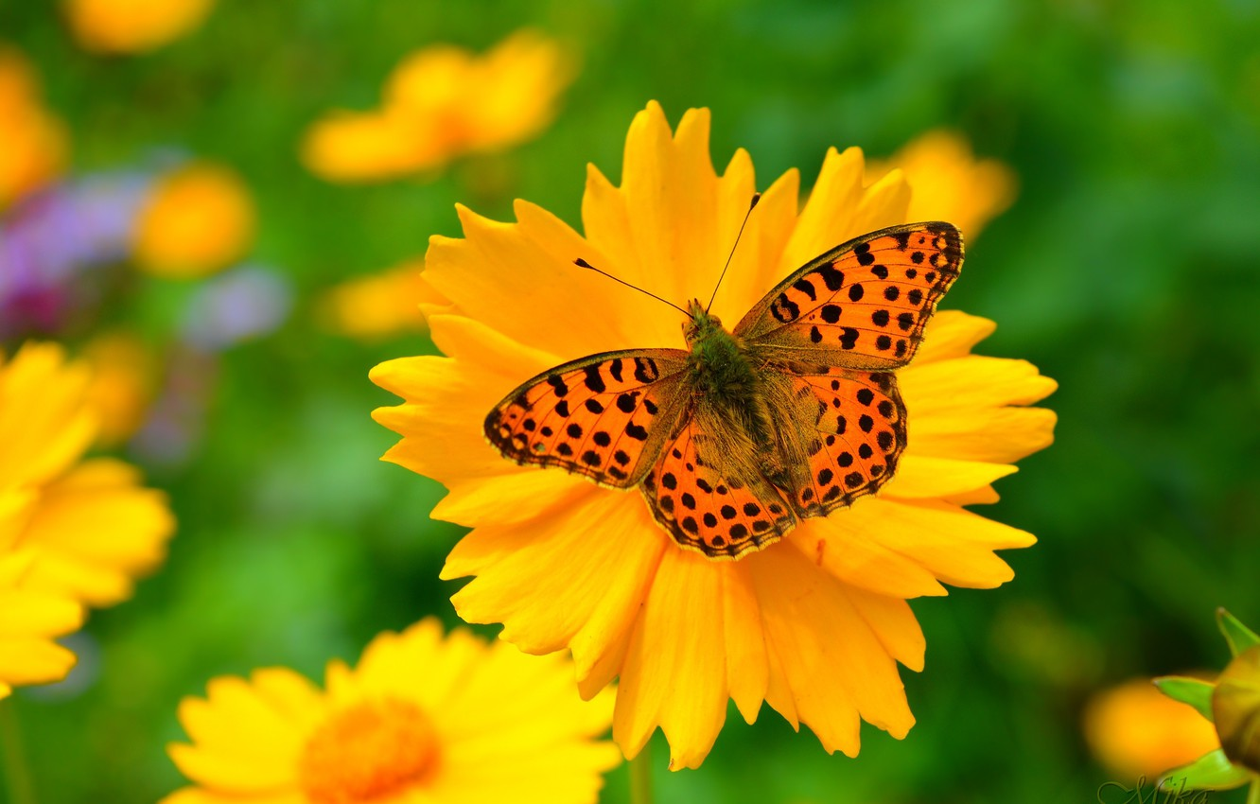
Welcome Everybody

Slide 2
Teacher’s identity
Md. Arafat Hossain
Assistant Teacher (English)
Haripur High School
Joypurhat Sadar, Joypurhat-5900.
E-mail: arifjoy1991@gmail.com
Contact: 01747994114

Slide 3
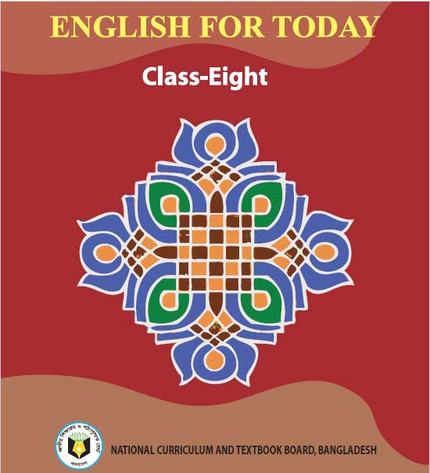
Lesson Introduction
Class: Eight
Subject: English For Today
Unit: One
Lesson: Two
Time: 45 Minutes

Slide 4
Look at the video

Slide 5
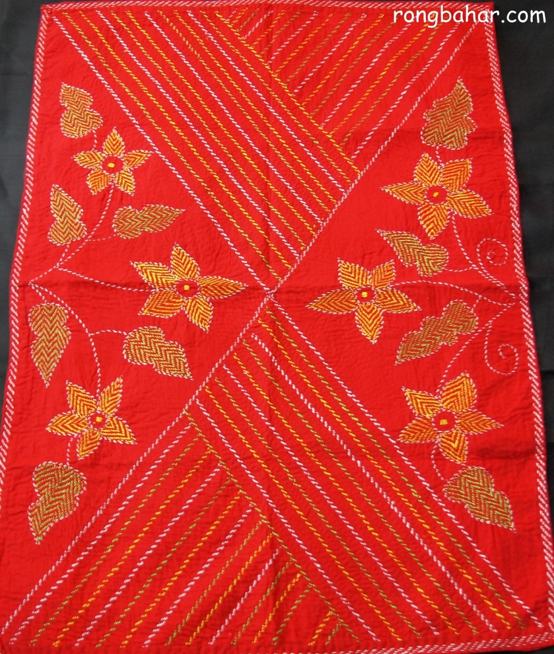
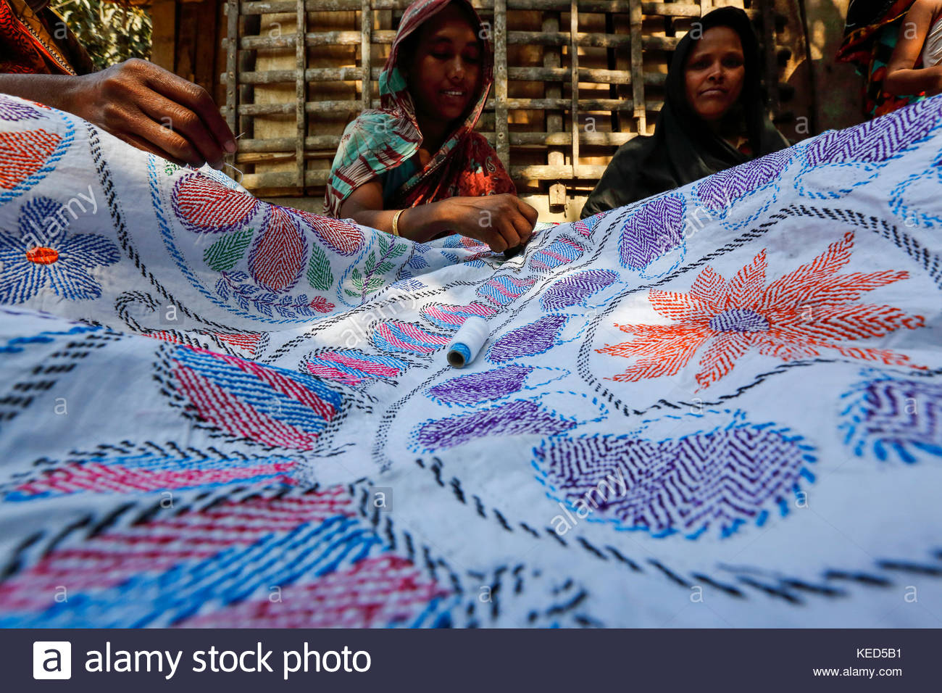
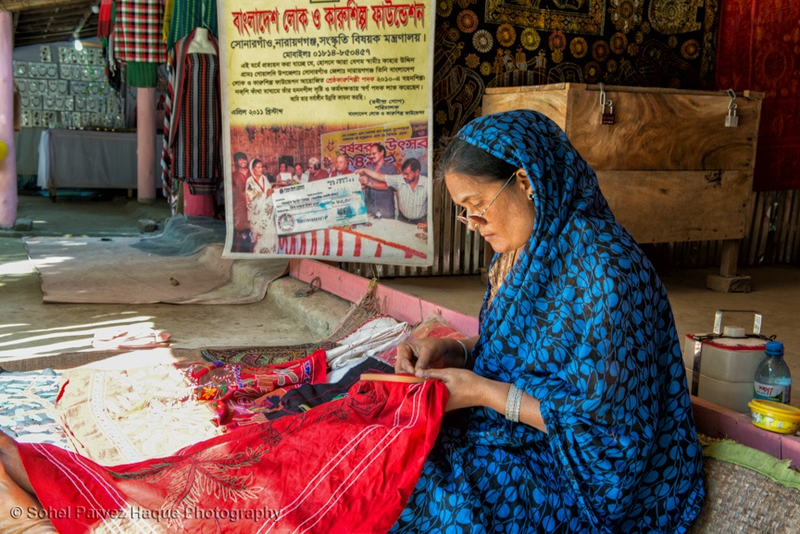
Look at the following pictures.

Slide 6
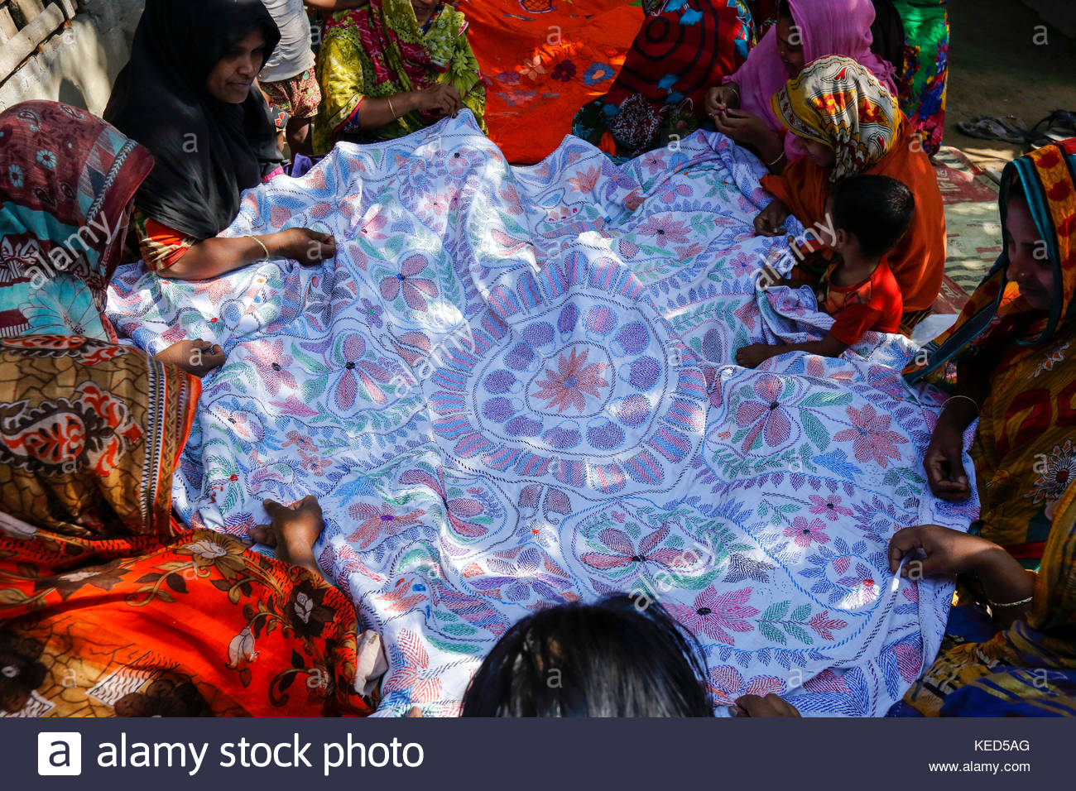
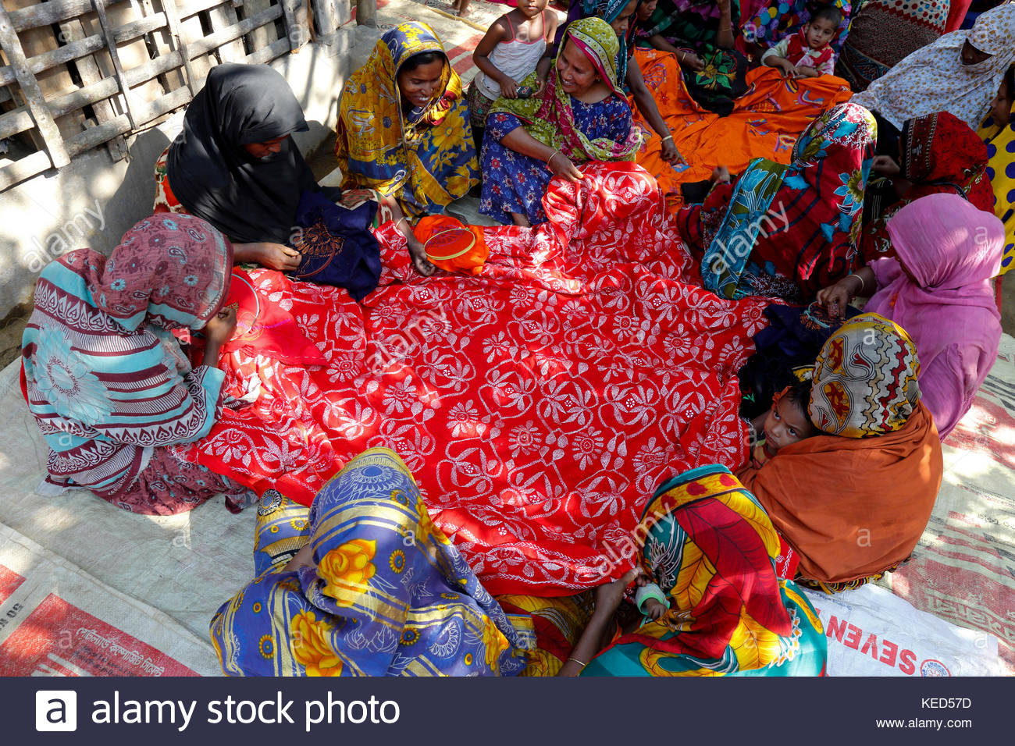

Slide 7
Today, we are going to discuss
“Nakshi Kantha”

Slide 8
Learning Outcomes
By the end of the lesson, the students will be able to-
Read and understand text through silent reading
Say the meaning of new words
Ask and answer questions
Write short paragraph.

Slide 9
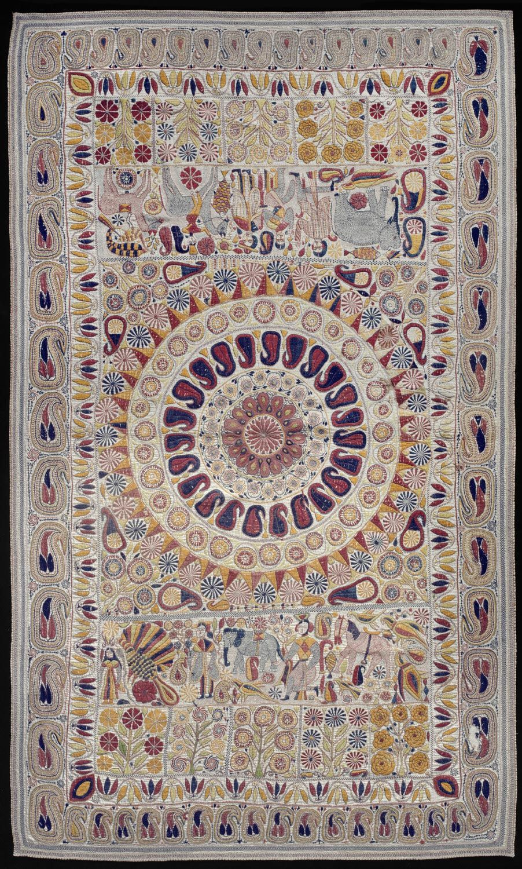
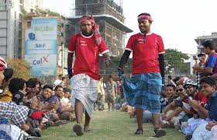
Key Words
Quilt
Noun
Coverlet, blanket, puff.
She saved up pieces of cloth to make a beautiful quilt.
Indigenous
Adjective
Native, aboriginal, local, ancient .
They are our indigenous people.

Slide 10
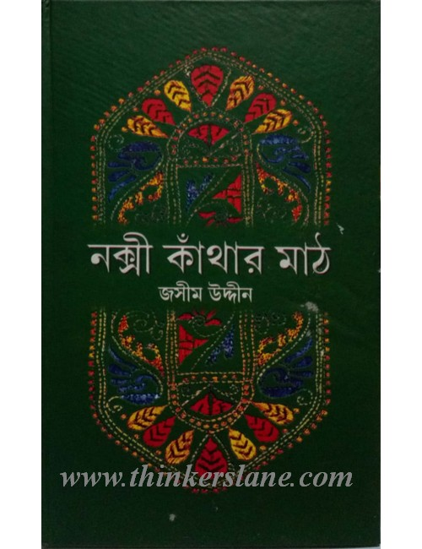
Practise
Verb
Rehearse, exercise, prepare, work out.
The art has been practised in rural Bengal.
Publish
Verb
Jasimuddin’s poem ‘Nakshi Kanthar Math’ was published
in 1929.
Disclose, leak, declare, announce.

Slide 11
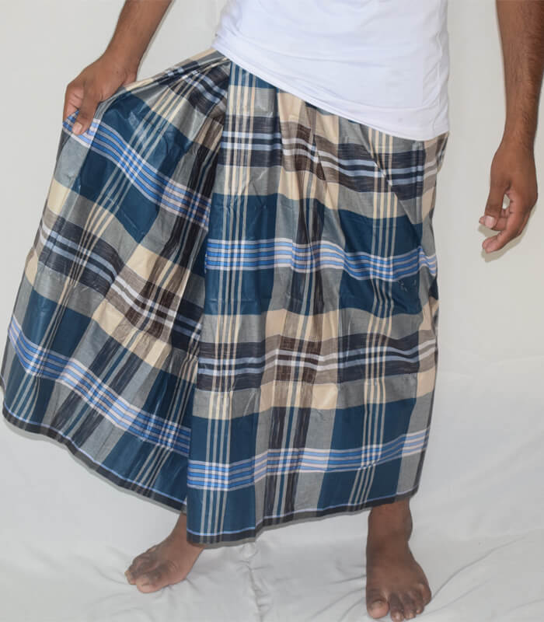
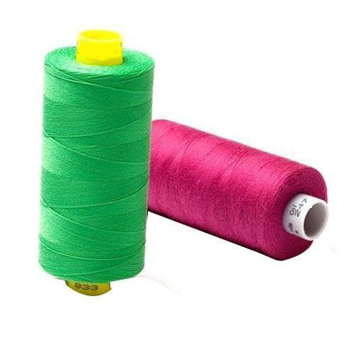
Traditional
Adjective
Conventional, customary, regular, old-fashioned.
Lungi is our traditional dress for men.
Thread
Noun
Cord, wool, cotton.
Old and new cloth and thread are used to make this quilts.

Slide 12
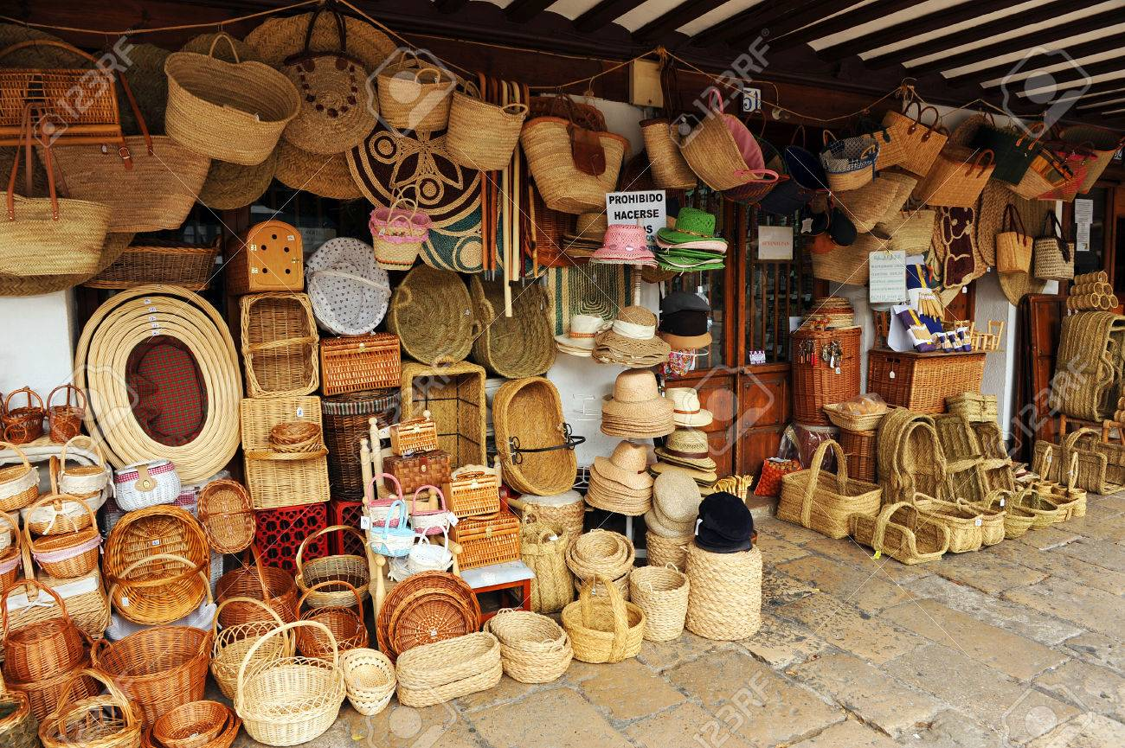
Produce
Verb
Manufacture, make, create, build.
Nakshi Kantha is produced now commercially.
Handicraft
Noun
Art, craft, handiwork, design.
This is a handicraft shop.

Slide 13
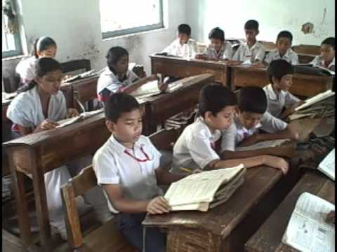
Read the text silently.

Slide 14
Aloud reading & Pronunciation
Probable words: Embroidered, Quilt, Artistic, Craft, Indigenous, Thread, Produce, Commercially, Handicraft.

Slide 15
Pair work
Complete the sentences with clues given.
Bengali,patterns,embroidery,years,fashion,art,rural,designs,quilt, noksha.
Naksha means artistic a) ……. .The name was taken from a b) ……… word c) ……… .The art has been practiced in d) ……. Bengal for
e) ……… Nakshi kanthas are now sold in f) ……… shops. Nakshi kanthas are in great demand because of their colourful g) ……….. and h)………… . Nakshi kanthas are a kind of i)……… .
a. patterns b. Bengali c. noksha d. rural e. years
f. fashion g. patterns h. designs i. art.

Slide 16
Group work
Answer the following question.
(a) What is Nakshi Kantha
(b) Where was the name taken from?
(c) Is Nakshi Kantha a traditional craft of Bangladesh and India?
(d) How long has the art been practiced?
(e) Why was the name popular?

Slide 17
Let’s see the probable answer.
a) Nakshi Kantha is a kind of embroidered quilt.
b) The name was taken form the Bengali Word “Naksha” meaning artistic pattern.
c) Yes, it is. The art of Nakshi Kantha has been practiced in rural areas of Bangladesh and West Bengal in India for centuries.
d) The art has been practiced for centuries.
e) The name was popular after poet Jasimudddin’s Poem “Nakshi Kanthar Math” had been published.

Slide 18
Home work
“ The quilts are now in great demand because of the colorful patterns and designs embroidered on them”- explain the statement within 100 words.

Slide 19
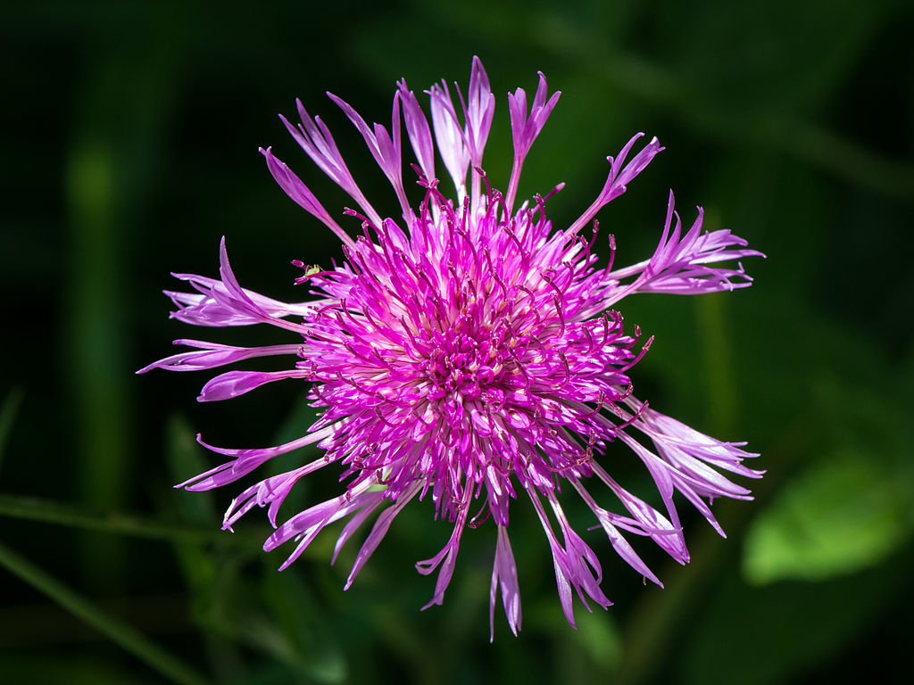
Thank you my dear students.
God bless you all.

